Slide 1
Thursday
18.5.20
Daily Plan

Slide 2
Morning
This Photo by Unknown Author is licensed under CC BY-SA

Slide 3
Spelling Starter
mood
pool
stool
spoon
cook
fool
moon
look
LI – I am learning the ‘oo’ sound
Complete one of the activities below to practise your spelling words.

Slide 4
Matilda Chapter 11
Listen to or read Chapter 11 of Matilda.
See the next slide for your activity.
Click on the picture to listen

Slide 5
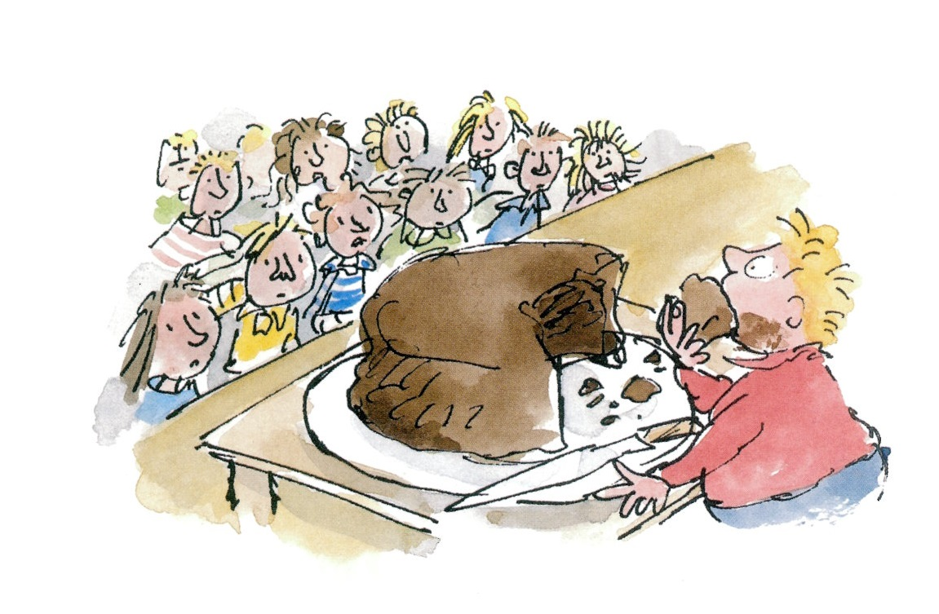
Chocolate Cake
Before we finished school we completed a block of instructional writing. We spent time learning about the key features of good instructions.
I have managed to get my hands on the instructions used to make The Trunchbull’s chocolate cake. (Can you believe it?!)
I just can’t help thinking that there are some key features missing.

Slide 6
Key Features
Can you use the instructions checklist to help me get to the bottom of it?
Remember you can highlight or colour yellow for yes or green for growth. You can even write two stars and a wish if you like.
Once you have identified the missing features re-write the instructions. Make sure you have included all of the important features that we identified in the best instructions.

Slide 7
Break Time
This Photo by Unknown Author is licensed under CC BY-SA

Slide 8
Mid Morning
This Photo by Unknown Author is licensed under CC BY-SA

Slide 9
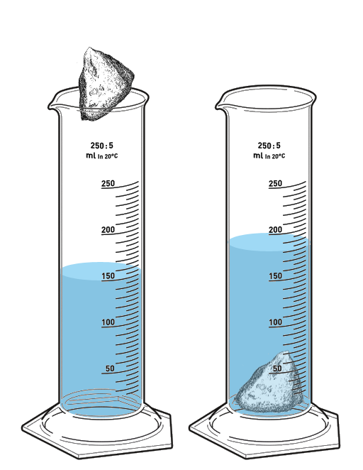
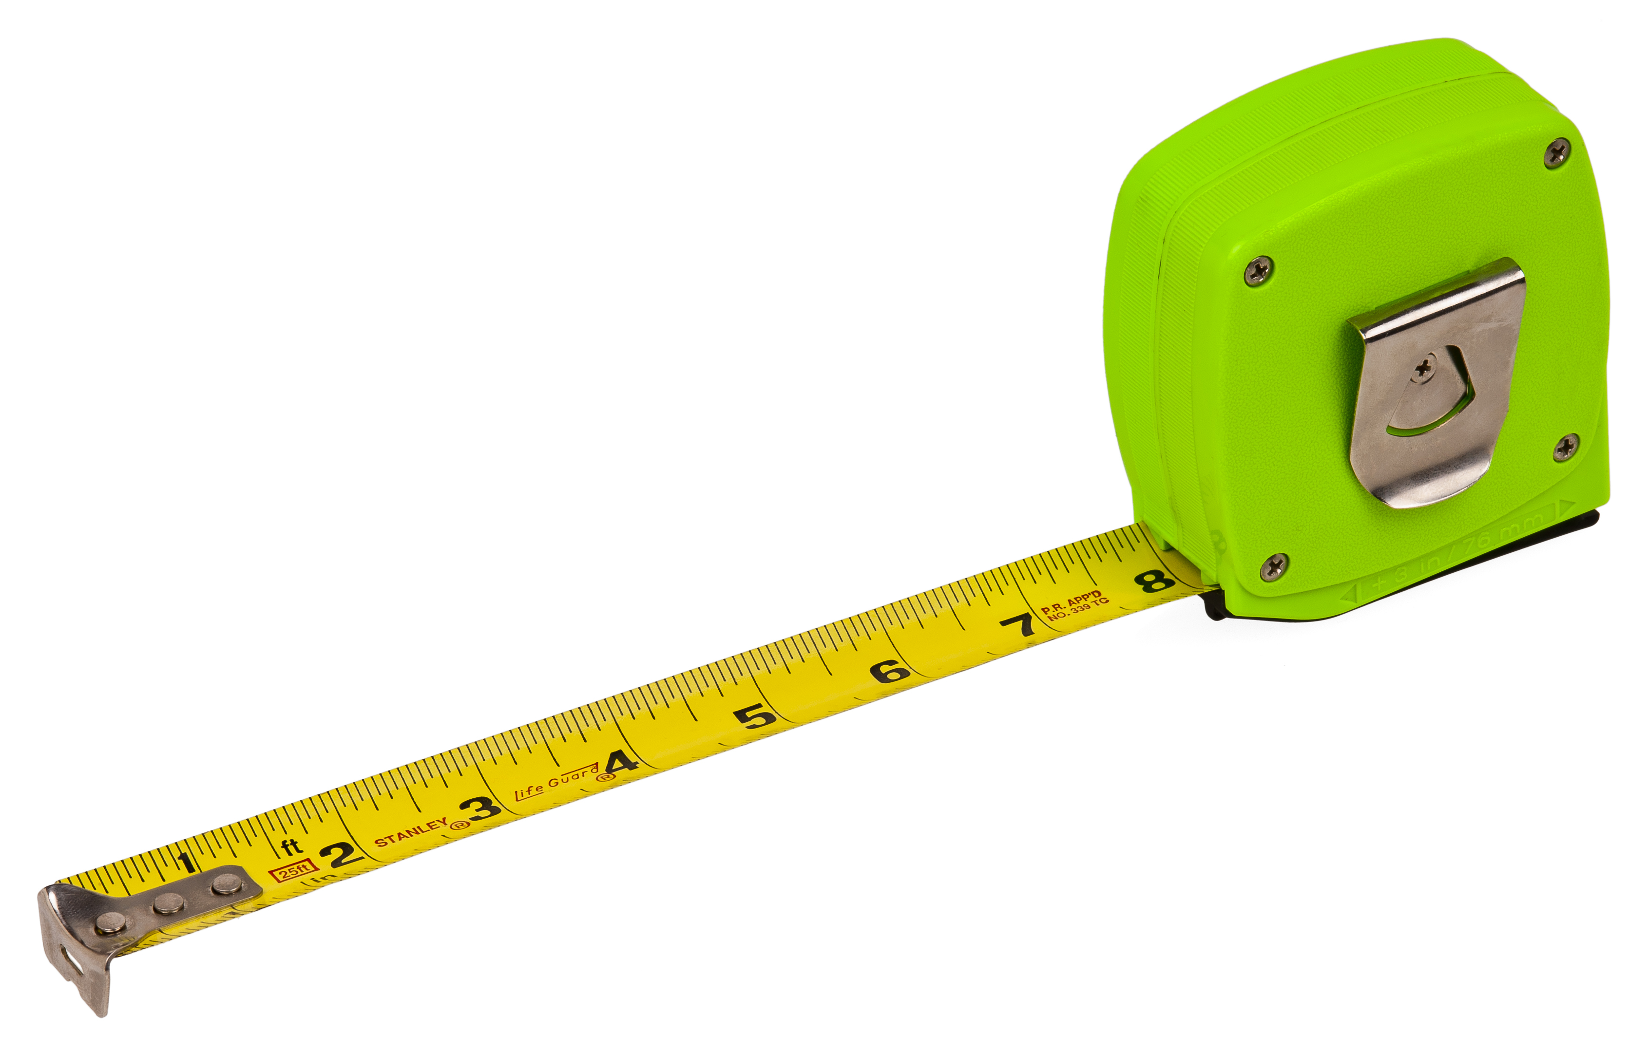
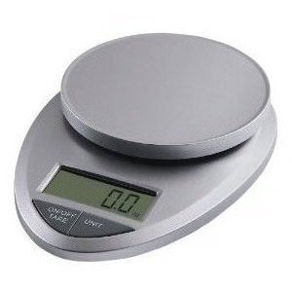
Maths
We have came to the end of our Measure topic in Maths.
You should now know that we can measure:
Weight – kg and g
Height – cm and m
Volume – ml and l
You have also learned how to read scales and
order items based on their size.

Slide 10
What have you learned?
Today I would like you to complete the two measure activities on the blog.
They have a range of questions, try to complete them independently if you can.
Extension – Create a poster all about measure for a younger pupil. Be sure to include all the information they need.

Slide 11
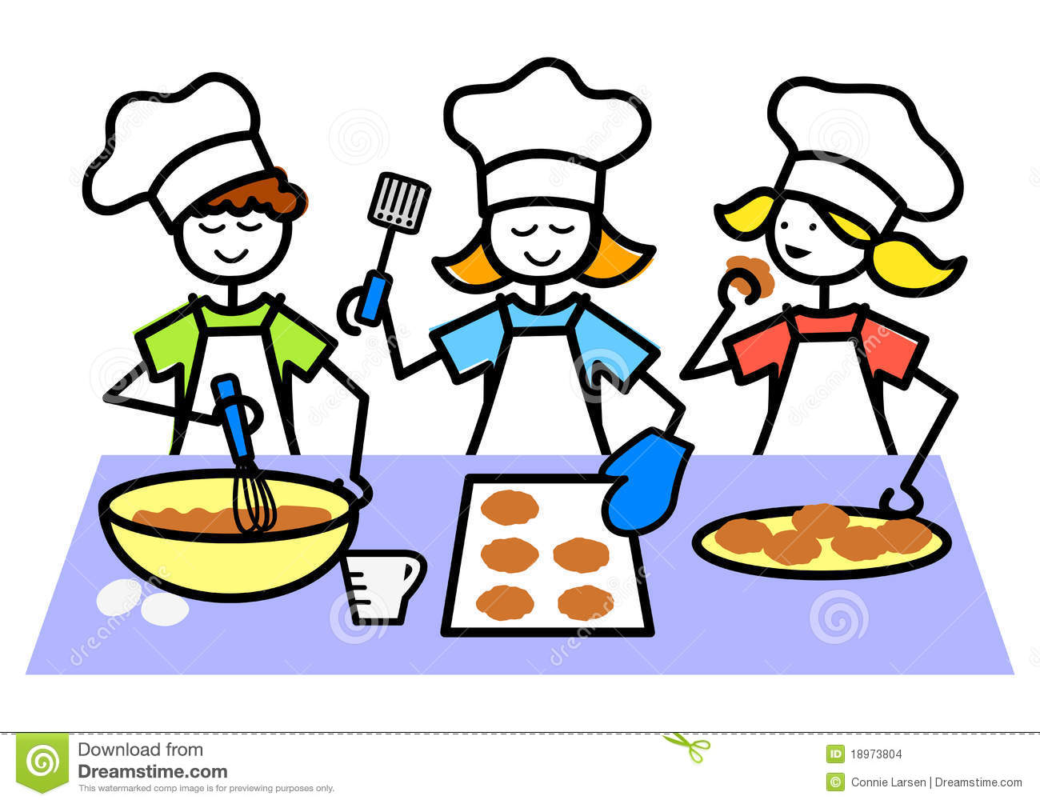
Extension
Now that you know how to weigh and measure different materials ask an adult if you can, with their help, follow a recipe to make something delicious.

Slide 12
Lunch Time
This Photo by Unknown Author is licensed under CC BY-SA

Slide 13
Afternoon
This Photo by Unknown Author is licensed under CC BY-SA

Slide 14
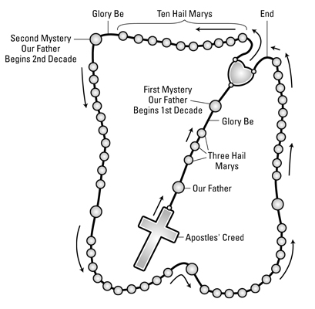
RE
LI – I am learning to pray The Rosary
As we continue to honour Our Lady during the month of May it is important to learn about The Rosary.
The Rosary is a special prayer to Mary. When we pray The Rosary we pray an Our father, ten Hail Marys and a Glory be to the Father, we repeat this for each of the mysteries we have chosen to dedicate the Rosary too.
We will learn about the Joyful Mysteries next week.

Slide 15
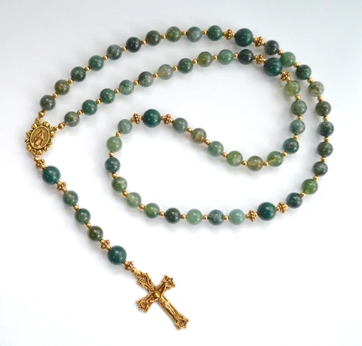
The Rosary
If you have Rosary beads at home ask an adult to show you them and explain which prayer each bead represents.
You may want to pray a decade of the Rosary together.

Slide 16
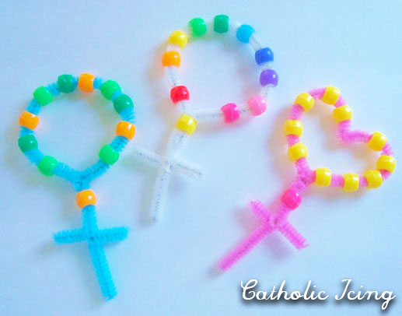
Activity
If you happen to have these resources at home you could create your own decade of The Rosary. I have also put a stained glass colouring sheet on the blog.

Slide 17
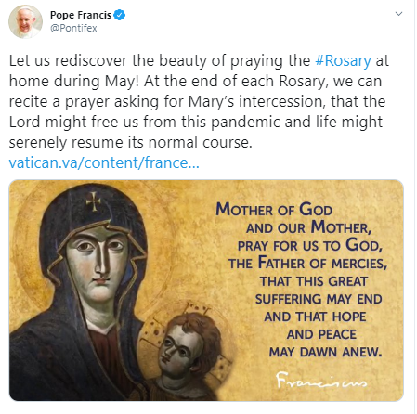

Slide 18
PE with Mrs McMaster
See the blog for you PE activities from Mrs McMaster, have fun!

