Slide 1
Wednesday
29.4.20
Daily Plan

Slide 2
Morning
This Photo by Unknown Author is licensed under CC BY-SA

Slide 3
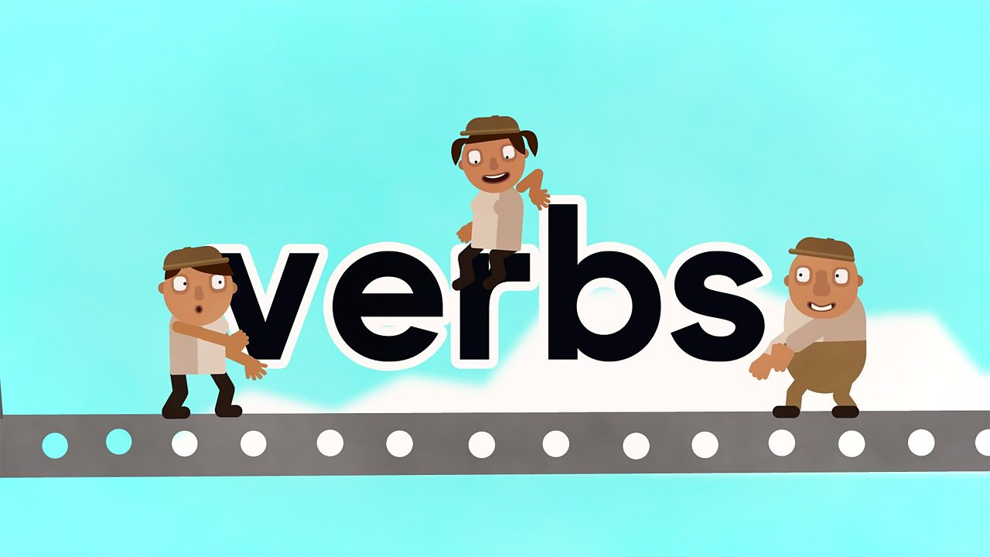
Grammar
LI – I am learning to identify a verb in a sentence
https://www.bbc.co.uk/bitesize/topics/zrqqtfr/articles/zpxhdxs
Task 1- Watch the verb video
Task 2 - Highlight the verb in the sentence game below the video.
Task 3- Take the verb quiz.

Slide 4
Task 4
Tell an adult, underline or highlight the verb in each of these sentences:
I walk to school.
Yesterday, they laughed at the clown
They help the teacher.
I washed my hands.
Do you know which sentences are present tense and which sentences are past tense? How do you know?

Slide 5
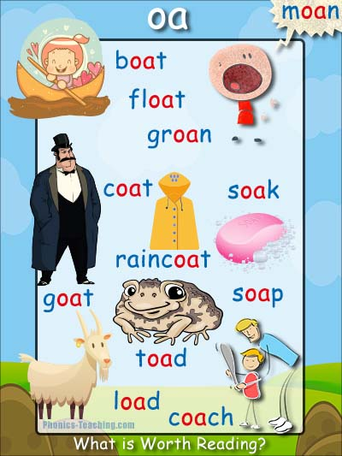
Extension - Spelling
Print and complete the ‘oa’ wordsearch on the blog.
or
Using your ‘oa’ spelling words, create your own word search.
https://thewordsearch.com/maker/

Slide 6
Break Time
This Photo by Unknown Author is licensed under CC BY-SA

Slide 7
Mid Morning
This Photo by Unknown Author is licensed under CC BY-SA

Slide 8
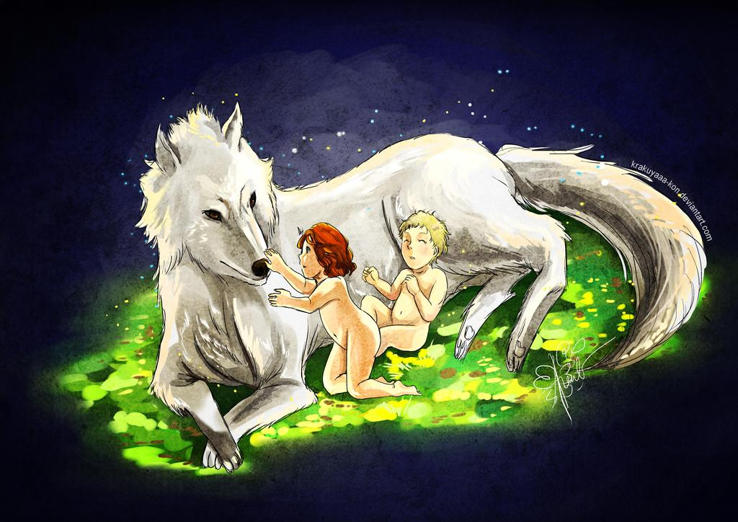
Morning Story
Today’s morning story is the legend of Romulus and Remus. The ancient Romans loved myths and legends.
This myth was created to explain how Rome was founded and named.
https://www.youtube.com/watch?v=wA1D9wd29jI

Slide 9
Maths - Length
LI - I am learning to estimate length using my knowledge of cm and m.
When you estimate you take an educated guess using the information you already know. This week you have been learning that you can measure length using cm and m.
You have also learned that there are 100 cm in a m.
If you take the metre strip you made yesterday and fold it in half how many cm do you think you have? ½ of 100cm?
If you then fold it in half again how many cm do you think you will have? ¼ of 100cm?

Slide 10
Maths - Length
Today you are going to use this knowledge to estimate the length of different objects then check your answer.
Task 1 - Without using your metre strip estimate
A- the height of your kitchen unit
B- the height of your bedroom door
C- the length of your television
D- the height of your parents
Task 2 - Use your metre strip (made yesterday) to measure all the above in task 1.
Extension- More measure challenge cards on the blog.
Decide which tool would be the best to use for each challenge, your ruler or your metre strip.

Slide 11
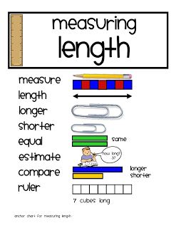
Extension
If you would like to continue practising measuring length I have popped some challenge cards on the blog.
Decide which tool would be the best to use for each challenge, your ruler or your metre strip.

Slide 12
Lunch Time
This Photo by Unknown Author is licensed under CC BY-SA

Slide 13
Afternoon
This Photo by Unknown Author is licensed under CC BY-SA

Slide 14
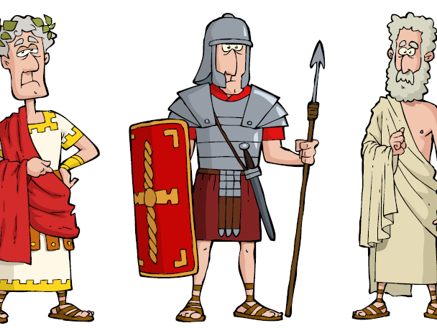
The Roman Empire
LI – I am learning where the Roman Empire began and where it spread to.
Task 1 – Read the information on the next slide.
Task 2 – Complete the Roman Empire sheet.

Slide 15
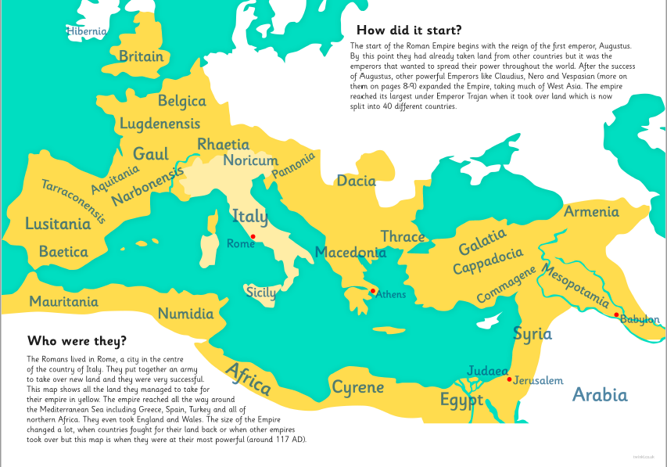
Facts -
LI – I am learning where the Roman Empire began and where it spread to.
Task 1 – Read page 1 of the Roman Empire booklet.
Task 2 – Complete the Roman Empire sheet.

Slide 16
Roman Research
You may want to continue your research, use the internet or any non-fiction books you may have access to, to find out more about the Roman Empire.
You may like to begin by listening to this video:
https://www.bbc.co.uk/bitesize/topics/zwmpfg8/articles/z2sm6sg
You can also read some facts on this website:
http://www.primaryhomeworkhelp.co.uk/Romans.html

Slide 17
Topic Afternoon
Mrs Scott and I would like to thank you for all your interesting ideas of things you would like to learn during this topic. We will make sure we cover them all during your topic afternoons this term.
We have also created an active topic challenges grid which I have posted on the blog today.
You can choose to complete the activities you are interested in, you will need to do some extra research to find out more information. We look forward to seeing lots of pictures.

