Slide 1

Thursday
23.4.20
Daily Plan

Slide 2
Thursday Activities
Talking and Listening
Numeracy
French

Slide 3


Creative Corner
Your creative corner challenge for today is to:
Play “I spy” from your garden or on your daily walk

Slide 4

Morning
This Photo by Unknown Author is licensed under CC BY-SA

Slide 5

Matilda Chapter 5
Listen to or read Chapter 5 of Matilda.
See the next slide for your activity.
Click on the picture to listen

Slide 6
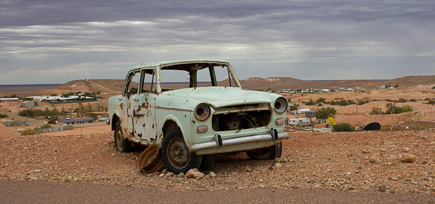
Imagination Station
You work for Mr Wormwood. He has asked you to film an advert to
sell this car, if you are successful he’ll give you a bonus!
Give it your best go…

Slide 7
Break Time
This Photo by Unknown Author is licensed under CC BY-SA

Slide 8
Mid Morning
This Photo by Unknown Author is licensed under CC BY-SA

Slide 9
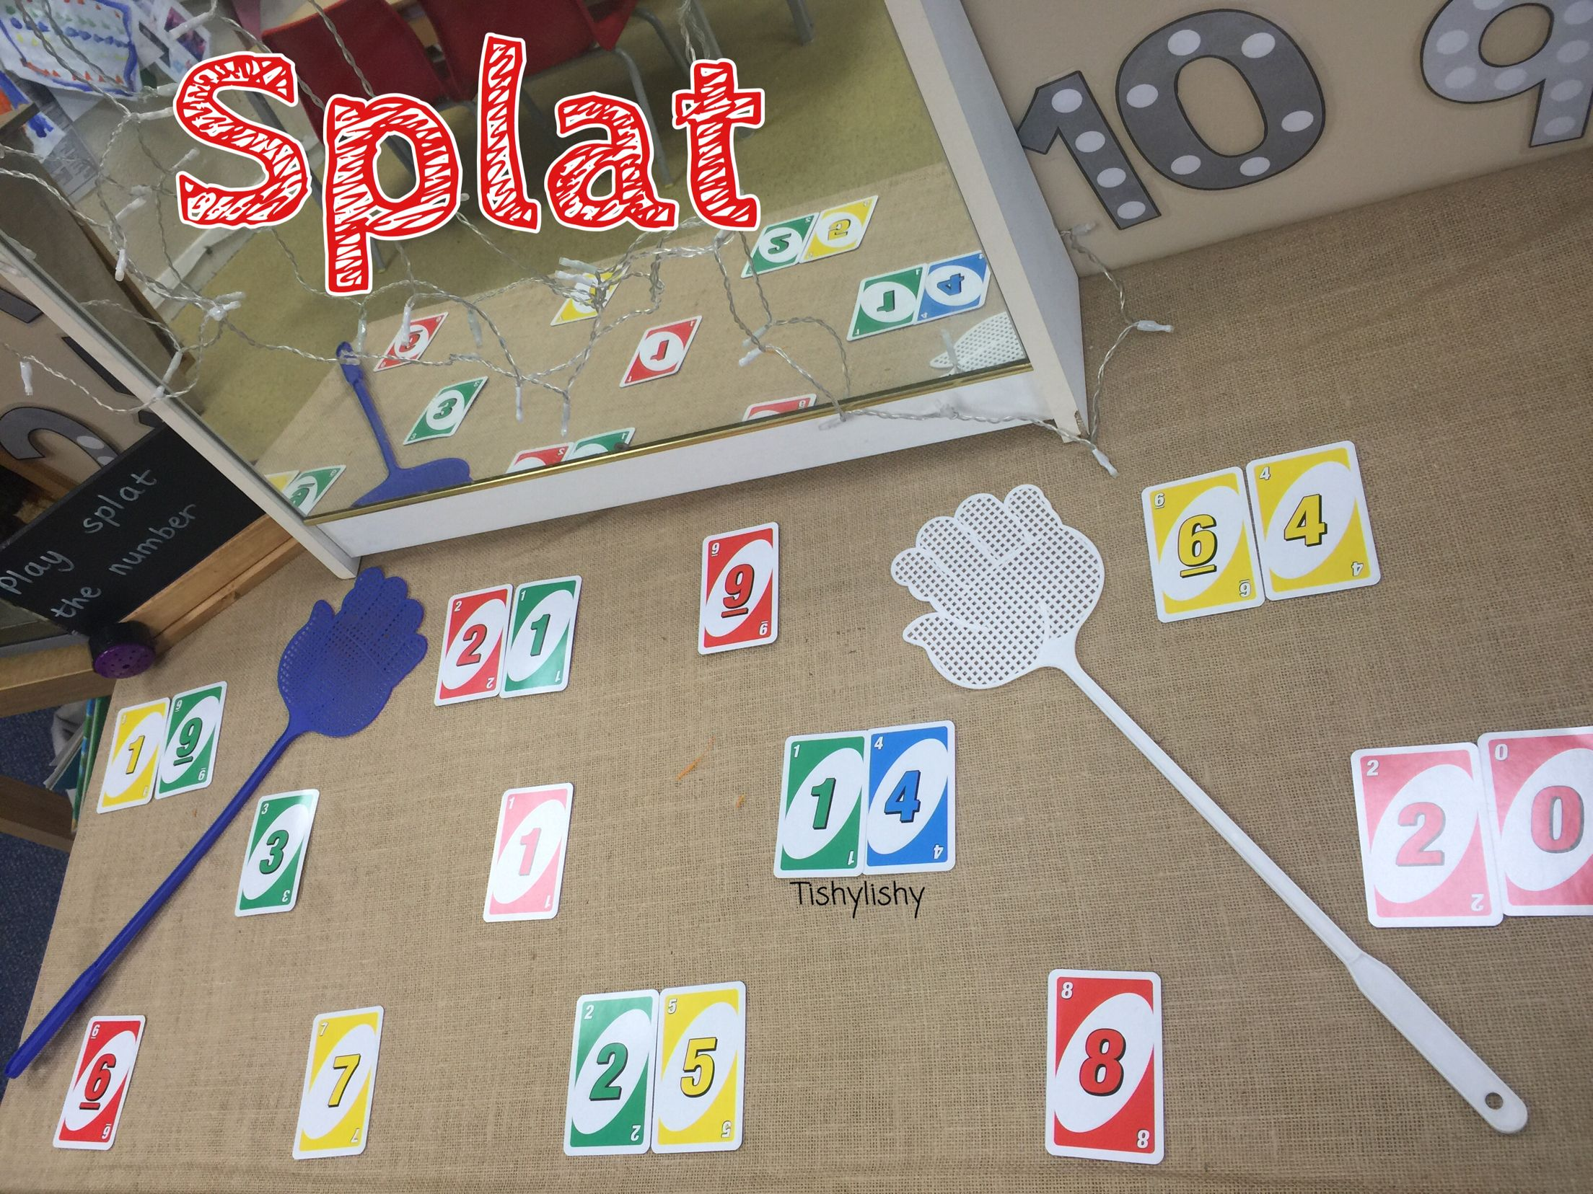
Splat the Number!
So many of you let me know that you enjoyed playing this game yesterday so I decided to set some subtraction questions today.
If you would like some written Maths today instead it’s page 74 of the Maths and Numeracy Revision booklet, questions 3 – 6 for the subtraction word problems.

Slide 10
Lunch Time
This Photo by Unknown Author is licensed under CC BY-SA

Slide 11
Afternoon
This Photo by Unknown Author is licensed under CC BY-SA

Slide 12
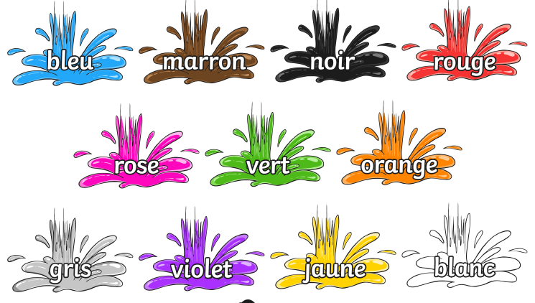
French
LI – I am learning the colours in French
Click on the picture below for video with pronunciation

Slide 13
French
Can you challenge yourself to colour the rainbow?
You can either print and colour or draw your own using the French words.
You can also do this activity outdoors, an adult could call out one of the French colours and you can draw something that colour on the ground using chalk.
e.g. jaune – sunflower

