Slide 1
Hedgehog Survey
Over the last two weeks the P4 – P7 Hedgehog Champions have been carrying out a survey to find out if we have hedgehogs in our school grounds

Slide 2
How did we do this?
We were given a Mammal Footprint Tunnel by the British Hedgehog preservation Society.
Then folded up to make this tunnel
(Triangular prism shaped)
It was flat packed like this.

Slide 3
Then
Using the instructions we prepared the tracking plate

Slide 4
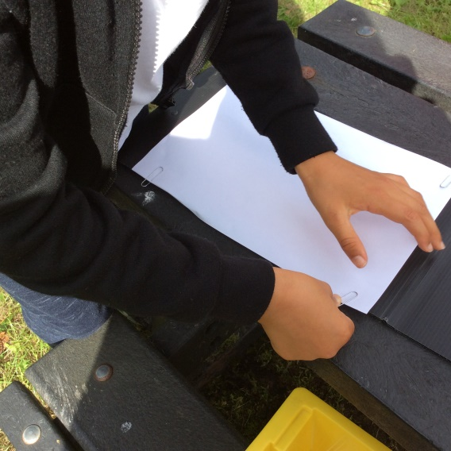
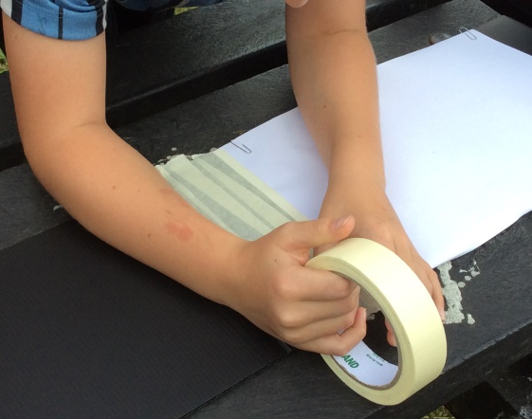
Tracking Plate
First we attached paper to each end of the tracking plate using paperclips
Then we added strips of masking tape to the inside edge of the two pieces of paper

Slide 5
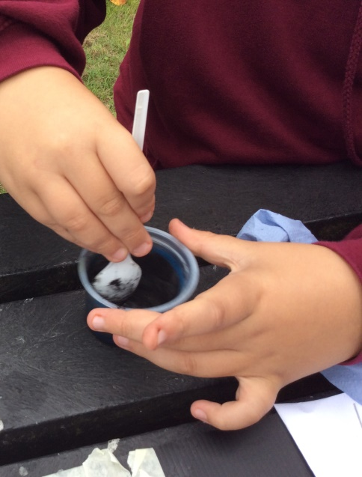
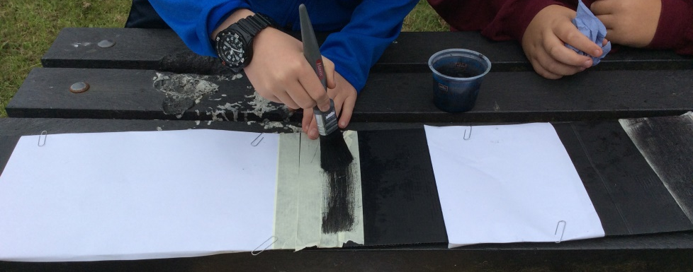
Tracking Plate
Next we took some charcoal powder and mixed it in a tub with a little bit of vegetable oil
After that we painted the mixture
onto the masking paper

Slide 6
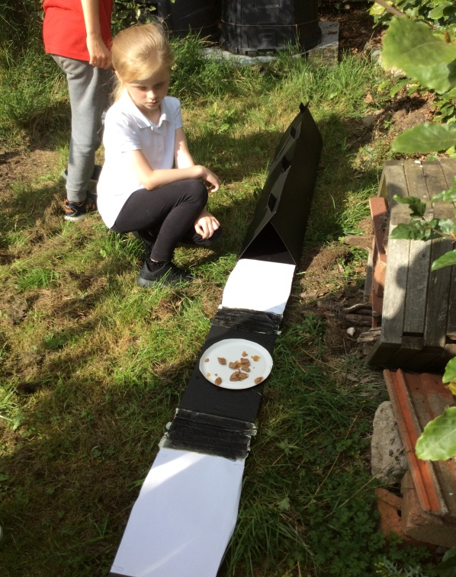
Tracking Plate
The tracking plate was slipped into the tunnel
The idea is that the hedgehog walks over the charcoal to get to the food and leaves footprints behind on the paper when it leaves. The charcoal does not hurt the hedgehog.
Dog food was placed on a paper plate in the middle of the tracking plate

Slide 7
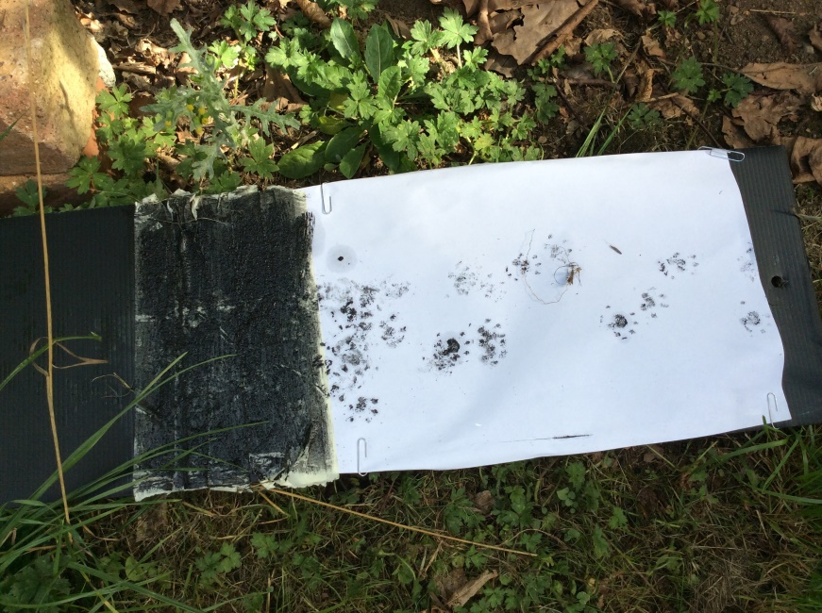
What did we find?
Hedgehog Footprints

Slide 8
A Camera was set up to record any movement
We were given a loan of this camera from the Hedgehog Friendly Campus
It works
using motion sensors, this means if something moves it triggers the video camera to start recording
It is camouflaged so it can’t be spotted

Slide 9
Look at what we recorded

Slide 10
Next Steps
We need to design and build some hedgehog homes
We need to remove litter and hazards from the school grounds
We need to create a wildflower meadow to attract insects to provide food for the hedgehogs
We need to carry out another survey next Spring to see if the hedgehog comes back
We need to create leaflets for our local community to explain how to help hedgehogs

Slide 11
Hedgehog Champions
Our Hedgehog Champions will provide more information on these activities over the coming months

