Slide 1
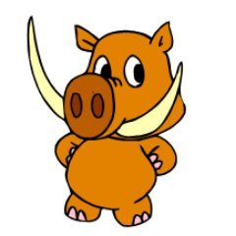
Thinking Reader Strategies
Primary 5 2020-2021
We Are Learning To (WALT):
Use strategies before, during and after reading to help us better understand a text.

Slide 2
The Strategies
Prior Knowledge
Metalinguistics
Visualisation
Inference
Main Ideas/Summarising

Slide 3
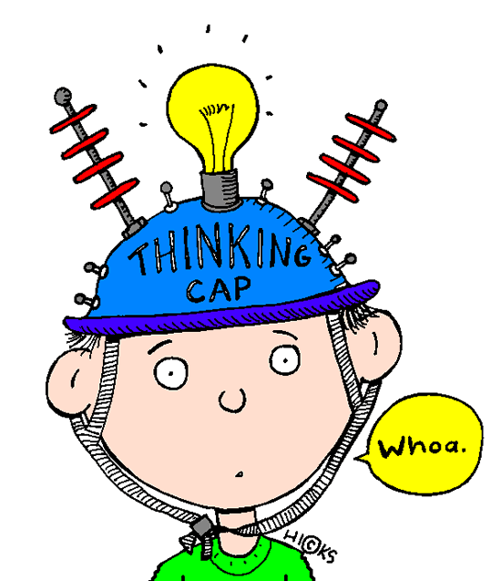
Prior Knowledge
When we talk about prior or previous knowledge, we refer to all of the experiences readers have had throughout their lives, including information they have learned elsewhere.
Have I seen or heard this before? In other books, on TV, in games, on the news…?
What do I already know about this topic?
Does this remind me of any experiences I’ve had?

Slide 4
Prior Knowledge
This is a ‘before’ reading strategy although it can be used throughout a text when a new character, setting or word is introduced.
Explore what you know about a text by:
Looking at the front cover and any images. What do they images tell you about characters, setting, plot, genre?
Who is the author/illustrator? Do you know any other books they have worked on?
Who are the main characters? What can you tell about them? Age, gender, characteristics…
What genre of book is it? How do you know?
Who do you think the book is aimed at? Why?
Do the colours used tell you anything? Have they used light, bright and happy colours? etc.

Slide 5
Prior Knowledge
3 Author
Who is the author?
Do you recognise the name?
Have you read any other books by this author?
Is the author famous for anything else?
1 Characters
Who are the main characters?
Can we work out anyone’s name? Why has the author chosen this name?
Describe what the character look like.
What emotions are they feeling? How do you know this?
What are the characters doing? Why do you think this?
4 Setting
Where is the story taking place?
What clues have the author and illustrator given us about the setting?
What flags can you see? Why might there be flags?
5 Genre & Plot
What genre is the story? How can we tell?
What do you think the story will be about? Why do you think this?
Who do you think the book is aimed at and why?
Do you have any experiences that might be similar to the characters in the story?
2 Title
What does the title of the book tell us?
Where might we hear the term ‘photo finish’ and why might it be used?

Slide 6
Task
What to do:
Choose at least 2 questions from each box (characters, title, author, setting and genre & plot) to answer. This means you should answer a minimum of 10 questions.
Refer back to the question to ensure you have answered it to the best of your ability.
Type your answers into the coloured text boxes on the next page or into a new word document.
Make sure we know which questions you are answering e.g. if you are answering a question about characters use the number ‘1’ followed by the letter – 1a.
Answer in full sentences, using capital letters where appropriate and correct punctuation.
Remember to support your answer with evidence e.g. I think _____ because _____.

