Slide 2
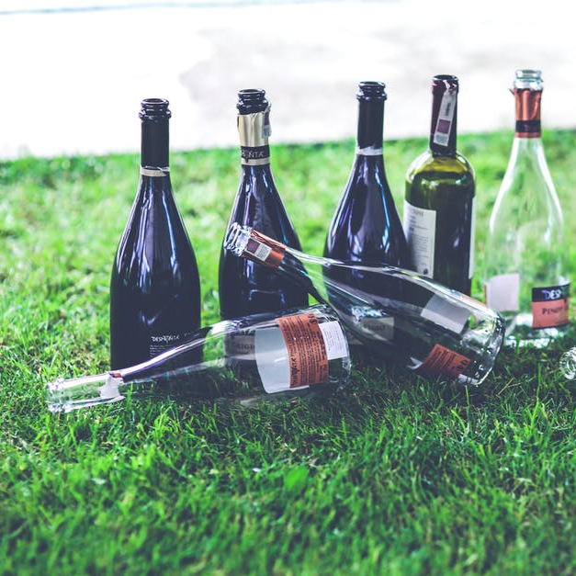
Recycling Quiz
How long does it take a glass bottle to decompose?
50 years
No one really knows – maybe never!
2000 years
next question

Slide 3
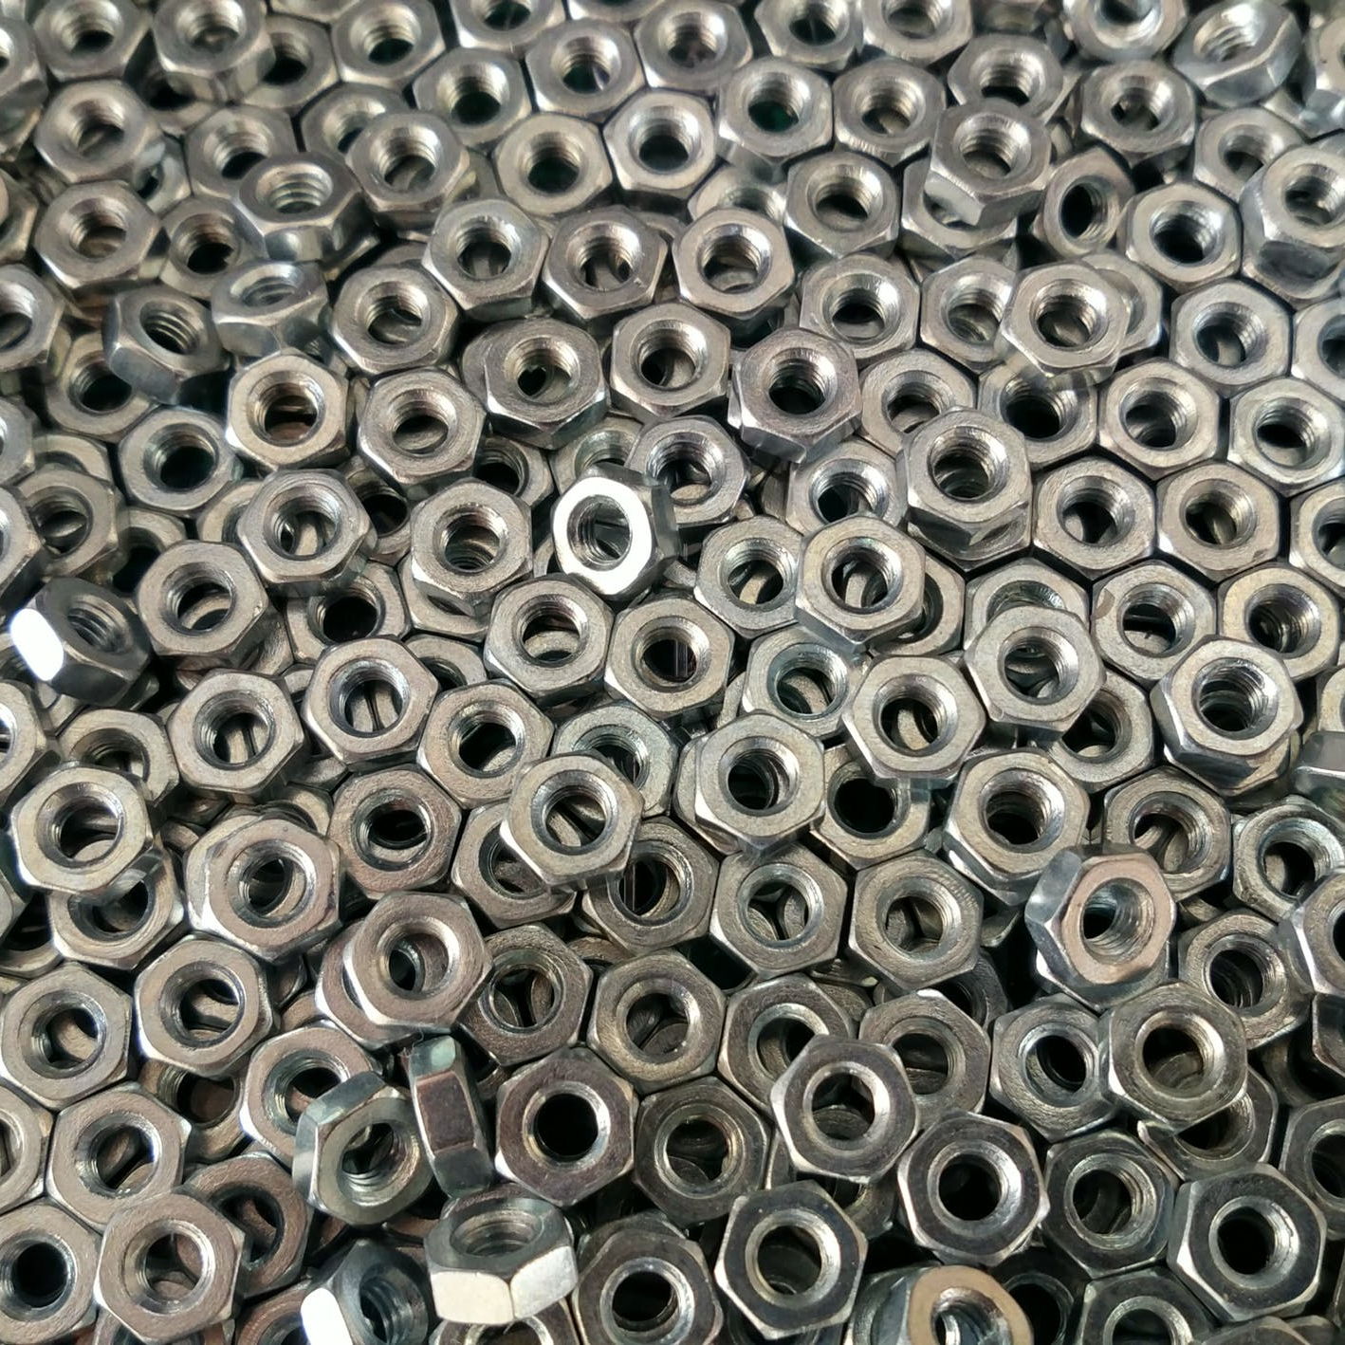
Recycling Quiz
How are steel and aluminium cans separated in a recycling centre?
with a magnet
by hand
they aren’t
next question

Slide 4
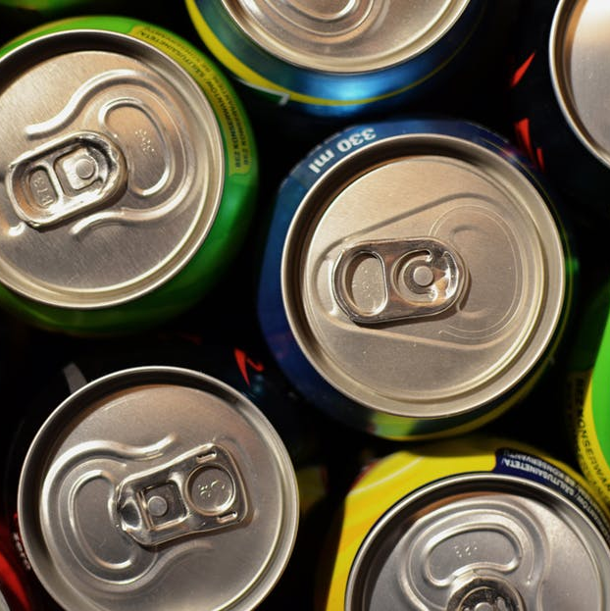
Recycling Quiz
How much energy does it save to recycle a drinks can rather than make a new one?
50%
75%
95%
next question

Slide 5
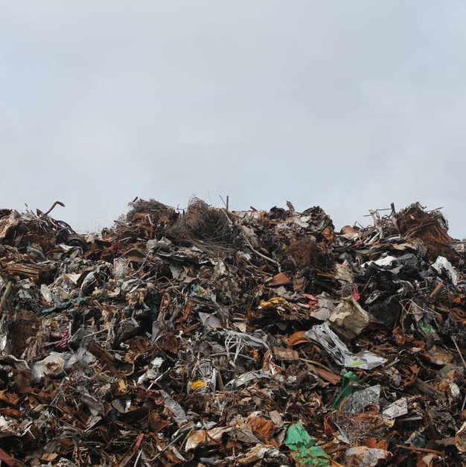
Recycling Quiz
On average, how much waste per person does the UK produce each year?
115kg
250kg
411kg
next question

Slide 6
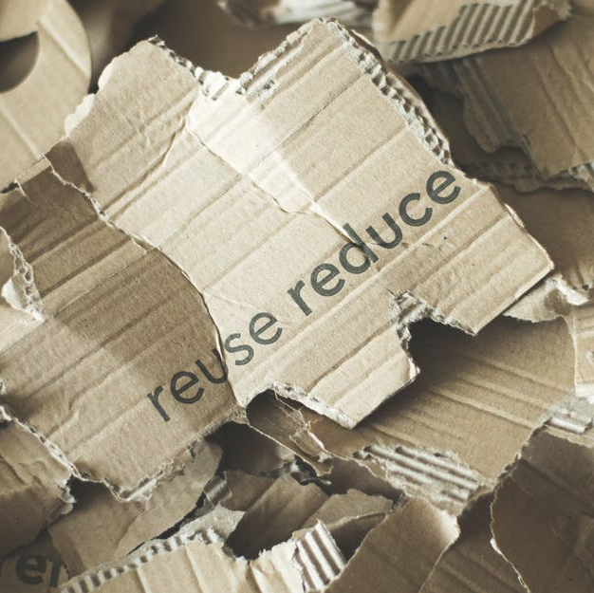
Recycling Quiz
What is a gyre?
It’s a flow of revolving water in an ocean
that can gather waste.
It’s the conveyor belt that is used for sorting waste.
It’s a paper pulping machine for recycling paper.
next question

Slide 7
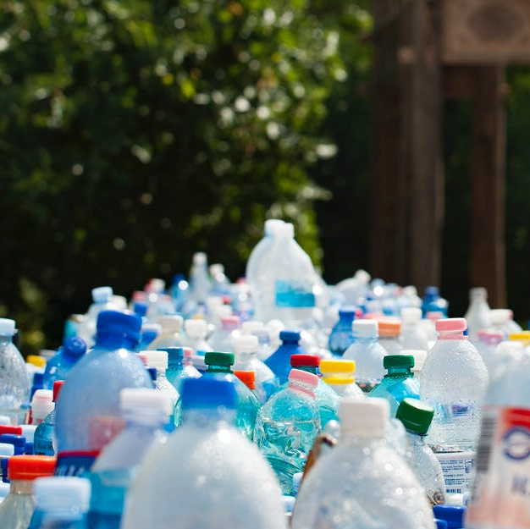
Recycling Quiz
What has the government done in recent years to encourage the usage of fewer plastic bags?
They banned plastic bags in shops..
They introduced the 5p charge on carrier bags.
They brought in a law to change to paper bags by 2020..
next question

Slide 8
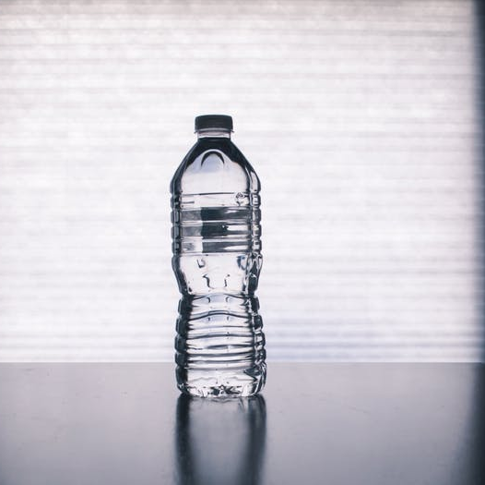
Recycling Quiz
Out of the average 500 plastic bottles used a year in every household in the UK, how many are recycled?
nearly 100%.
just over 50%
around 80%.
next question

Slide 9
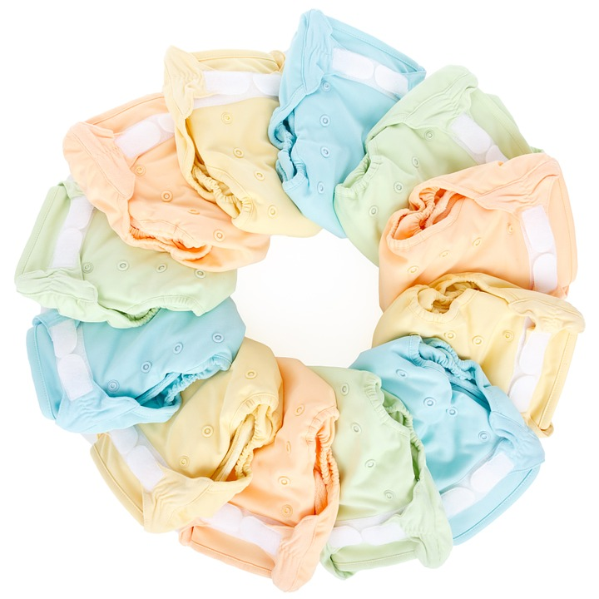
Recycling Quiz
How long do disposable nappies take to decompose in landfill?
around 500 years
6 months
25 years
That means every nappy that has ever been used is still here!
next question

Slide 10
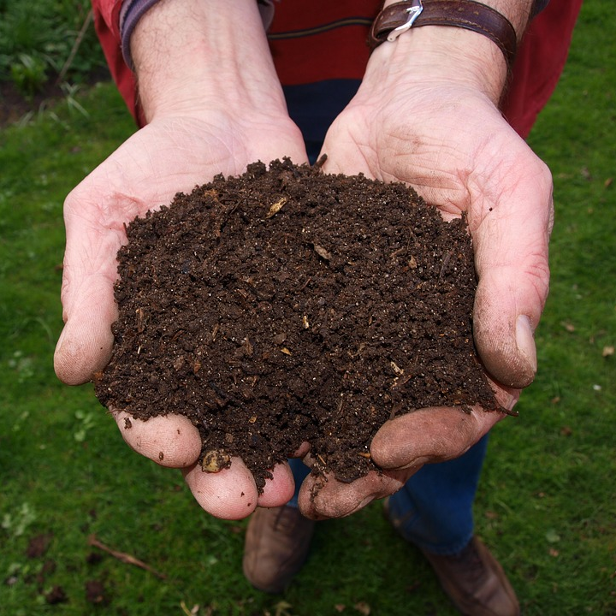
Recycling Quiz
Which of these items can be put in a compost bin?
coffee grounds (from making ‘real’ coffee)
egg shells and vegetable peelings
dead leaves and grass cuttings
next question

Slide 11
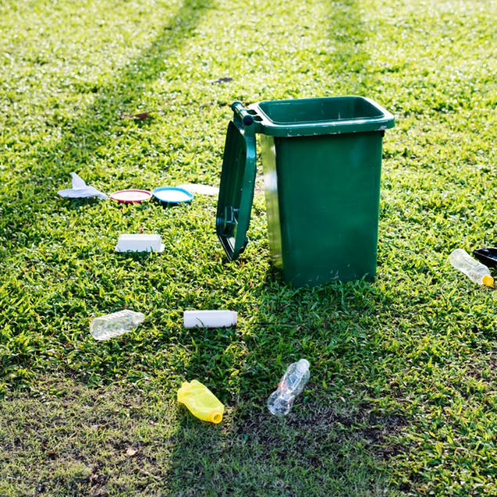
Recycling Quiz
Some waste produces harmful greenhouse gases but what is a greenhouse gas?
They are gases used for growing food only found in greenhouses.
They are gases needed for green plants to grow.
They are gases that stop heat from escaping Earth and therefore heat up the atmosphere..
next question

Slide 12
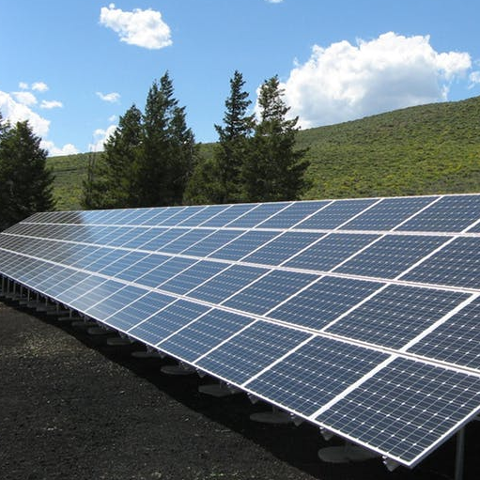
Recycling Quiz
What is ‘green energy’?
energy from a renewable source such as wind, sun or tidal
energy made from plants
energy made from coal or oil
next question

Slide 13
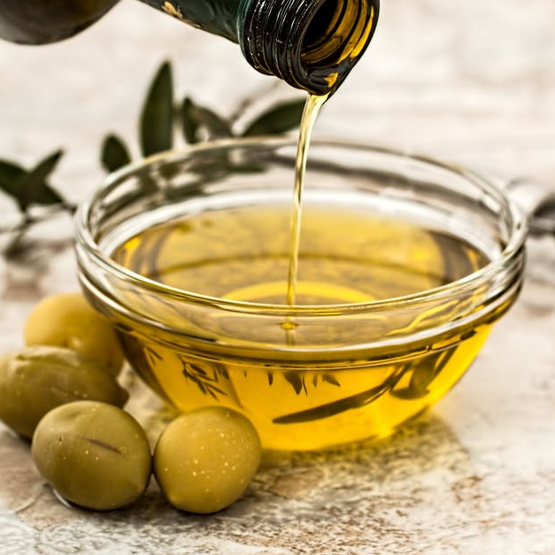
Recycling Quiz
Used cooking oil can be recycled into what?
bioplastic also called ‘oilastic’’
biofuel for vehicles
more cooking oil
next question

Slide 14
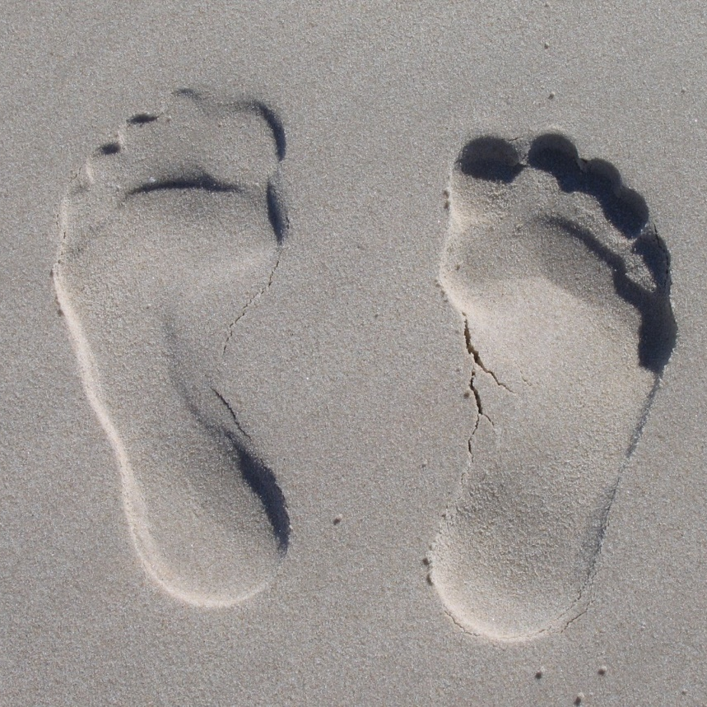
Recycling Quiz
What is a carbon footprint?
It is the amount of carbon left after
something is made or finished..
It is a black footprint found on
beaches or ice caps.
It is the trail left by Earth as it
orbits the Sun..
next question

Slide 15
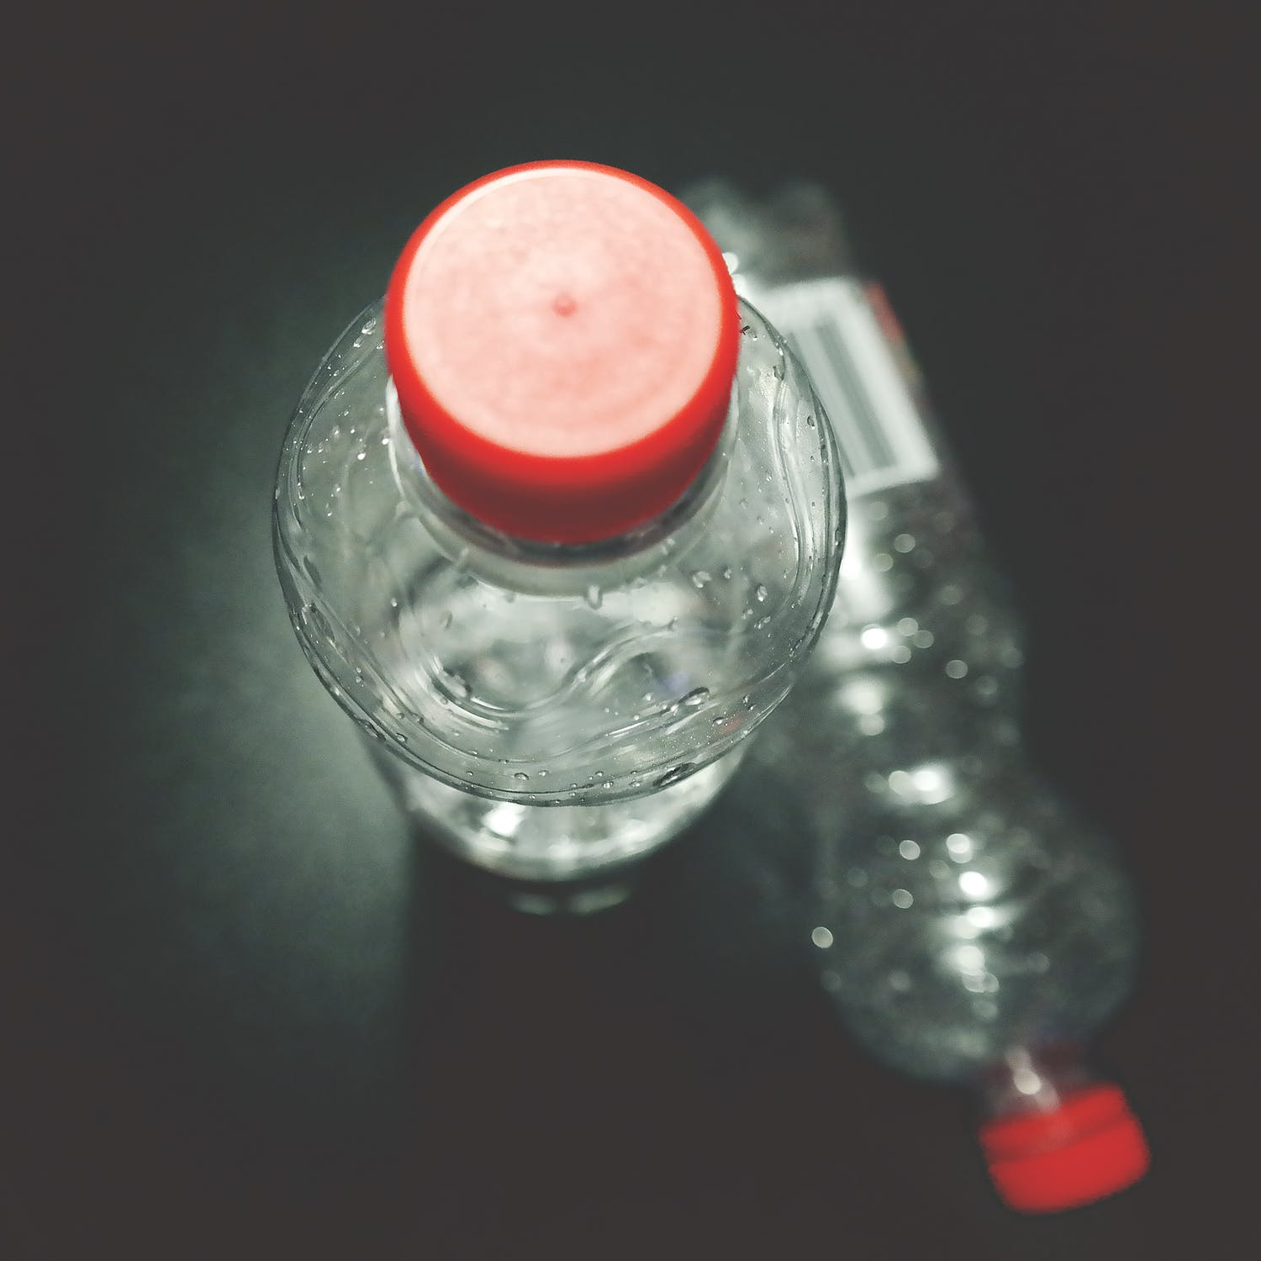
Recycling Quiz
Which of these can be made from recycled plastic bottles?
carpets
a fleece jacket
traffic cones.
next question

Slide 16
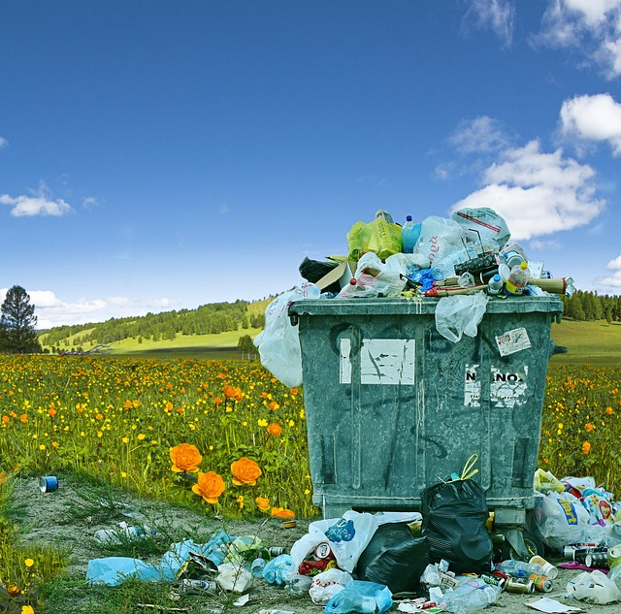
Recycling Quiz
What are the three ‘R’s?
Refuse, Rubbish, Recycle
Recycle, Repurpose, Repair
Reduce, Re-use, Recycle

