Slide 2
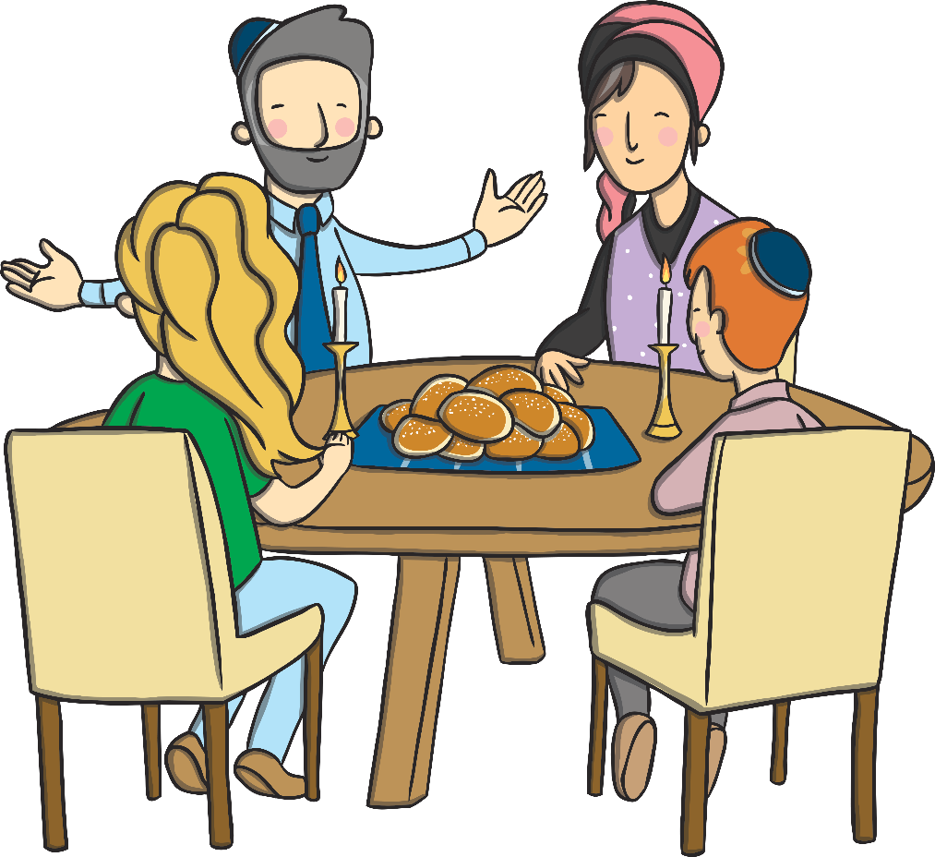
How Is Shabbat Celebrated?
When Shabbat begins on Friday evening, everyone puts on their best clothes and gather for a special meal. Other family members or friends may join the family for this special occasion.
There are lots of traditions that take place at a Shabbat meal.

Slide 3
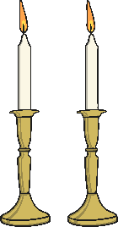
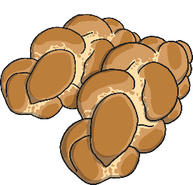
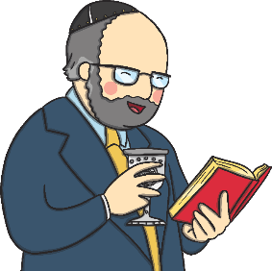
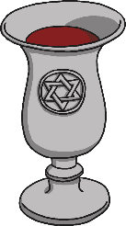
Shabbat Traditions
Shabbat Candles are lit on the dinner table.
Challah bread is eaten.
Wine (or grape juice) is shared in a Kiddush cup.
Blessings are recited.

Slide 4
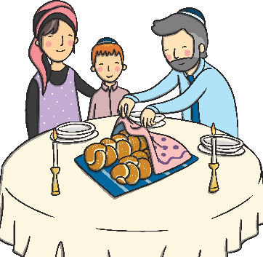
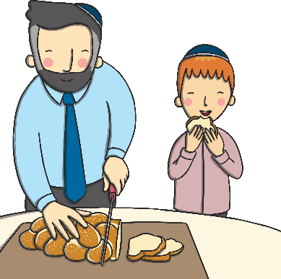
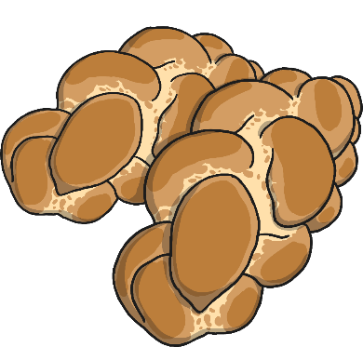
Challah Bread
Challah is a special plaited loaf that is bought fresh on Friday morning, ready for the Shabbat.
Two loaves are always bought together.
The loaves are covered with a special Challah cover, so they can’t ‘see’ the wine when it is blessed.
Challah tastes much sweeter than normal bread. This helps remind people that Shabbat is special.

Slide 5
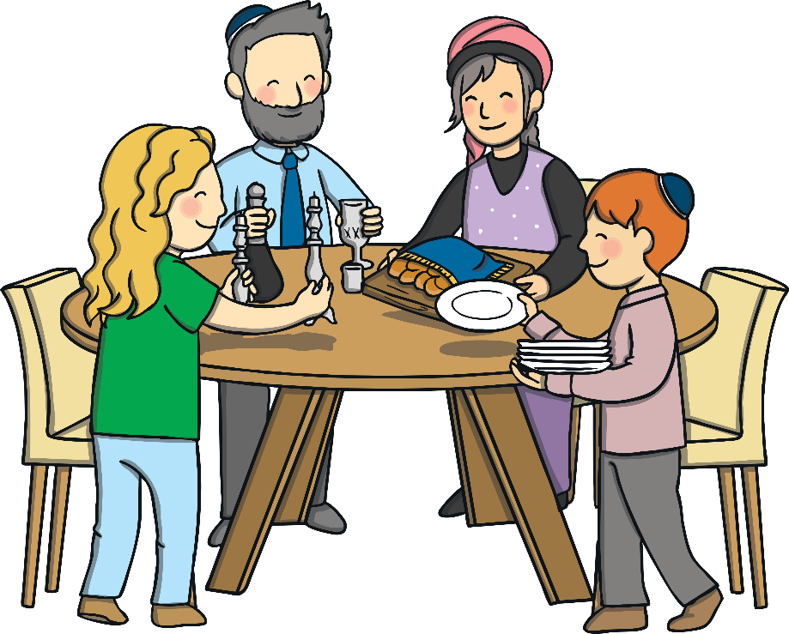
Other Customs
Families will visit a Synagogue during Shabbat.
No work can be done. Including homework!
Havdalah is the end of Shabbat. A special plaited candle is lit and prayers are read. Special spices are smelt and finally the candle is put out in the wine.
Families enjoy talking together. Children can stay up late and tell and listen to stories. Songs are sung.

