Slide 2
Sleep
Have a quick discussion about the following points:
1. Why do we need sleep?
2. What happens when we sleep?
3. How much sleep do we need?
4. What happens if we don’t get enough sleep?

Slide 3
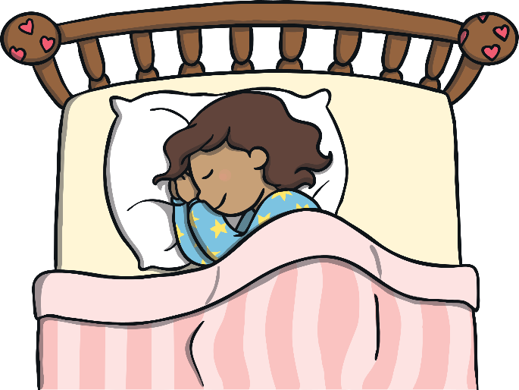
Why Do We Need Sleep?
We need sleep to recharge. We all have busy days! Working hard at school, playing at playtime and lunchtime, after-school activities and lots more! So, we use a lot of energy.
Sleeping well at night can help your body get ready for the next action-packed day.
So, when we go to bed, our bodies just sleep and do nothing?
back

Slide 4
What Happens When We Sleep?
We don’t just get into bed and sleep. There is a pattern to sleep, known as the sleep cycle. Everybody goes through these five stages. One full cycle can take around 90 minutes and is repeated many times throughout the night.
Stage 1
Light sleep
Stage 5
Stage 2
REM sleep
We relax
Sleep Cycle
Stage 4
Stage 3
Deep sleep
Slow brain waves
Deep sleep
back

Slide 5
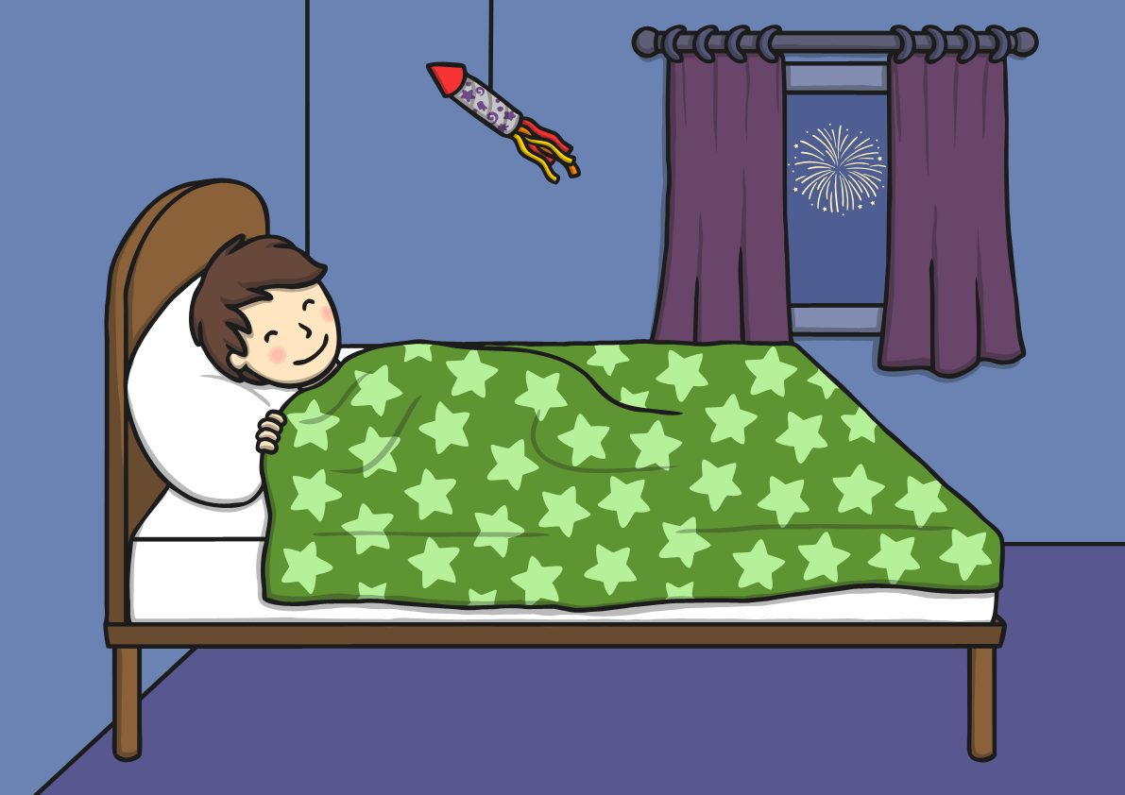
Stage 1
The first stage is quite a light sleep. Our eyes and muscles will slow down but we can be easily woken up from this stage. Sometimes, our muscles will tense and we get the feeling of falling!

Slide 6
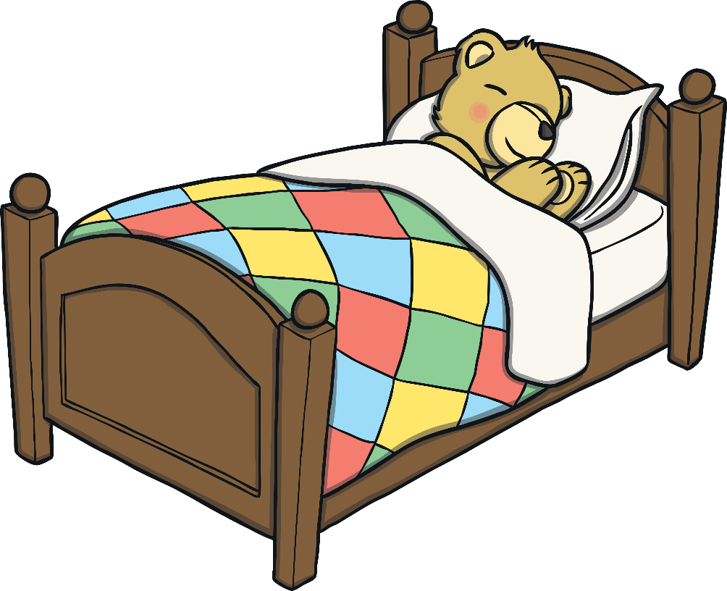
Stage 2
During stage 2, everything slows down to get ready for a deep sleep. Our eyes stop moving, our body temperature gets lower and our brain waves and heart rate slow down. In other words, we completely relax!

Slide 7
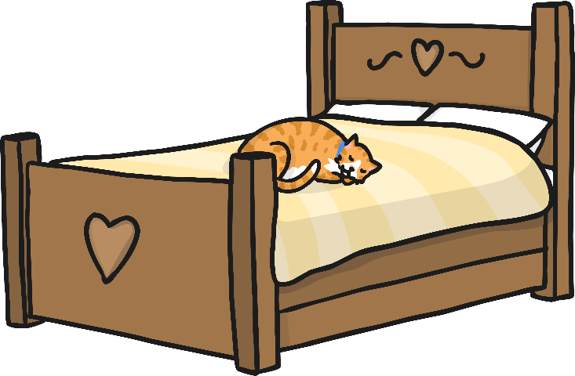
Stage 3
In the third stage of our sleep pattern, our brain activity changes yet again. Our slow brain waves (which are called delta waves) are interrupted with little bursts of faster waves. This is you in a deep sleep.
However, this is also the stage when some people can talk in their sleep or even sleep walk! This is rare but will usually happen when our cycle moves from non-REM to REM sleep.

Slide 8
Stage 4
The fourth stage is the final non-REM stage of our cycle. We are now in a deep sleep with our brain waves mostly staying slow.
If you are woken up during this stage, you can feel a little confused for a couple of minutes.

Slide 9
Stage 5
Finally, we enter REM (rapid eye movement) sleep. Our brain waves change yet again! During REM sleep, our brain waves look the same as when we are waking up. Our eyes move very quickly from side-to-side but stay closed. It is thought that this is when we dream the most!
After all of this, we go back to stage 1 and start again.
It is common to wake up between cycles and sometimes we aren’t even aware of it!

Slide 10
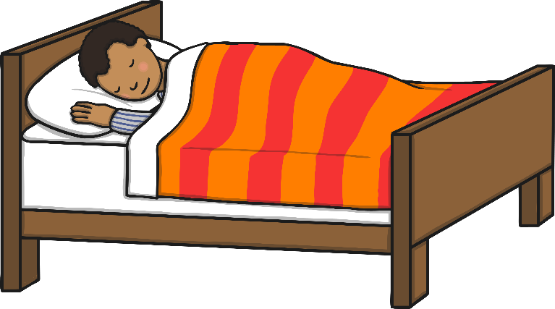
How Much Sleep Do We Need?
The amount of sleep we need changes depending on our age.
It is thought that:
Newborn babies between 0 and 3 months need 14-17 hours
Infants between 4 and 11 months need between 12-15 hours
Toddlers between 1 and 2 years will need between 11-14 hours
Preschool children between 3 and 5 years will need between 10-13 hours
School-age children between 6 and 13 years will need between 9-11 hours
Teenagers between 14 and 17 years will need between 8-10 hours
back

Slide 11
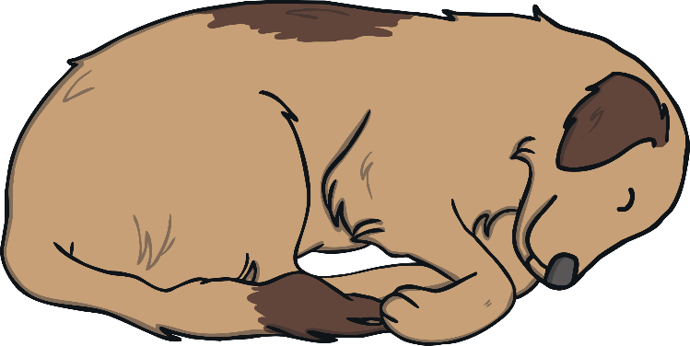
What Happens If We Don’t Get Enough Sleep?
Getting enough sleep can:
boost your immune system to keep healthy;
give you more energy to keep active;
make you happier;
improve your memory;
help you to concentrate better.

Slide 12
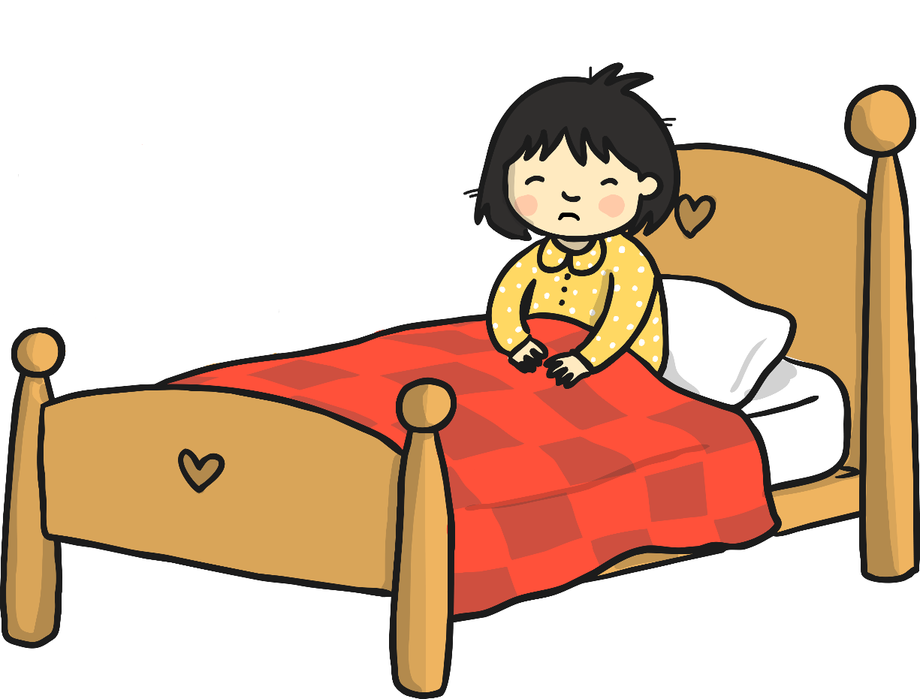
What Happens If We Don’t Get Enough Sleep?
Not getting enough sleep can:
make you irritable and impatient;
lower your energy levels;
cause difficulty concentrating;
make remembering things more difficult.
back

Slide 13
Are You Getting Enough Sleep?

