Slide 1
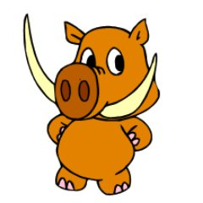
Subtraction Strategies
Primary 5 2019-2020
This resources goes over the strategies taught in class.
We’ve tried to include descriptions, videos and further resources such as online games to help with each.

Slide 2
Vocabulary
When we see the sign ‘-’ we know this means we need to subtract. We might also hear the words/phrases:
Take away
Find the difference
Count back
Less than / fewer than
Minus
Remember for subtraction, start with the larger number! Example: 56 – 13 = ___ NOT 13 – 56 = Starting with 13 would leave you with a negative number and we don’t want that!

Slide 3
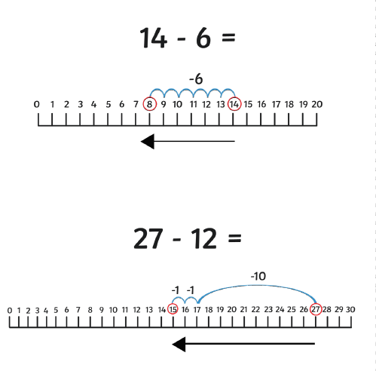
Counting Back
For this strategy you may wish to draw a number line or use a 100 square.
Remember the number line doe not have to go all the way to zero.
You don’t have to count back in ones, you could count back in 2s, 5s or 10s to make it easier/quicker. The example in the video counts back in 10s:
https://www.youtube.com/watch?v=8LYJa6Av1PA

Slide 4
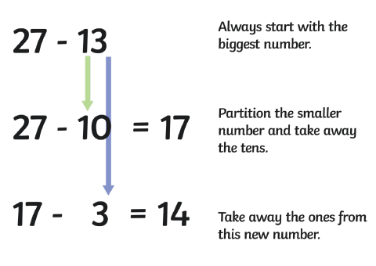
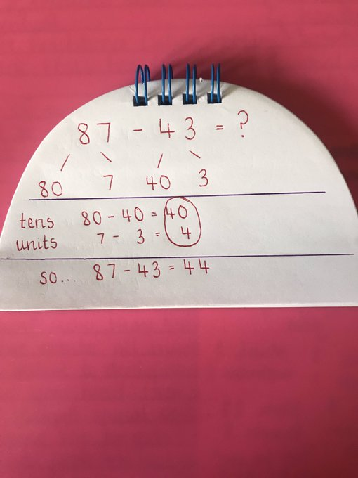
Partitioning
Partitioning means breaking apart a number into units, tens, hundreds, thousands etc.

Slide 5
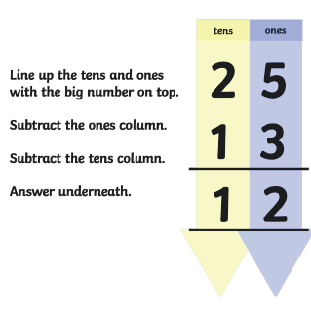
Formal Written Method 1 (Chimney Sum) – No borrowing
Notice that the top number (25) has a higher tens and units value than the bottom number (13). This means we do not have to borrow as we can do:
5 – 3 and 2 – 1
Ensure you columns line up neatly!

Slide 6
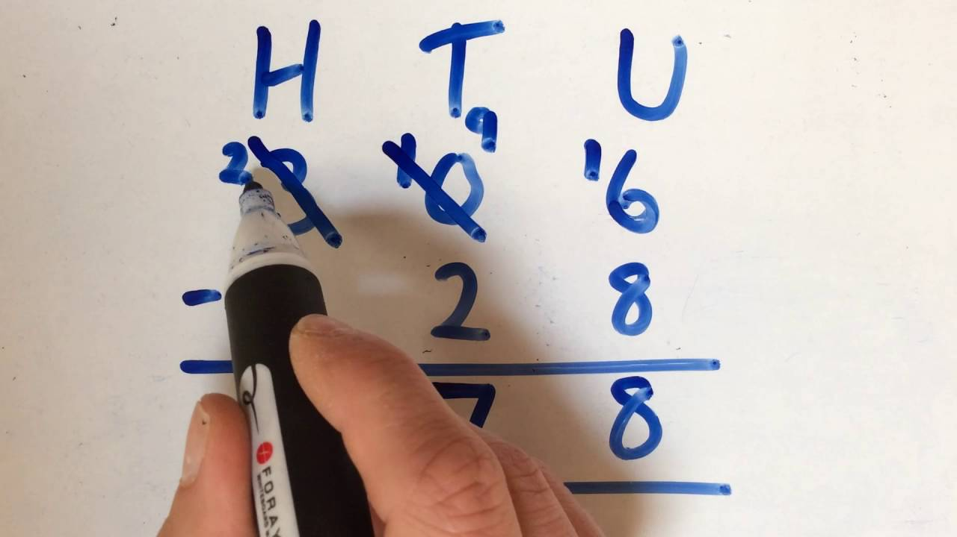
Formal Written Method 2 (Chimney Sum) – Borrowing
Videos with examples of how to use this method. Please watch both:
https://www.youtube.com/watch?v=YfXiaEjTnQM
I personally love this next video as it reminds me of the way I was taught to think of it when I was in primary school!
https://www.youtube.com/watch?v=NCWfLrLirKQ

Slide 7
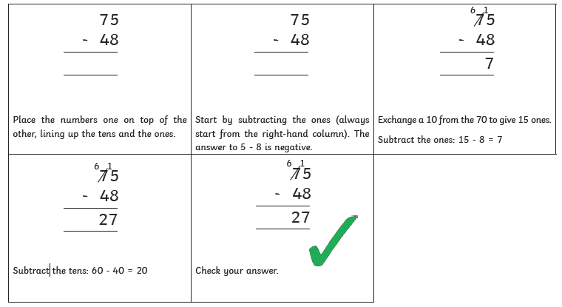
Formal Written Method 2 (Chimney Sum) – Borrowing

