Slide 1
Imaginative Writing
As we have just returned from the ‘Easter Holidays’, this week we would like you to write a short imaginative story on a visit to a different country. Before you start writing, think about the structure, setting, who is there and what is going to happen – remember it is an Imaginative piece, so anything can happen!! Remember to think about your Core Targets when you are writing as they are there to support and guide you. Have fun!!
Structure
Think about the structure, most stories have a beginning, middle and end.
In the beginning, establish your setting and characters.
In the middle, you could add a day trip you went on or a problem you had to solve.
At the end there could be a dramatic rescue. The ending could be happy or sad.

Slide 2
Setting
Remember to think about the setting. A setting is where and when a story is set. When writing a story, the setting is really important. Thinking about these things will help your writing.
Think about what the setting is like, is it day-time or night-time?
How does the setting impact the characters?
Can you picture the setting clearly? This will help you describe it to the reader.
Have a look at the photos in this power point to give you inspiration, or maybe you have a place in mind already that you have visited before. You could always use Google Maps to help choose a destination.
Characters
Think about who is there, asking questions can help you create a new character.
What's their name? How does the character behave? What do they like to do? How old are they? What do they feel and what are they thinking? Can you think of some more things you should know about your characters?

Slide 3
Pupils core writing targets
Second Level
I can
create texts regularly for a range of purposes and audiences selecting appropriate genre form, structure and style.
spell out commonly used words correctly by applying rules and strategies.
spell less commonly used words with accuracy.
confidently and accurately use capital letters, full stops, commas inverted commas, exclamations marks and/or apostrophes.
Uses sentences of different lengths and complexity.
ensure sentences are grammatically accurate, nouns, verbs and tenses agree.
accurately use paragraph to separate ideas/events.
use a wide variety of conjunctions/connectives to link ideas and join sentences, eg furthermore, nonetheless.
proof read and edit writing accurately.
Use linked legible handwriting to present work attractively using correct forms of layout.

Slide 5
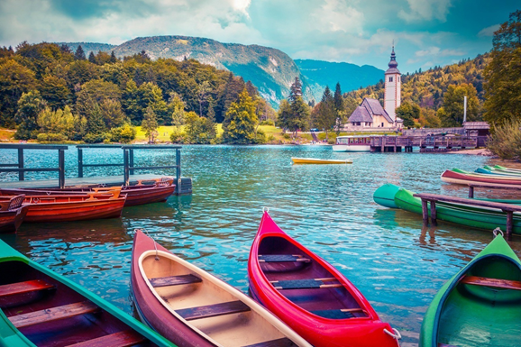

Slide 6
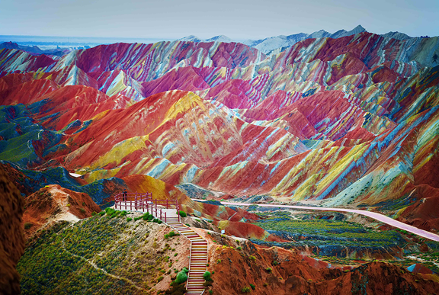

Slide 7
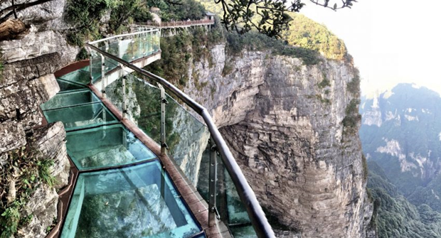

Slide 9
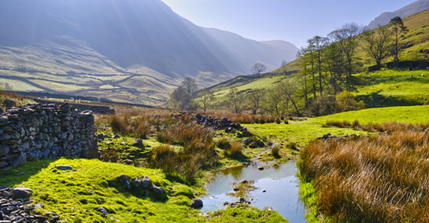

Slide 10
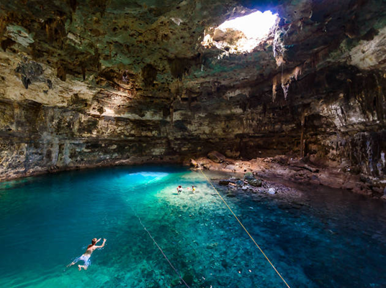

Slide 11
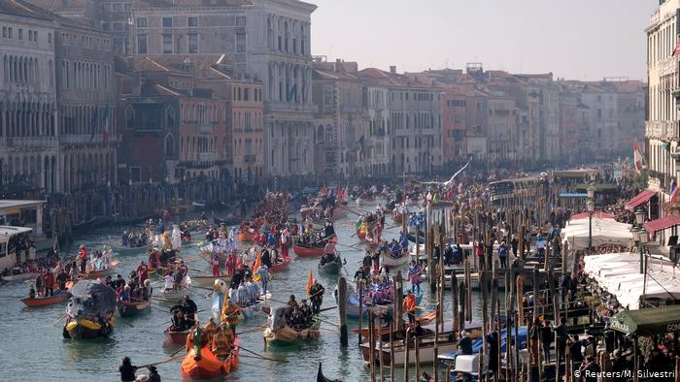

Slide 12
