Slide 2
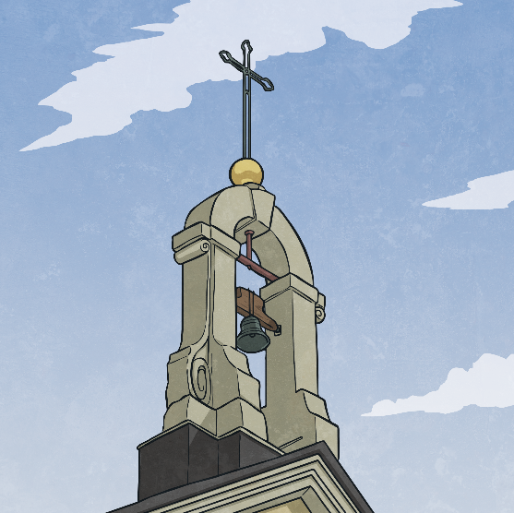
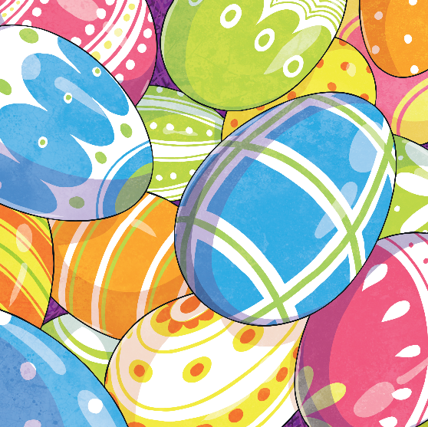
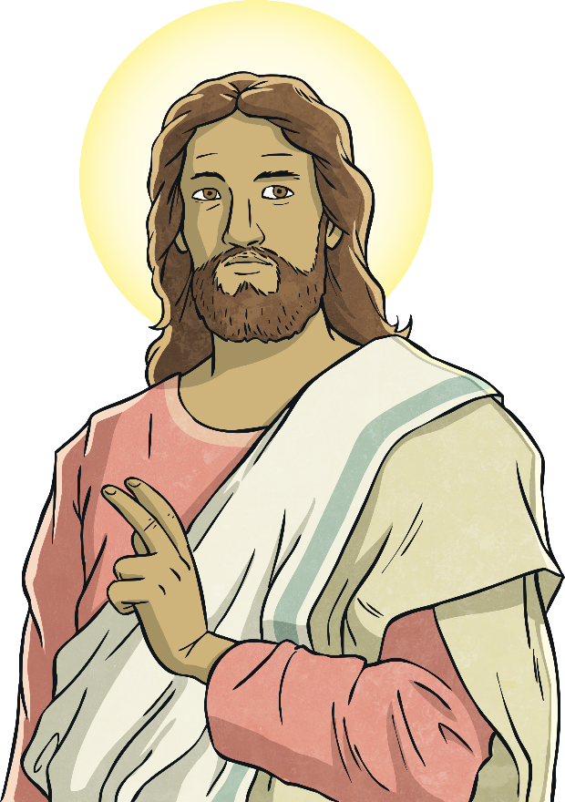
Easter Traditions
Easter is a time of celebration for Christians, who remember when Jesus was crucified on Good Friday and rose from the dead on Easter Sunday.
There are many Easter traditions, such as eating
chocolate eggs, going on Easter egg hunts and making
Easter bonnets. However, in France there are other
traditional ways of celebrating Easter.

Slide 3
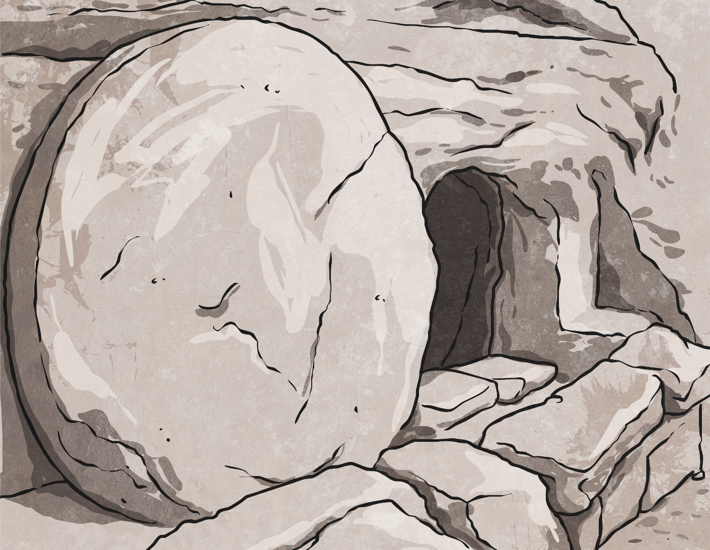
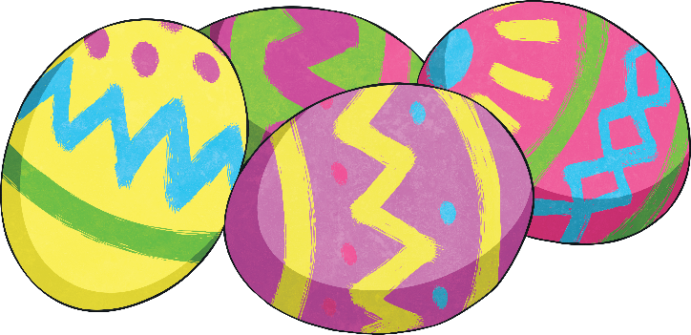
Rolling Eggs
In some parts of France, people join in
the contest of egg rolling. This involves rolling eggs down a slope.
The winning egg, which remains intact, represents the stone which was rolled away from the tomb where Jesus had been laid after his death.

Slide 4
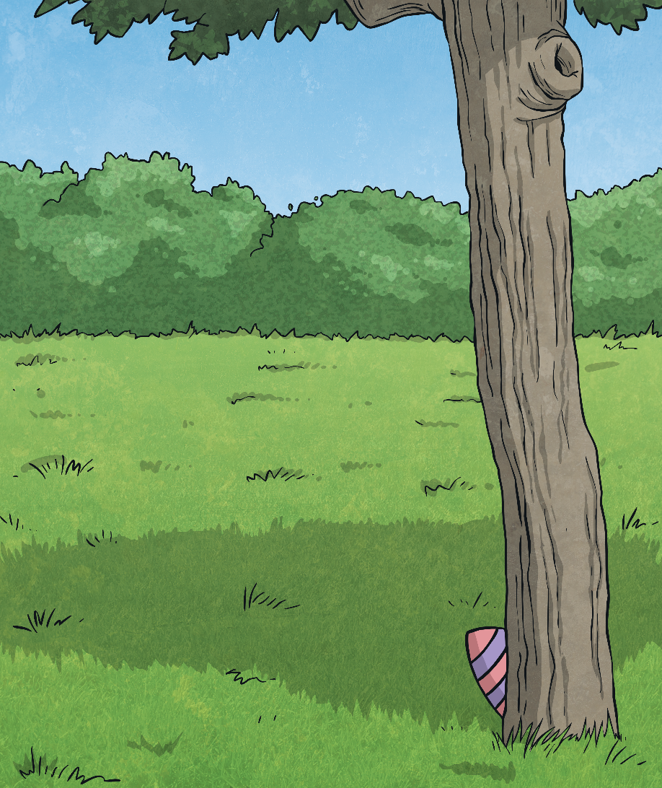
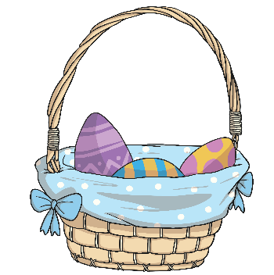
Easter Egg Hunts
Many people in France join in with Easter egg hunts. In the grounds of the Château de Vaux-le-Vicomte, which is just outside Paris, the largest egg hunt in France is held. Tens of thousands of eggs are hidden for children and adults to find.

Slide 5
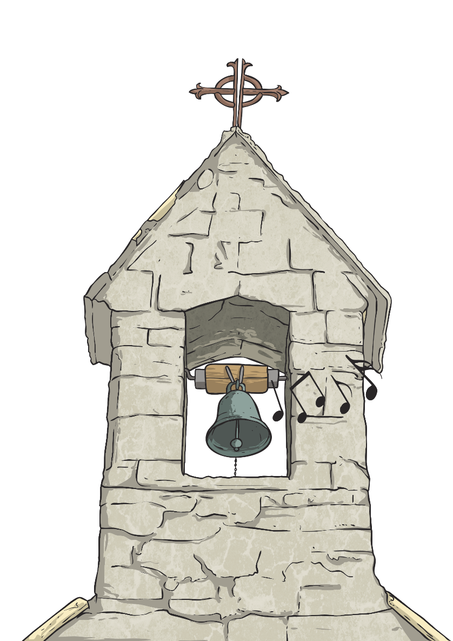
Les Cloches de Pâques
Les Cloches de Pâques, or ‘Easter bells’, is a popular tradition in France. No church bells are rung from Good Friday to Easter Sunday in mourning for Jesus’ crucifixion.
It is said that on Good Friday, the bells in France
fly to the Vatican in Rome where the Pope
blesses them. They then return on Easter
Sunday, bringing with them chocolate
eggs which are dropped in gardens.
Then, on Easter Sunday morning,
children will run out into the garden to
find their chocolate eggs, bunnies and
chickens. The church bells ring again.
Chocolate bells are sold in the shops,
to remember this tradition.

Slide 6
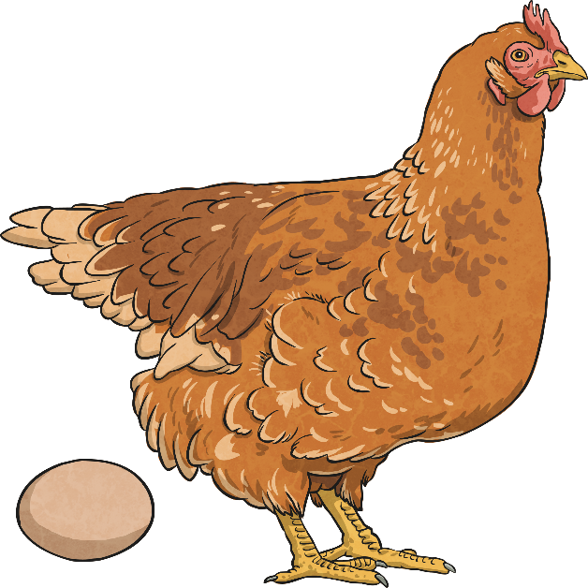
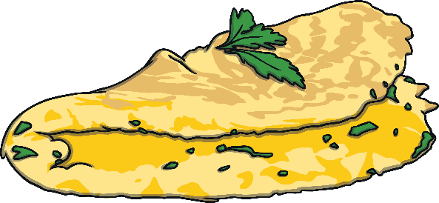
Omelettes at Easter
Many years ago, church law banned Christians from eating eggs during Lent – the forty days and nights before Easter Sunday. This meant that hens carried on laying eggs but no one was using them.
On Easter Sunday, people would make
omelettes to use up the eggs.
This tradition still continues today.
Legend told that, if the first thing you
ate on Easter Sunday was an egg that had been laid on Good Friday, you would
be protected from illness until the next
Easter.

Slide 7
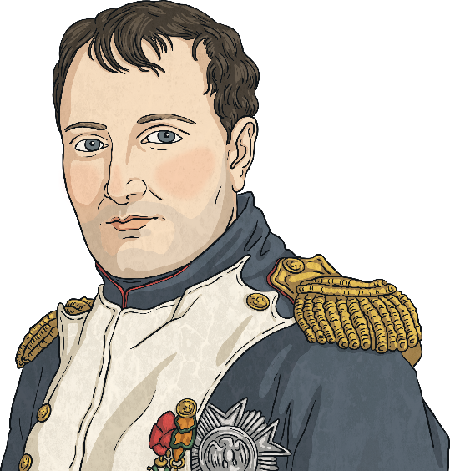
Napoleon and Omelettes
In Bessières, near Toulouse in France, it
is a tradition for the townspeople to make a huge omelette.
This is because Napoleon Bonaparte and his army stayed for a night near the town. After Napoleon had eaten his omelette, made by the innkeeper, he ordered the people of the town to collect all the eggs they had and make an enormous omelette for his army.

Slide 8
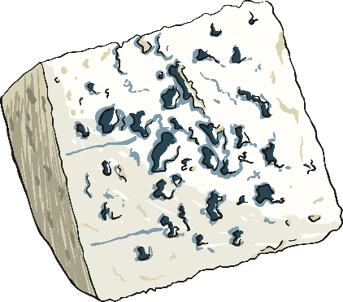
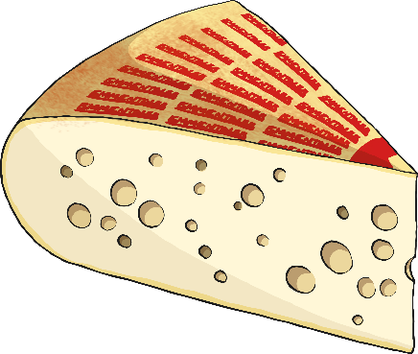
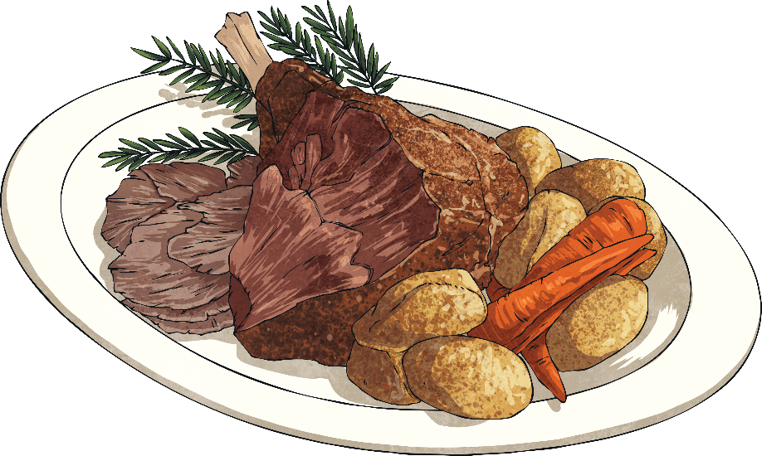
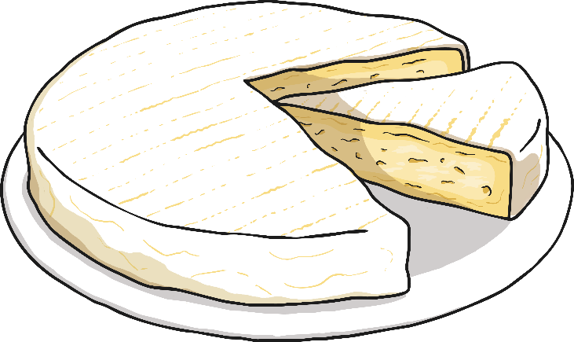
Easter Food
The main Easter meal traditionally consists of lamb. Families gather together and share the meal. Lamb represents new life and spring. Sometimes it will be a joint of lamb or a stew. Pudding will usually include chocolate, with a traditional cheeseboard afterwards.

