Slide 1
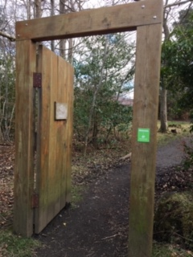
The Magic Door
Imagine that you have found a magic doorway into another world!
What does you door look like?
Where is your door?
What sort of magic will be on the other side? (Another planet, the past, the future, a magic world of wizards?)
How do your characters get back to the real world?

Slide 2
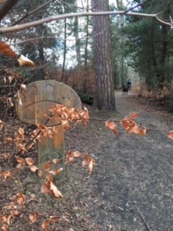
Mrs Fairley’s ‘The Magic Door’
Story Writing competition
Task- Write an imaginative story titled ‘The Magic Door’
Create a story in any way you want- on paper or using ICT. It can be as long (Chapters!) or as short as you like. It can include illustrations.
To enter- email to school (wlharrysmuir-ps@westlothian.org.uk ), upload onto TEAMS or send/bring a copy up to school if you are able to- FAO Mrs Fairley
Prize- Trip to Waterstones for a Pupil from each class once we are back at school ☺
Please send entries in by Thursday 30th April

