Slide 1
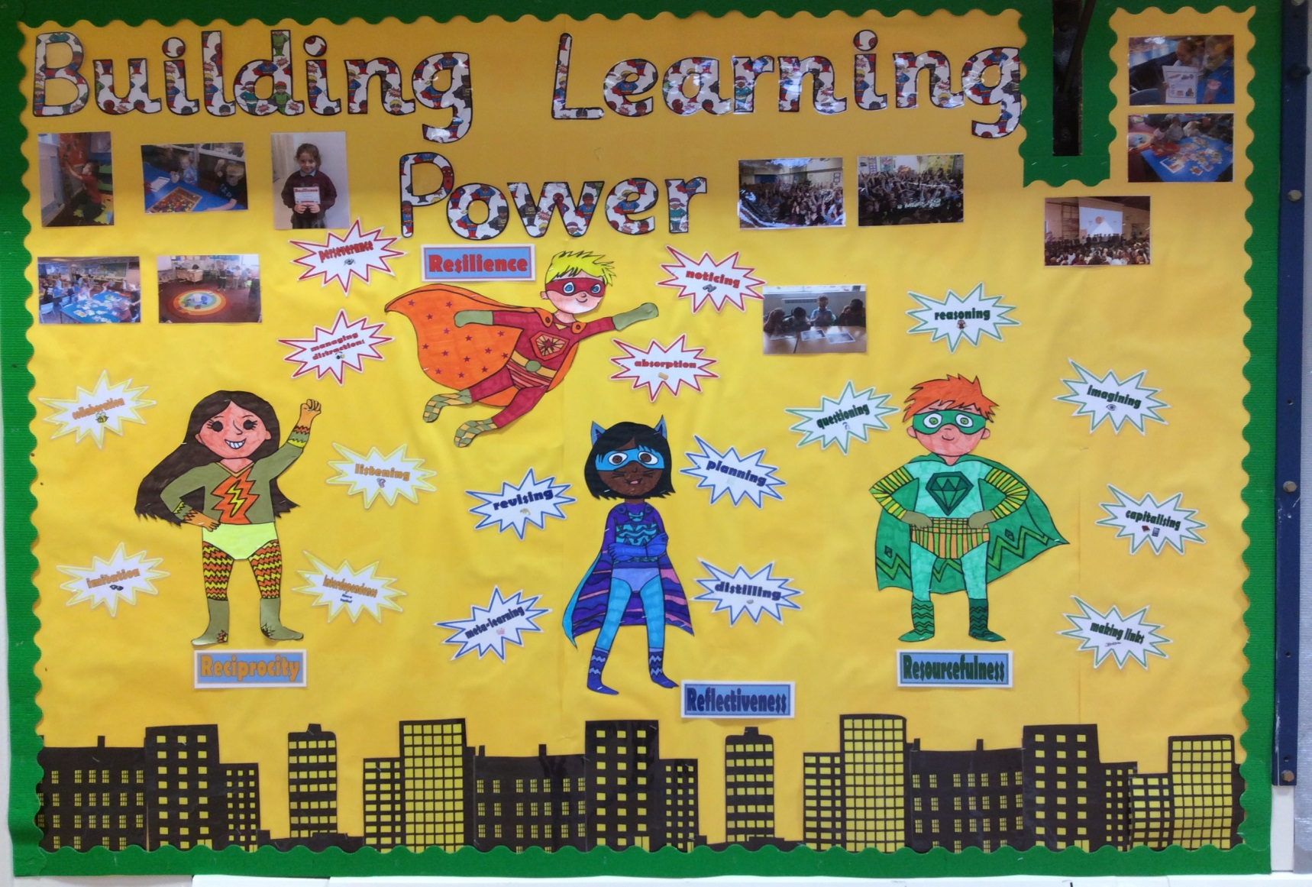
Building Learning Power Assembly
https://www.youtube.com/watch?v=FzfYOa9ewlk
Notes:
Welcome to our Building Learning Power Assembly. Who can remember which group of learning muscles we learned about last time? What were the 4 learning muscles?

Slide 2
What does Building Learning Power look like?
There are four main learning characteristics (The 4 R’s):
Resilience: not giving up,
Resourcefulness: being able to use a range of learning strategies and knowing what to do when you get stuck,
Reflectiveness: being able to think about yourself as a learner and how you might be able to do this better,
Reciprocity: being able to learn with and from others, as well as on your own.
These characteristics are then split into seventeen learning ‘muscles’ that you can ‘stretch’ within your everyday lessons and activities and apply to different aspects of your learning.

Slide 3

What is resourcefulness?
https://www.youtube.com/watch?v=Wqb6iVXwJ7c

Slide 4
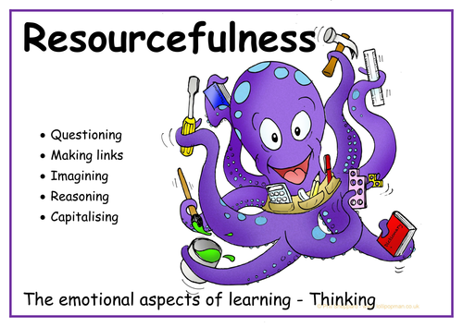

Slide 5
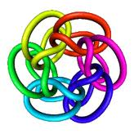

Resourcefulness
Questioning
Asking questions of yourself and others.
Being curious and playful with ideas delving beneath the surface of things.
Making Links
Seeing connections between events and experiences.
Building patterns- weaving a web of understanding.
Imagining
Using your imagination and intuition to put yourself through new experiences or to explore possibilities.
Wondering ‘what if...?’
Reasoning
Calling up your logical and rational skills to work things out methodically and rigorously; constructing good arguments and spotting the flaws in others.
Capitalising
Drawing on the full range of resources from the wider world- other people, books, the Internet, past experience, future opportunities.

Slide 6

Questioning

Slide 7
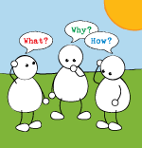
What it means?
Questioning
Being curious
Wanting to get to the bottom of things
Puzzling things out
Often wonder why
https://www.youtube.com/watch?v=bJXEAmAQqeo

Slide 8
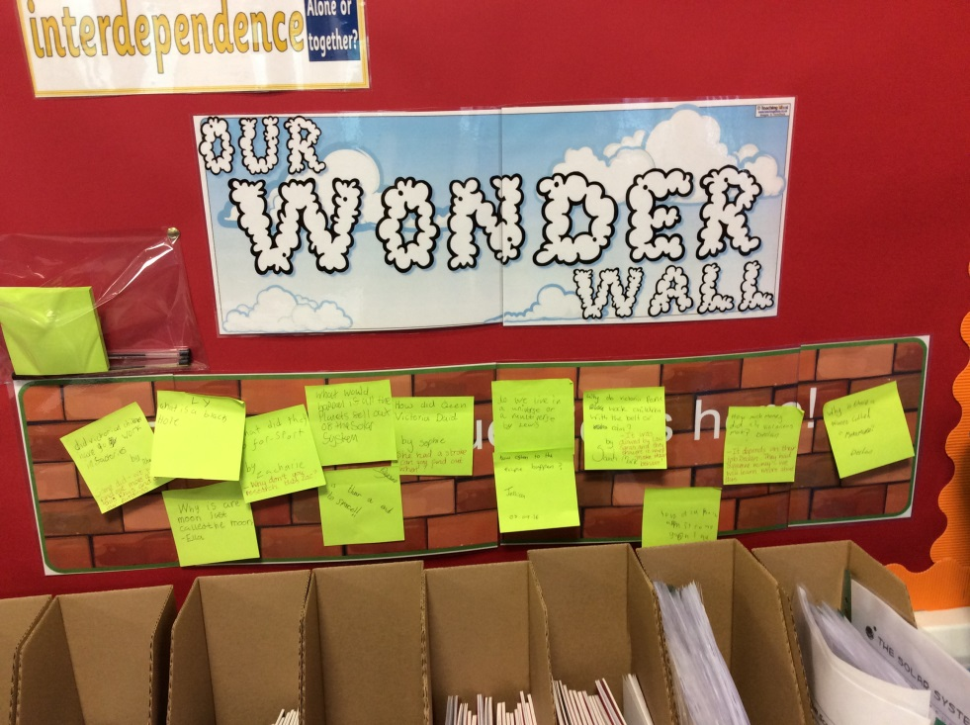
Examples of how you can build up this learning muscle
Have a question wall in your classroom
Ask more questions
Research types of questions
Interview people to expand your muscle
Play the ‘why’ game
be more expressive

Slide 9
Things we can say to encourage questioning…
What different sorts of questions are there?
That’s a great/interesting question…
I don’t really know the answer, how could we find out?
What do you think an alien would ask if they were here?
What else might we want to know?
Why is it fun to ask questions?

Slide 10
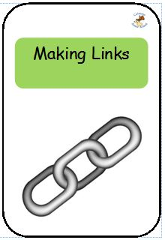
Making Links
Look for connections between experiences or ideas
Find pleasure in seeing how things fit together, make patterns
Connect new ideas to how you think and feel already
Look for connections in your memory that will help you with something complicated
https://www.youtube.com/watch?v=5Ui21oHvOXA

Slide 11
Examples of how you can build up this learning muscle
Use story bags to make links between objects in it for story writing
Create mind maps to show linked ideas
Have a ‘link of the week’ board using pictures
Find links to words in different languages
Make a class ‘chain of thought’ to share knowledge and identify connections

Slide 12
Language to encourage making links
How could it fit?
What does… tell you about…?
Can you see any connections?
Can you see a pattern here?
What else do you already know?
Can you see a link between what we did in… and…?
Now that you know… has it changed how you think about…?

Slide 13
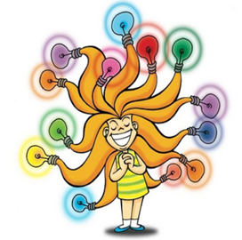

IMAGINING
https://www.youtube.com/watch?v=PlYP4iF7GjM

Slide 14
This is what imagining means
.Let your mind explore and play with possibilities and ideas
.Picture how things might look, sound, feel, be
.Build up stories around objects, facts, theories or other things
.Rehearse things in your mind before doing them for real

Slide 15
Examples of how you can build up this learning muscle
Surprising photos- have pictures around school which are astonishing!
Use music, candles, lights or silence to create a calm space
Puzzling starters- describe objects and ask pupils to imagine what they might be

Slide 16
Language to encourage imagining
What can we learn from our dreams?
Try to picture… in your mind.
What else do you imagine might be happening?

Slide 17

Reasoning- What does it mean?
Reasoning Means…
To create logical arguments.
To spot flaws in other peoples arguments.
To realise what might happen.
To look for evidence.
https://www.youtube.com/watch?v=tIUPW2ARTso

Slide 18

How can we use reasoning?
Here is a short play to show you. It’s a crime scene.
Play Sudoku, the problems can be solved by logic and reasoning.
Put pictures in the correct sequence, explain the reasons for the order.
Identify the odd one out and give reasons.

Slide 19
Things to say when reasoning
Which of these things fit together? Why?
How many reasons can we find for…?
What evidence can you find to support your argument?
How have you come to that conclusion?
Which thinking tool would help us to solve this puzzle?
What can you assume from this?

Slide 20

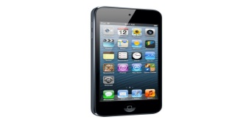
Capitalising- What it means
It means you learn from many different sources – people , books , the internet and music.
Making intelligent use of all kinds of things to aid learning
https://www.youtube.com/watch?v=Nuby-vJm_fE

Slide 21
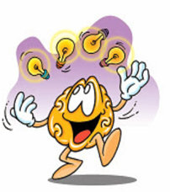
How you can build capitalising…
You can build this muscle by reading books, by listening to other people and even by listening to music.
Encourage questions.
Demonstrate making links between different ideas.
Don’t allow your imagination to shrivel up!
Find different ways of using resources such as reference books, dictionaries and the Internet.

Slide 22
Language to build your muscle
Who could help you?
What can we use to help us with this?
Where else might we go to find out about that?
What led you to choose to use that?
If you could use anything you wanted, what would you use?
What skills do we need as a team so that we can succeed in this task?

Slide 23
Capitalising Story
We are now going to tell you a story about people using capitalising …
It all starts in an Internet cafe….

Slide 24
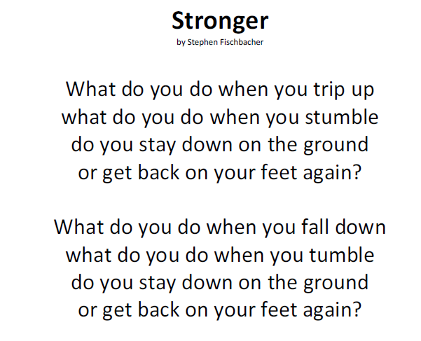
http://www.fischy.com/songs/sample-song-stronger/

Slide 25
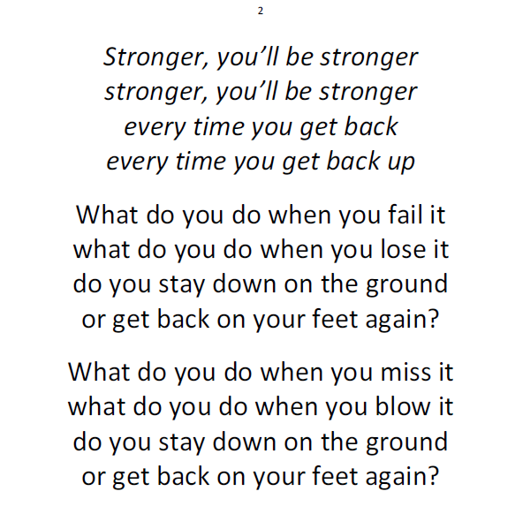

Slide 26
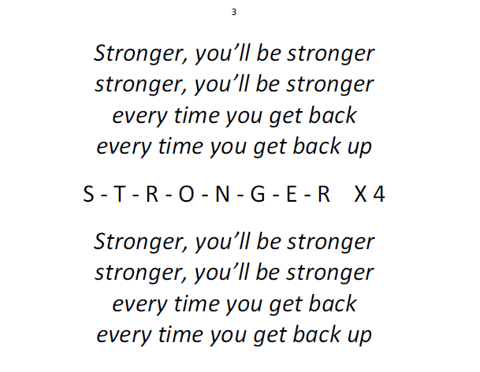

Slide 27

Let’s recap!

Slide 28
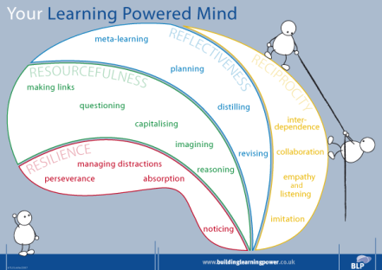

What five things do we need to do to become a resourceful learner?

Slide 29
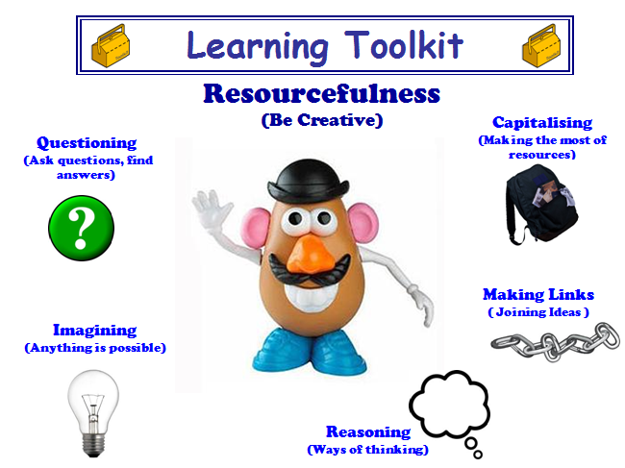

Slide 30
It’s Competition Time!

Slide 31
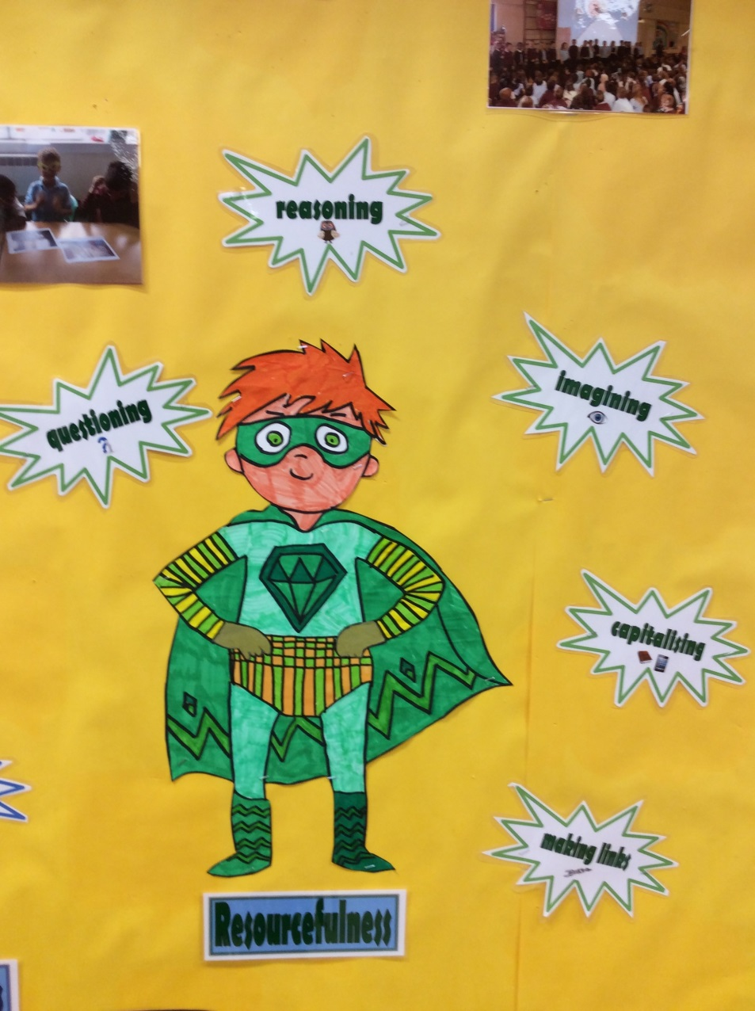
Design a Resourcefulness Superhero
More details to follow from Mrs Fairley

Slide 33
Keep building your learning power in and out of school ☺

Slide 34

As we go now
As we go now from this moment
As we leave behind our time together
May we walk with one another
May we help each other on the way
As we go now from this moment
As we go into the future together
May we treasure one another
May we realise how precious we are
(Repeat)

