Slide 1
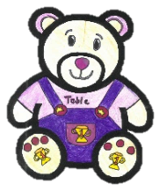
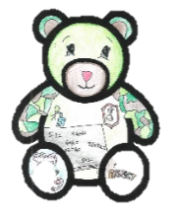
Eastertoun Primary
School and ELC
Practical Ideas for Parents/Carers to
Support Transition

Slide 8
