Slide 1
Social Story
Primary 2A

Slide 2

You go to East Calder Primary School and will have lots of fun here!

Slide 3
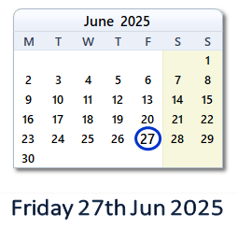
You are going to be off from June 27th for the summer holidays. You will be off for nearly 7 weeks.

Slide 4
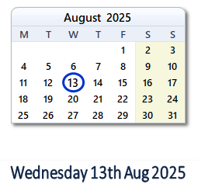
You will go back to school on Wednesday 13th August.

Slide 5
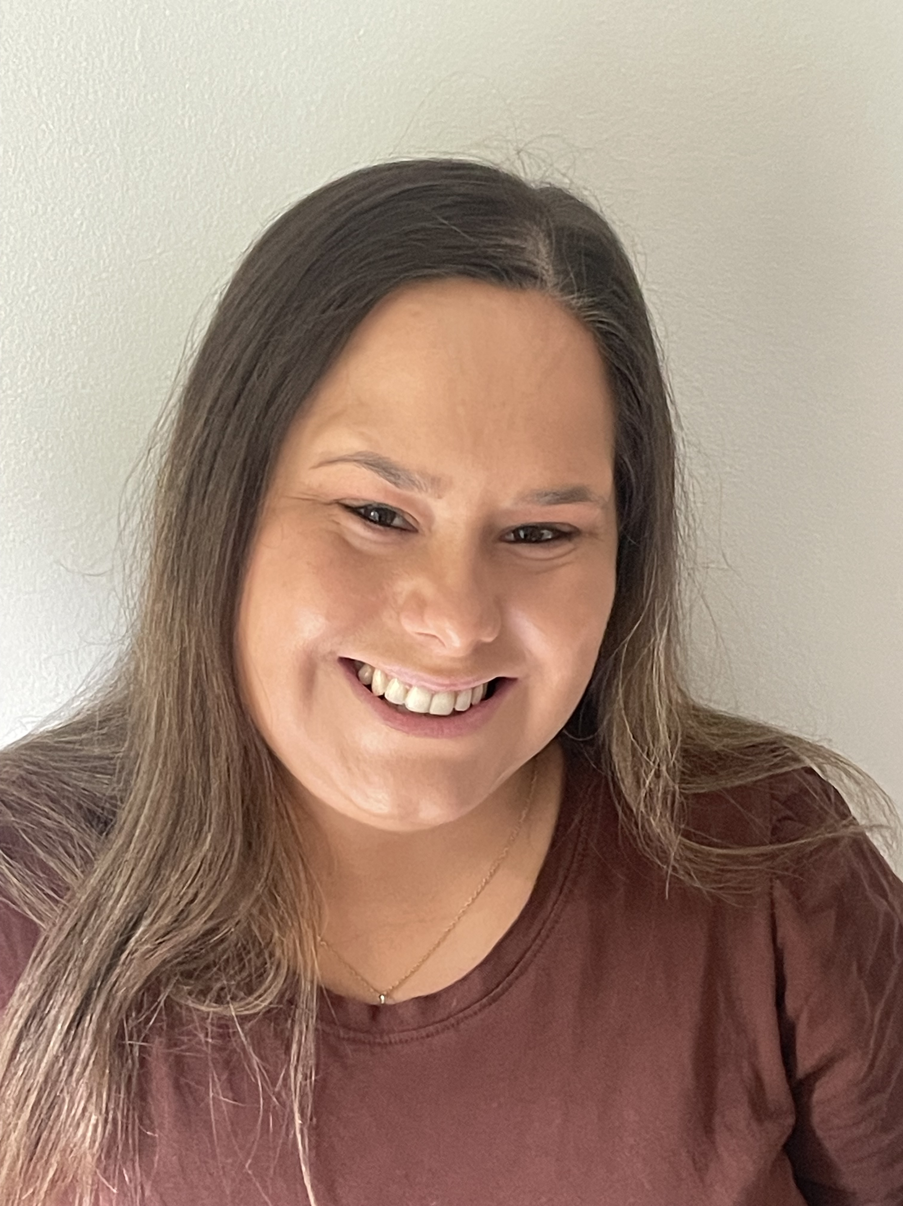
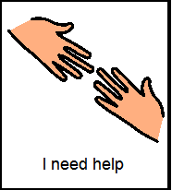
Your new class is Primary 2A. Your new teacher will be Miss Marra.
They will be able to help you.

Slide 6
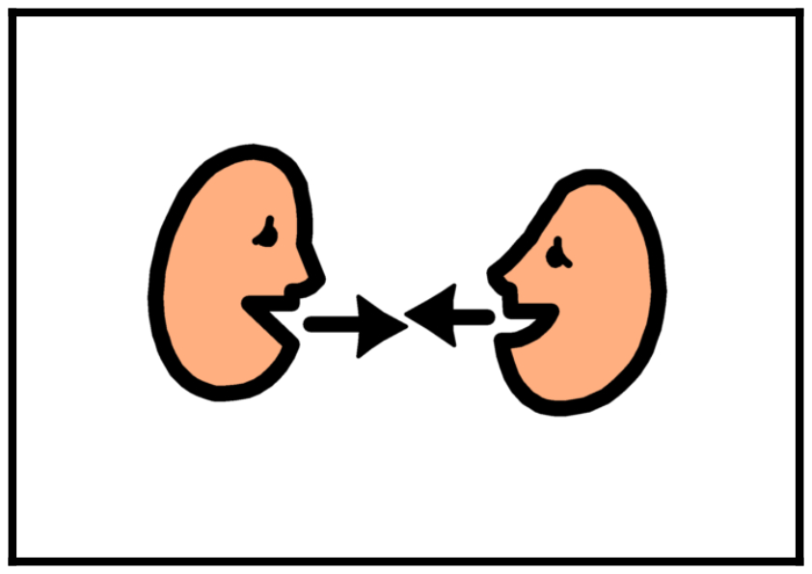

You can ask your teacher for help when you need it. This will make you feel happy.

Slide 7
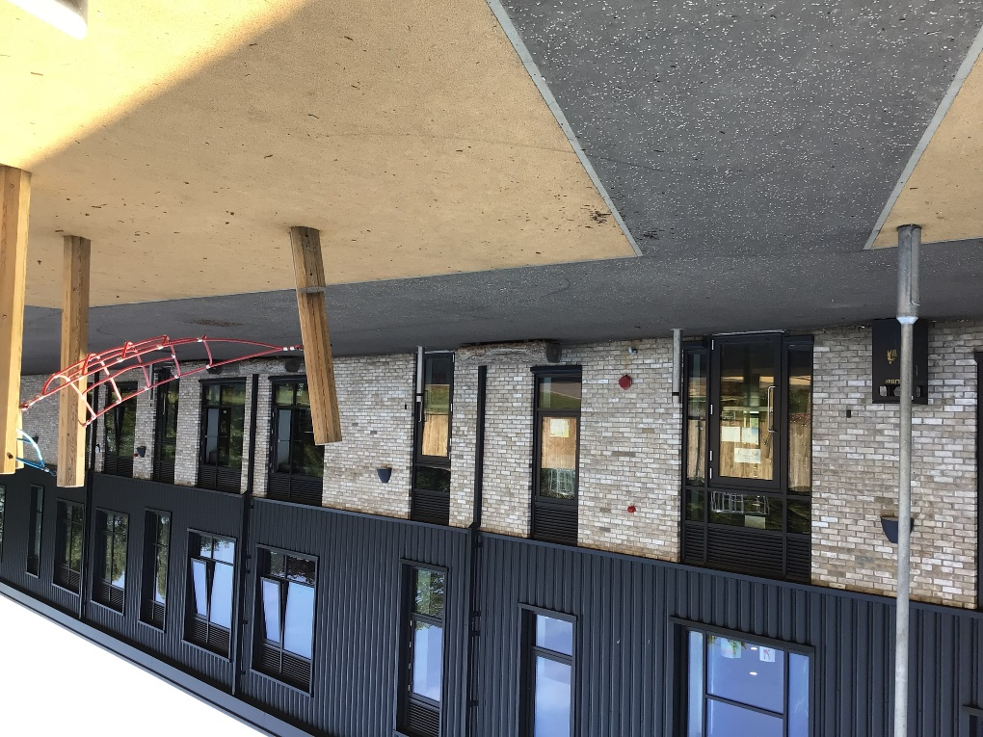
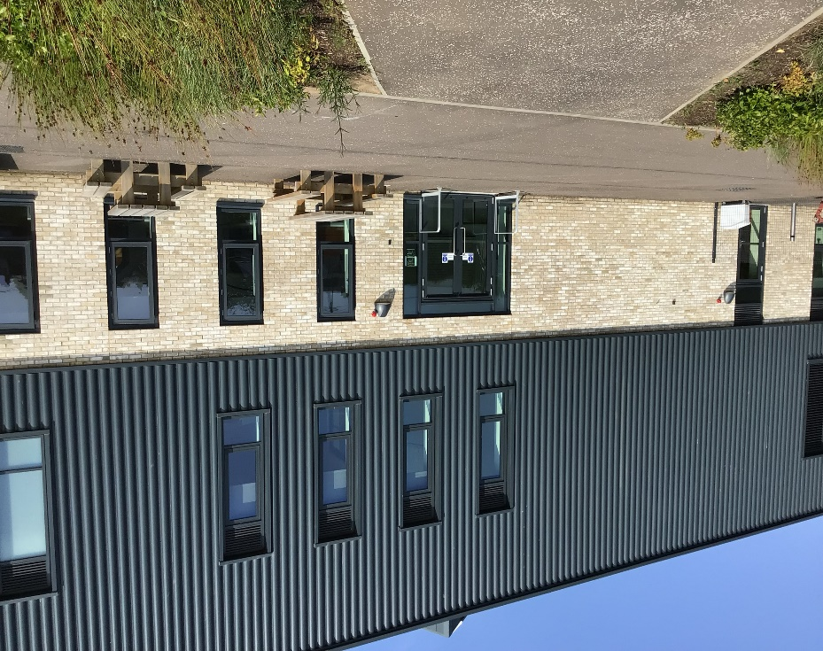
You can use this door or the breakfast club door to come into school in the morning. Our staff will help you if you need anything.

Slide 8
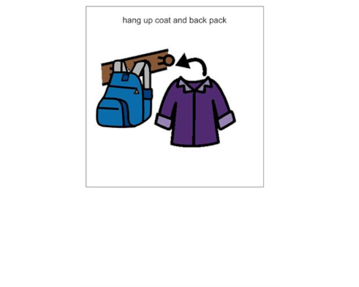
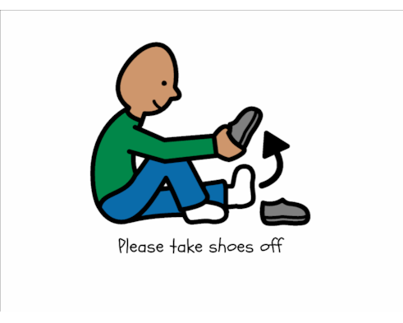
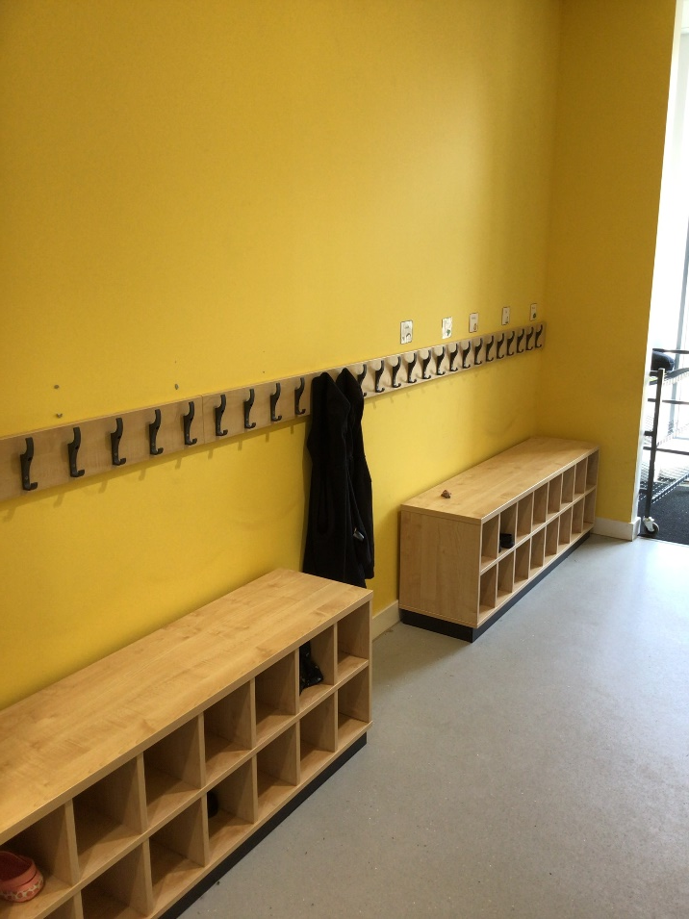
You will hang your coat and bag in the peg area beside your class. You can change into your indoor shoes too.

Slide 9
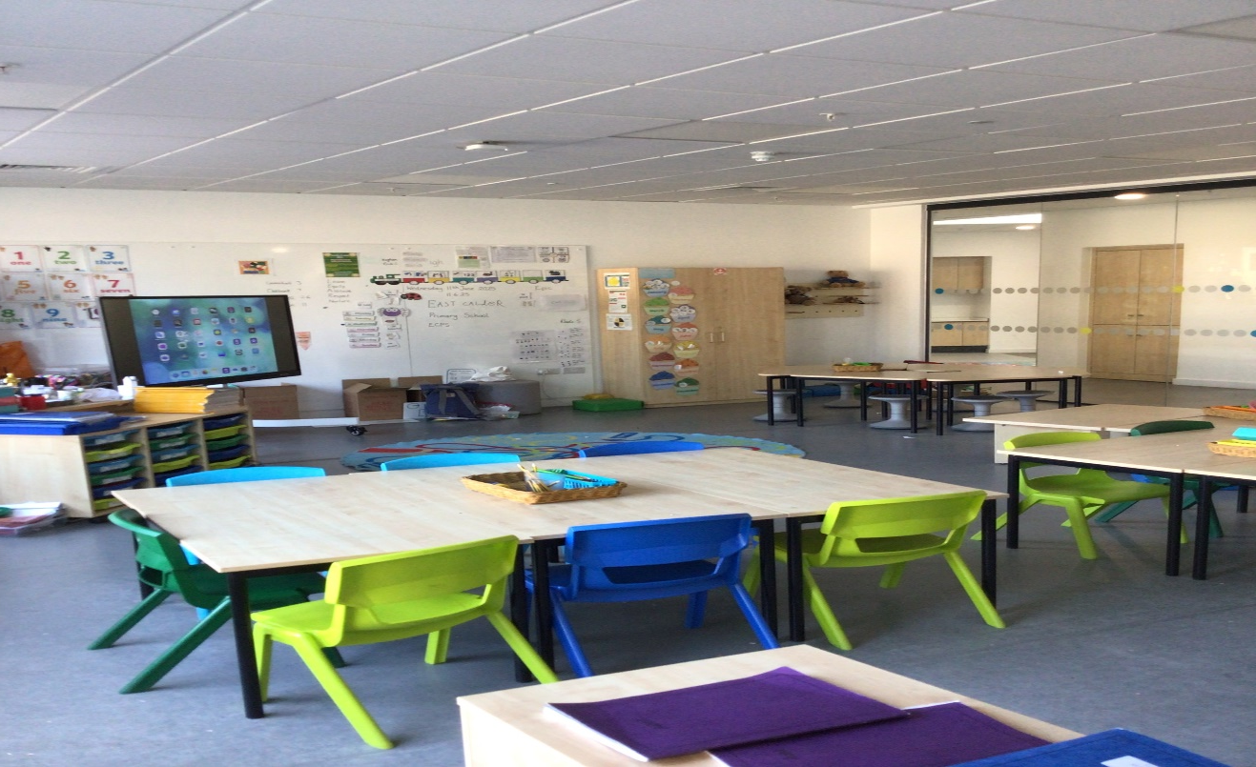
This is your new classroom. It might look a little different after the holidays. You, your class and your new teacher can make it look good together.

Slide 10
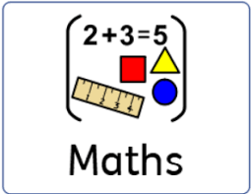


You will have fun in your new class and will learn lots of new things.

Slide 11
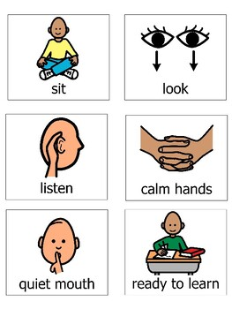
You will listen to your new teacher and follow the school rules.
s
You will listen to your new teacher and follow the school rules.
You will listen to your new teacher and follow the school rules.

Slide 12
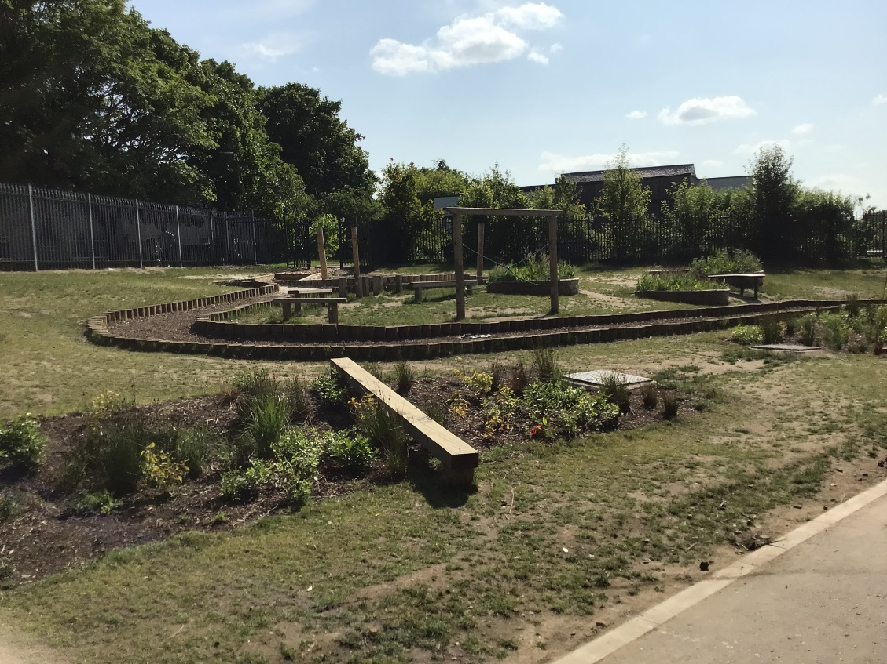

This is your playground where you will have fun with your friends.
You will listen to your new teacher and follow the school rules.
You will listen to your new teacher and follow the school rules.

Slide 13
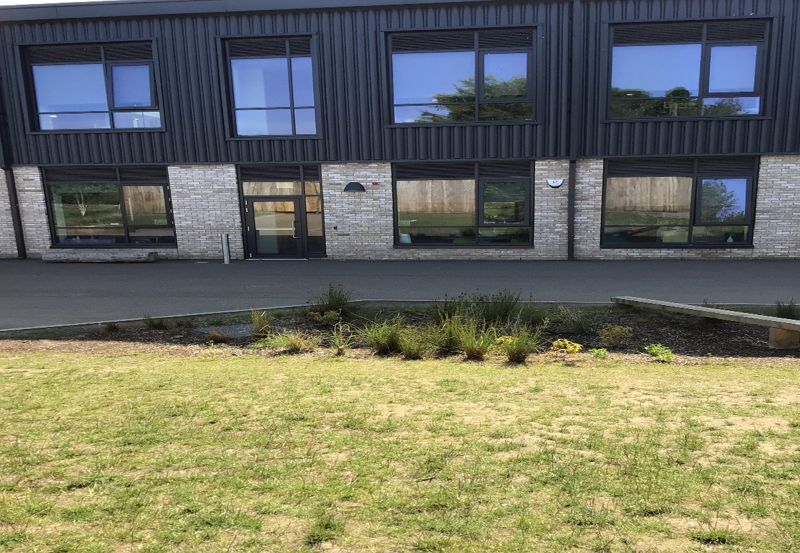
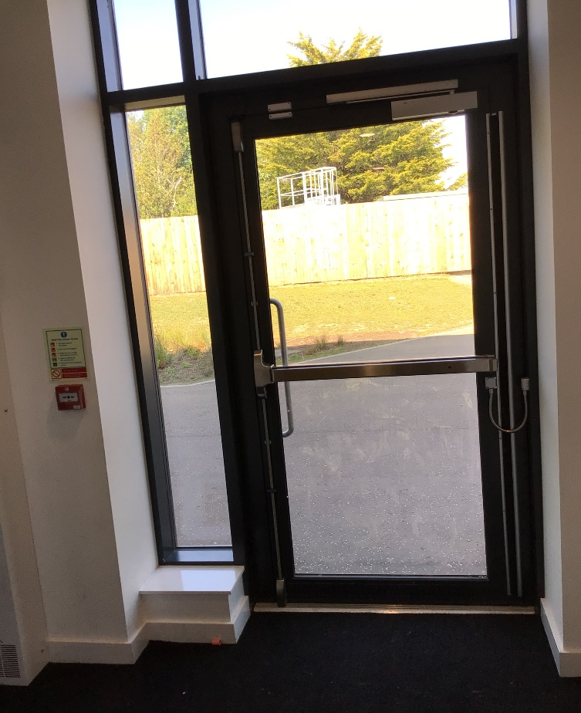
At the end of the day, you will leave using this door beside your class which will lead into the upper playground.
You will listen to your new teacher and follow the school rules.

Slide 14
Being in a new class will be lots of fun! You might make new friends in your class. This will make you happy.
You will listen to your new teacher and follow the school rules.
You will listen to your new teacher and follow the school rules.

Slide 15

You can go home at the end of the day and tell your parents/carers all about your new class and your new teacher.
You will listen to your new teacher and follow the school rules.
You will listen to your new teacher and follow the school rules.

