Slide 1
Social Story
Primary 1A

Slide 2

You are now in Primary 1 at East Calder Primary School and will have lots of fun here!

Slide 3
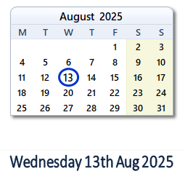
Your first day of school will be on Wednesday 13th August.

Slide 4
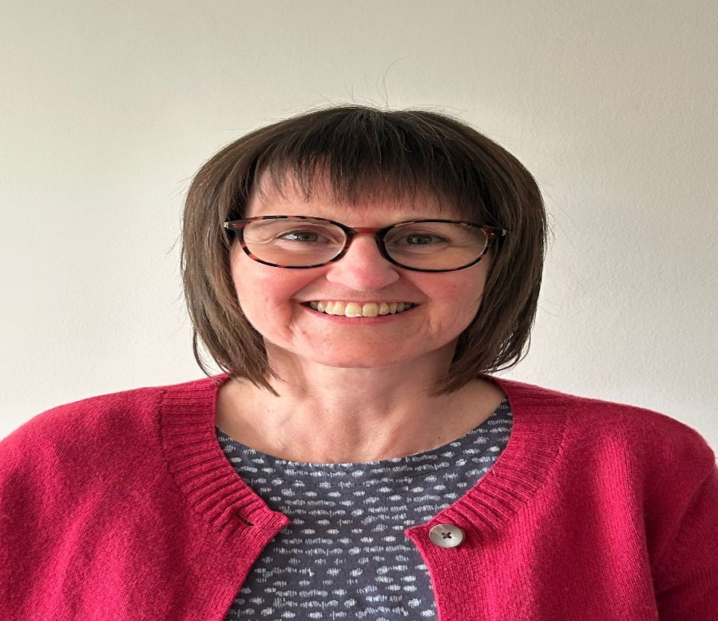

Your new class is Primary 1A. Your new teacher will be Mrs Murdoch. They will be able to help you.

Slide 5
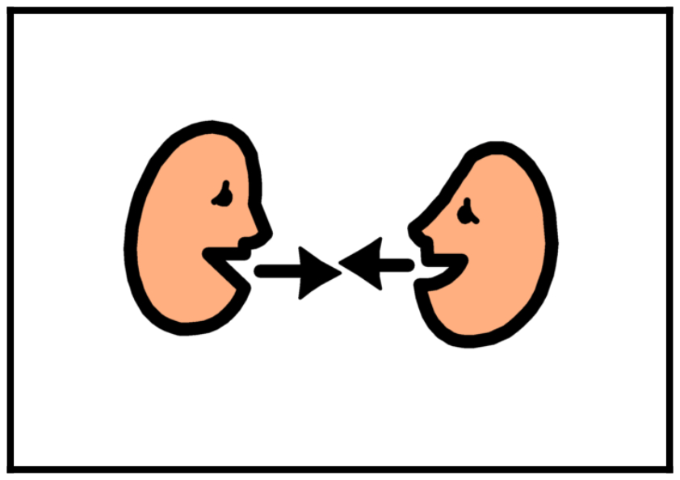

You can ask your teacher for help when you need it. This will make you feel happy.

Slide 6
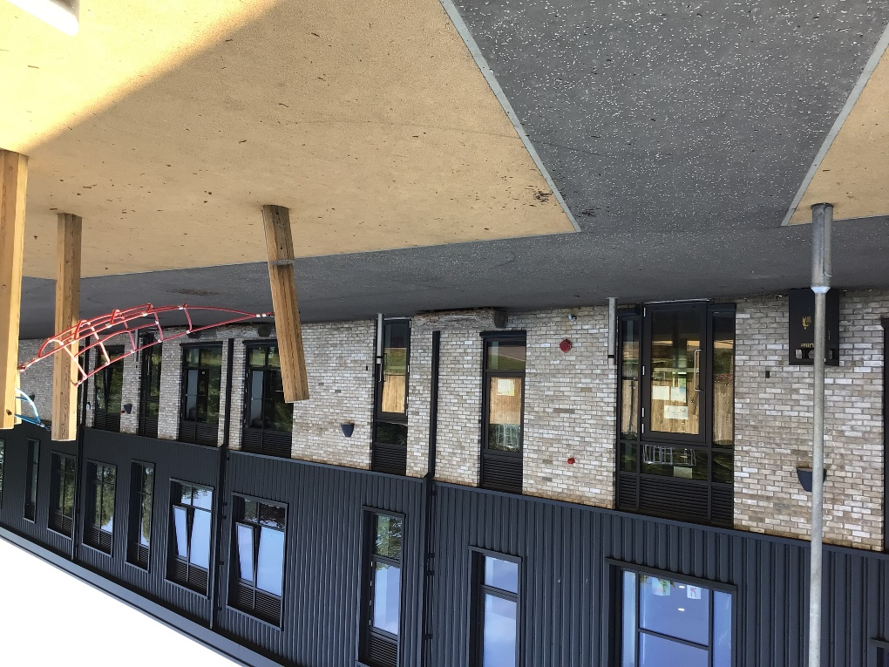
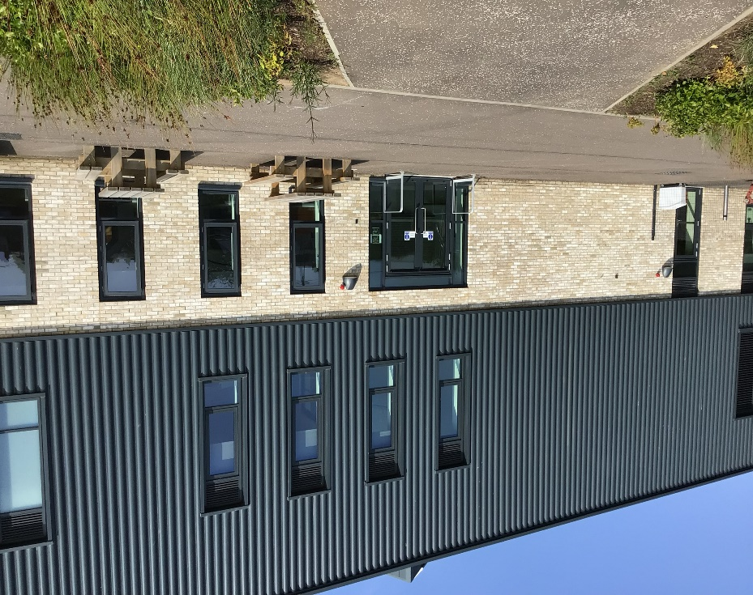
You can use this door or the breakfast club door to come into school in the morning. Our staff will help you if you need anything.

Slide 7
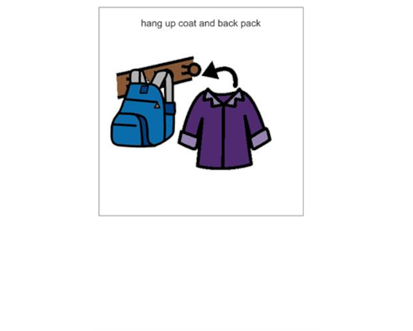
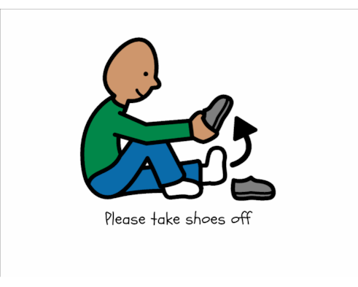
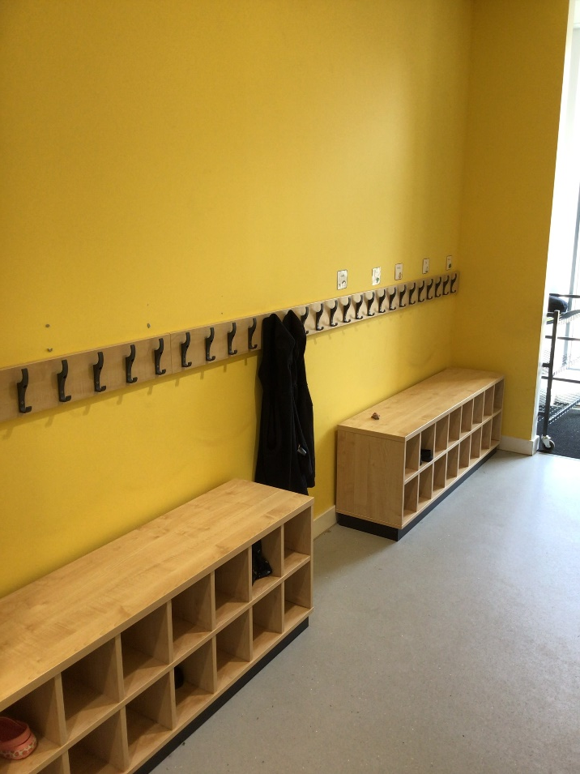
You will hang your coat and bag in the peg area beside your class. You can change into your indoor shoes too.

Slide 8
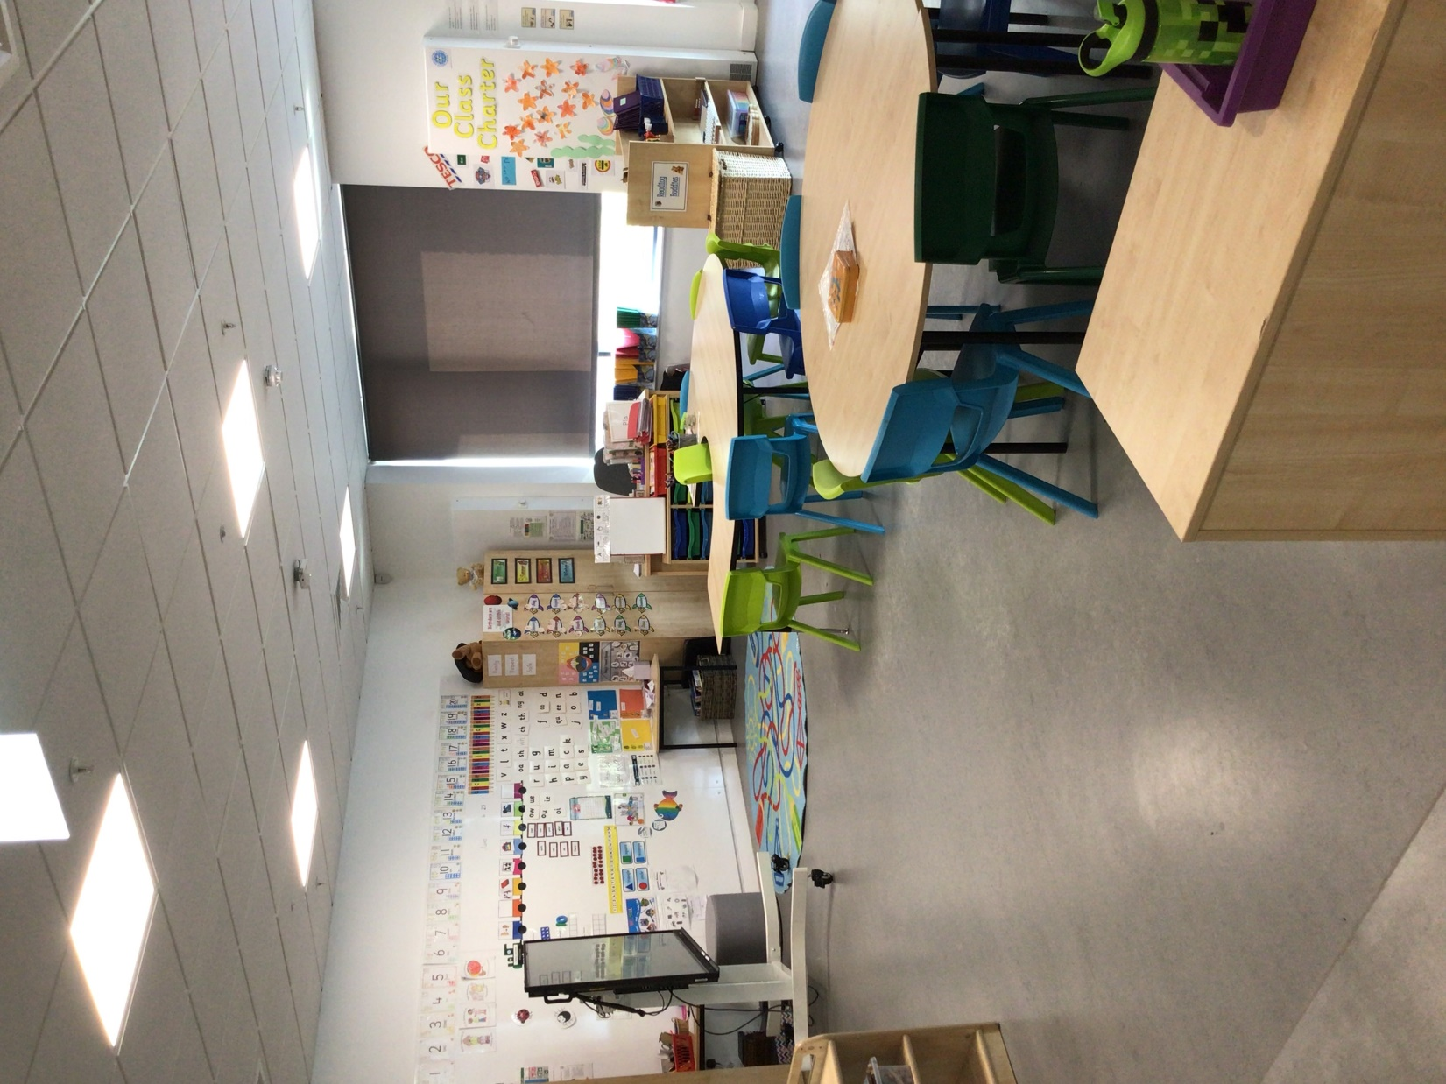
This is your new classroom. It might look a little different after the holidays. You, your class and your new teacher can make it look good together.

Slide 9



You will have fun in your new class and will learn lots of new things.

Slide 10
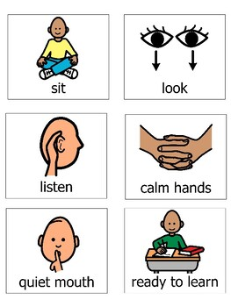
You will listen to your new teacher and follow the school rules.
s
You will listen to your new teacher and follow the school rules.
You will listen to your new teacher and follow the school rules.

Slide 11
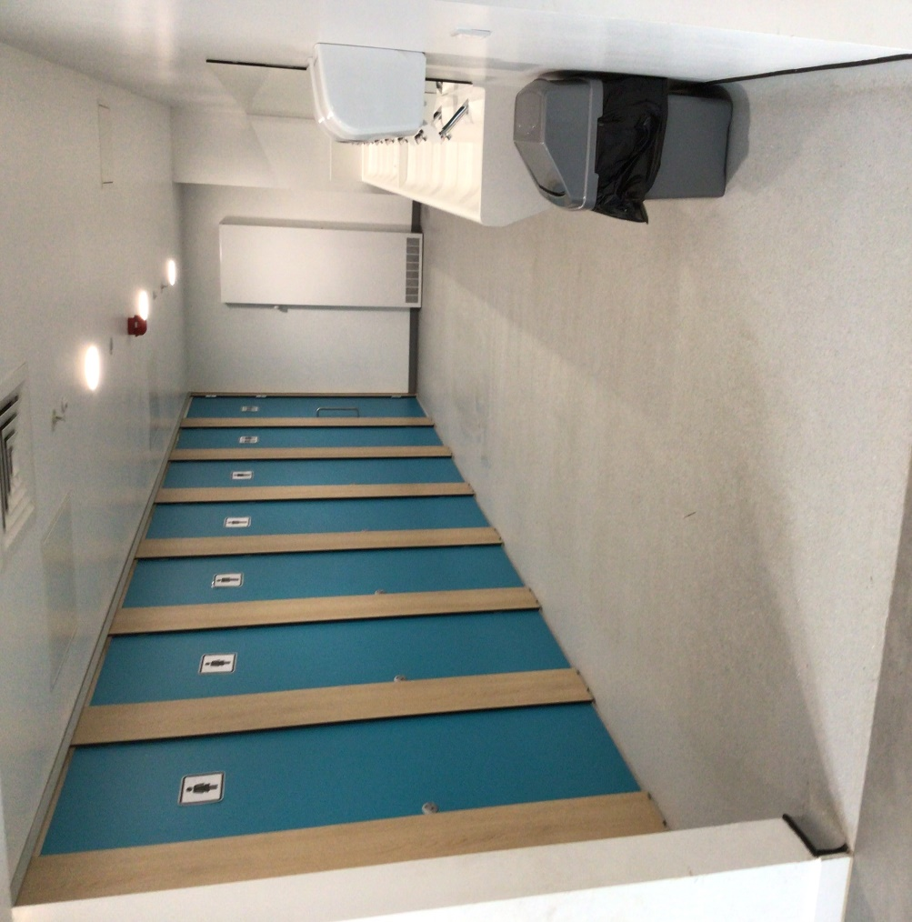
There are toilets beside your class that you can use. You must ask your teacher before going.

Slide 12
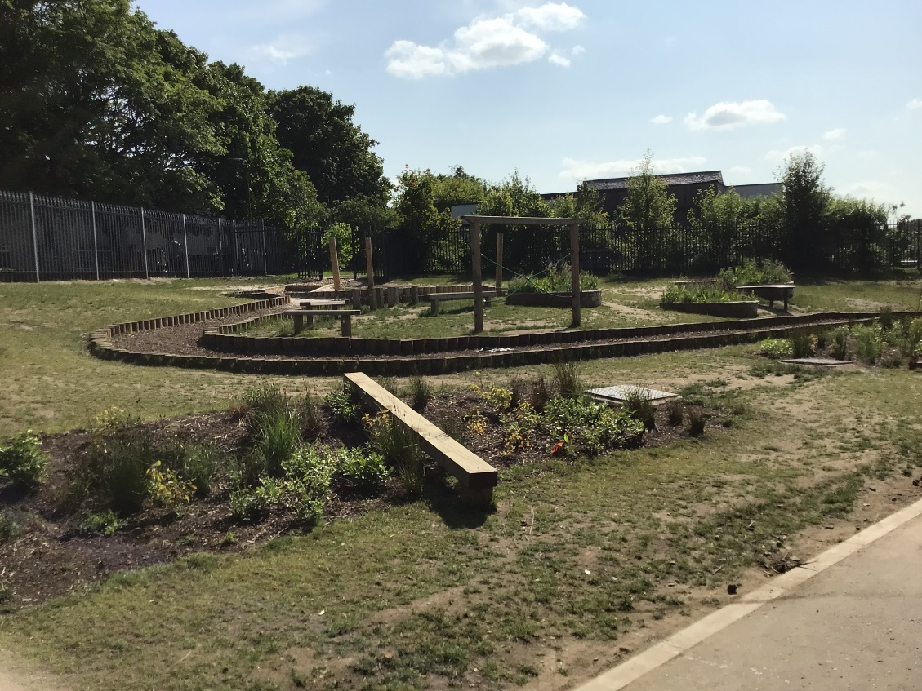

This is your playground where you will have fun with your friends.
You will listen to your new teacher and follow the school rules.
You will listen to your new teacher and follow the school rules.

Slide 13
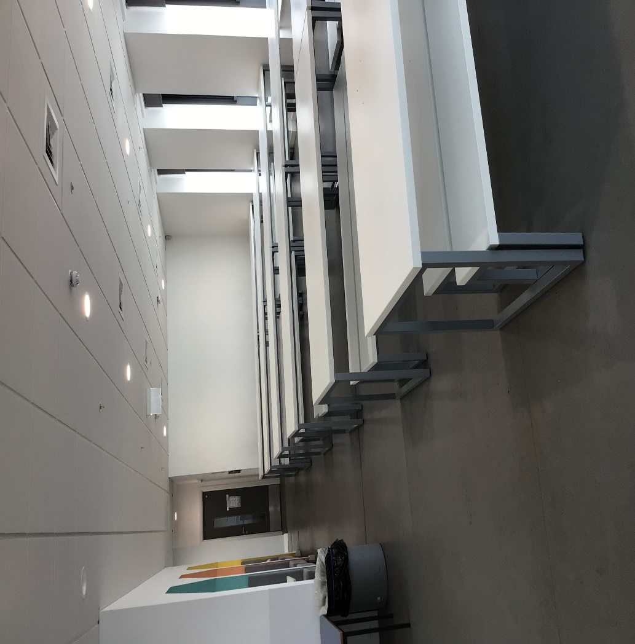
This is the lunch hall where you will eat lunch with your friends.
You will listen to your new teacher and follow the school rules.
You will listen to your new teacher and follow the school rules.

Slide 14
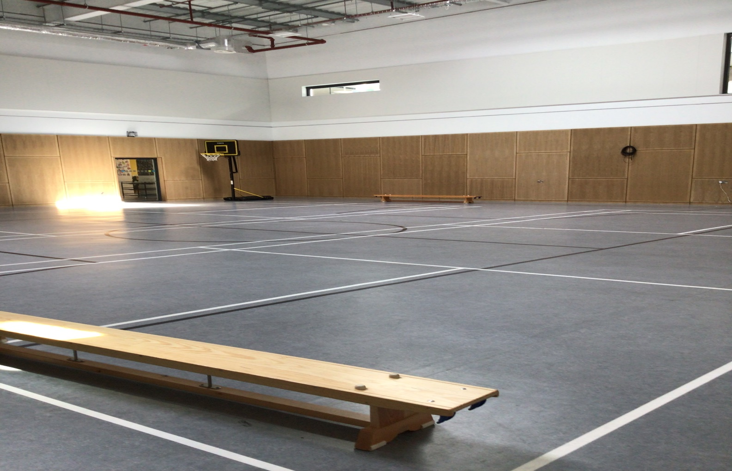
This is the gym hall where you will have lots of fun. School assemblies are also held in here.
You will listen to your new teacher and follow the school rules.
You will listen to your new teacher and follow the school rules.

Slide 15
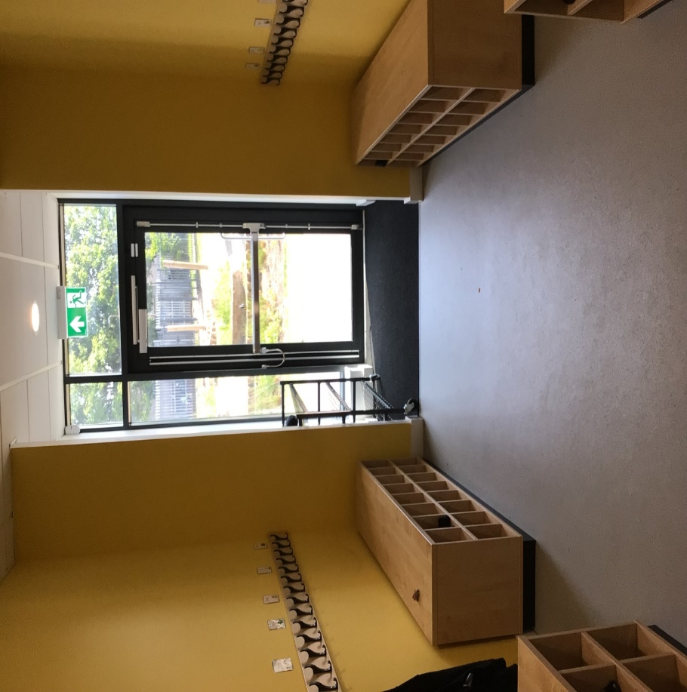
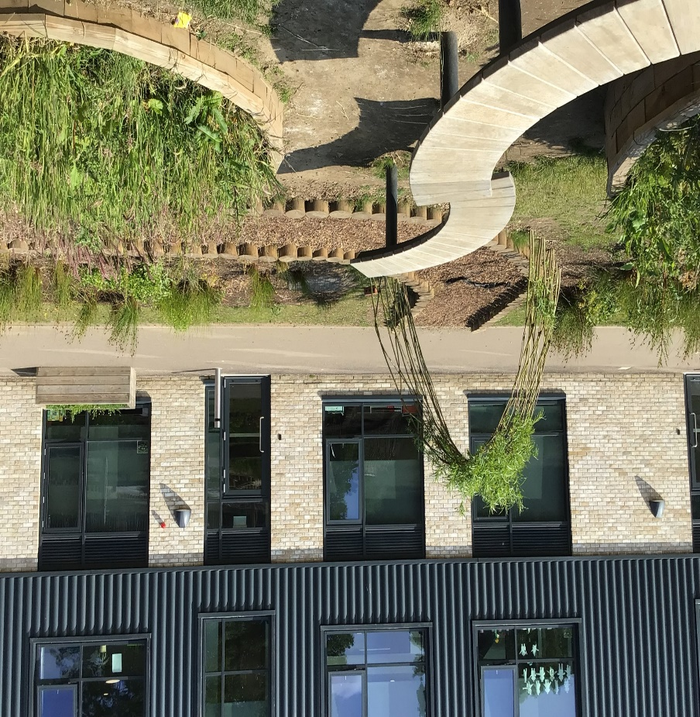
At the end of the day, you will leave using this door beside your class which will lead into the lower playground.
You will listen to your new teacher and follow the school rules.

Slide 16
Being in a new class will be lots of fun! You will make new friends in your class. This will make you happy.
listen to your new teacher and follow the school rules.
You will listen to your new teacher and follow the school rules.
You will listen to your new teacher and follow the school rules.

Slide 17

You can go home at the end of the day and tell your parents/carers all about your new class and your new teacher.
You will listen to your new teacher and follow the school rules.
You will listen to your new teacher and follow the school rules.

