Slide 1
Why Study A Modern Language?
Ross Phillips
Careers Adviser @ Linlithgow Academy
Notes:
Today, we are going to think about studying a language, the usefulness of this and perhaps why it may often be overlooked. I’d like to spend time today unpicking the skills you can gain by studying a language, as these aren't always obvious.
Pupils will learn the importance of having the right information before making a decision
Pupils will learn that decisions can be influenced by others and that it is important to be aware of peer pressure
Pupils will learn that it is important to get reliable information from a trustworthy source
Debate and argument within groups will enhance teamwork and problem solving as a group

Slide 2
Career Management Skills
These are the skills you need to make your career a success.
I am just one of the people who can help you develop these skills.
Some of them you’ll have already – just by being you!
Notes:
Some are fairly obvious, for example, travelling to another country and being able to express yourself clearly.
We will discuss the skills you can develop by learning a language. Whilst looking at how these could complement other subjects in school or lend well to a variety of careers.
Hopefully, by looking at Modern Languages as an individual subject today, it encourages you to think about the skillset you gain from each of your subjects.

Slide 3
When considering studying a language, it is important to think about your SELF.
Do I enjoy talking to others?
Am I good at listening or want to get better?
Am I patient?
Do I like trying out new things?
Do I enjoy being creative?
Do I like to stand out from the crowd?
Notes:
Learning a language requires commitment, and requires resilience – when things don't always go right the first time.
Think about your Learning style too. At National 5 level, read, listen, talk and write in Spanish, and reflect on how this relates to English. You’ve got written assignments too, and performance assessments too.
the questions you should be asking
yourselves when deciding whether to
choose that subject

Slide 4
By learning another language, you gain better understanding of your own language.
It also makes you a better listener!
Communication is the number one skills employers are looking for and helps with things like interviews, CV and job applications – even securing a part time job!
Communication Skills Are Enhanced!
Doctor
Solicitor
Engineer
Lecturer
Notes:
Communication is a skill we all possess, whether its verbal, written. When we look to the future, the focus will be on how we communicate and convey ideas effectively and clearly.
#1 skill required in the world of work.

Slide 5
Creativity Is Encouraged!
Creativity is encouraged...
Often, learning a language is as much of an art as it is a science.
Think about the creative ways you express yourself when learning a new language…
Chef
Child care assistant
Journalist
Retail Buyer
Public Relations Officer
Notes:
Linguistics is the science of language, and linguists are scientists who apply the scientific method to questions about the nature and function of language. Linguists conduct formal studies of speech sounds, grammatical structures, and meaning.
But in an artistic sense, languages allow you to be creative with how you communicate, and do it with a bit of flair and imagination.

Slide 6
Problem Solving & Decision Making Skills Are Developed!
Learning a Modern Language challenges you to recognise and negotiate with meaning of things.
Think about your brain like a muscle: it functions better with exercise.
Memorising rules and vocabulary has been shown to increase brain capacity.
Notes:
Learning a language allows us to focus on the relevant information, what is needed. Think how valuable a skill that is, in a world where we are stimulated all day, every day, you will be able to filter/sort information to maintain focus.
Learning a language is a complex process, with lots of information. You have to be open minded, solve problems, make decisions, and focus really hard on lots of new and different information.

Slide 7
Activity!
Notes:
Your future is your choice. We want you to feel confident to say... ‘I know my self, I know what I like, I know what I’m all about’.
We want you to feel positive, upbeat and excited about your future, and we’d like you to start setting goals.
Earlier, we asked what you’d like to achieve in five years time. Now, we’d like you to imagine yourselves five years from now, and to imagine that everything’s gone brilliantly – the best it possibly could be.
We’d like to do a bit of Time Travelling, let you be imaginative and creative, and think about the answers to the questions on this worksheet.
USE YOUR COMMUNICATION SKILLS, CREATIVITY AND DECISION MAKING SKILLS!

Slide 8
When considering studying a language, it is important to think about your STRENGTHS.
Are you a good problem solver?
Are you able to think things through
critically?
Are you a creative learner?
Are you a social, people person?
Are you an active learner?
Notes:
Let’s think about the skills and strengths you develop in this subject. If something’s a strength, chnaces are that you’ll enjoy doing it. And at this stage, they can help you work towards your goals.
Here’s what you can achieve when you’re using your strengths:
• You’ll learn fast
• You’ll pick up tasks and take in information much quicker if they use your strengths
• Enthusiasm
• If something plays to your strengths, you’ll be keen to do it. Your teachers will notice your motivation.
• Personal development
You learn best in areas where you already have strengths. So, using them helps you
develop.
• Confidence
If you’re doing things you do well, you feel confident that you can achieve more.

Slide 9
These Are Some of the Strengths You’ll Develop With
Modern Languages!
Notes:
Moving forward, the world of work will demand more of a focus on skills. Shift from qualifications and experience, to the skills you can offer that compliment your qualifications and experience.

Slide 10
When considering studying a language, it is important to think about your HORIZONS.
Are you planning on staying until S6?
Are you thinking of leaving school sooner?
Are you already thinking about University?
How about your other options?
What are you going to need for your future?
Notes:
examples of where the subject could lead -
courses, jobs, training and covering a wide
range of entry levels.

Slide 11
What Will The World of Work Look Like In Ten Years Time?
Notes:
You will shortly move into S4, where you are beginning to focus more on what you want to do when you leave. I want you to imagine the world in ten years time. It’s a very different place to what you would have experienced ten years ago, when you guys were back in Primary 1.
Fourth Industrial Revolution – steam and water (1st), electrical power (2nd), electronics began to surface (3rd), technological advances (4th). - - VIDEO - -

Slide 12
META-SKILLS 4.0 2035
“catalysts for learning”. “Skills are temporary; meta-skills are permanent”.
- Self management -
Managing the now
Focus
Integr
ity
- Social intelligence -
Connecting with the world
Communication
Adaptation
Initiative
Feeling
Collaboration
Leadership
- Innovation -
Creating our own change
Curiosity
Creativity
Sense making
Critical thinking
Attention
Filtering
Self-awareness
Self-control
Ethics
Openness
Flexibility
Self-learning
Resilience
Courage
Self-belief
Independent thinking
Decision making
Responsibility
Enterprise
Receiving information
Active listening
Giving information
Storytelling
Empathy
Social conscience
Social perceptiveness
Teamworking
Global & cultural competence
Inspiring
Influencing
Motivating
Developing/coaching
Catalysing change
Noticing
Questioning
Sourcing information
Defining problem
Imagination
Generating ideas
Visualising/Realising
Making solutions
Pattern recognition
Holistic thinking
Synthesis
Opportunity recognition
Analysis
Deconstruction
Logical thinking
Judgement
Computational thinking
Sorting
Reflection
Self-motivation
Relationship building
Meta Skills: Skills For The Future
Notes:
In the future, change will be the norm. What skills do we need to thrive in this ongoing change? These are the skills for the future.

Slide 13
Activity!
Notes:
Your future is your choice. We want you to feel confident to say... ‘I know my self, I know what I like, I know what I’m all about’.
This is a big part of our careers: our personalities and our preferences are really important. It’s also said that our personalities and preferences can be divided into colours. Colours have particular traits, and it’s important for you to understand these for a couple of reasons.
Not only can this help you understand other people better, and help you get the best out of them too. Also, if you recognise what colour you are, then others will be able to get the best out of you, your likes and dislikes, your strengths and your weaknesses.

Slide 14
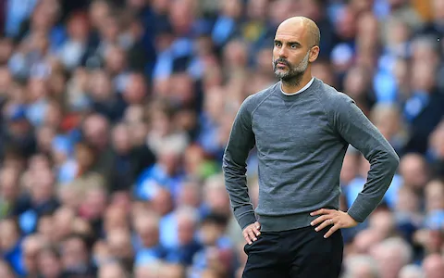
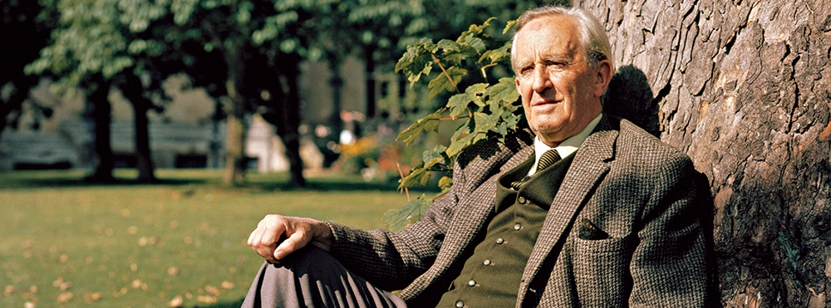
Notes:
The following famous people all speak another language. Can you guess which language they speak?
Mila Kunis – Russian
Was born in the Ukraine and lived there until the age of seven – so Russian, rather than English, is her native language. What’s more she still speaks Russian with her family and her fluency and ease with both languages makes her a popular ambassador for her work in Russia and former Soviet states.
Emma Watson – French
Emma Watson was born in France. Her parents (both of whom are lawyers) are fluent in French whereas Emma Watson can also speak the language but not with much fluency as she moved to England when she was five years old. Still, conversational languages have helped her with the media aspects of her profession: there’s lots of interviews online where she is speaking with interviewers in French.
Pep Guardiola - Catalan, Spanish, English, German and Italian
Guardiola took extra tuition between jobs to be able to communicate effectively with his team. This really displays the commitment level needed to be successful where you face a language barrier.
J.R.R. Tolkien –
Aside from writing one of the greatest pieces of literature, Lord of the Rings, author J.R.R. Tolkien is also famous for creating fictional languages. It is no secret that Tolkien studied several languages and took inspiration from these to invent 8 or 10 languages, two of which have substantial vocabularies: Qenya and Sindarin. He learned Latin, French and German from his mother and *studied several other languages at school and throughout his life. He took a deep interest in learning Germanic language and had gained basic understanding of Middle English, Finnish, Gothic, Greek, Italian, Old Norse, Spanish, Welsh, Medieval Welsh, Danish, Dutch and many more.

Slide 15
Where Could A Modern Language Take You?
Notes:
Learning a new language allows you to connect with different people and their cultures. The ability to use language is at the centre of thinking. You reflect, communicate and develop ideas through language.
French is the second most popular learned language in the world after English, and is spoken in around 30 countries. These include: Belgium, Canada, Switzerland and many countries in central and north Africa. It is one of the official languages of the European Union.
~
German is widely spoken in Europe, in countries such as: Austria, Belgium, Luxembourg, Switzerland and, of course, Germany. It is one of the ten most spoken languages in the world. Germany is the biggest economy in Europe and the fourth biggest in the world. So, there are plenty of opportunities to use German in a wide range of industries and organisations. It is one of the top five business languages currently in demand in the UK.
~
Spanish is useful for both business and travel. Around 400 million people worldwide speak Spanish, especially in South American countries such as Mexico and Venezuela. Spain is a beautiful country rich in history and culture, making it a popular holiday destination for British people. And, Spain is also an important trading partner of the UK. Many companies need employees who are fluent in one or more European languages. So, learning Spanish gives you many options for your future career.
The skills you develop in Spanish are useful in many different career areas.

Slide 16
Thanks everybody!
If you’d like to speak with me about you and your career at any point, please find me in the Careers Interview Room, in the library.
If you’ve not yet been offered a careers appointment since I saw you in PSE, don’t worry – this will happen before Christmas!
We’re Skills Development Scotland, and we’re here four days a week!

