Slide 1



Your Routes & Pathways
Ross Phillips, Careers Adviser
@ Linlithgow Academy

Slide 2

Career Management Skills

Slide 3
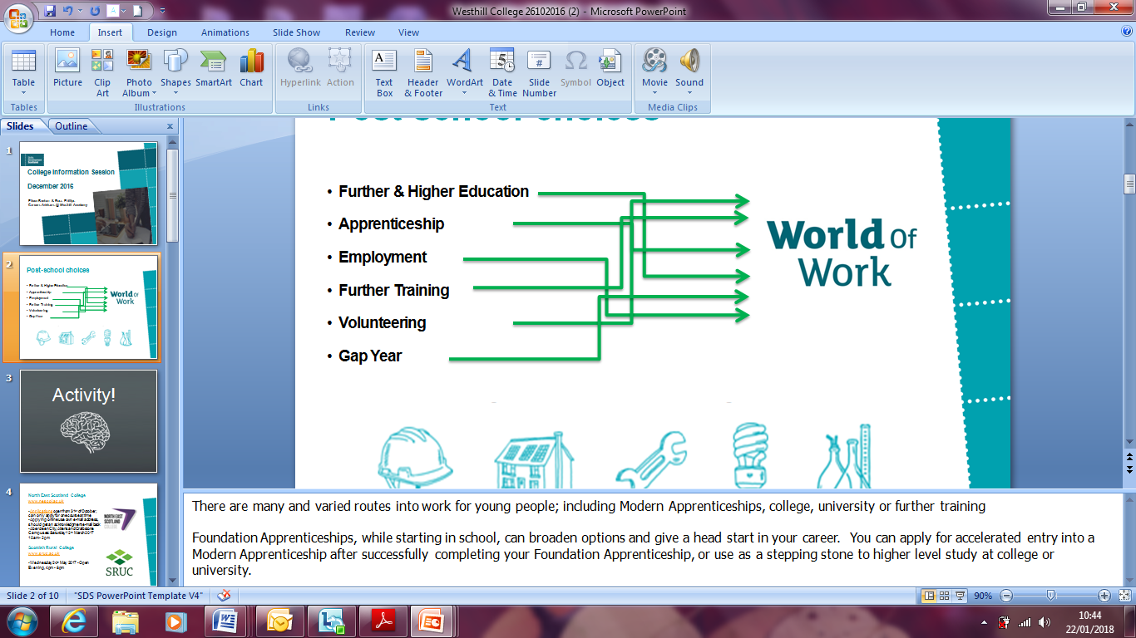
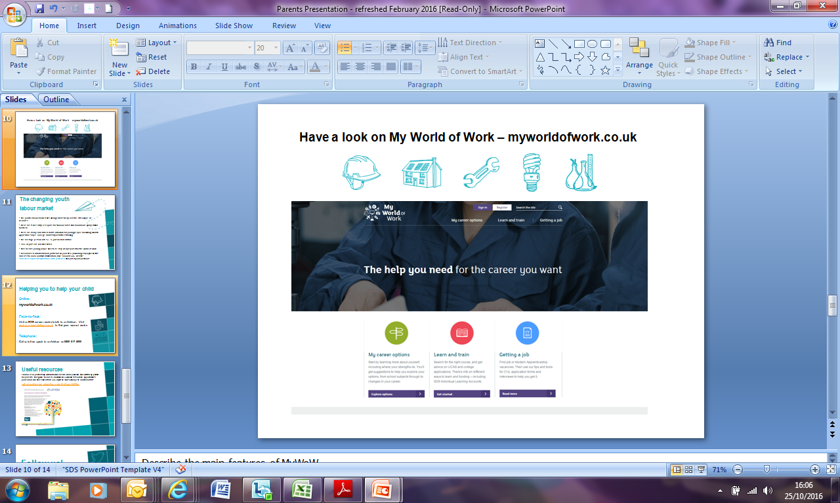
Your Routes & Pathways

Slide 4
Where did last year’s leavers go?
Initial School Leavers Destinations in Scotland
Higher Education
41%
Further Education
27%
Employment
22%
Unemployment
6%
Training
4%

Slide 5
Where did last year’s leavers go?
Initial School Leavers Destinations from Linlithgow Academy
Higher Education
60%
Further Education
16%
Employment
22%
Unemployment
3%
Training
3%
Notes:
209 senior phase pupils across S4, S5 and S6 left Linlithgow Academy between August 1st 2018 and July 31st 2019.
117 went into Higher Education, meaning an HND or university. The vast majority of these 117 went to university straight after S6.
34 went into Further Education, meaning they progressed onto an ‘Introduction To’ course, or and NC, or an HNC.
45 went into Full-Time or Part-Time Employment, in career sectors such as Retail, Hospitality, IT and Manufacturing & Production. This includes Modern Apprenticeships in career sectors such as Care, Finance and Construction. Volunteering too, other types of personal skills development. That includes Gap Years, gaining more life experience.
7 were unemployed.
6 went into other types of training.

Slide 6

University Admissions Statistics
University of Aberdeen: Undergraduate Admissions for 2018/2019 Session –
MA (Hons) Primary Education: 806 applicants
563 interviews
385 offers
143 offers taken up
MBChB (Hons) Medicine: 152 places; approx. 2,600 applicants
University of Abertay: Undergraduate Admissions for 2018/2019 Session –
BA (Hons) Games Design & Production: “approximately eight applications per place”
BA (Hons) Sports Development & Coaching: “approximately eleven applications per place”
University of Strathclyde: Undergraduate Admissions for 2018/2019 Session –
Science: 770 places; 4,622 applicants
Engineering: 885 places; 4,172 applicants
Strathclyde Business School: 479 places; 4,337 applicants
Humanities & Social Sciences: 972 places; 8,569 applicants

Slide 7
University Admissions Statistics
University of Strathclyde: Undergraduate Admissions for 2018/2019 Session –
Science: 962 enrolments; 4,130 applicants
Engineering: 1,400 enrolments; 4,019 applicants
Strathclyde Business School: 684 enrolments; 3,841 applicants
Humanities & Social Sciences: 1,099 enrolments; 7,952 applicants
University of Edinburgh: Undergraduate Admissions for 2019/2020 Session –
60,983 applications 27,878 offers (46% offer rate) 6,346 acceptances

Slide 8

Consider Which Route You Want To Take
University after S5/S6
College after S4/S5/S6
Apprenticeship, in or out of school
Full-time or part-time employment
Work-Based Training
Gap Year after S4/S5/S6

Slide 9

MAKE THE MOST OF YOUR
STRENGTHS AND ABILITIES AT COLLEGE
Notes:
University really isn't for everyone! And it's not the only path to a successful career. So, it is worth knowing about the alternatives.
College offer a range of higher education courses at different levels, and courses that can help you make to most of your strengths and abilities.

Slide 10
COLLEGE: WHAT’S SIMILAR?
Students attend a structured timetable of classes.
Students are required to meet all deadlines for the submission of work.
Students are expected to behave in a responsible way such that the learning of others is not affected.
You will be assigned a guidance tutor, which is like a Pupil Support teacher, to help you with any problems you may have.
The focus of your education is on employability and preparing you for the world of work - drawing on the range of skills, abilities and attributes that you have developed.

Slide 11
COLLEGE: WHAT’S DIFFERENT?
There is no upper age limit, so there may be adult learners in your class.
You have made the decision to choose college and a particular course that interests you.
You are no longer a pupil and you can expect be to be treated like a young adult.
You have the opportunity to start afresh if things haven’t gone so well at school.
For many courses you will not have to attend every day or for full days. This can allow for time to get a part time job or some voluntary experience.

Slide 12
COLLEGE: NEXT STEPS
To research other courses, use www.myworldofwork.co.uk and look at local college websites. Also, please consider:
Entry requirements - what qualifications do you need?
Selection process – interview, auditions, portfolio, etc.
Course content and structure – what will you learn?
Assessment methods – how are you tested?
Employer Links – who can you work with?
Student destinations – what do people go on to do?

Slide 13


Find out more at www.apprenticeships.scot
Notes:
Apprenticeships have changed a lot over the last ten years, and they’ve gained a proven track record of not only developing important employability skills, but maturity, knowledge and self-confidence too.

Slide 14



Work on real
projects with some
of Scotland’s biggest and best employers whilst still at
school.
Get a job, get paid
and get qualified
once you’ve left
school.
A brand new way to work, learn and earn
Notes:
Apprenticeships are all about getting you out of the classroom or lecture hall, and into the world of work.
We’re going to talk about three different sorts of apprenticeship today.
Introduce Foundation – key point that this is something you do WHILST STILL AT SCHOOL.
You'll complete your Foundation Apprenticeship over one or two years, usually starting in S5 or S6. Most major universities and colleges in Scotland accept Foundation Apprenticeships as entry requirements, equivalent to one SQA Higher. Please see online for more information.
West Lothian College are going to be offering TWELVE types of foundation apprenticeship, starting in August 2019. Examples include Software Development, Scientific Technologies and Civil Engineering. These will appear as some of your S5 subject choices. SOCIAL SERVICES AND HEALTHCARE is being delivered by WLC in Linlithgow Academy.
Introduce Modern – which is something you can do after school.
Introduce Graduate -
Graduate Apprenticeships provide a new way into degree-level study for individuals who want to go straight into work.
Employees can equip themselves with higher levels of academic learning and industry accreditation, which helps them progress as professionals.
By investing in their staff through the apprenticeships, employers can develop their workforce and support staff to develop their skills to industry and professional standards.
Available in areas such as Civil Engineering, Business Management and Cyber Security.
In 2019, there will be 11 courses on offer at 12 different universities and colleges, such as Edinburgh Napier University, Heriot - Watt University , Queen Margaret University , Robert Gordon University, University of Dundee, University of Glasgow and University of Strathclyde.
Taken as part of pupils subject choices alongside other qualifications
2 year programmes: Start in S5 and complete at the end of S6:
In S5: spend two afternoons/one day a week at Learning Provider (such as a College) with some employer engagement i.e. site visits, industry talks etc.
In S6: spend one day a week at an employer, additional time at Learning Provider. Civil Engineering and Engineering frameworks require a block employer placement also.
1 year programme: Mainly targeted at S6 pupils from August to June:
Spend two days a week on programme – mix of Learning Provider and employer placement
Qualification: National Progression Award or a National Certificate at SCQF Level 6 (same level of learning as a Higher) plus units of an SVQ Level 2/Level 3 (Industry recognised qualification)
- PVG/PPE and travel costs are covered for pupils
- Entrance Criteria: Pupils must have an interest in developing a greater awareness of the industry with a potential desire to pursue a career in the area and be capable of working at an SCQF Level 6 by the end of S6. In addition to this some frameworks have specific entry criteria as detailed in College website/prospectus.

Slide 15
STARTING AN APPRENTICESHIP
Improve your prospects
Gain different, work-based qualifications
Build your confidence and self-esteem
Gives you a paid job with training along the way
Learn important new skills and develop your personal qualities
Notes:
Instead of thinking about how things might happen in the real world, you'll be putting your learning into practice right away.
An apprenticeship helps you build the skills and knowledge that Scottish industries need. You'll work, get paid, and achieve a qualification – even up to masters level.
You'll spend most of your time learning on the job, but will also be a student at a university or college.
The work you do counts towards gaining your qualification – meaning you could gain your degree faster
Apprenticeships are designed by industry and for industry – so you can be confident that what you learn is relevant, and right for the role you're in.

Slide 16

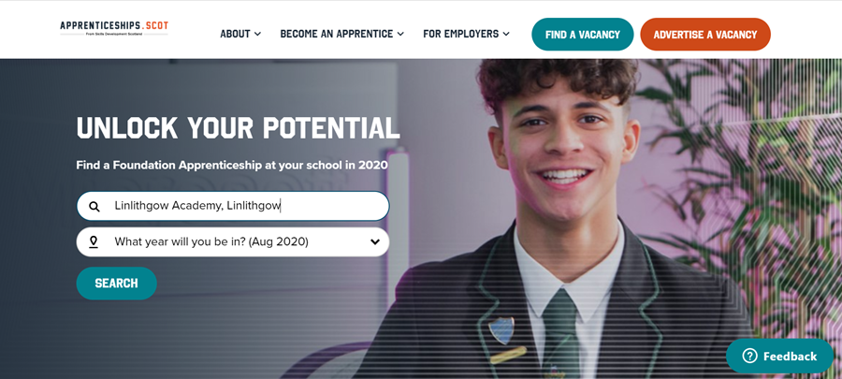
Contact me at the Careers Interview Room, speak with me after class, or speak with your Pupil Support teacher.
Visit apprenticeships.scot for further information!

Slide 17



So it’s not just a case of leaving school and going into a university course, college course, job or apprenticeship. You need to know:
Your
Your
You also need to be
well prepared...
Notes:
You need to be well prepared to do this they need to know their Horizons, know and able to use their Networks
They need to get prepared………………….

Slide 18
How Ready Am I?
I know what I want from a job
I feel confident about speaking
to the people who can help me
I know how I would use my
strengths in what I plan to do
I know all the options
available to me
I know how to learn
I feel confident about
applying for my chosen career
I feel confident that
I know my strengths
I know who can help me
Notes:
Activity How ready am I
As pupils are about to make some big decisions it is important that they understand themselves and where they are with their individual confidence levels. Are they ready to make a decision?
Issue pupils with a “how ready am I” worksheet and explain the statements below, so ensuring pupils understand the meaning of the statements.
Further detail on facilitators notes.

Slide 19













Make Use of Your Networks!
Friends
Open days
Job shadow
Work
experience
Research
Volunteer
My World
of Work
Teachers
Relatives
Careers
Adviser
Events
Social
media
Notes:
Remind pupils as they take their next step the importance of their individual Networks. As they mature so will their networks and it is important to continue to grow and build networks now and throughout their careers.

Slide 20

Thank you!
If you’d like to speak with me about you and your career at any point, please find us in the Careers Interview Room, in the library.
Or, please make an appointment through your pupil support teacher.
We’re Skills Development Scotland, and we’re here four days a week!

