Slide 1
My World Of Work

Slide 2
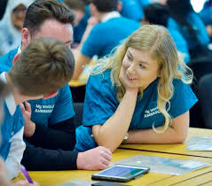
Who are we?
Your My Wow Ambassadors
S6s
Aisling
Susie
S5s
Mohamad
Maya

Slide 3
Game time
STAND UP JOB GAME:)

Slide 4
Are you good with your hands?
Are you interested in science?
Would you like to work outdoors in any weather?
Are you fit and healthy?
Do you like animals?
Do you like learning new skills?
6

Slide 5
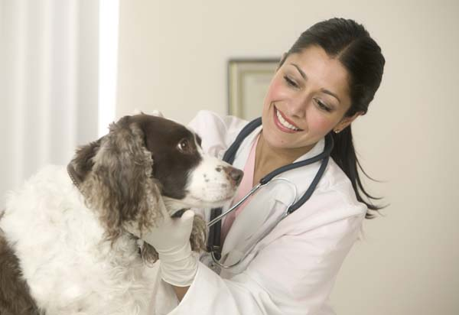
Veterinary Surgeon

Slide 6
Are you good at writing reports?
Could you follow detailed instructions?
Could you work long hours (possibly evenings and weekends)?
Are you good at solving problems?
Do you have good communication skills?
Are you good at science?
6

Slide 7
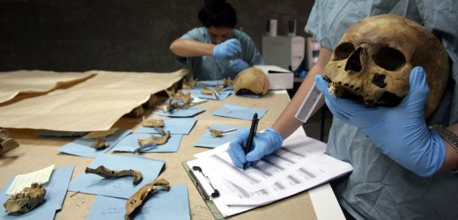
Forensic Scientist

Slide 8
Do you like being the centre of attention?
Are you artistic?
Are you fit and strong?
Would you like working with other people?
Do you have a healthy diet?
Are you good at expressing yourself?
6

Slide 9
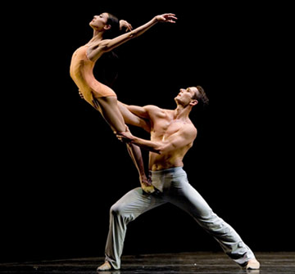
Ballet Dancer

Slide 10
Would you like to work outdoors?
Can you work well as part of a team?
Could you lift or move heavy objects?
Could you operate basic machinery?
Would you be able to get up early?
Are you responsible and reliable?
6

Slide 11
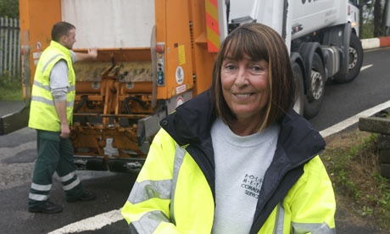
Refuse Collector

Slide 12
Are you artistic and creative?
Would you like to work with your hands?
Could you work quickly and accurately?
Could you explain your ideas clearly to other people?
Would you be able to stand for long periods of time?
Are you outgoing and friendly?
6

Slide 13
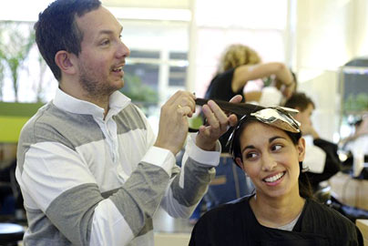
Hairdresser

Slide 14
Are you observant and persistent?
Can you work accurately and pay attention to detail?
Are you able to work under pressure and meet deadlines?
Are you interested in current affairs?
Are you confident?
Are you able to write good clear English and vary your
writing styles?
6

Slide 15
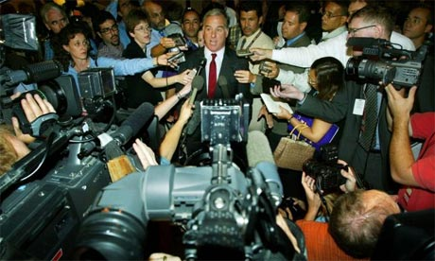
Journalist

Slide 16
Do you have a good memory and concentration span?
Can you learn new skills quickly?
Would you be able to work accurately and pay attention
to detail?
Could you work on your own and as part of a team?
Are you good at problem solving?
Are you good at using IT?
6

Slide 17
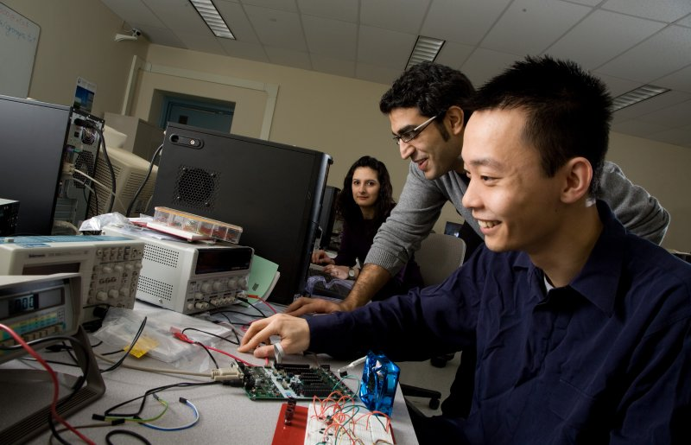
Software Engineer

Slide 18
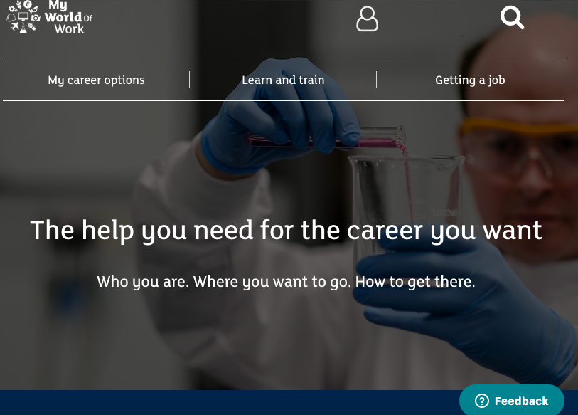
What is My World Of Work

Slide 19
Signing up
ITS EASY TO DO!
Grab your phones :)

Slide 20
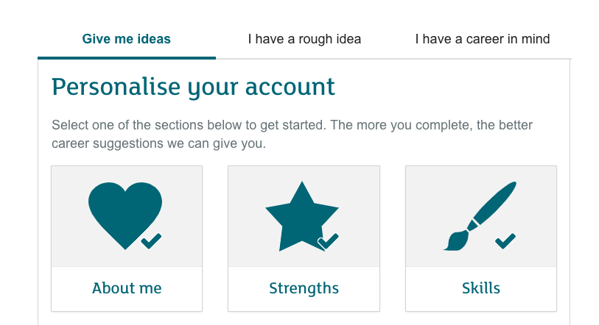
QUIZ!

Slide 21
Any questions?

