Slide 1
S6 Experience & Moving on
S6 June 2019

Slide 2
S6 PD
Purpose
To enhance current skills
To develop new skills
To gain new experiences
To build resilience
Gain Saltire Award
Expectations
Commitment
Responsibility
Respect
Role model
Pride
Resilience

Slide 3
S6 PD Opportunities
In-School Opportunities
Prefect (rota) IF SELECTED
Mentor (Coaching for Improvement)
House Captain – (interview)
Sports Captain – (interview)
Perfetto
Ball Committee
Yearbook/Hoodies
Charity Group
Young Enterprise
Autism Resource Ambassador
Junior Class Ambassador
HWB Ambassadors
Green Flag Ambassador
S1 Drama Club
My WOW Ambassadors
Cooking – Life Skills
Art Club
Photography Club
Established Group e.g. Dance/Sports/Chess
New group/club
Opportunities Out Of School
Donaldson’s College
Primary Link
Linlithgow Nursing Home
St Michael’s Day Care Centre*
St Michael’s Hospital*
Kumon
Springfield Out of School Club
Own Placement (School form, WLC form & Company public liability insurance certificate due by Friday 14th June)
*Apply via NHS website

Slide 4
Options post S6
Employment
apprenticeship
College
University
Gap year

Slide 5
student responsibility
You will need to apply
reasons for applying
Academic ability
commitment
skills
qualities
Experience
Hobbies/interests

Slide 6
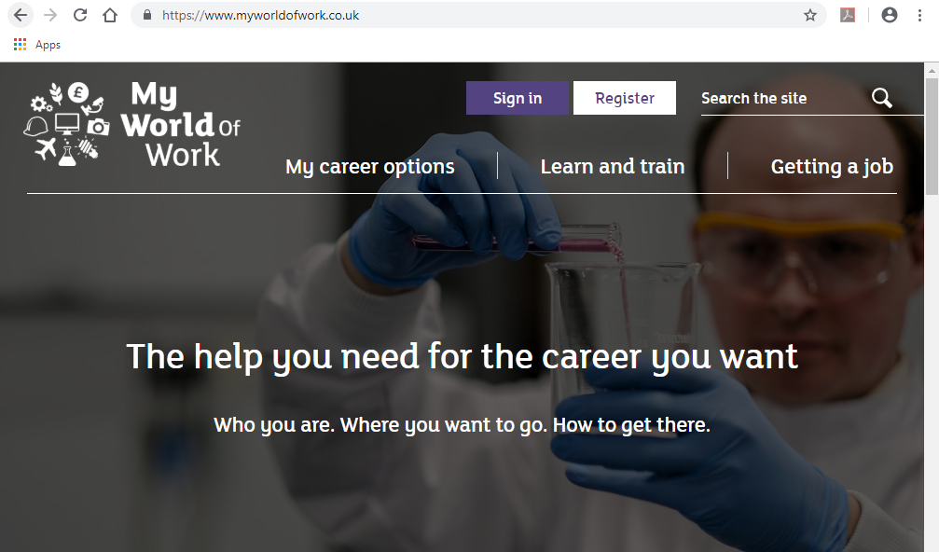
Making a decision
Not easy!
Consider a careers interview
My world of work

Slide 7
Getting started
Open days
Prospectuses
Courses/places
Early ucas applicants – medicine, dentistry, vet med, oxford, Cambridge, RCS
Do I know who you are?????
Registering with ucas ……

Slide 8
Getting organised - UCAS
Go to https://www.ucas.com/undergraduate/ucas-undergraduate-apply-and-track
Scroll down to 2020 application
Click on sign in to apply 2020
Click on register, read and accept the information detailed then start to complete the various pages of personal information.
You will be asked to set up a password and security questions – remember these!
Please ensure your email address is appropriate!
You will be asked to give the school buzzword, this is Christmas

Slide 9
Getting organised – Pupil info sheet

Slide 10
Getting organised – reference request

Slide 11
Getting organised – support

Slide 12
Getting organised – support

Slide 13
Getting organised – meeting deadlines

Slide 14
Getting organised – meeting deadlines

Slide 15
Assessments to consider student responsibility
BMAT (Biomedical admissions test) - aptitude test required by a handful of medical, dental and veterinary schools
https://www.themedicportal.com/application-guide/bmat/
UKCAT - admissions test to assess students’ suitability to study medicine
https://www.themedicportal.com/application-guide/ukcat/ukcat-faqs/#q1jump
CAMBRIDGE
https://www.undergraduate.study.cam.ac.uk/applying/admission-assessments
Oxford
http://www.ox.ac.uk/admissions/undergraduate/applying-to-oxford/guide/admissions-tests

Slide 16
Get started ….. early

Slide 17
Access resources
How to use ucas
Timelines
Pupil info sheet
Reference request slip
Personal statement guide
Sign up to personal statement workshops
Get writing!
Electronic copies will be emailed to parents/carers to access

