Slide 1
Growth Mindset
S5 PSE

Slide 2
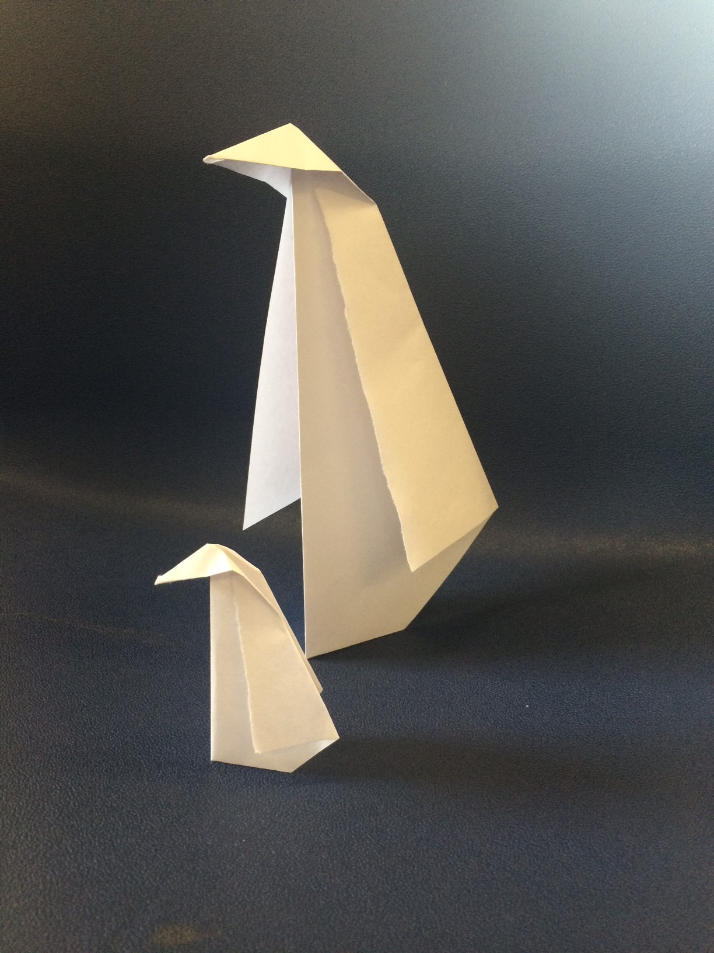
Your challenge is to create an origami penguin from the sheet of paper in front of you.
Good luck!

Slide 3
?

Slide 4
Did you give up immediately?
Did you try and then give up?
Did you expect to fail?
Did you expect to succeed?
Notes:
What happens in school when we a faced with a difficult task?

Slide 5
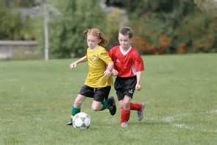
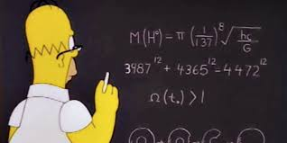
A mindset is a way of thinking that affects how you attempt activities and tasks.

Slide 6

1 | What kind of Mindset do I have?
Notes:
Stand on one side if you think that people are born smart. True or False

Slide 7
A fixed mindset is the belief that no matter how hard you try, skills and abilities cannot be developed. You are either born smart and talented or you are not.

Slide 8
A growth mindset is the belief that skills and abilities can be developed over time, through dedication, practice and hard work.

Slide 9
Which one are you?
Or a
?
Fixed
Mindset
Mindset

Slide 10
How does your brain work?
Notes:
Did you know that your brain is like a muscle?
What happens when you work out a muscle?
Yes, it changes and gets stronger when you use it.
Show video clip: The Learning Brain (up to 3:28)
https://www.youtube.com/watch?v=cgLYkV689s4

Slide 11

 | If you only try easy tasks, you do not exercise your brain. We only learn something if we did not know it before and if we have to think or work hard to figure it out.

Slide 12

Remember making a mistake helps us to learn too!
Making mistakes is a GOOD thing as long as we use our mistakes as an opportunity to learn and understand things better.
Notes:
What can we do if we get stuck ?

Slide 13

What can we do if we get stuck ?
Ideas please …….

Slide 14
Ask yourself some questions…
Have I done something like this before?
What strategy could I use try to and figure this out?
Is there something or someone who could help me out?
What about skipping a part and moving onto the next part. YOU can always go back later.
Is this working? If not what else can I do?

Slide 15
Ok. Lets go and grow our brains!
Notes:
I want you to have another go at creating an origami penguin, but this time you’ll have instructions.
I want the penguin to be a reminder to you that, over time and with a bit of help and a positive attitude, everyone can achieve success

