Slide 1
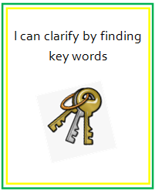
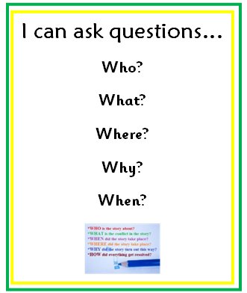
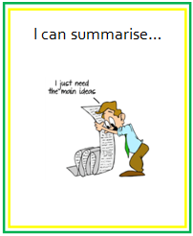
Literacy and English Pedagogy team, Marion Cochrane and Michael stephenson
Teaching questioning and summarising

Slide 2
Before, during and after

Slide 3
Asking questions before reading
What type of this text is this going to be?
What is the text going to be about?
Do I already know anything about this?
Who is the boy in the photograph?
What does the headline mean?

Slide 4
Asking questions during reading
Can we answer any of our ‘before’ questions?
Do we have any new ones?

Slide 5
Asking questions during reading
What does it mean to have a stammer?
How many people are affected by stammering?

Slide 6
Asking questions during reading
What help is there for stammering if people need it?
How can I help?

Slide 7
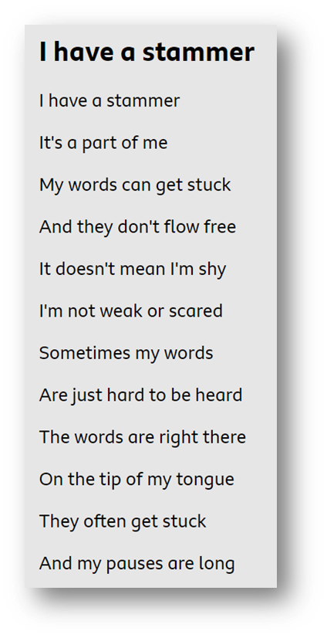
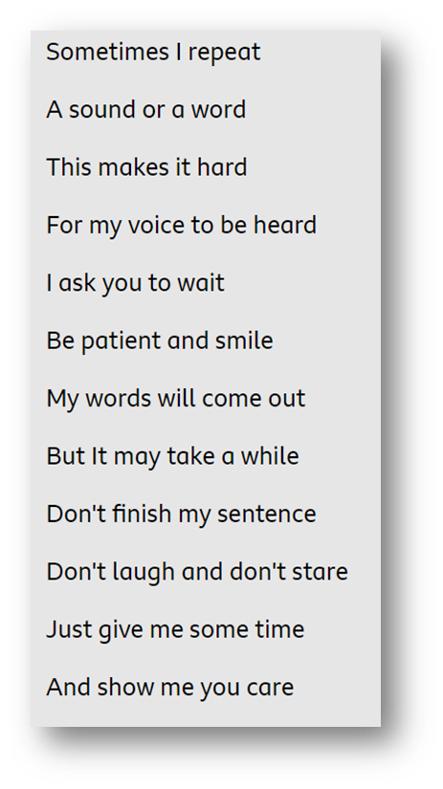
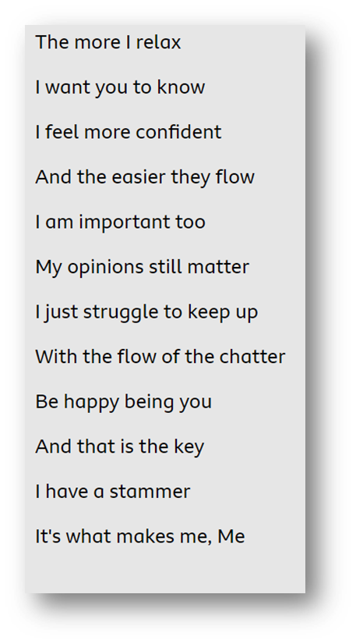
Asking questions during reading
How does Sam feel about having a stammer?

Slide 8
Asking questions after reading
What “before” and “during” questions have we been able to answer?
What have I learned?
Have I enjoyed reading this?
How effective was the text? Why?
Could I relate to this experience?
Where could I find out more?

