Slide 2
LI: To find out about the experiences of children
who were evacuated during WW2
Success Criteria
I can describe what evacuees needed to take with them on their journey.
I can use different thinking skills to help me organise information about being evacuated.
I can explain when, where and why children were evacuated.
I can describe how it might have felt to be evacuated.
I can take notes from the video

Slide 3
Watch the video

Slide 4
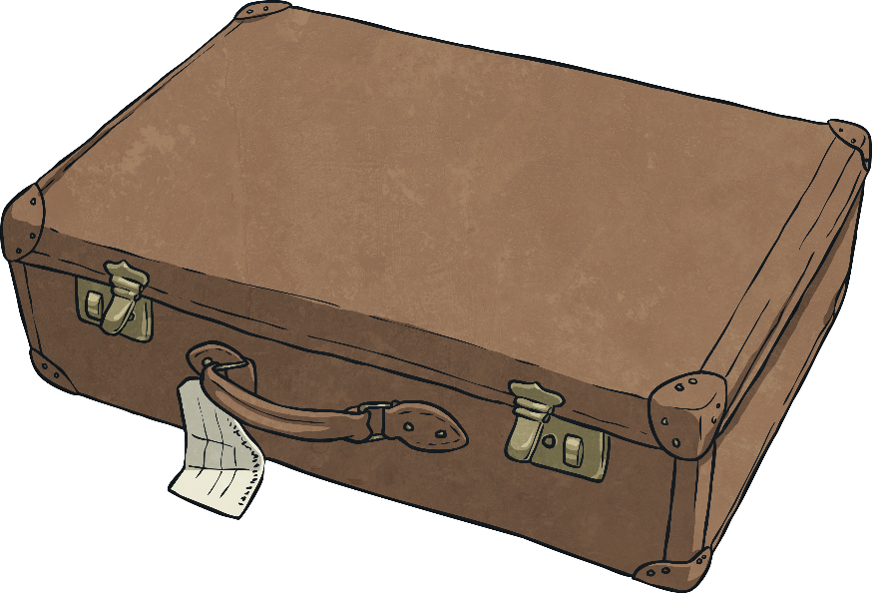
The Suitcase
Look at the suitcase and its contents.
Write down the answers to at least 4 of the questions:
How old do you think the suitcase is?
Who do you think the suitcase belongs to?
What do you think it is to be used for?
What do you know about the contents of the case?
What do the contents tell us about the owner of the case?
Why would the owner of the case need those items?
What else might the owner want to pack in the case?

Slide 5
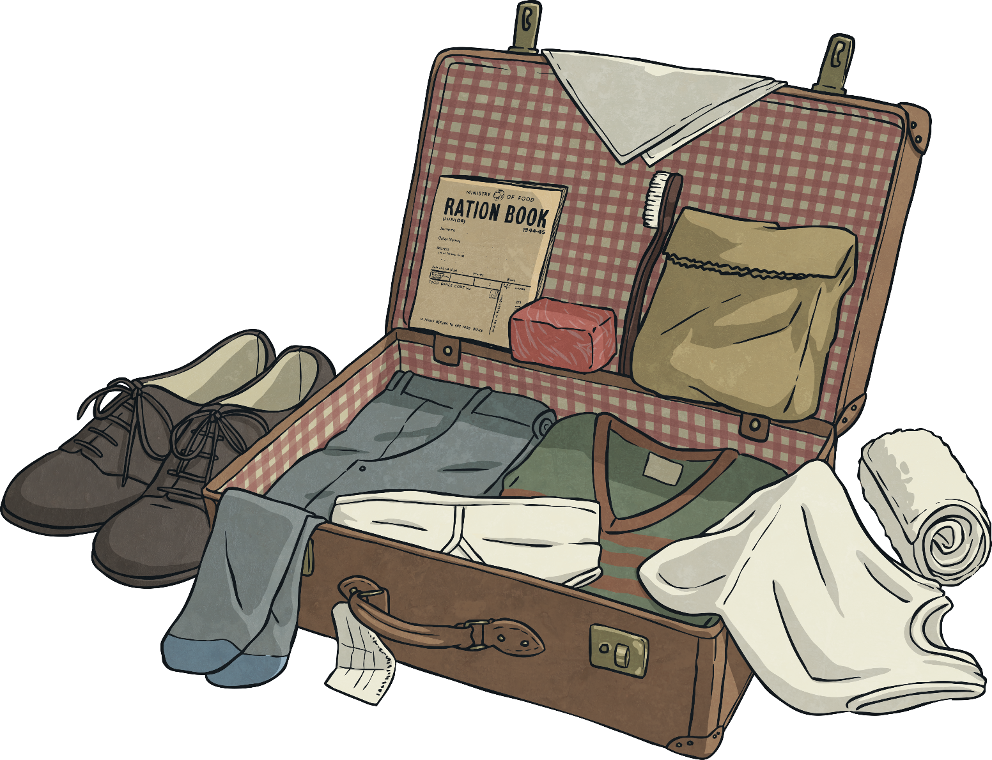
The Suitcase

Slide 6
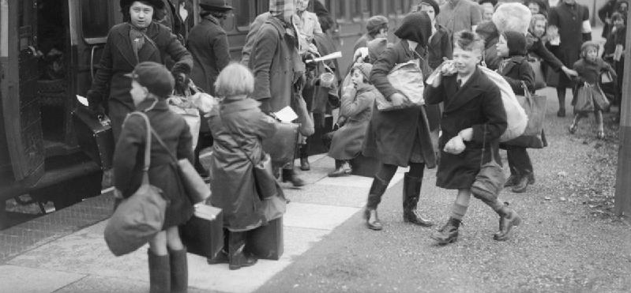
The Suitcase
During World War II, many people were evacuated from the cities to the countryside where it was believed they would be safer from bombing.
In total, over 3.5 million children were evacuated.

Slide 7
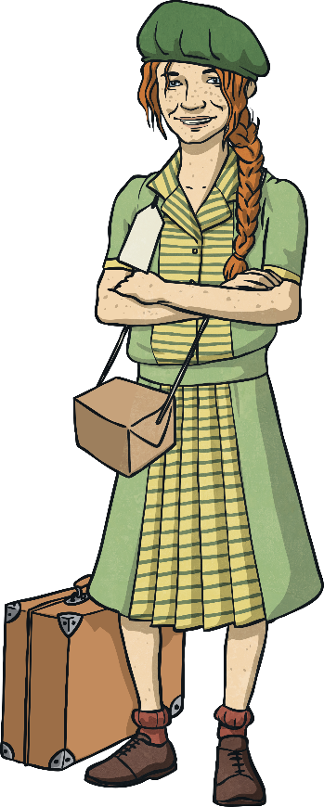
Evacuation
Mostly children were evacuated but other evacuees included mothers with very young children, pregnant women, disabled people, teachers and helpers to look after the children.
Evacuation happened in distinct waves with the first wave of evacuations beginning on the 1st September, 1939, which was two days before Britain officially declared war on Germany. Other waves occurred at the start of the Battle of Britain in June 1940 and at the start of the Blitz in September 1940.
Mostly children were evacuated but other evacuees included mothers with very young children, pregnant women, disabled people, teachers and helpers to look after the children.
Evacuation happened in distinct waves with the first wave of evacuations beginning on the 1st September, 1939, which was two days before Britain officially declared war on Germany. Other waves occurred at the start of the Battle of Britain in June 1940 and at the start of the Blitz in September 1940.
True or False?
TRUE
FALSE
Evacuation only happened once during the war.
Only children were evacuated.
Evacuation only happened once during the war.
Mostly children were evacuated.

Slide 8
Evacuation Read and Remember
On evacuation day, children travelled with their teacher or helper by train to their destination.
All children had to wear an identity label and take their gas mask, ration book, identity card and food for the journey. Many children also took a suitcase containing clothes and personal items.
When they reached their destination, billeting officers were responsible for arranging for children to stay with host families. For many children this involved being selected out a line by their host. This was an upsetting experience for some children who felt unwanted or rejected.
On evacuation day, children travelled with their teacher or helper by train to their destination.
All children had to wear an identity label and take their gas mask, ration book, identity card and food for the journey. Many children also took a suitcase containing clothes and personal items.
When they reached their destination, billeting officers were responsible for arranging for children to stay with host families. For many children this involved being selected out a line by their host. This was an upsetting experience for some children who felt unwanted or rejected.
True or False?
TRUE
FALSE
All children had to carry a gas mask.
Evacuation only happened once during the war.
Only children were evacuated.
Children travelled to the countryside with their parents.

Slide 9
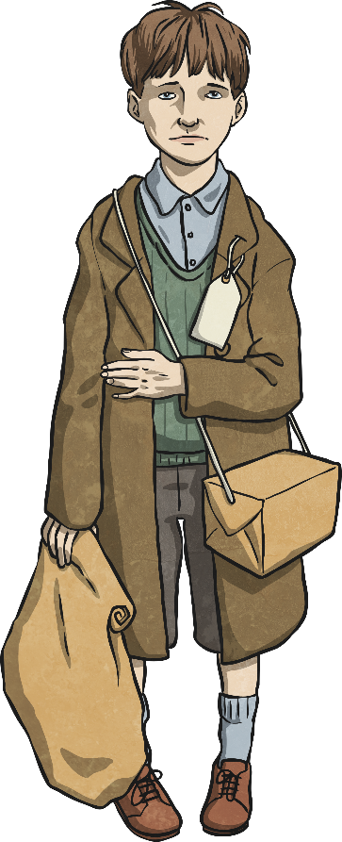
Evacuation Read and Remember
At the start of the war, to many people in Britain, it seemed that not much was happening. As a result, some parents decided to bring their children home again.
Some children were evacuated overseas and lived with host families in places as far away as Australia and Canada.
At the start of the war, to many people in Britain, it seemed that not much was happening. As a result, some parents decided to bring their children home again.
Some children were evacuated overseas and lived with host families in places as far away as Australia and Canada.
True or False?
FALSE
TRUE
Children stayed in the country for the whole of the war.
Evacuation only happened once during the war.
Only children were evacuated.
Some children were evacuated to other countries.

Slide 10
In Their Shoes
Imagine you are a child who is being evacuated. You are bound to have a mixture of emotions about what you are about to experience.
Choose at least two thinking hats and answer the questions that surround them. Write your answers in your jotter or use your laptop.
Black:
Problems
Blue:
Thinking
White:
Information
Green:
Creative
Red:
Emotions
Yellow:
Positives

Slide 11
In Their Shoes
White: Information
What do I know already about evacuation?
What else would I like to know?
What key facts
can I recall?
What else do I need to know?

Slide 12
In Their Shoes
Blue: Thinking
What do I need to think about as I embark on my journey?
How can I prepare myself for this?
What will I do next?

Slide 13
In Their Shoes
Black: Problems
What might go wrong or not as expected?
Is evacuation going to work out?
Will my new family accept me?

Slide 14
In Their Shoes
Green: Creative
What can I do to make this experience as pleasant as possible?
How can I help others?
How can I solve the black hat evacuation problems?

Slide 15
In Their Shoes
Red: Emotions
How do I feel about being evacuated?
What do I not like about being evacuated?
What do I like about being evacuated?
What am I most nervous or worried about?
What do I find most exciting or interesting?

Slide 16
In Their Shoes
Yellow: Positives
Why is evacuation happening?
What are the good points about being evacuated?
How is being evacuated going to help me?

Slide 17
Evacuee Letter
Here is an example of a letter sent by an evacuee
https://youtu.be/szx_wv17_CE
Your challenge is to write a letter in role as an evacuee from World War II.
Use your responses to the thinking hat questions and the prompts on the Evacuee Letter Activity Sheet to help you.

Slide 18
LI: To find out about the experiences of children
who were evacuated during WW2
Success Criteria
I can describe what evacuees needed to take with them on their journey.
I can use different thinking skills to help me organise information about being evacuated.
I can explain when, where and why children were evacuated.
I can describe how it might have felt to be evacuated.
I can take notes from the video

