Slide 1
LI… To calculate the total amount.
SC… I can use my knowledge of addition and multiplication strategies.
  I can put the decimal in the correct place.
  I can align numbers acoording to their place value.

Slide 2
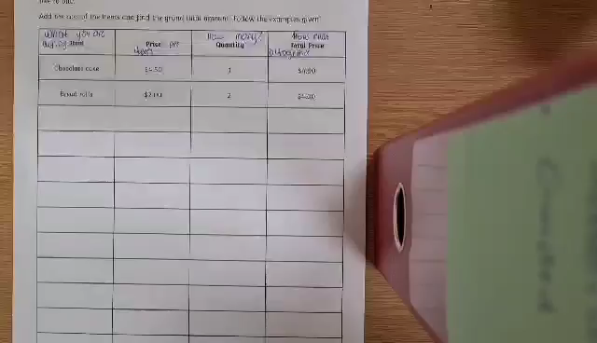

Slide 3
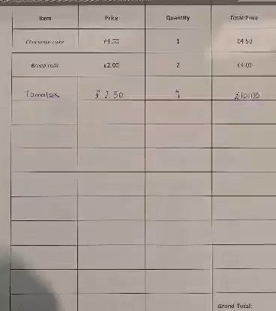

Slide 4
Your task…..
Is to choose the appropriate chili challenge for yourself. Here is the link to all the worksheets.

