Slide 1
Basic Decimals
Learning Question:
Can I divide integers by decimals using short division?

Slide 2
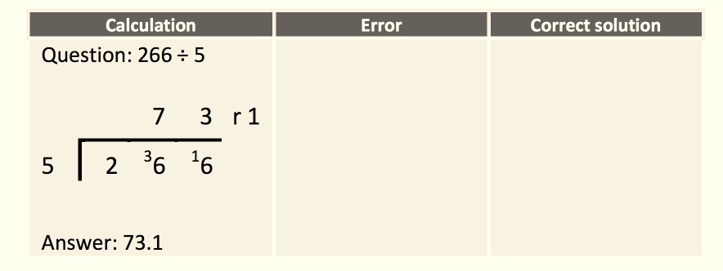
Dividing by Decimals
Engage-Recap
There are errors in the following division.
Find the errors that have been made, and find the correct answer.
I can divide integers with decimals up to 1 decimal place.
I can divide integers with decimals up to 2 decimal places.
I can divide decimals in context by integers.

Slide 3

Dividing by Decimals
Solution
Should have carried the 2, not 3.
Remainder 1 does not mean a tenth.
Remainder 1 means $\frac{1}{5}$ or 0.2
0
5
3
1
5
2
1
5
2
6
6
I can divide integers with decimals up to 1 decimal place.
I can divide integers with decimals up to 2 decimal places.
I can divide decimals in context by integers.

Slide 4
Dividing by Decimals
Explore
What method could you use?
Tresco sells 6 eggs for £1.14
Sandsberry sells 8 eggs for £1.68 Waitflower sells 12 eggs for £2.64
Which shop is best value?
I can divide integers with decimals up to 1 decimal place.
I can divide integers with decimals up to 2 decimal places.
I can divide decimals in context by integers.

Slide 5
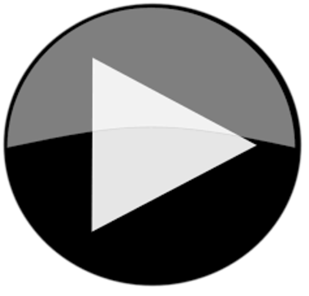
Dividing by Decimals
Explain
Whilst you are watching the video; have a whiteboard to hand.
You will need to watch carefully so that you can create your success criteria.
I can divide integers with decimals up to 1 decimal places
I can divide integers with decimals up to 2 decimal places
I can divide decimals in context by integers.

Slide 6
Dividing by Decimals
Independent Practise
Now you have had a little practise,
Choose either the: , or worksheet.
Use the skill you have learnt to answer the questions on your sheet.
Don’t forget to use your success criteria on your whiteboard.
I can divide whole numbers with decimals up to 1 decimal place.
I can divide whole numbers with decimals up to 2 decimal places.
I can divide decimals by a whole number.

Slide 7
Dividing by Decimals
Evaluate
Create two of your own decimal division sentences using the cards below, ask a family member to solve your question.
3
5
.
2
9
0
4
7
1
I can divide integers with decimals up to 1 decimal place.
I can divide integers with decimals up to 2 decimal places.
I can divide decimals in context by integers.

