Slide 1
Week 1:
Introduction & The Caber Toss
FOR YOUR SAFETY:
Please make sure that you are taking care performing any of the activities. Safety is key in any physical activity and Physical Education (PE). Please make sure that you have enough space around you to perform and complete your activity. Move any objects out of the way before starting that may be a hazard and wearing clothing that is suitable for PE Activities, your laces are tied and that you are being supervised appropriately.

Slide 2
The History behind the highland games..
What do you already know about the history of the Highland games? Each week we are going to be taking part in different activities with a Highland Games link, for example; Caber Toss, Farmers Dash, Highland steps and the Welly throw to name a few.
INTERESTING FACT: Did you know that the Highland Games are a Scottish Tradition that date back more than a 1000 years!!
Can you find out some interesting facts and share them with your family?
Here is a link to get you started:
https://www.visitscotland.com/see-do/events/highland-games/facts/
How could you share your interesting facts?
Pictures
Powerpoint
Drawings
Writing
Presentation

Slide 3
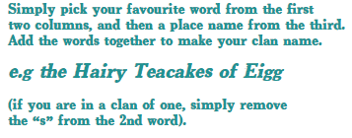
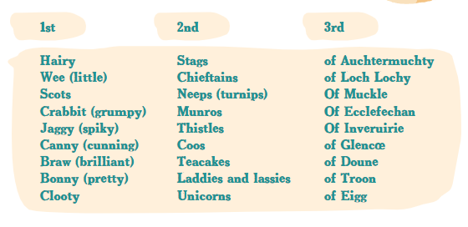
So lets begin… Whats your ‘Clan’ name going to be?
Mrs Howard’s would be …. ‘Bonny Coos from Muiravonside clan’

Slide 4
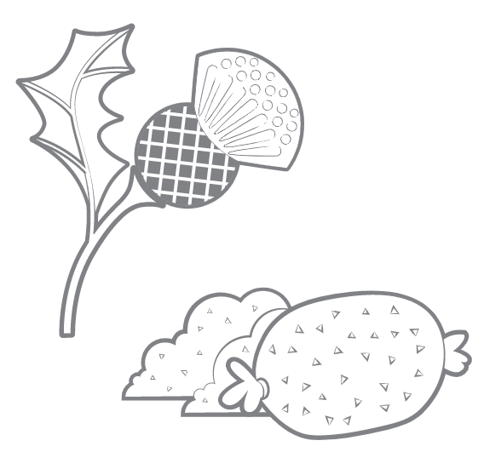
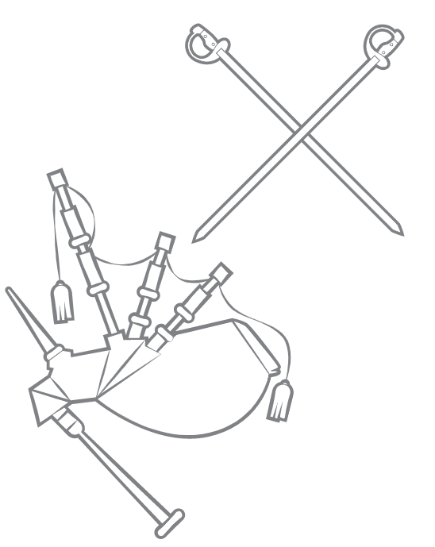
Create your Clan Flag ….
Use the flag on next
slide if you wish or a plain
piece of paper.

Slide 6
Activity 1: Caber Toss
Benchmarks:
Flexibiliity Rhythm & Timing Motivation
Instructions:
1. Get yourself a ‘Caber’ this could be a stick, long roll of cardboard, swimming noodle
2. Make sure you mark one end of your caber
3. The Caber toss is NOT about distance it is making sure it does a full rotation and as straight as possible
5. Can you improve your throw and make it straighter?
Extension Task:
Can you make your caber heavier?

Slide 7
Activity 1: Caber Toss (Indoor alternative)
Benchmarks:
Speed Rhythm & Timing Motivation
Instructions:
Get yourself an empty plastic juice or water bottle (500ml)
Fill slightly with water
Holding the bottle by the lid end, how many times in 1 minute can you flip the bottle to land upright?
Can you beat your score?
How straight can you keep your flip?
Extension task:
Can you reduce the space you flip your bottle onto?

Slide 8
Don’t forget…..
Share what you have been getting up to and let me know how you are doing through the following ways;
Teams
Seesaw
School email address FAO: Mrs Howard
Wlwilliamston-ps@westlothian.org.uk
Good luck and have fun!

