Slide 2
Alcohol
Alcohol is a drug that can have negative effects on your body.
Maybe you already know some of them. What are they?
feeling sick
tired
loss of balance
acting strangely
can’t speak properly
vomiting
These are the effects that you can see or hear.
There are others that happen inside the body that are not so obvious.

Slide 3
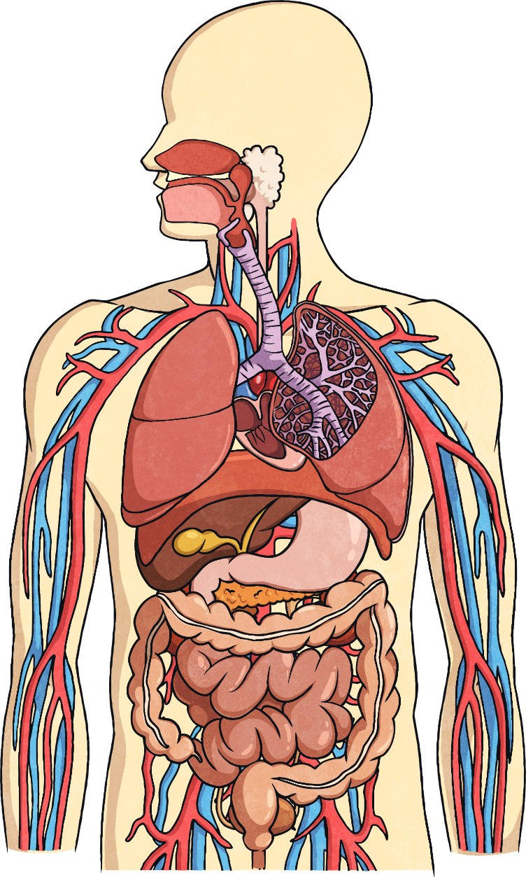
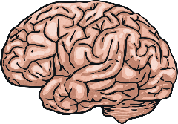
Brain
Drinking alcohol can stop your brain from working properly. It makes it more difficult to co-ordinate your arms and legs. It makes it hard for you to concentrate.

Slide 4
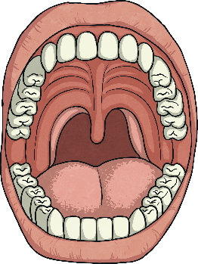
Mouth and Oesophagus
Drinking alcohol can cause bleeding of the oesophagus (food pipe). It reduces your desire to eat and dulls your taste.

Slide 5
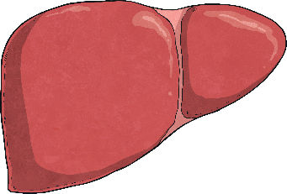
Liver
If you drink alcohol over a long period of time, your liver might stop working properly. This disease is called cirrhosis.

Slide 6
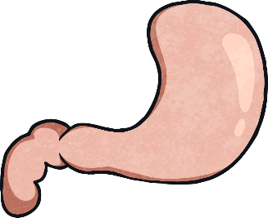
Stomach
Drinking alcohol can cause irritation of stomach lining, inflammation, bleeding and cancer. Drinking alcohol makes you put on weight. It will also make you sick if you drink too much.

Slide 7
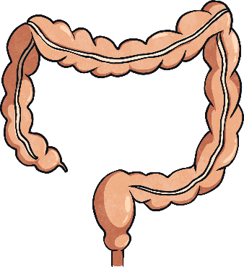
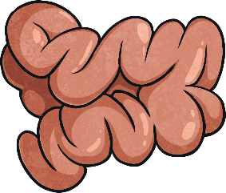
Intestine
Drinking alcohol can cause diarrhoea, vomiting, sweating and loss of appetite, as well as cancer, in extreme cases.

Slide 8
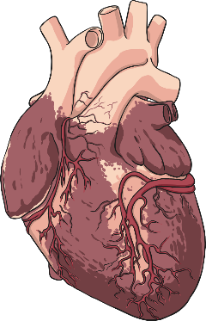
Heart and Blood
Drinking alcohol weakens the heart’s ability to pump. This means that having a heart attack is more likely.

Slide 9
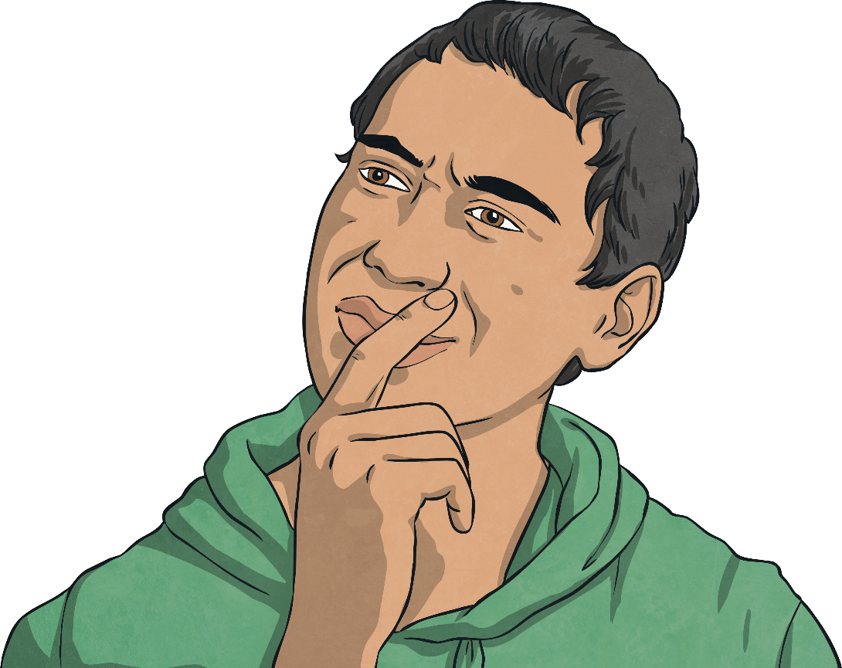
Let’s Think
You are at your friend’s house. They tell you that there is some alcohol in the kitchen cupboard and that you should try it.
What do you do?

