Slide 1

Presentation
What are the links between jobs and money?

Slide 2

In pairs, come up with an answer to
What is a job?

Slide 3
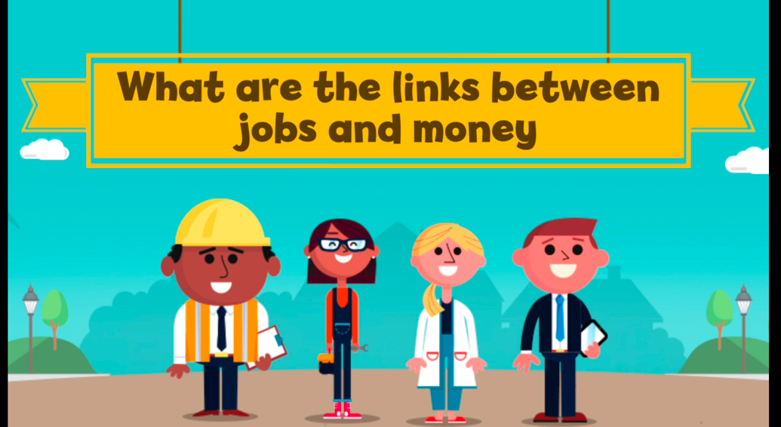
‘What are the links between
jobs and money?’ video
What are your thoughts about jobs and money?

Slide 4
What is a job?
Full time
or
part time
Permanent or temporary
Paid
or
unpaid
A full-time worker
will usually work
35 hours or more
a week, but this
can vary
Temporary staff
will be hired for a specific amount of time, and will often know their end date
Can you think of reasons someone
would do
unpaid work?
Can you think of any jobs that are often part time?

Slide 5

How are people paid for jobs?
Jobs can be paid in a number of ways
If you get paid a salary, this is
when you are told the amount of money you will earn in one year. You will normally receive the same amount of pay every month in your bank account.
Some people get paid an hourly rate, when you earn a set amount for every hour that you work. The more hours you work, the more pay you’ll receive.
You can get paid piece work – this is when you’re paid a set amount for every item you make. The more items you produce, the more you’ll be paid.
Sometimes people get commission – this is mostly for sales jobs, when you receive a share of all the sales you make. Often you will get commission as an extra on top
of your salary.

Slide 6
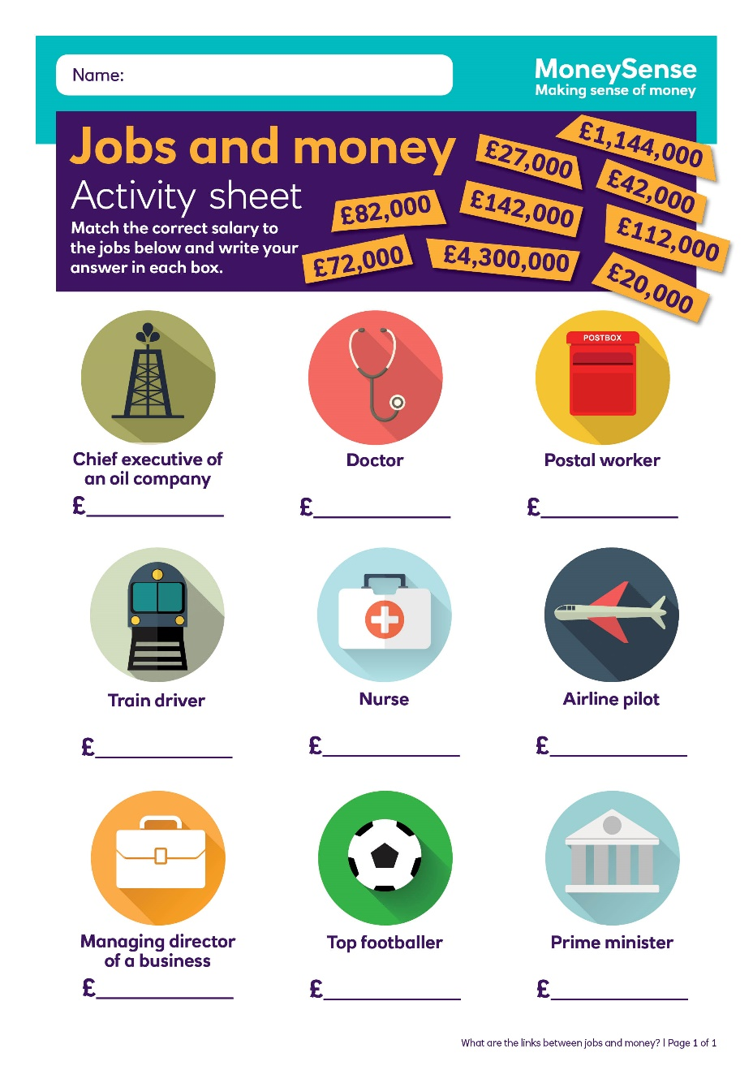
‘Jobs and money’
activity sheet
Match the salaries with the nine jobs listed

Slide 7
‘Jobs and money’ activity sheet answers
Chief executive of an oil company | £4,300,000
Top footballer | £1,144,000
Prime minister | £142,000
Managing director of a business | £112,000
Doctor | £82,000
Airline pilot | £72,000
Train driver | £42,000
Nurse | £27,000
Postal worker | £20,000
(Source: Office for National Statistics, 2012)

Slide 8

Write a list of factors that influence job choices
What factors might people consider when picking a job?
How do people decide what job they want to do?
Challenge: arrange your ideas in lists in order of what you
think would be the most important to the least important.
How can I pay for things? | 8

Slide 9
Jobs and money bingo
unpaid job
full time
commission
permanent
salary
hourly
rate
piece
work
temporary
part time

