Slide 1
Nelson Skills
Thursday 4th June 2020

Slide 2
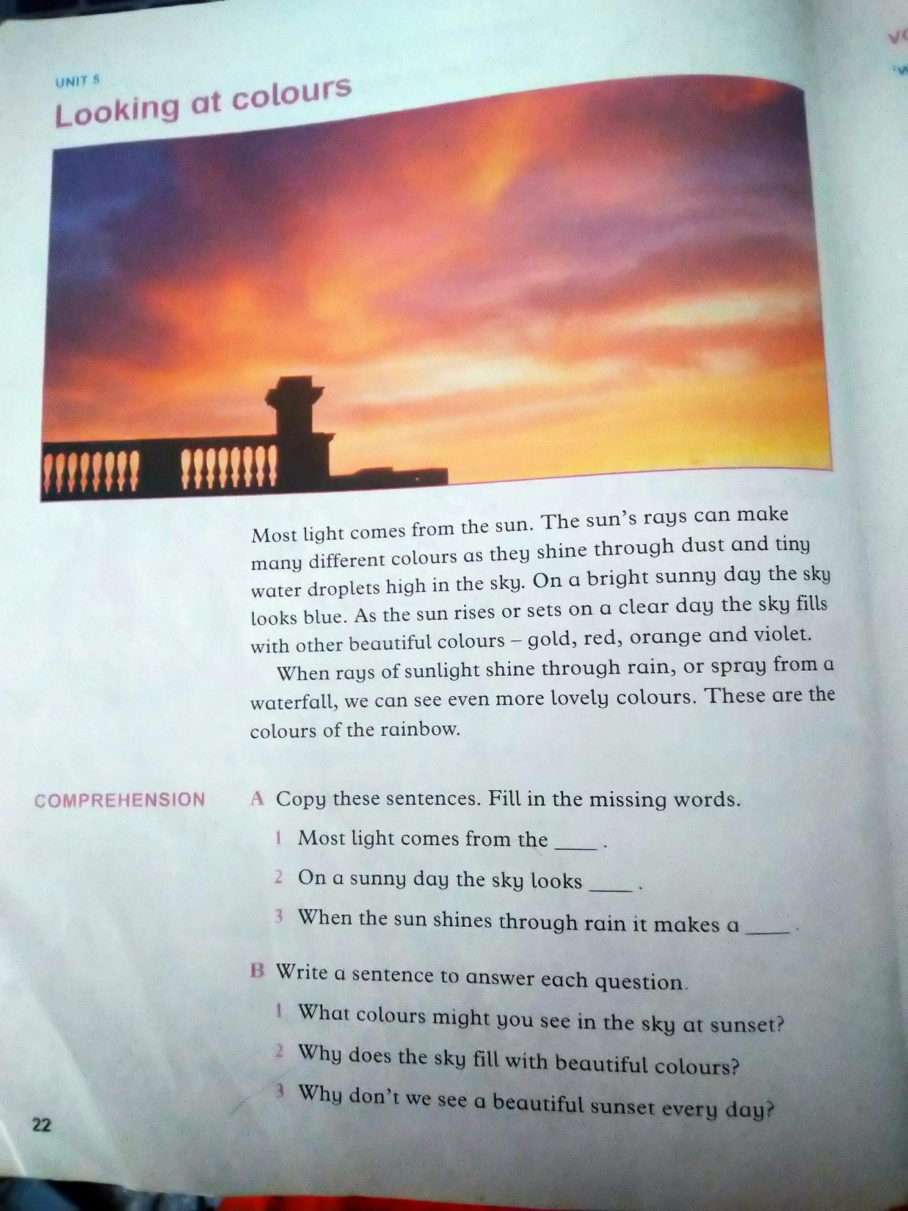

Slide 3
