Slide 1
Maths
Measurement
Year One
Maths | Year 3 | Measurement | Measure, Compare, Add and Subtract Units of Measurement | Lesson 3 of 5: Measuring Kilograms and Grams

Slide 2
Measuring Kilograms and Grams

Slide 3
Aim
I can measure mass in kilograms and grams.
Success Criteria
I can calculate the intervals on a scale.
I can read scales to measure in kilograms and grams.

Slide 4
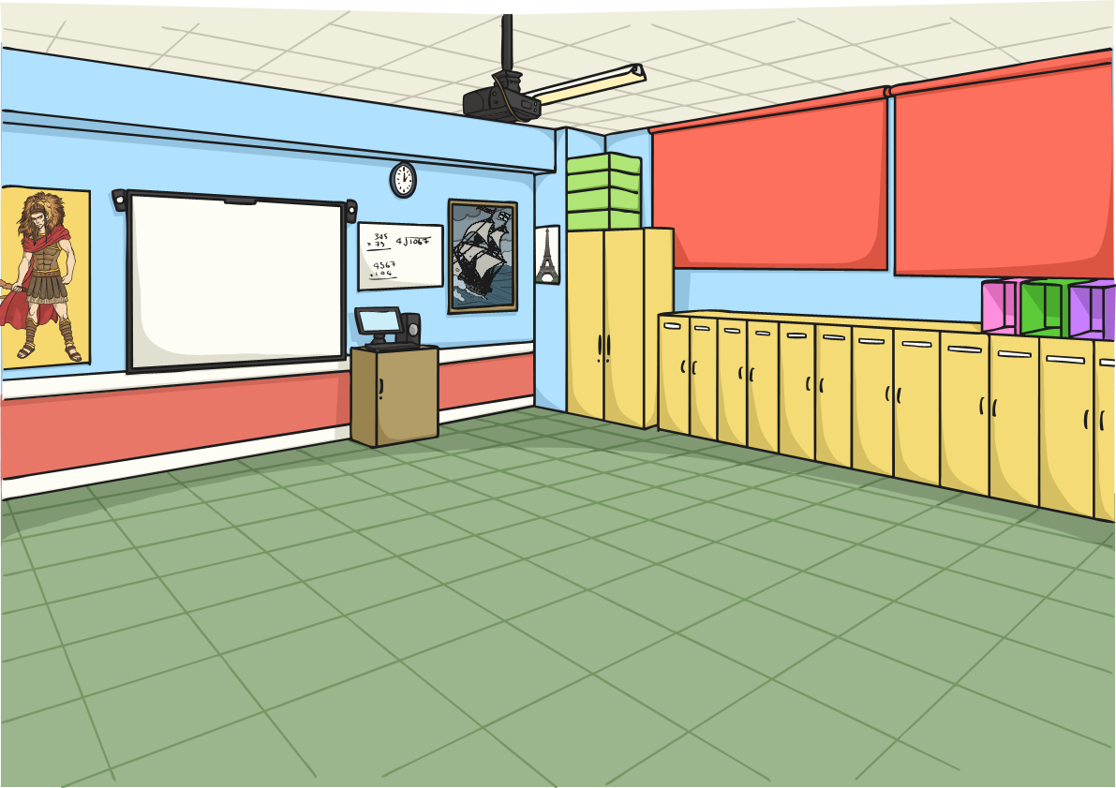
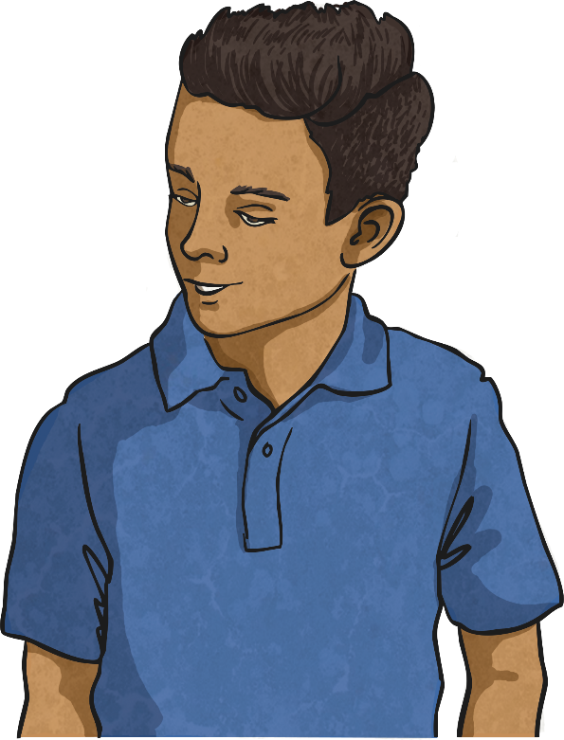
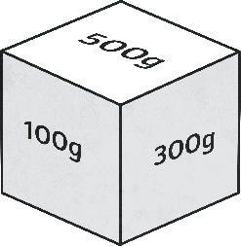
Make a Kilogram
In pairs, take turns to roll the Grams Dice. Keep a running total of your score.
I have rolled exactly one kilogram so I win a point!
I rolled 300g
Then 200g which totals 500g
Then 400g which totals 900g
Then 100g which totals 1000g
I have gone over 1kg so I have to start again!
I rolled 200g
Then 100g which totals 300g
Then 500g which totals 800g
Then 100g which totals 900g
Then 300g which totals 1200g
The first person to reach exactly 1kg wins 1 point. If your total goes over 1kg (1000g) then you have to start from zero again!
The person who scores the most points in three minutes wins!

Slide 5
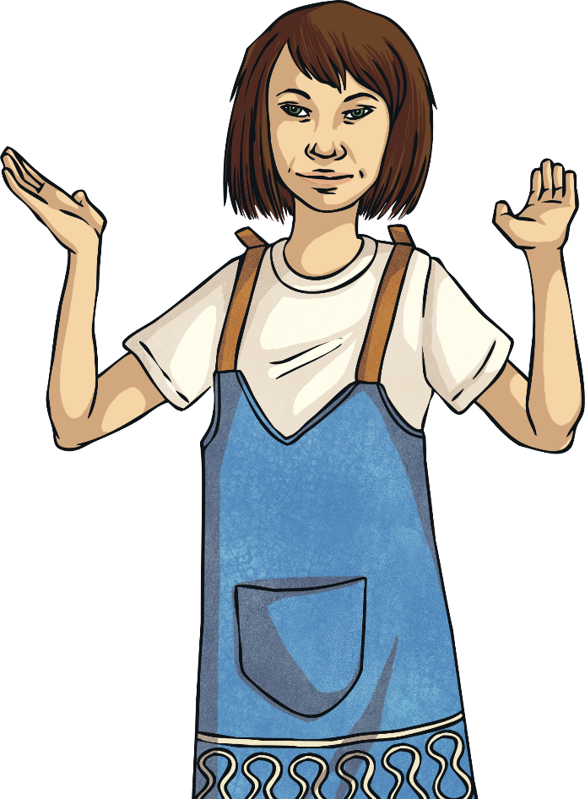
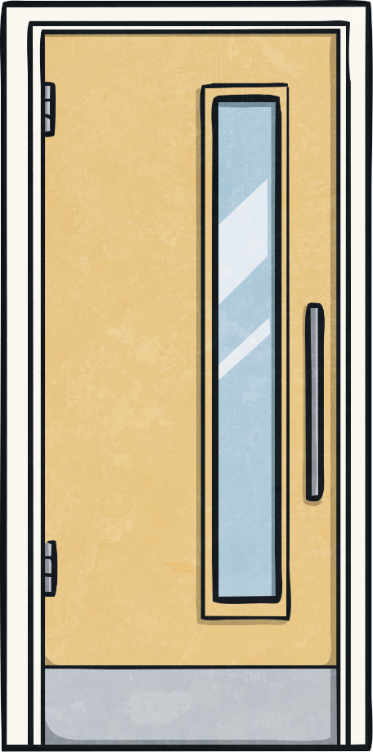
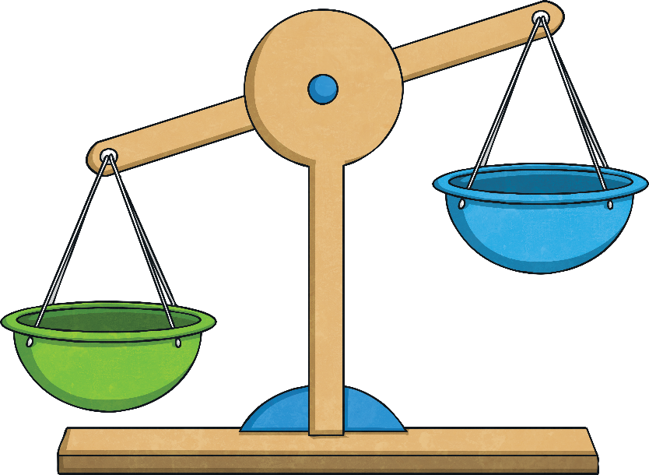
Lighter or Heavier?
Estimate if each object is heavier or lighter than a kilogram.
Write the name of each object in the correct column on your Estimate the Mass Activity Sheet.

Slide 6
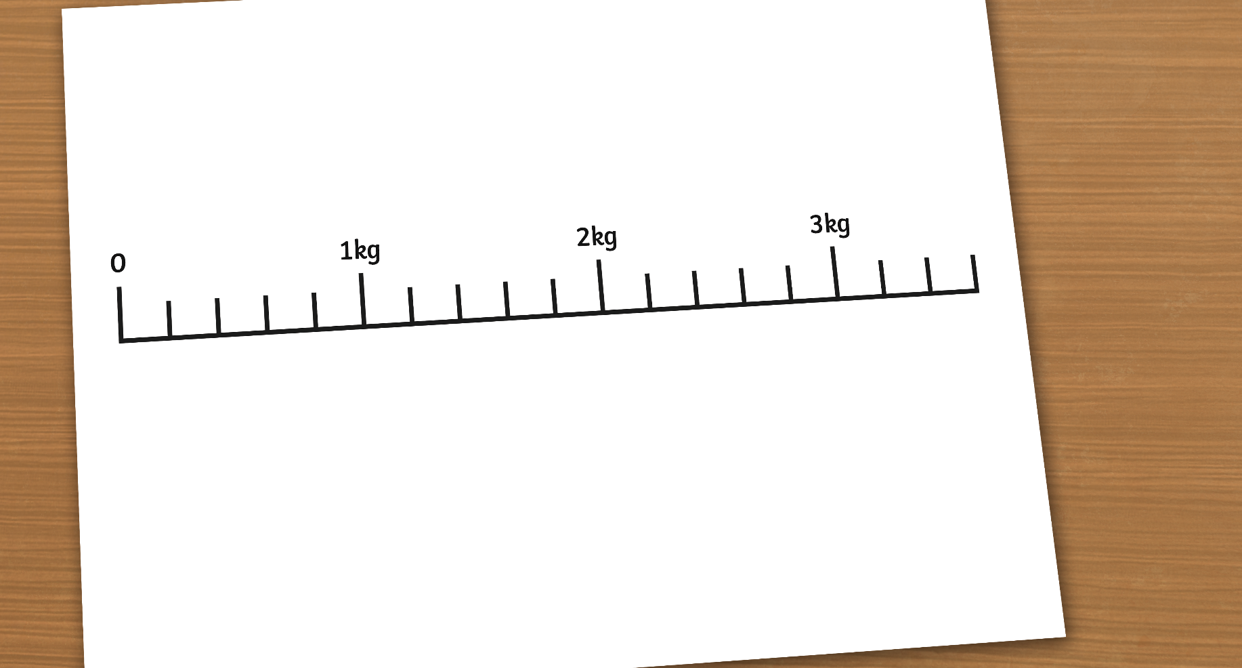
Reading Scales to Measure Kilograms
If we are going to measure objects in kilograms, we need to calculate what the small intervals on the scale measure.
2000g
3000g
1000g
This scale has 5 intervals between each kilogram. To find out which interval is worth, we divide 1000 by 5.
1000 ÷ 5 = 200,
so each interval is worth 200g.
First, we need to convert kilograms to grams.
1 kilogram = 1000 grams.

Slide 7
Reading Scales to Measure Kilograms
I’m pointing at 3 intervals after 2kg.
As each interval is worth 200g, 3 intervals makes 600g.
I am pointing to 2kg + 600g = 2kg 600g

Slide 8
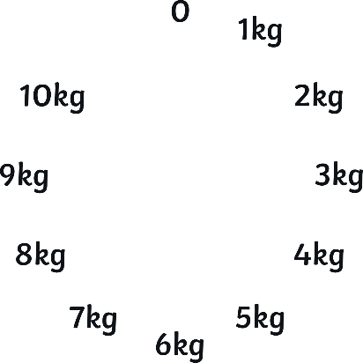
Reading Scales to Measure Kilograms
With your partner, calculate the mass that each arrow is pointing to.
C
A
B

Slide 9
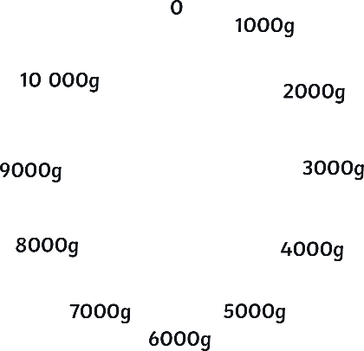
Reading Scales to Measure Kilograms
First change kg to g.
C
A
B
1000 ÷ 10 = 100, so each interval is worth 100g.
To work out what each interval is worth, we divide 1000 by 10.

Slide 10
Reading Scales to Measure Kilograms
Arrow A is pointing 5 intervals after 2kg.
A
2kg + 500g = 2kg 500g

Slide 11
Reading Scales to Measure Kilograms
Arrow B is pointing 2 intervals after 5kg.
B
5kg + 200g = 5kg 200g

Slide 12
Reading Scales to Measure Kilograms
Arrow C is pointing 6 intervals after 9kg.
C
9kg + 600g = 9kg 600g

Slide 13
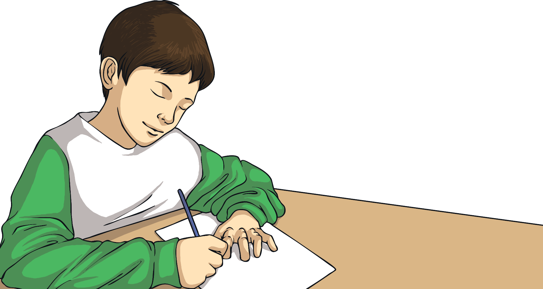
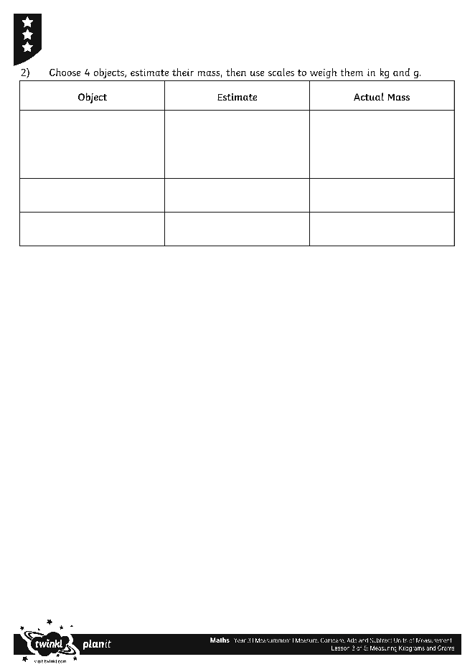
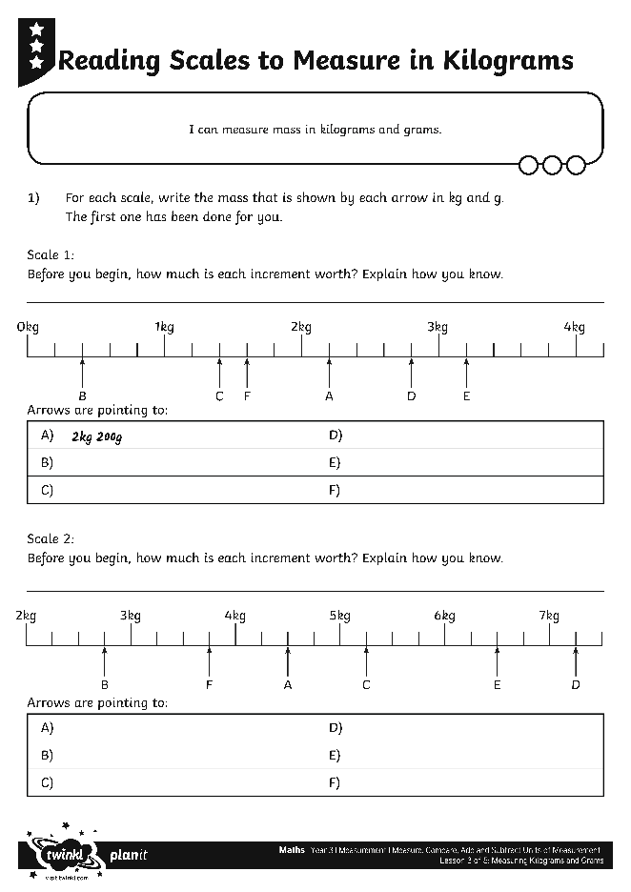
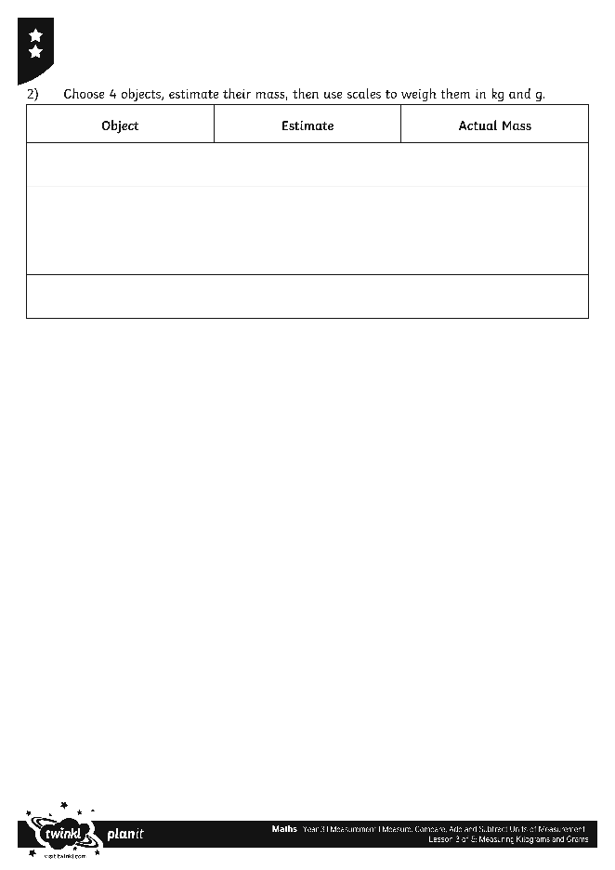
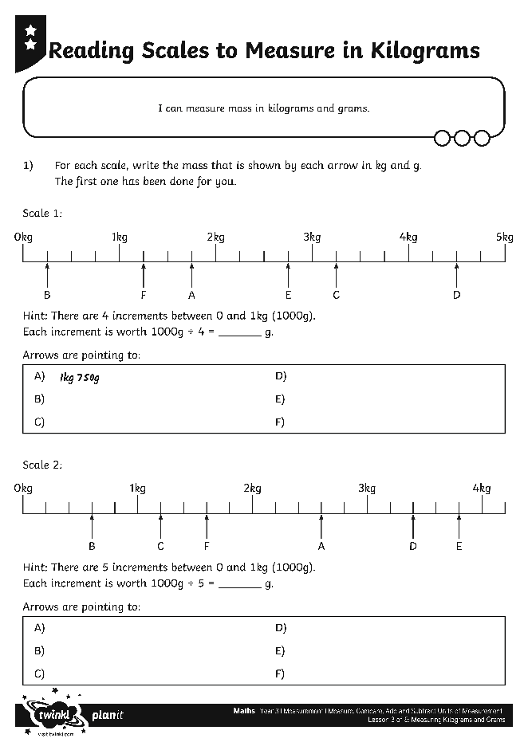
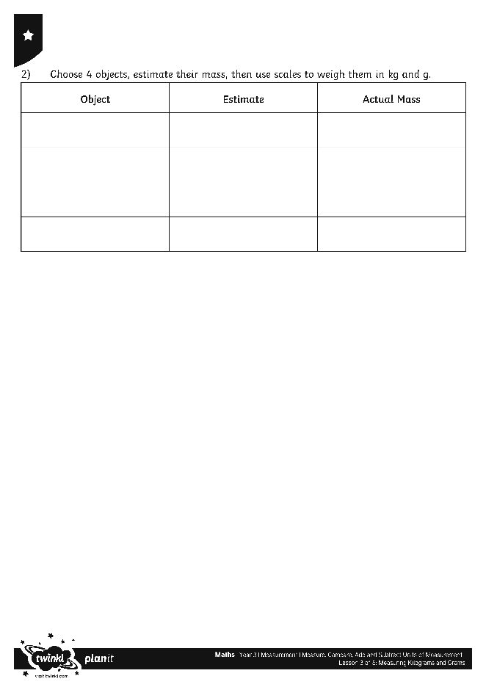
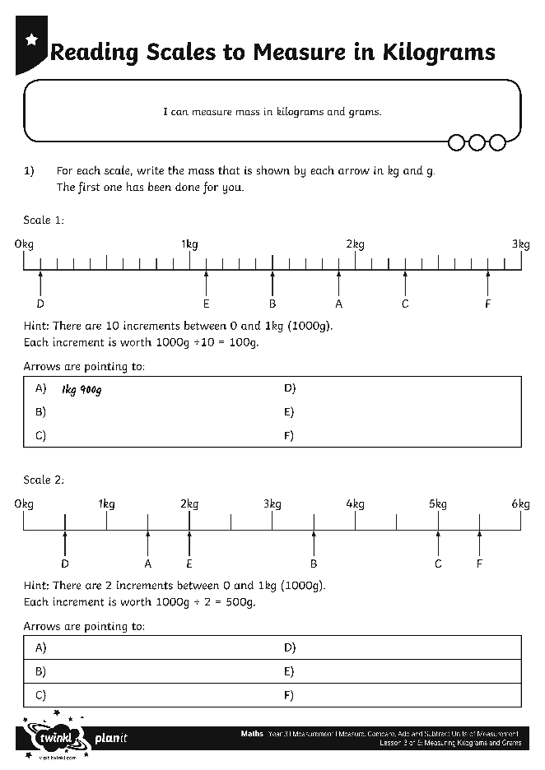
Reading Scales
Use your marvellous measuring skills to complete these activity sheets:

Slide 14
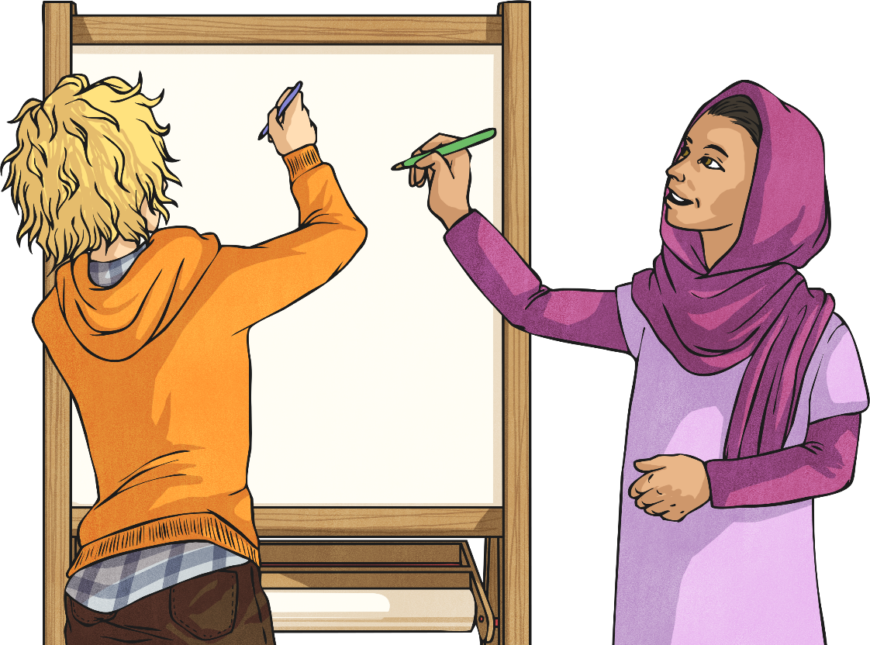
Be the Teacher
With your partner, take it in turns to be the teacher.
Teach your partner the key skills you have learnt in this lesson.
Explain how you know that you have learnt them.
Describe why this learning might help you in your life outside of school.

Slide 15
Aim
I can measure mass in kilograms and grams.
Success Criteria
I can calculate the intervals on a scale.
I can read scales to measure in kilograms and grams.

