Slide 1
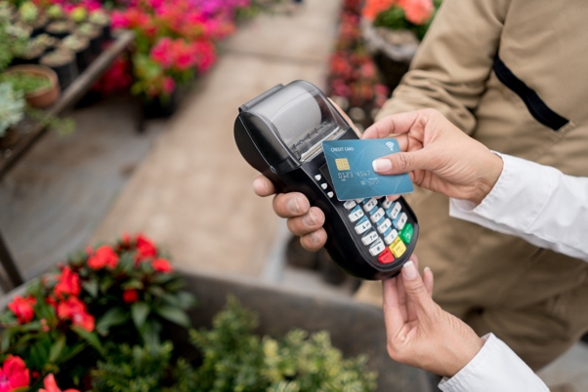
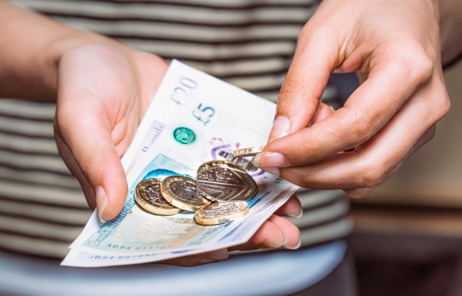
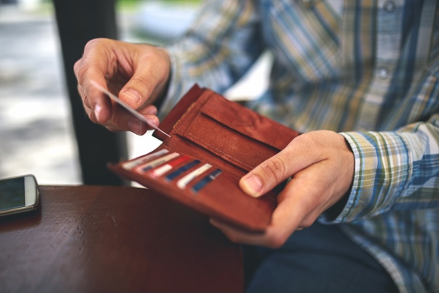
How can I pay for things?
Presentation

Slide 2
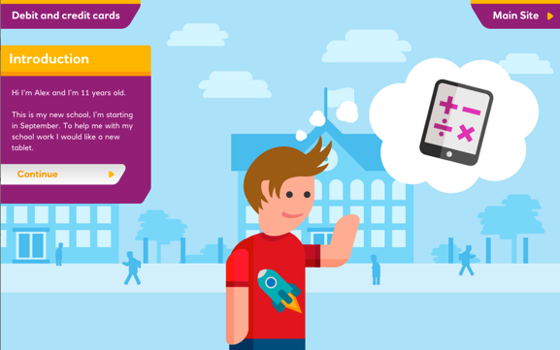
Before the next lesson please complete the
‘Debit and credit cards – meet Alex’ interactive activity at home.

Slide 3
Learning objectives/intentions
• Understand there are many different payment methods
• Understand what the most appropriate way of paying in different situations is
• Use appropriately and understand some of the key language relating to credit and debit card use

Slide 4
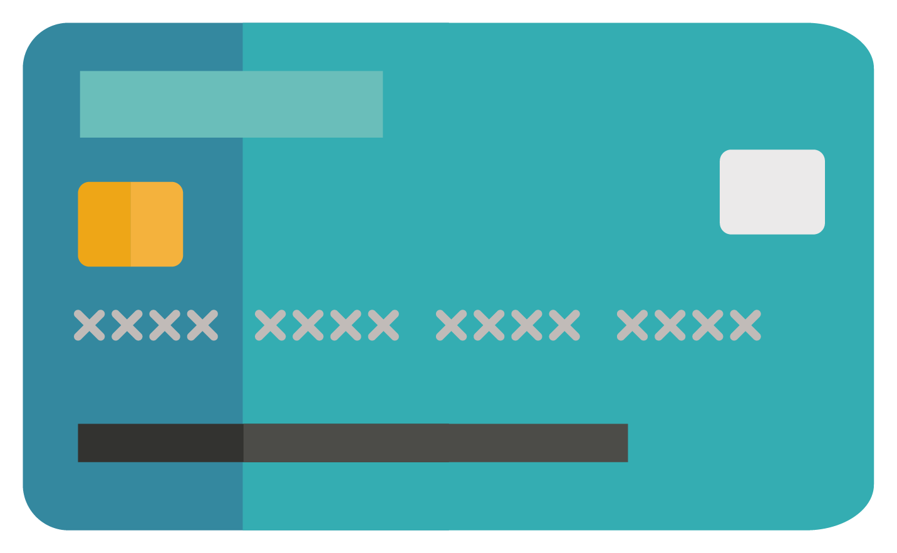
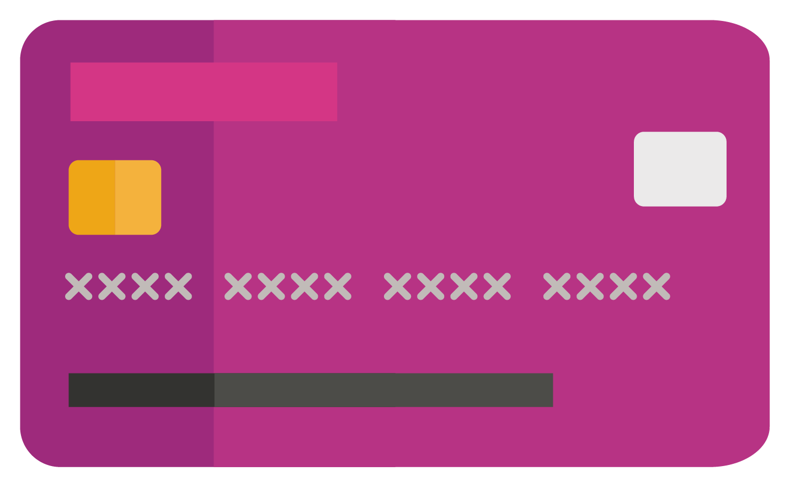
How can I pay
for things?
When you go shopping should you use a debit or a credit card?
DEBIT
CREDIT

Slide 5
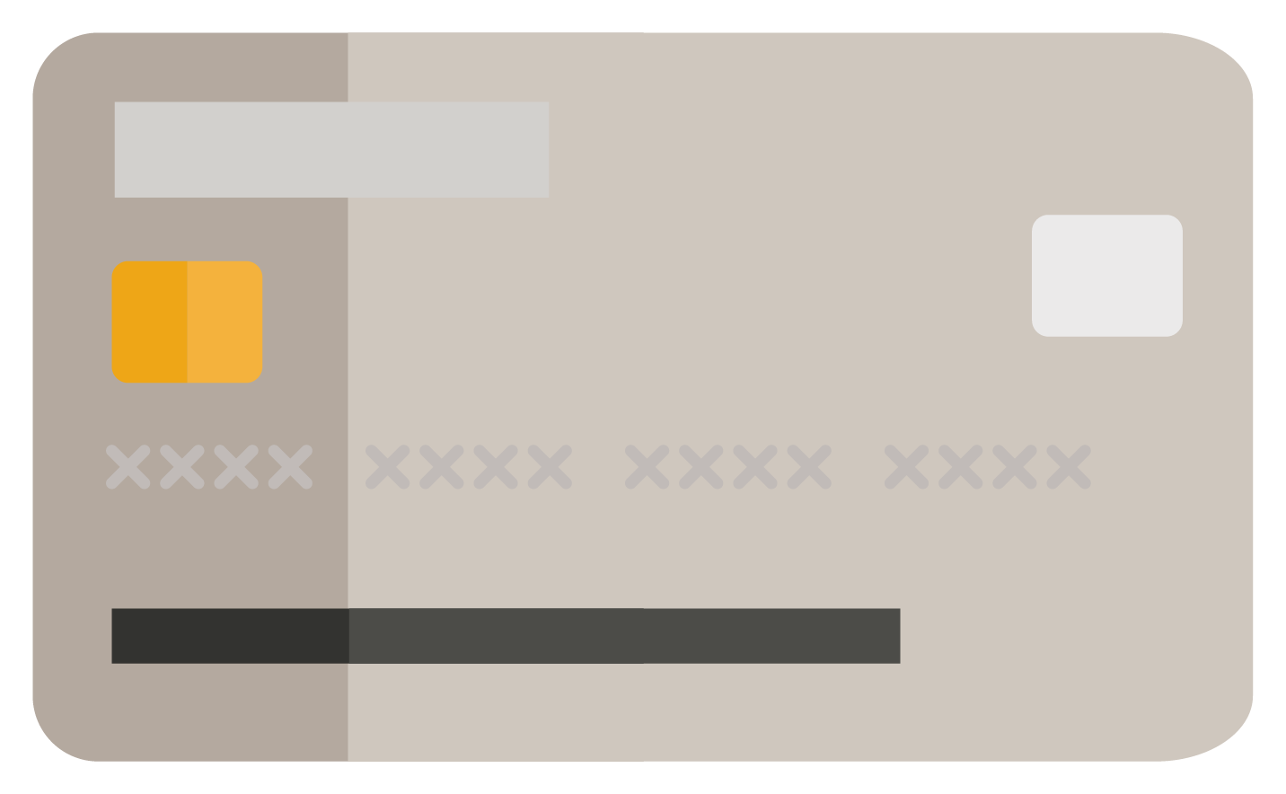
How can I pay?
DEBIT
CREDIT
STORE
When you want to buy goods, how do you pay?
Which of these have you seen before?
What are they and how do they work when paying?

Slide 6
Here is my list of
things I need to buy
before I begin
school next term.
How should he pay today?
• An e-reader or tablet
• A bag
• Plain white trainers
• A bike and a
safety helmet
Should I use my
debit card or ask to
use my parents’
credit card?

Slide 7
Debit card or credit card?
Help the Williams family to pay their bills.
Look at the list of costs.
Decide whether they should pay for each cost using a debit card or a credit card.
If you choose the debit card, remember to write in the new account balance.

Slide 8
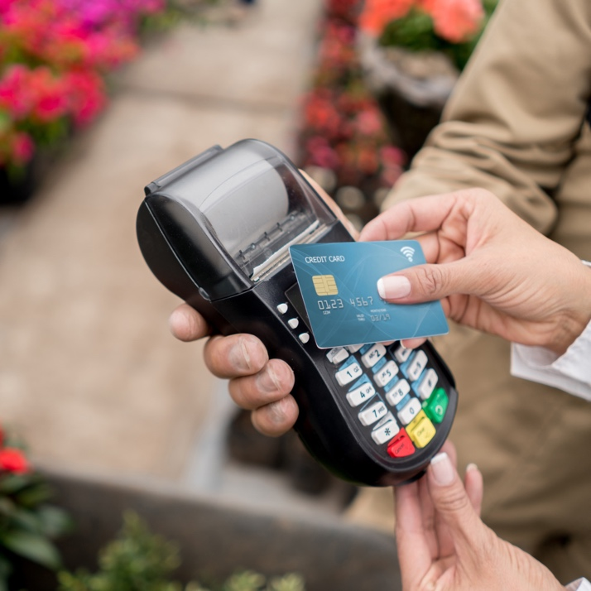
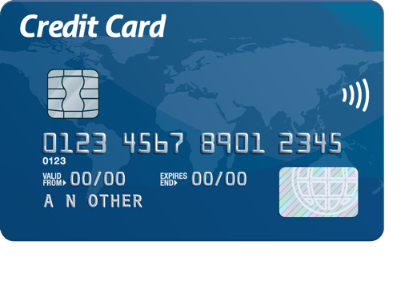
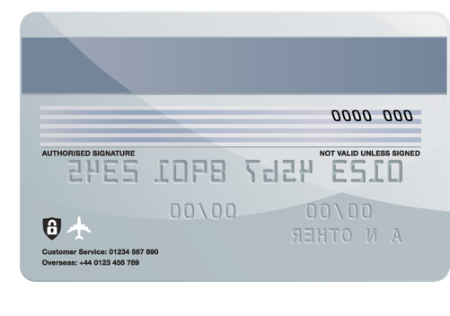
When and how do I use a contactless card?
• How does my contactless card work?
• Can I pay for everything using my contactless card?
• Is there anything I need to think about when using a contactless debit or credit card?

