Slide 1
Triangles - Fractions
Tuesday 12th May 2020

Slide 2
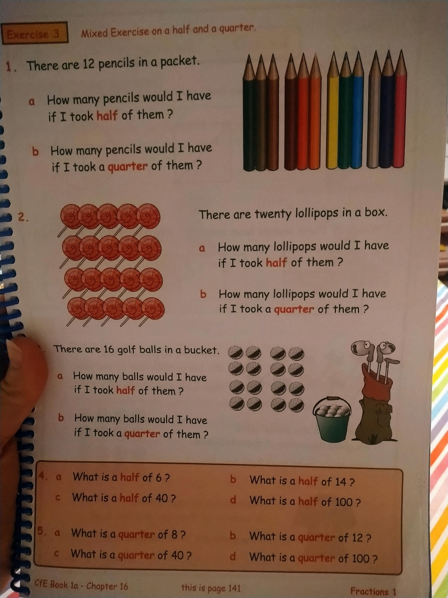

Slide 3
