Slide 1
Circles - Fractions
Wednesday 6th May 2020

Slide 2
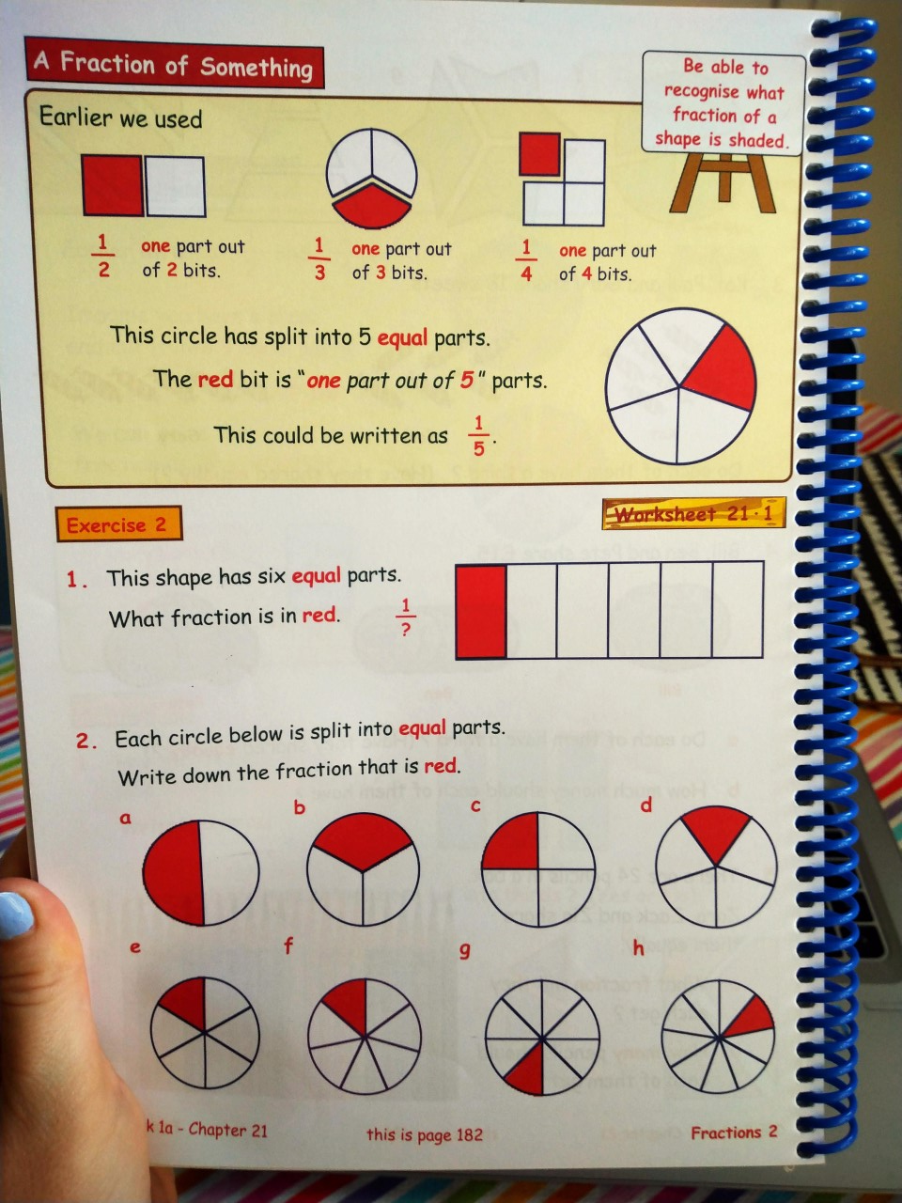

Slide 3
