Slide 1
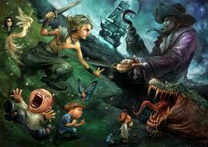
Modal and Imperative Verbs
What can you see in the picture?
What is happening?
What are the moods and emotions?

Slide 2
Learning Objective: To identify and use modal and imperative verbs.
WILF:
I can write some sentences with modal and imperative verbs in.
I can identify and use some modal and imperative verbs accurately.
I can identify and use a variety of modal and imperative verbs accurately and consistently.
I can identify and use a wide range of modal and imperative verbs creatively and accurately.

Slide 3
Title - Modal Verbs
Modal Verbs
could
might
should
may
ought
must
would
We use modal verbs to show if we believe something is certain, probable or possible (or not).

Slide 4
Title - Modal Verbs
Modal Verbs
could
might
should
may
ought
must
would
What is the difference between these two sentences?
You must do your homework.
You could do your homework.
What is a modal verb?
Write 3 examples.
Write 3 sentences with different modals in.

Slide 5
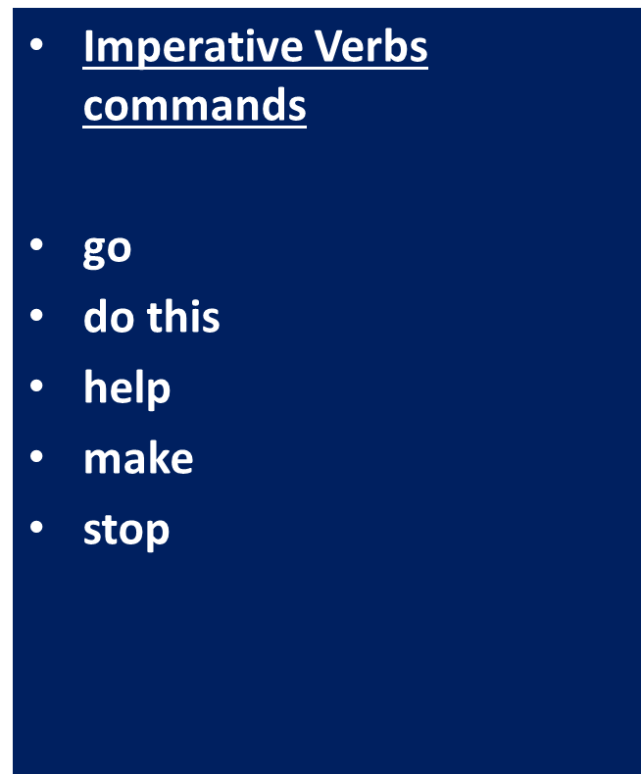
Title - Imperative Verbs
Imperative verbs are orders or commands. They tell you what to do!
Can we think of some more examples?

Slide 6
Title - Imperative Verbs
They tell you what to do.
They are doing words.
What is an imperative verb?
Write 3 examples.
Write 3 sentences with different imperatives in.

Slide 7
Look for these words in the paragraph 1: playing and must. Label all the modal and imperatives in paragraph 1. Label all the modals and imperatives in paragraph 1 and 2. Label all the modals and imperatives across the text.

Slide 9
‘All children, except one, grow up.’
Should children have to grow up or not?

Slide 10
‘All children, except one, grow up.’
I think children should not grow up. They could spend all their time playing on their Xboxes instead.
They can grow up but they would have to work instead!

Slide 11
‘All children, except one, grow up.’
Should children have to grow up or not?
Use these words in your answer: should, will, must, work, play, run.
Use modals and imperatives.
Use modals, imperatives, adverbial starts.
Use modals, imperatives, adverbial starts and ambitious punctuation such as colons and semi colons.

Slide 12
Self Assess
Using a red pen, underline and label your imperative verbs and modal verbs.
Modal verb
I think children should not grow up. They could spend all their time playing on their Xboxes instead.
They can grow up but they would have to work instead!
Imperative verb

