Slide 2
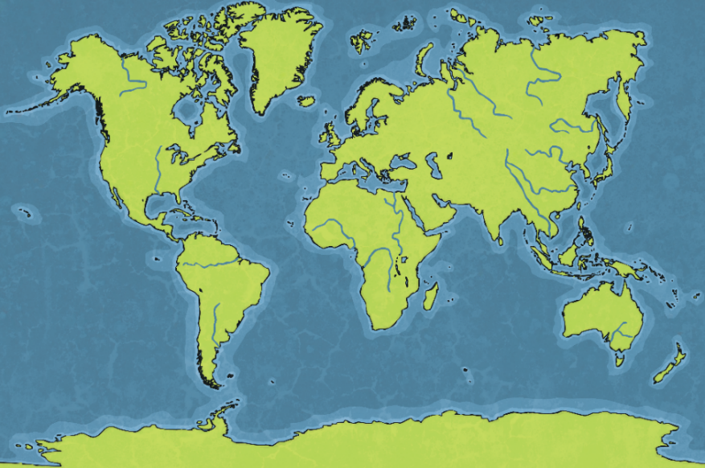
Question 1
Can you name two Axis Powers and two Allies?
Reveal Answer
Axis Powers
Germany
Italy
Japan
Allies
Britain
France
Australia
Canada
New Zealand
India
China
United States of America
USSR

Slide 3
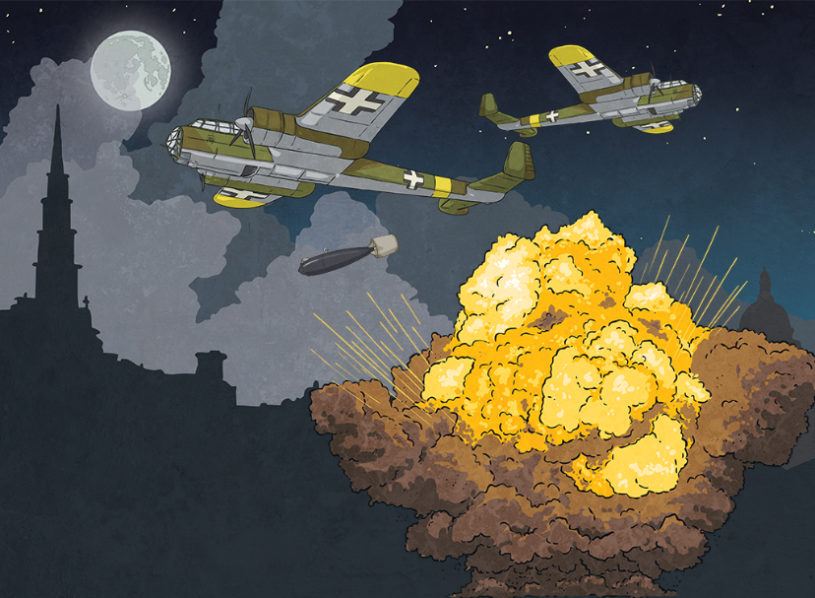
Question 2
What was the German word used to describe an air raid attack?
Reveal Answer
Blitzkrieg, or Blitz for short.

Slide 4
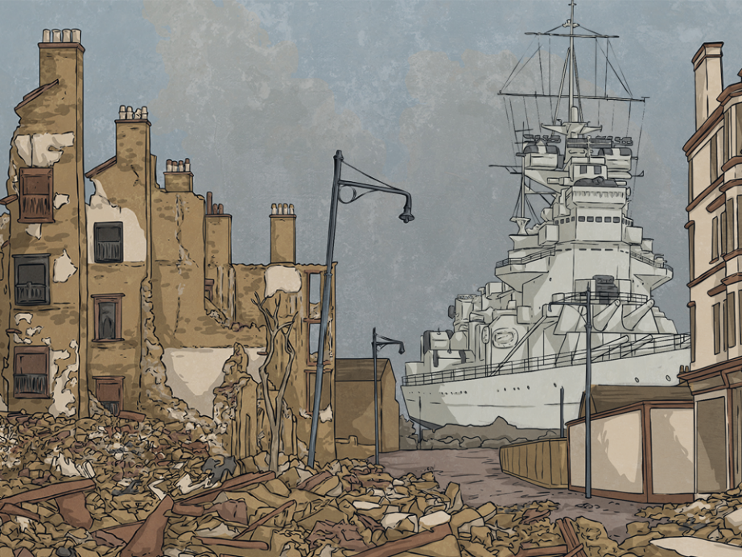
Question 3
Where would Germany target with this kind of attack?
Reveal Answer
Towns and cities were targets, especially ones that contributed to the British war effort, such as Clydebank.

Slide 5
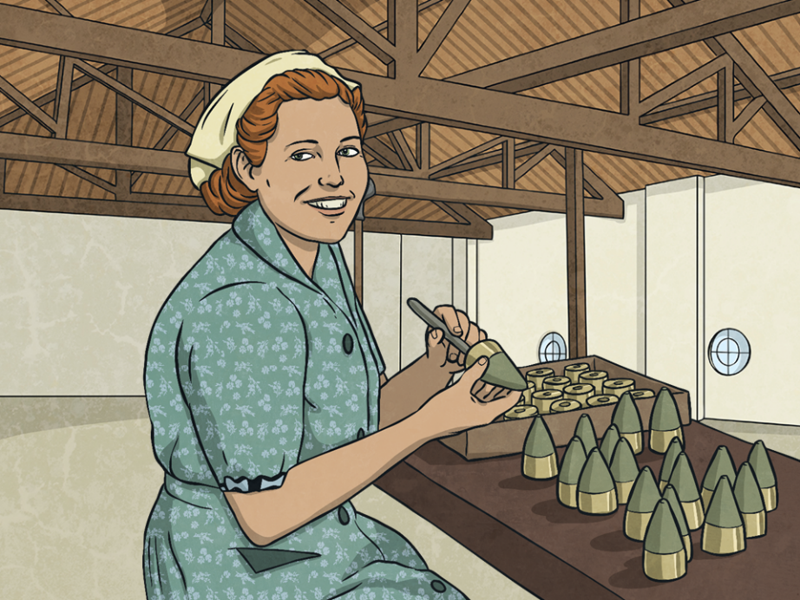
Question 4
Why was Clydebank a target during an air raid?
Reveal Answer
Clydebank was a main provider of arms, munitions and battleships and was vital to Britain’s war effort. This made it a target for Hitler in an attempt to disadvantage Britain.

Slide 6
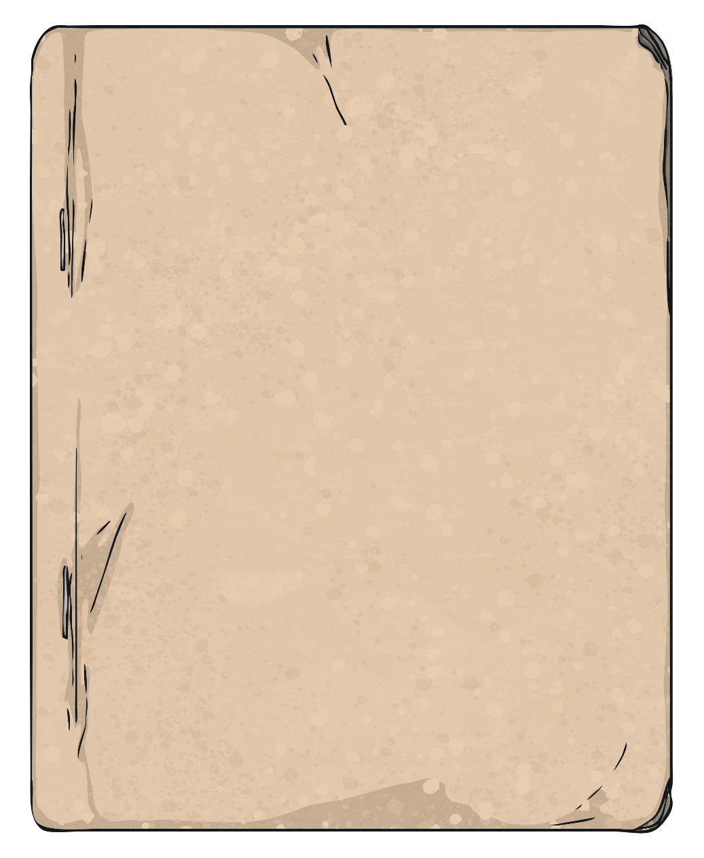
Question 5
= 1000 people
How many people lived in Clydebank at the time of the Blitz?
Reveal Answer
There were around 50,000 people in Clydebank.

Slide 7
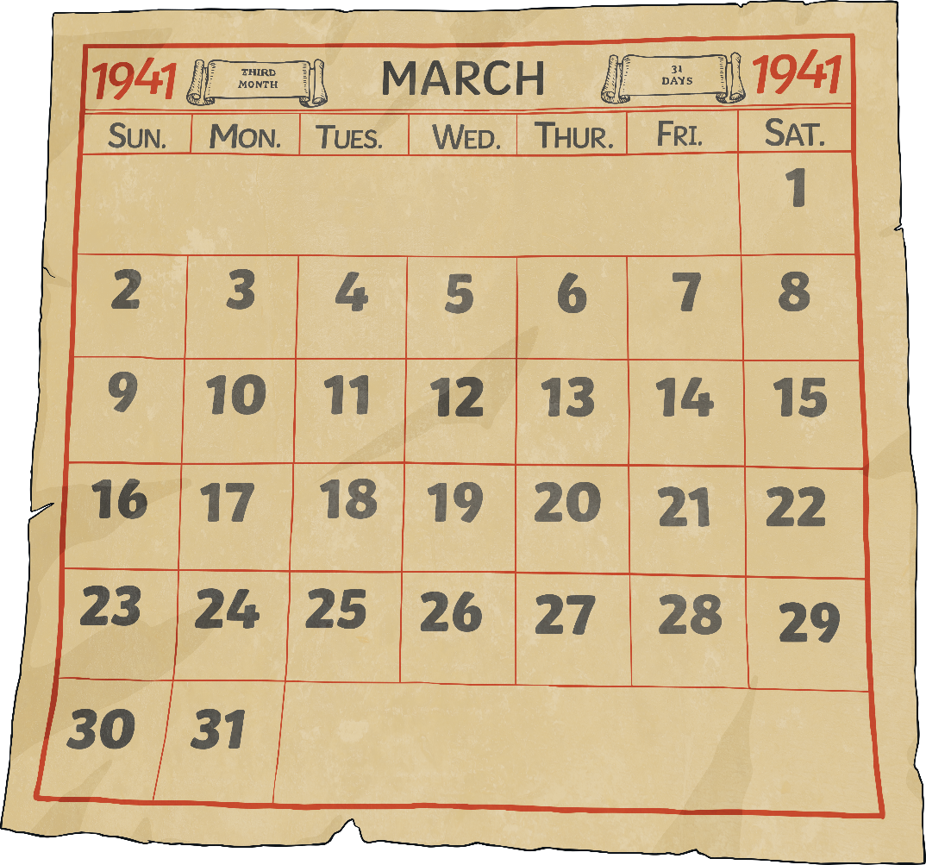
Question 6
When did the Clydebank Blitz take place?
Reveal Answer
The German bombings took place on the 13th and 14th March 1941.

Slide 8
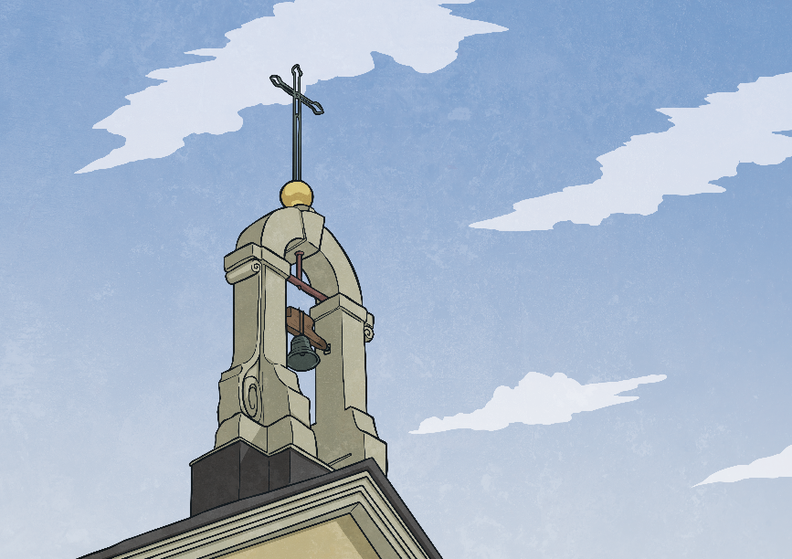
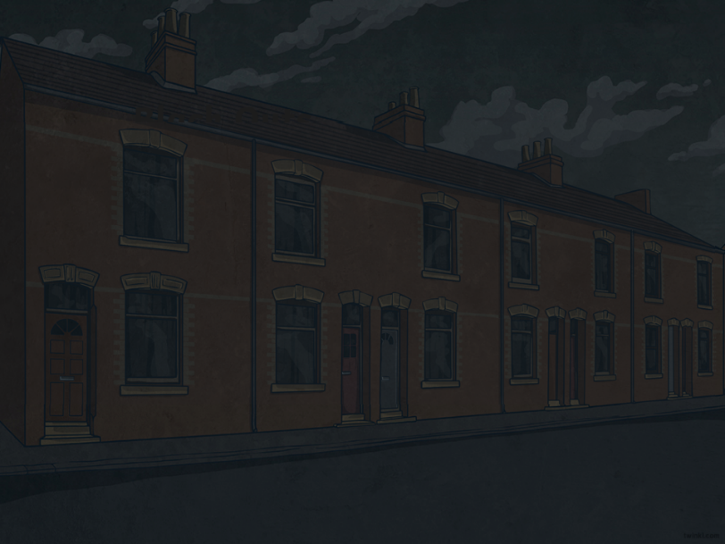
Question 7
During the air raids, how did the people of Clydebank stay safe?
Reveal Answer
The people of Clydebank had several ways of staying safe. These included:
finding a shelter;
going to an underground railway;
evacuating Clydebank;
turning all lights off;
going to an air raid shelter or a communal shelter like a church or a stairwell in a tenement building, etc.

Slide 9
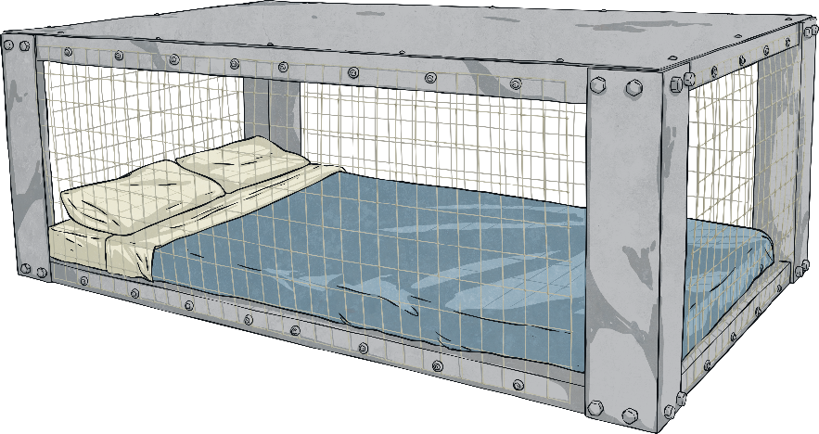
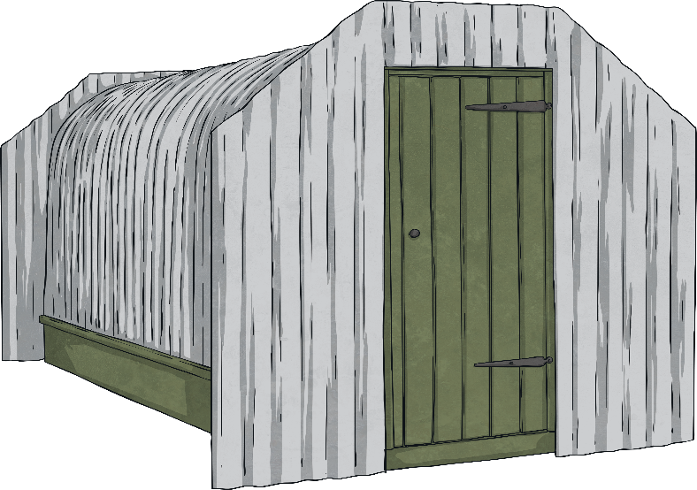
Question 8
Name two types of shelters that were used during the Second World War.
Reveal Answer
Morrison and Anderson Shelters.

Slide 10
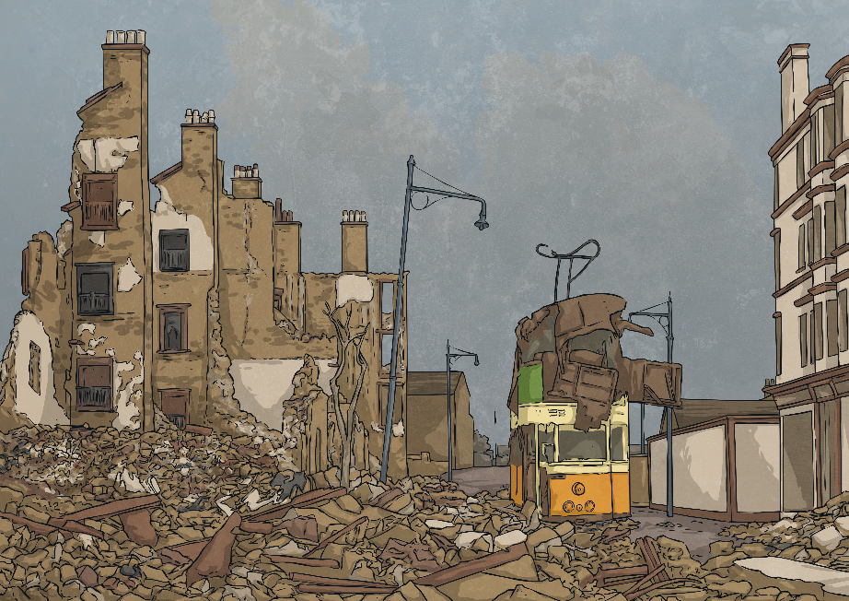
Question 9
How many factories and homes were left undamaged after the Clydebank Blitz?
Reveal Answer
All factories were damaged and destroyed and less than ten homes were left undamaged.

Slide 11
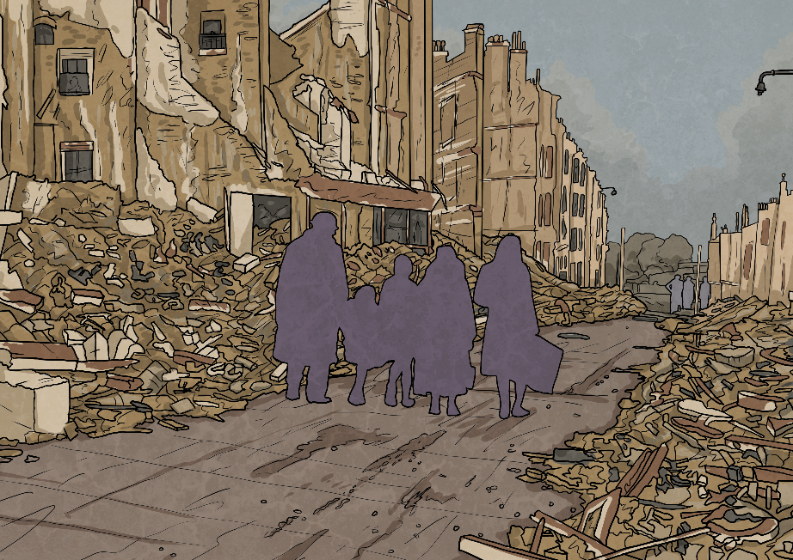
Question 10
What happened after the Clydebank Blitz?
Reveal Answer
Some workers quickly returned back to work to restore Clydebank’s homes and factories. Within a few weeks, factories were back to producing vast amounts of arms, munitions and battleships. However, some workers and residents never returned to Clydebank again.

