Slide 2
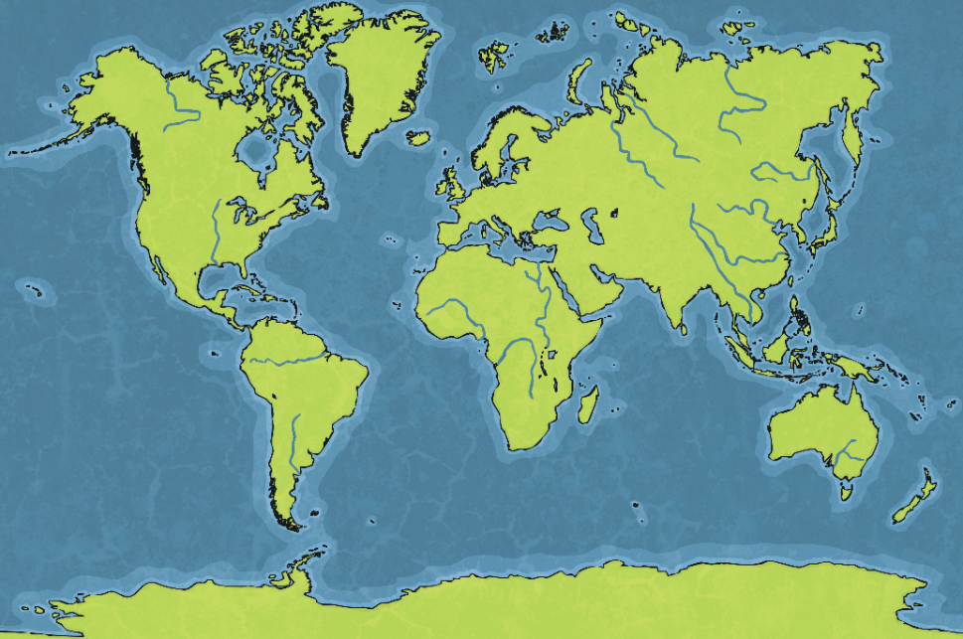
Second World War
The Second World War began in 1939 and finished in 1945.
The war was fought between two groups of countries.
Axis Powers
Germany
Italy
Japan
Allies
Britain
France
Australia
Canada
New Zealand
India
China
United States of America
USSR

Slide 3
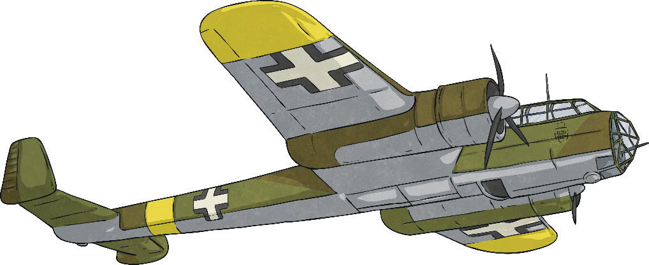
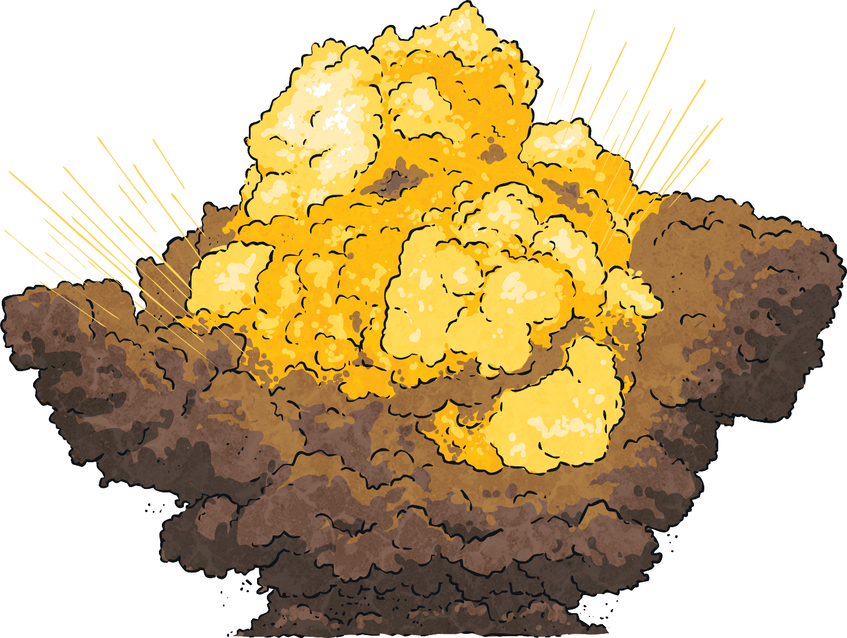
What Does Blitz Mean?
The word Blitz is short for the German word ‘Blitzkrieg’, which means ‘lightning war’.
From September 1940 until May 1941, Germany began air raids in which they bombed parts of Britain at night time. Each air raid usually targeted large towns and cities like London, Edinburgh and Clydebank.

Slide 4
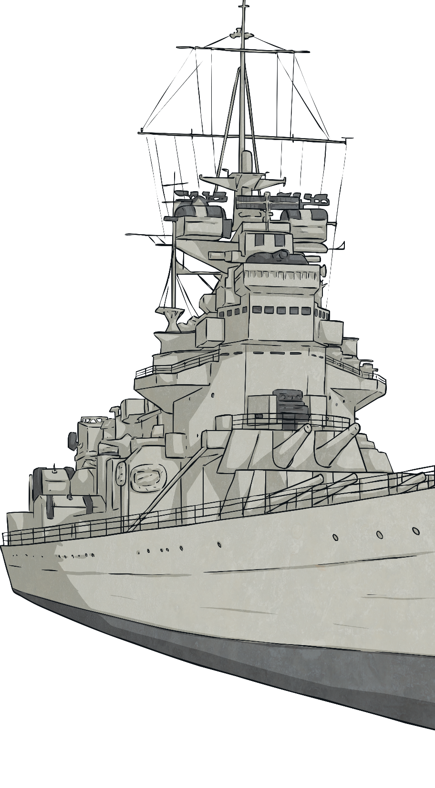
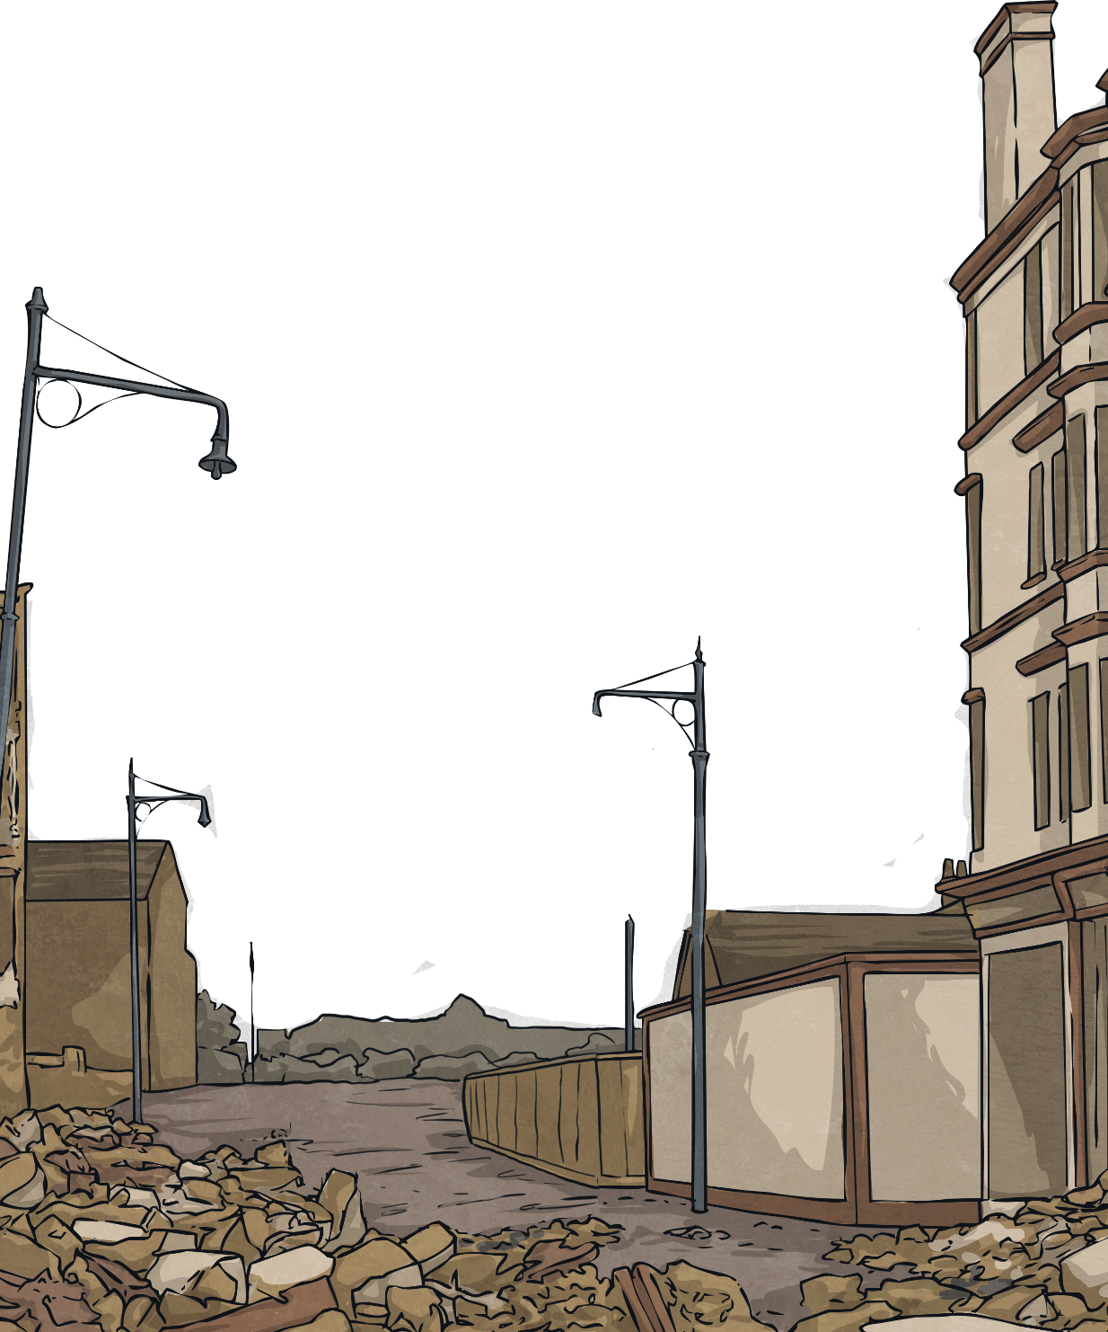
Why Were the Germans Bombing?
The Germans wanted to damage industrial areas, like factories and ports, so that it made it harder for the British to make or move weapons to fight them.
Adolf Hitler thought that if the people of Britain saw others being killed and that their country was being destroyed, they would give up and stop fighting them, allowing Germany to take control of their country.

Slide 5
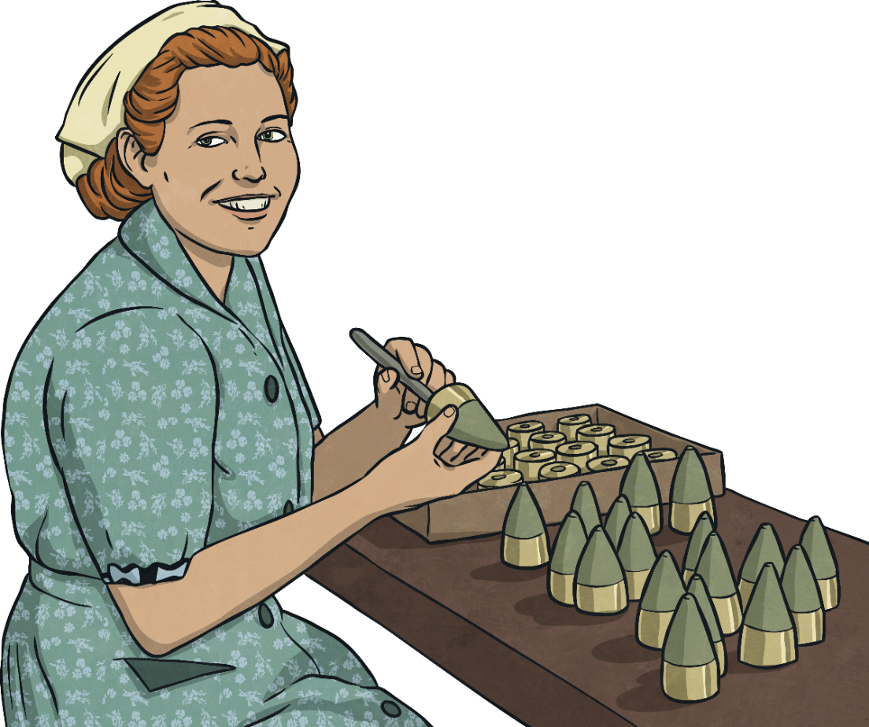
Clydebank
Clydebank was a main provider of arms, munitions and battleships and so was vital for Britain’s war effort.
So many arms, munitions and battleships were produced at Clydebank that the factories had to be open 24 hours a day, 7 days a week. This meant there had to be lots of workers who were able to work shifts.
Most people who lived in Clydebank at the time worked in the factories. With around 50 000 people living there, there were a lot of workers!
twinkl.com

Slide 6
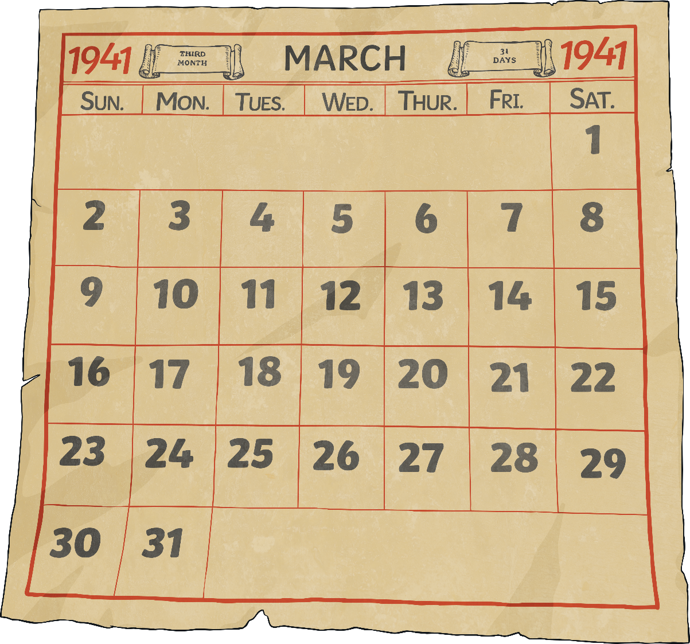
Clydebank Blitz
One of the most intense German bombings took place on the 13th and 14th March 1941. Clydebank was the target of these air raids.
Clydebank was a main target for a bomb strike as it played a vital part in the war effort by providing a vast number of arms, munitions and battleships.
Hitler thought that by destroying the factories and the workers homes, there would be a halt in production of munitions making Britain surrender and allow Germany to win the war.

Slide 7
Staying Safe
During the air raids, the people of Clydebank had several ways of staying safe.
One way was to try and prevent a Blitz. This meant trying to hide the towns and cities from the German pilots. As a Blitz would happen during the night, the only way the pilots knew where to drop bombs was to search for areas that had lots of lights.
Therefore, Britain had ‘blackouts’ to try and make towns and cities appear to the German bombers like the countryside so they wouldn’t drop the bombs.

Slide 8
Blackout
The government ordered that after dark, street lights must be turned off, cars had to have special headlamps and people had to cover their windows and doors to stop any light.
In Clydebank, this was very difficult as the factories continued working throughout the night.

Slide 9
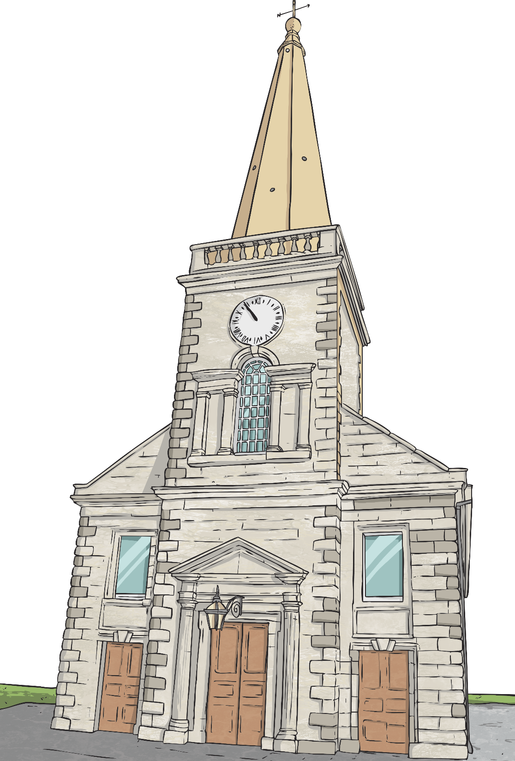
Shelters to Stay Safe
Even with the blackouts, German bombers could often find towns and cities.
When German bombers were seen approaching, air raid sirens would sound. As soon as the people of Clydebank heard these sirens they knew to seek shelter. Some people could not afford their own shelter or did not have the space for a shelter and so used communal shelters.
These could be:
churches
underground railways or subway stations
stairwells of tenement buildings
Air Raid Siren Sound File @ oragnefreesounds.com is licensed under CC 4.0

Slide 10
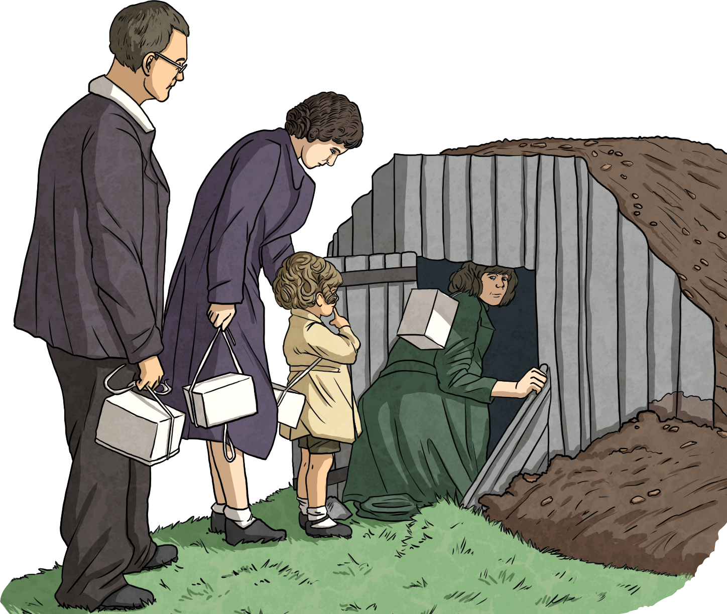
Anderson Shelter
Some people built Anderson shelters in their gardens. These were made from strong steel sheets with soil over the top. There would often be a bench inside where people could sleep and a small entrance at one end.

Slide 11
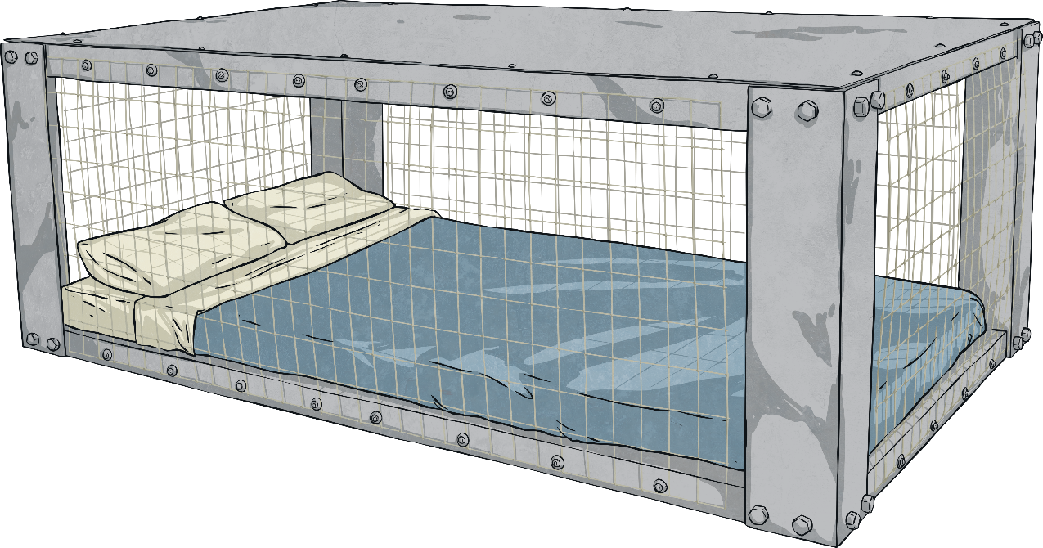
Morrison Shelter
From 1941 onwards, people could have a Morrison shelter which was kept indoors. It looked like a cage with steel mesh around the sides and a thick sheet of steel on the top. People would sleep inside it, although it was quite squashed.
The Morrison shelter was very strong and even if the ceiling collapsed above, usually the people inside would be safe.

Slide 12
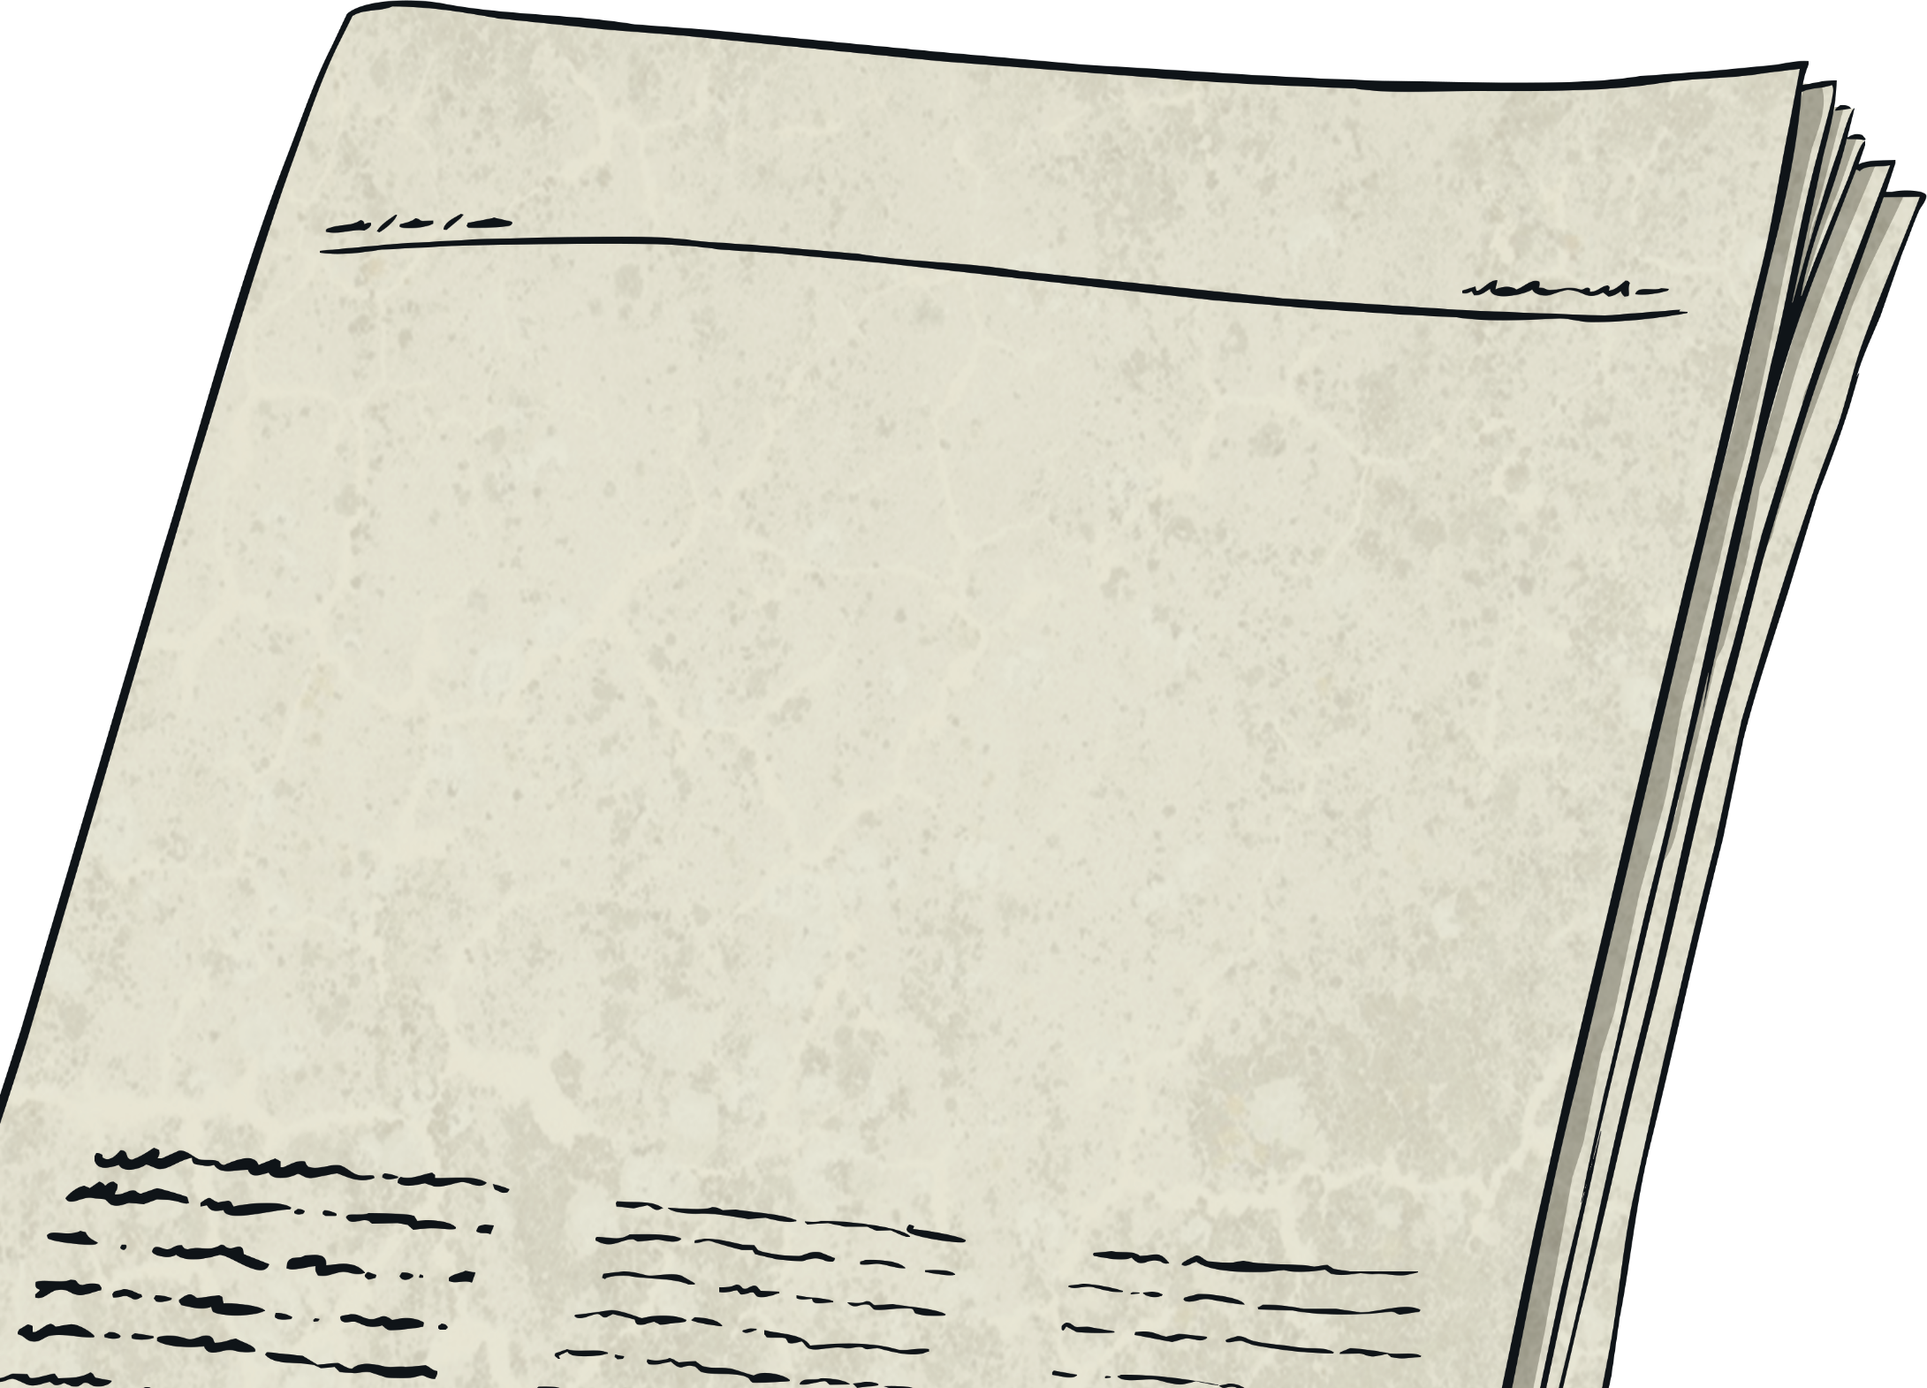
Destruction
Over the two nights, over 200 German bombers attacked Clydebank.
It is argued that it was the most destructive attack of the Second World War in Scotland.
The first night, 13th March 1941, German bombers targeted the factories to halt production.
On the second night, 14th March 1941, German bombers targeted the workers homes in the hope that they would flee Clydebank and not come back to work.

Slide 13
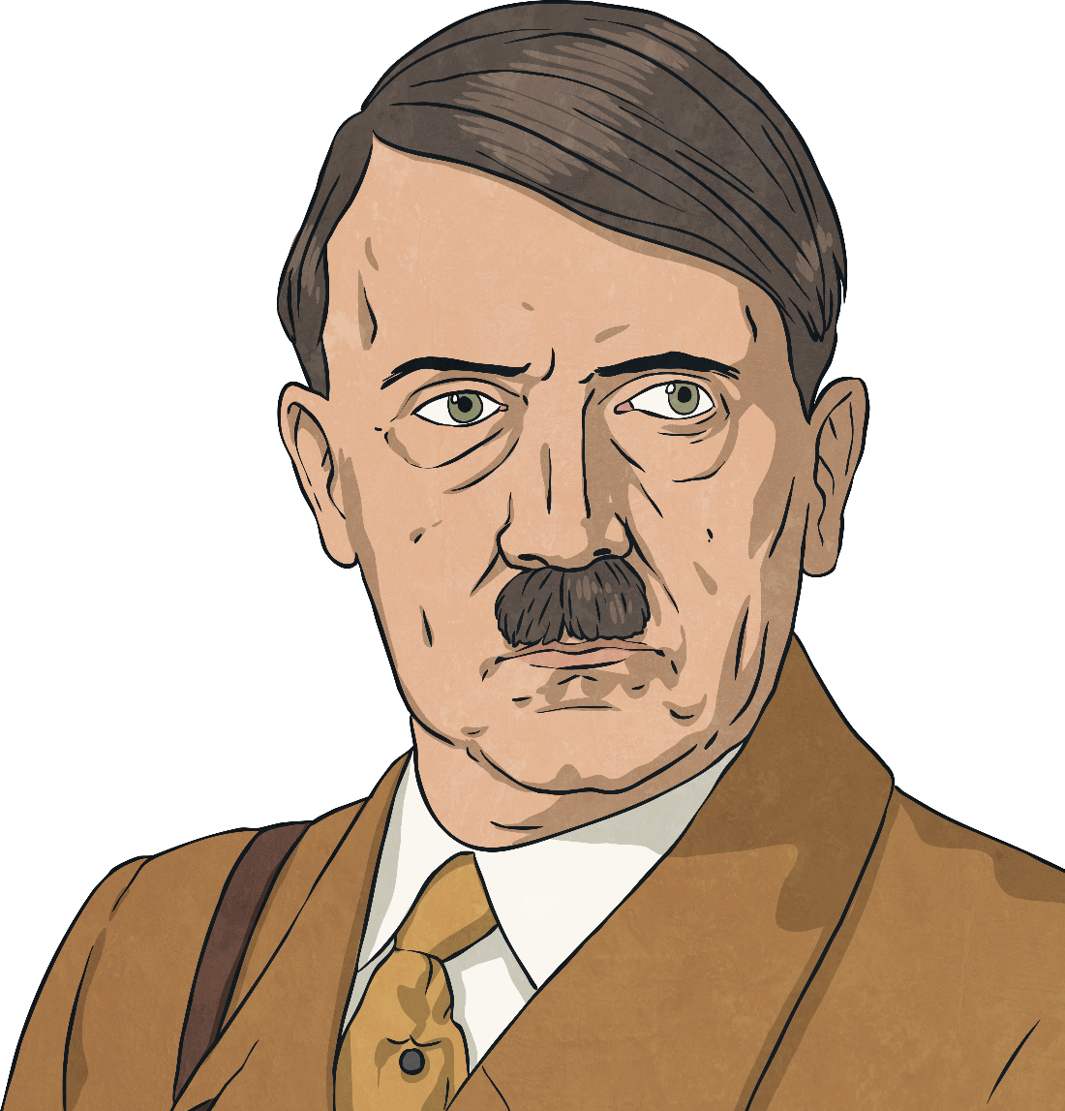
Destruction
This was a very successful attack by the Germans as out of 12 000 homes, less than ten homes were left undamaged.
Out of the 50 000 residents of Clydebank, only around 48 000 did flee Clydebank for safety.
Official records show a total death toll of 528 people from these air raids. However, many people dispute this number and argue the number was much higher.
Hitler’s plan had worked! The factories were destroyed and the workers left Clydebank meaning an instant stop in the production of munitions.
twinkl.com

Slide 14
After the Blitz
After negotiations with their bosses and the Government, workers quickly returned back to work to restore Clydebank.
Due to lack of housing, most workers had to stay in churches or bomb shelters.
Within weeks, factories were restored and production was back up at their normal rate!
Unfortunately for Hitler, he underestimated the sheer grit and determination of the Scottish workforce!

