Slide 1
Circles - Fractions
Wednesday 22nd April 2020

Slide 2
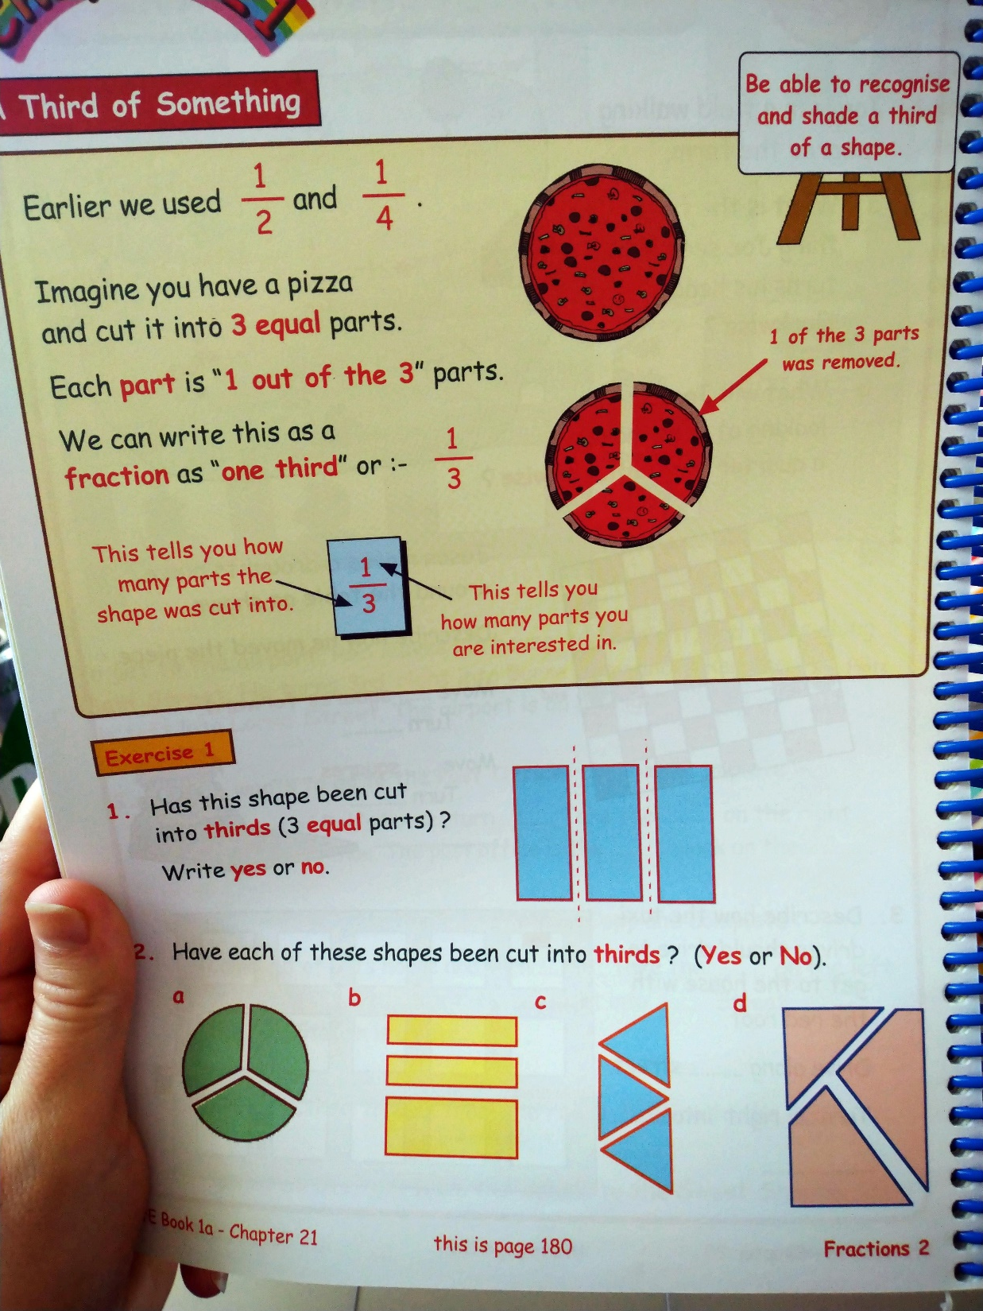

Slide 3
