Slide 1
Squares - Fractions
Tuesday 21st April 2020

Slide 2
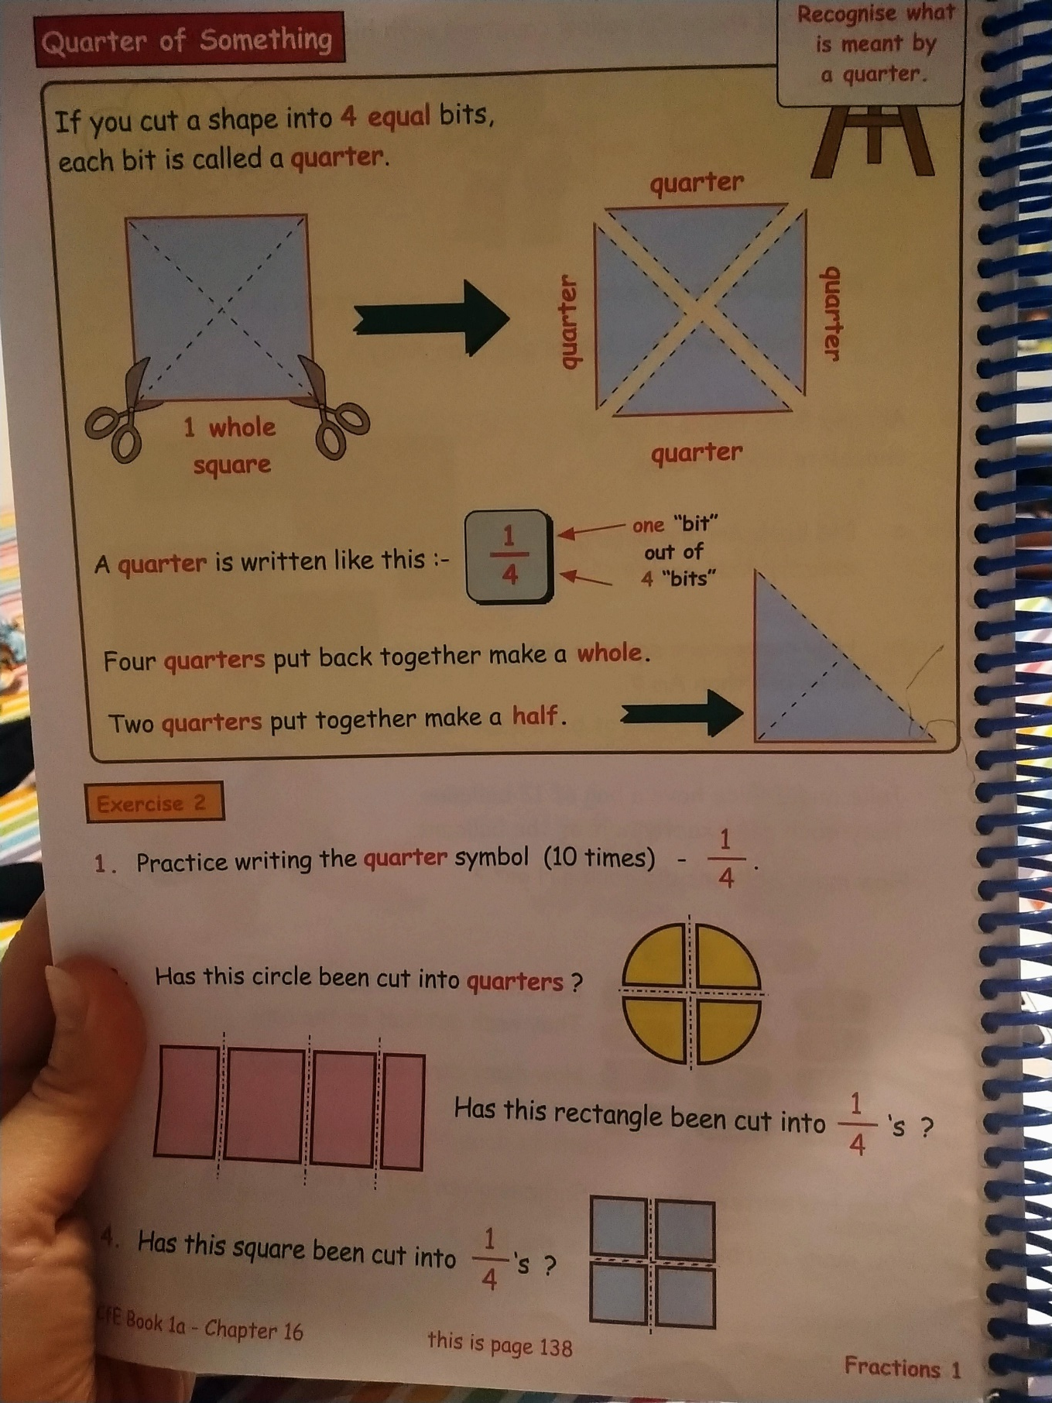

Slide 3
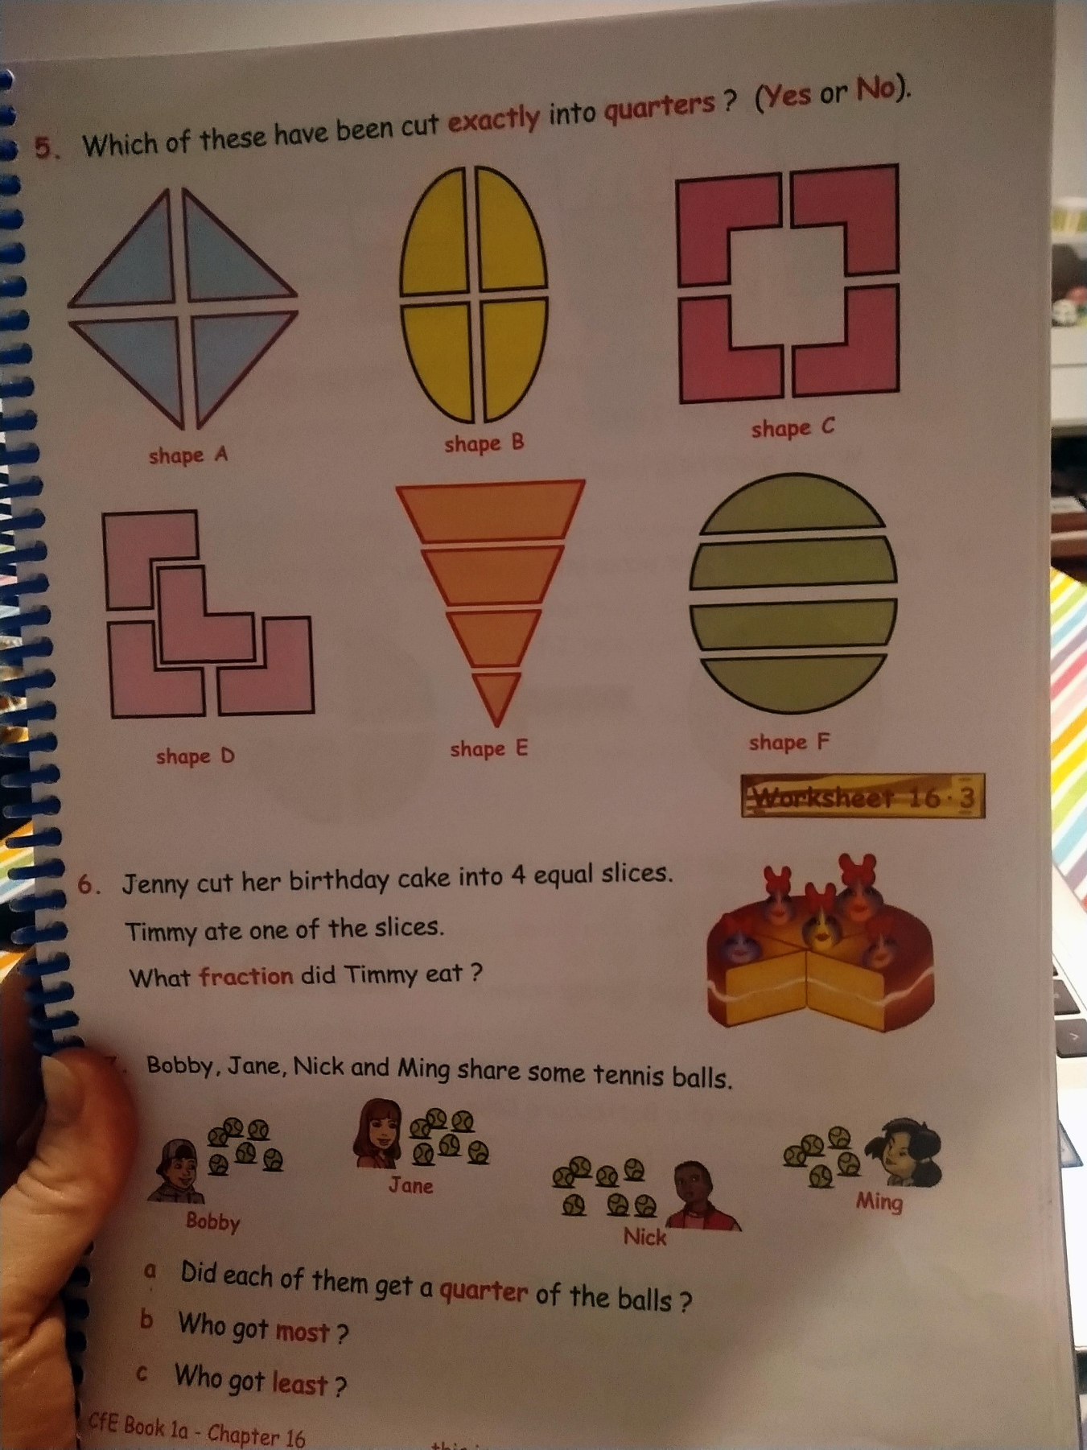

Slide 4
