Slide 1
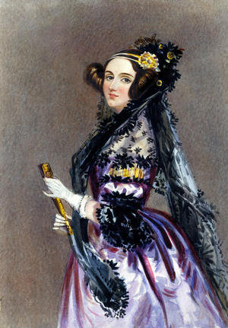
Super
Scientists
Ada Lovelace
First computer programmer
Notes:
Ada Lovelace was an incredibly talented mathematician and was the world’s first computer programmer.
Ada used maths to write the first set of instructions for a computer and had brand new ideas for what computers could be like in the future.
Today we are going to take a journey through her life to discover:
who Ada was
what she worked on
and why she changed the world.

Slide 2
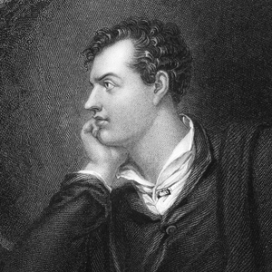
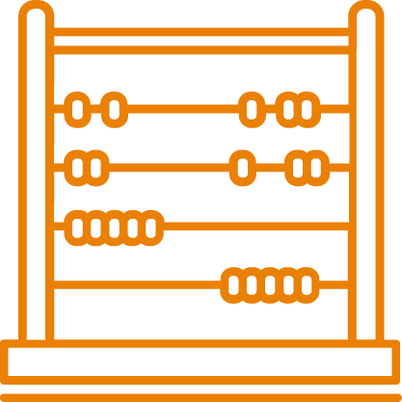
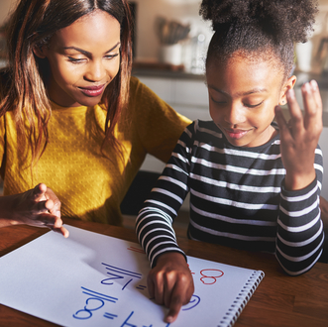
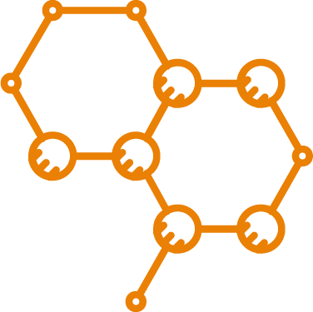

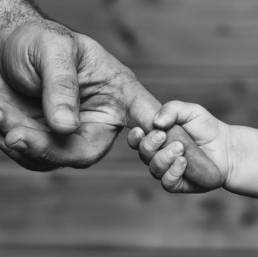

Ada studies maths and science
Born
10 December 1815
Ada’s father is the poet Lord Byron
She studies maths and science…
He leaves when she is a baby
…subjects not usually taught to girls at that time
Notes:
Ada was born on 10 December 1815 in London, England.
Her father was the moody but talented poet Lord Byron, who was famously labelled ‘mad, bad and dangerous to know’! Lord Byron wanted a son, and he was disappointed when Ada was born. When she was just a few months old her parents separated, and Lord Byron left England – Ada would never see him again.
Ada’s mother did not take a great interest in her daughter, but she was keen that Ada did not follow in her father’s footsteps and become a poet. Rich girls did not go to school in those days, so Ada’s mother hired a private tutor to teach her daughter maths and science – subjects which girls did not usually study, but ones her mother loved.
Q: How would you feel about having all your lessons at home?
Q: Which subjects would you want your tutor to spend the most time on?

Slide 3

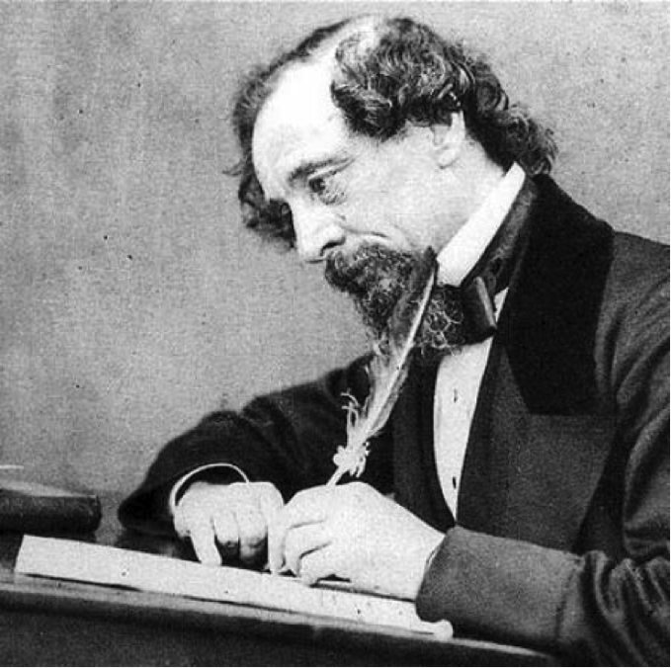

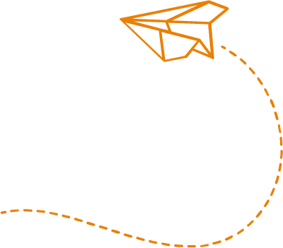
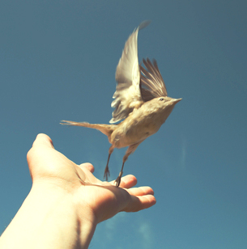


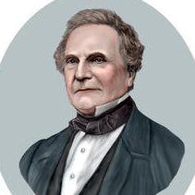


Ada discovers her passion
Ada designs a flying machine at 12
At 17 she meets famous people at dances…
…but they
don’t take her seriously because she is
a girl
Ada meets Charles Babbage…
…he realises her potential
Notes:
Ada did very well at her lessons and quickly realised she shared her mother’s passion for numbers.
One day, when she was 12, Ada was watching birds fly, and wondered whether a machine could be built to allow people to fly too. She tested different wing materials scientifically, studied bird anatomy and created a design for a steam-powered flying machine, over 70 years before planes would become a reality. This was her first taste of working with machines and she loved it.
At 17 she started going to dances and balls with other wealthy girls. There she mingled with many leading scientists and famous people, such as Michael Faraday, who worked on electromagnetism, and the author Charles Dickens (shown in the photograph above). Her brilliant mind and arrow-sharp wit quickly impressed them, but for a girl of her class, it wasn’t thought proper that she take her interests further.
However, that all changed when she was introduced to the mathematician and inventor Charles Babbage. Charles immediately saw Ada’s potential, and more importantly did not dismiss her just because she was a girl. It was Charles who would change Ada’s life forever.

Slide 4
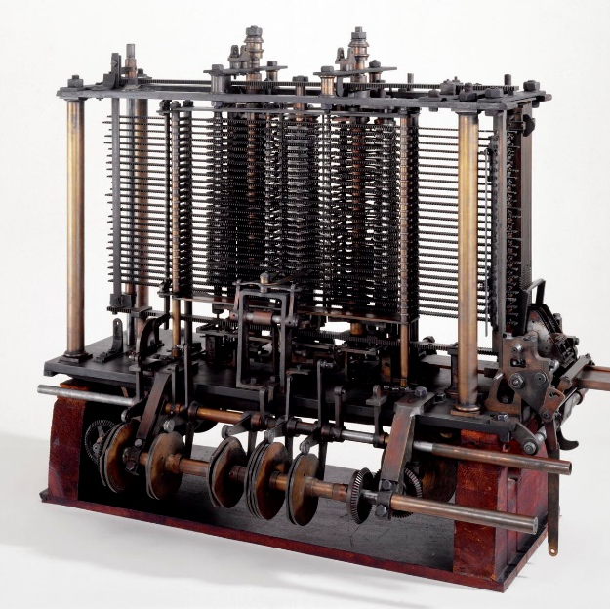
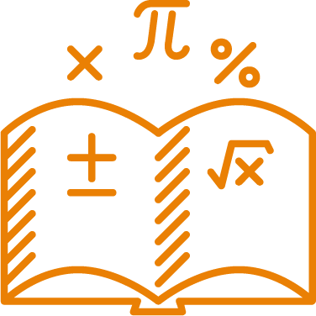
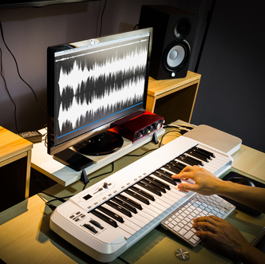
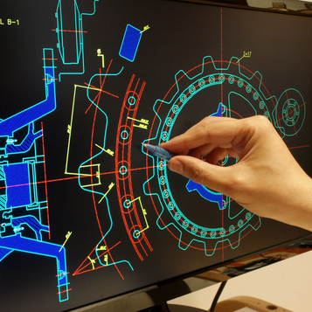
Ada designs a computer
Ada works
on the first computer
She writes the first computer algorithm
...for composing music
Ada realises
the potential of computers…
...and for drawing pictures
She
publishes her work but it gets little attention
Notes:
Charles asked Ada to help him with his big project - designing the Analytical Engine, a steam-powered machine which could solve maths calculations.
This machine would be as big as a room, made of brass and iron. Although it would look very different to our modern computers, it was the first step on the road to creating them. It would have some features we recognise today – like memory, a printer, and a way of giving the computer instructions – but it used a card with holes punched in it instead of a keyboard!
Ada was fascinated and soon became an expert on the machine. Her brilliance with numbers paid off when she noticed and corrected mistakes in Charles’ calculations. She also wrote out a fully complete set of instructions which could be given to the machine – we now call this a computer algorithm and is why Ada is called the first computer programmer.
Explain that a computer algorithm is a list of steps or a set of rules the computer follows to solve a problem – like a recipe for a meal.
If pupils have created their own algorithms, e.g. using Scratch, ask them to reflect on how it worked.
But perhaps more importantly, Ada realised the full potential of the computer to our future. She predicted that you could write instructions for a computer using symbols as well as numbers, so more detailed instructions could be given. This is something all modern computers use today.
She also realised that computers could be used for much more than just mathematical calculations – like composing music and drawing pictures. Unfortunately computers wouldn’t be able to do these things for 100 years!
Her ideas were published, but they received little attention until they were republished in 1953, as the digital age finally dawned.

Slide 5
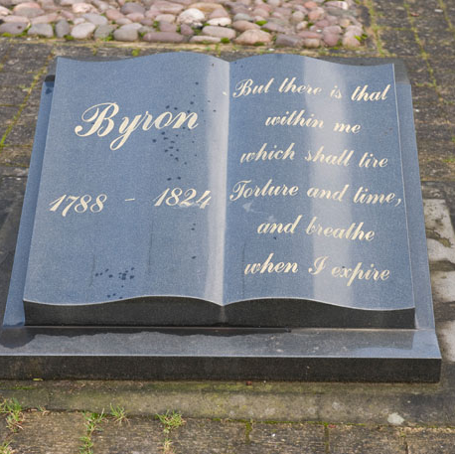
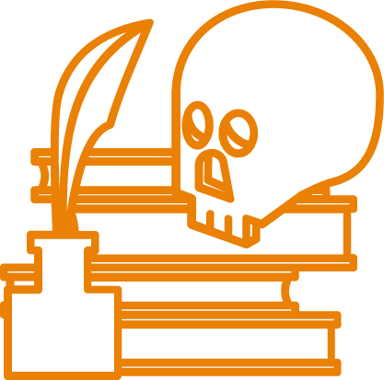
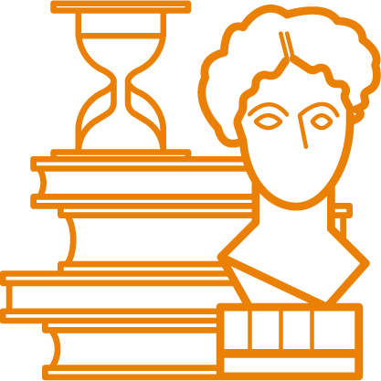
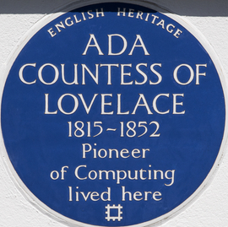
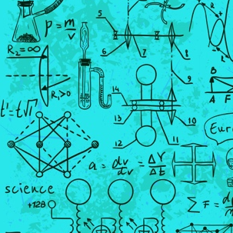

Ada isn’t recognised until long after her death
Ada spends
20 years working on
the machine
…and is buried next to her father
She dies in 1852 aged 36
Ada was
not recognised until the 1950s
Now she has
a computing language named after her
…and
her very own day
Notes:
Ada spent the next 20 years working with Charles improving the designs of the machine.
However, in 1852, Ada died. She was just 36 – the same age her father had been. They are now buried side by side.
Due to a lack of money, Ada and Charles’ great Analytical Engine was never built, but mathematicians today agree that the computer would have worked as predicted. Just imagine what the world would be like today if computers were built 100 years earlier!
Ada was not recognised for her amazing work until the 1950s, when the computers Ada imagined started to be built.
Today she is known and respected as the first computer programmer. She has a computer language named after her and even her own day dedicated to her.
Ada Lovelace Day is on the second Tuesday of October each year.

Slide 6
Super
Scientists
Ada Lovelace
First computer programmer
Find more resources about Ada Lovelace as well as other inspiring scientists at: www.bp.com/bpes/superscientists

