Slide 1
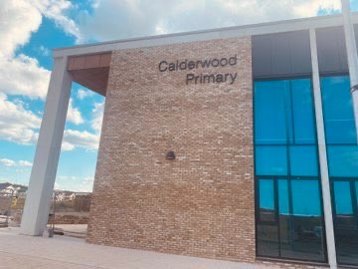


HALLOWEEN AT CALDERWOOD
Primary 1 -2 Parties

Slide 2

On Friday morning, I will be celebrating Halloween at Calderwood.
Different things will be happening in school to celebrate Halloween.

Slide 3
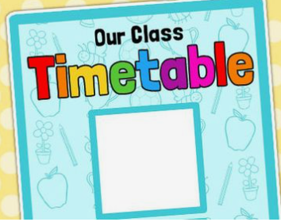
My Clan timetable for Friday will be different from usual.
I will probably do some fun Halloween activities with my Clan.

Slide 4



For Halloween, lots of children and adults will be wearing costumes.
A costume is different from normal clothes.

Slide 5
I can wear a costume if I want to.

Slide 6


If my costume makes me itchy or hot I can ask to take it off.

Slide 7
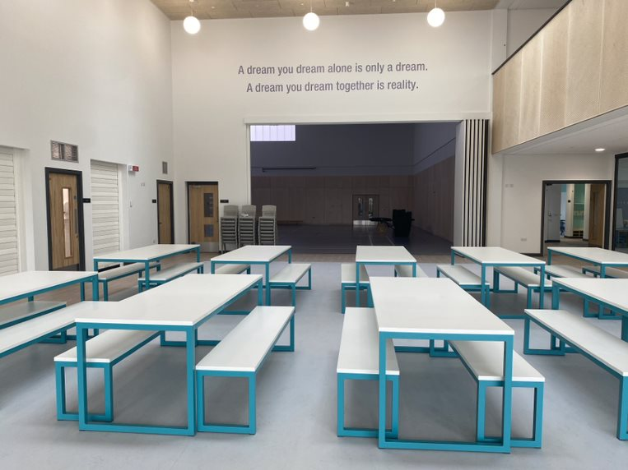

I will have a drink and a snack in the lunch hall with my Clan.

Slide 8
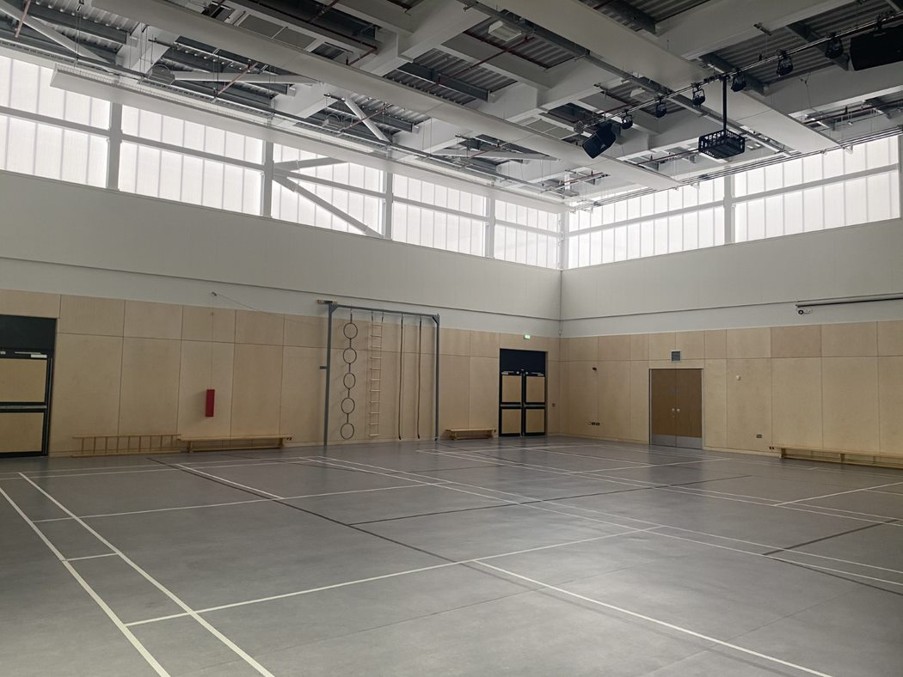
There will be a Halloween disco in the hall.

Slide 9



There will be loud music at the disco and lots of dancing.
The hall will probably be decorated for Halloween.

Slide 10

If I need some time in a quiet space, I can ask a Champion to help me.

Slide 11

At the end of the day I can tell everyone at home about my Halloween day in school.

