Slide 1
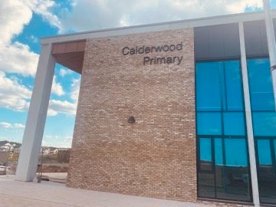


HALLOWEEN AT CALDERWOOD
Dress Down Day

Slide 2

On Friday morning, we will be celebrating Halloween at Calderwood.

Slide 3



For Halloween, lots of children and adults will be wearing costumes.
A costume is different from normal clothes.

Slide 4

I can wear a costume if I want to.
If my costume has a mask, I need to leave this at home.

Slide 5


If my costume makes me itchy or hot I can ask to take it off.

