Slide 1
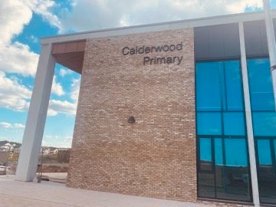

After the summer holidays, I will be starting Primary 7 at Calderwood Primary.

Slide 2
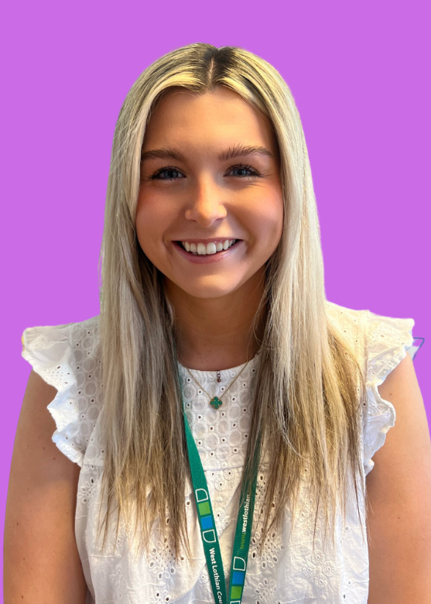
I will be in Mackintosh Clan (Primary 7).
My champion (teacher) is called Miss Kirkwood and this is what she looks like.

Slide 3
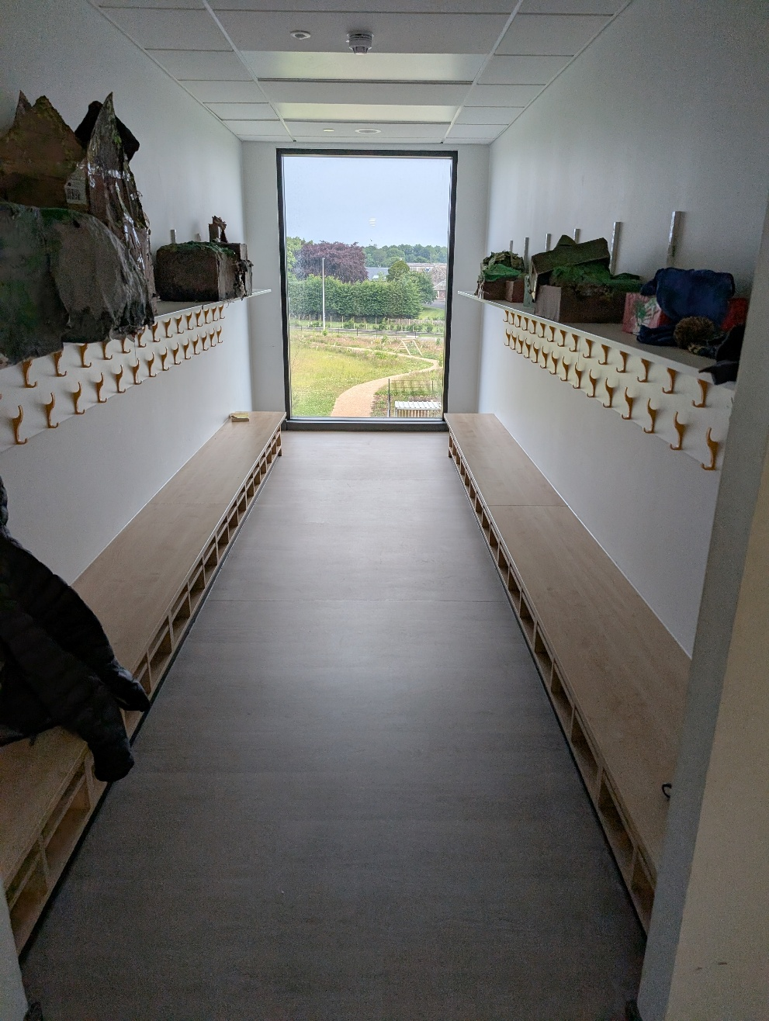
I will have a peg to hang my coat on.
It will probably have my name on it.

Slide 4

This will be my Mackintosh Clan room.

Slide 5
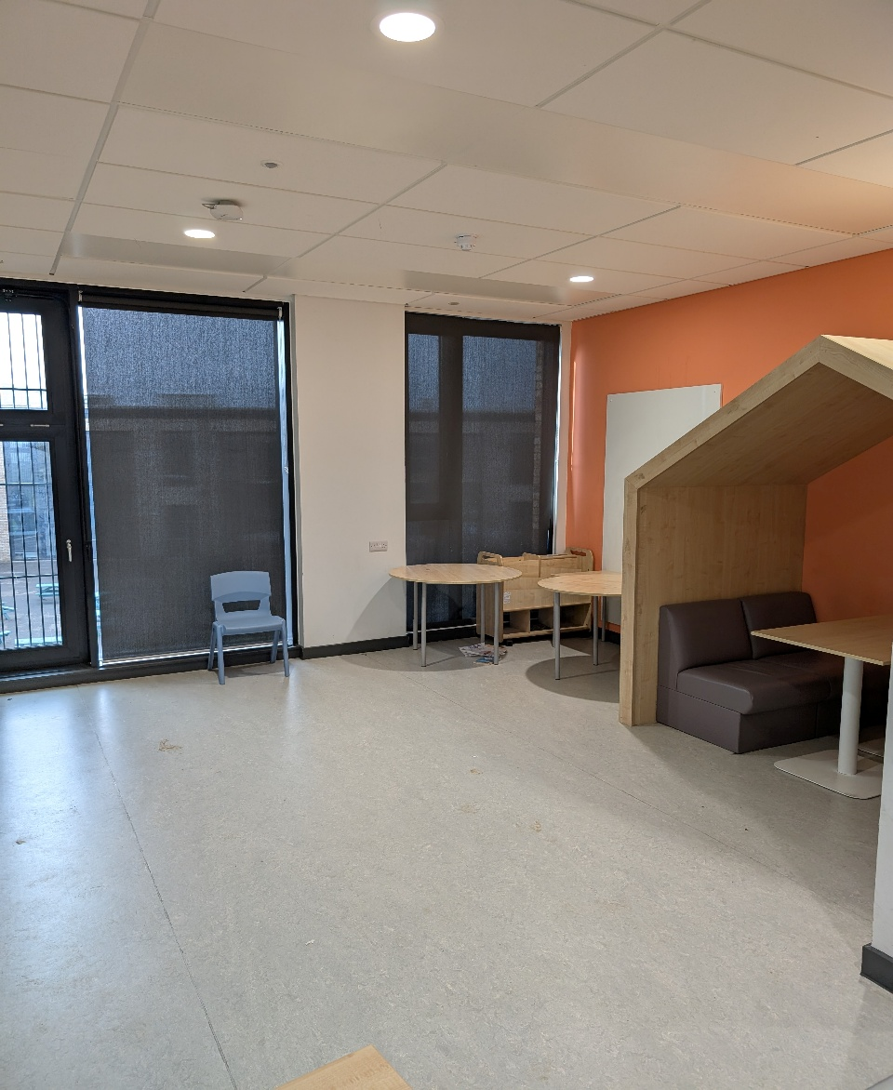
There are break out spaces for learning and quiet time.

Slide 6
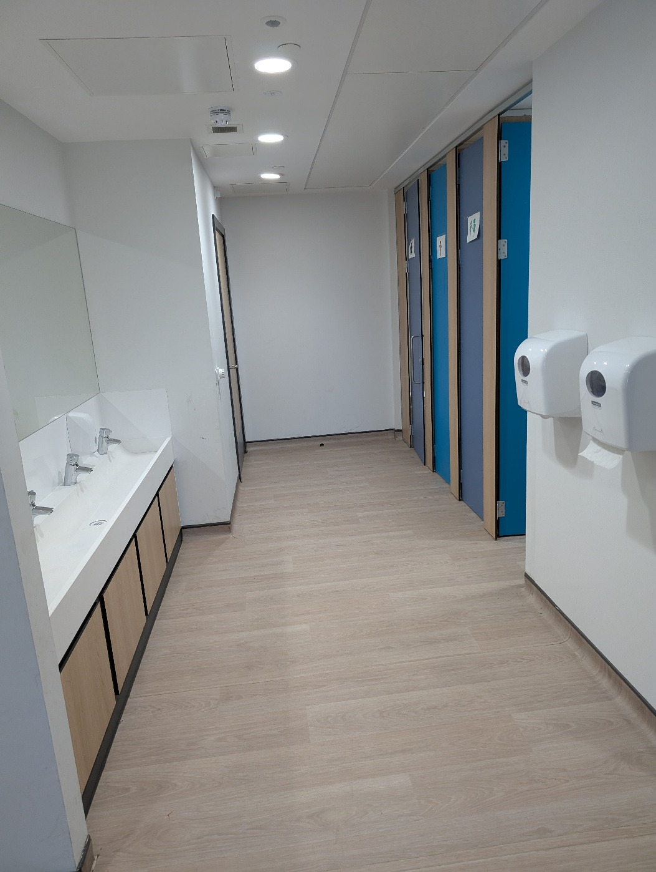
These are the toilets I will use.

Slide 7
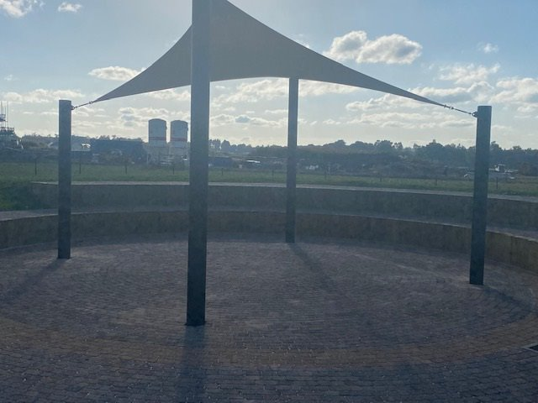
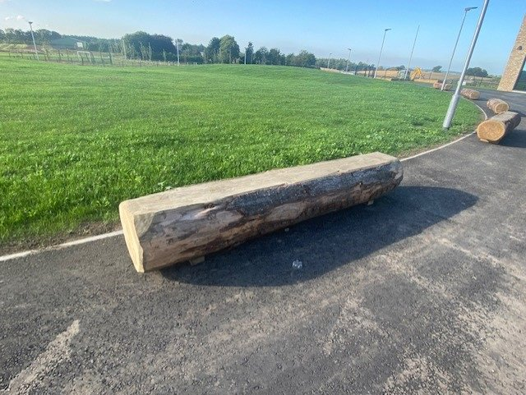
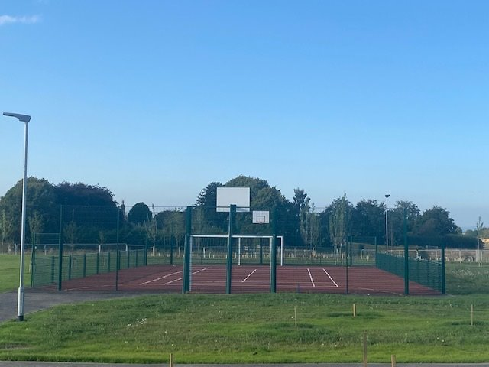
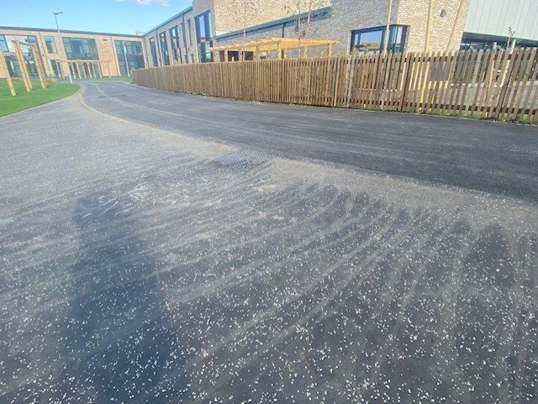
Most days I will probably go out to play. This is called playtime or break.

Slide 8
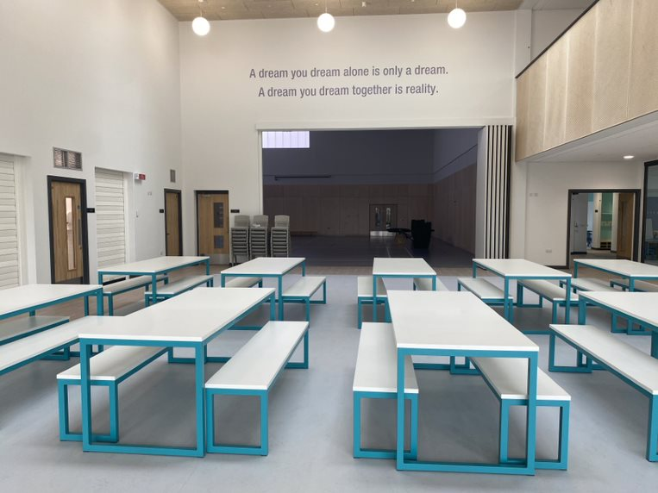
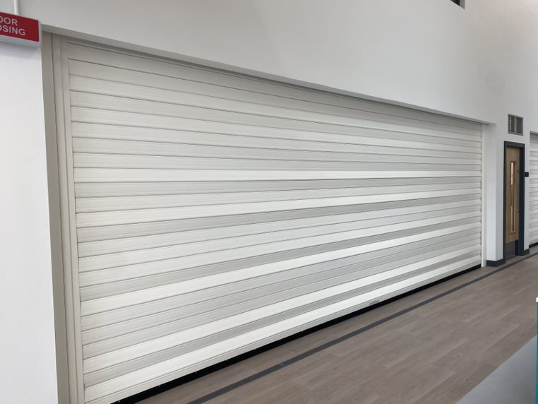
At lunchtime I will eat my lunch in the café.

Slide 9
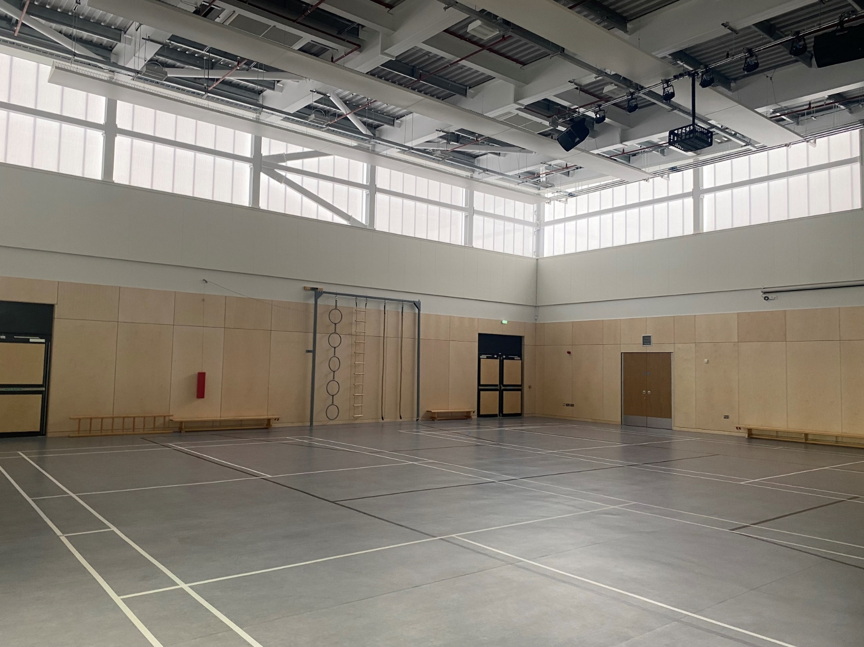
I will have indoor PE in the Arena on PE days.

Slide 10
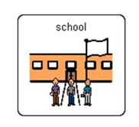





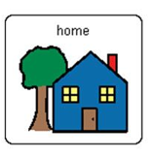
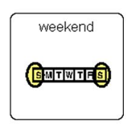


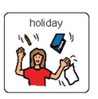
I will usually go to school on Mondays, Tuesday, Wednesdays, Thursdays, Fridays
I will usually be at home on the weekend – Saturday and Sunday
I will sometimes be on holiday

Slide 11


I will probably have a school bag to take to school
I can use it to take a snack to school and for carrying books

Slide 12
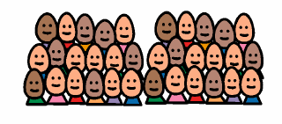
There are lots of children at school and in my clan.

Slide 13
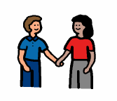
Going to school can be fun.
I might make some new friends.

Slide 14
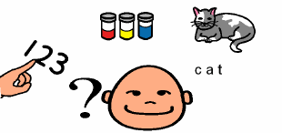
I will learn lots of new things.

Slide 15
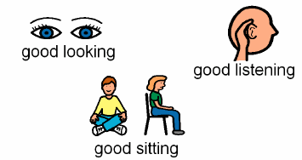
At school it is important to do…

Slide 16




At school it is important to use…
Kind words
Kind hands
Kind feet

Slide 17
My champion (teacher) is there to help me.
I can ask my teacher if I need help.

Slide 18

At the end of the day I can tell everyone at home about my day in school.

Slide 19

School can be fun!

