Slide 1
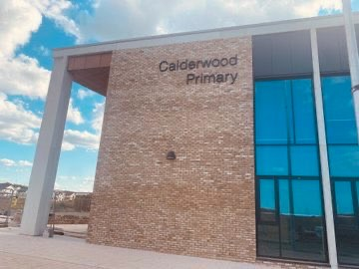
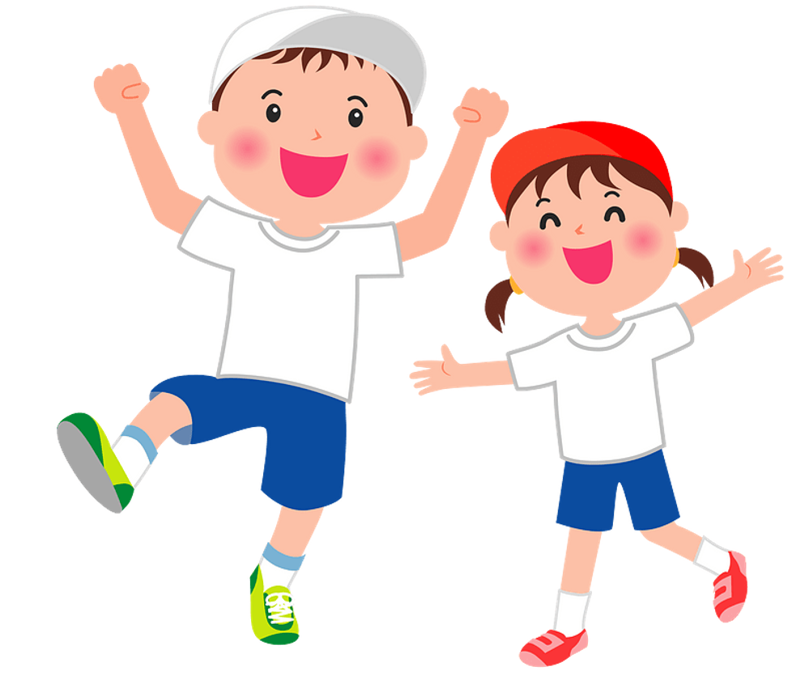

SPORTS DAY AT CALDERWOOD

Slide 2


On Wednesday afternoon, I will be attending Sports Day at Calderwood.
Different things will be happening during Sports Day.

Slide 3

My Clan timetable for Wednesday will be different from usual.

Slide 4

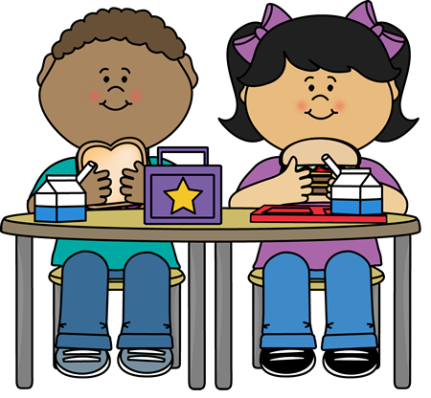
My Clan will have lunch at a different time so we can take part in Sports Day.

Slide 5
There will be different Sports happening in different places.
My Clan will be able to take part in all of them.
My Clan Champion or another adult will tell me which Sport I am doing First and then Next.

Slide 6
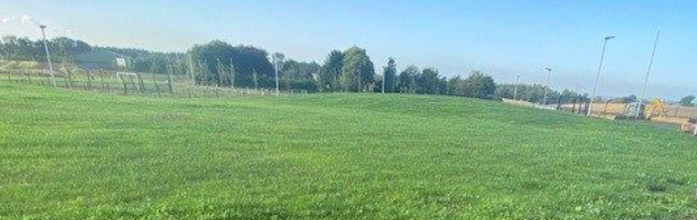

Games in the Field
During these games, people will be in teams. My teacher will tell me which team I am in. Some people might cheer when we are playing.
I don’t have to do an activity if I don’t want to.

Slide 7
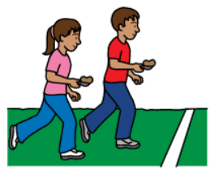

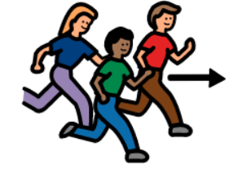
Races in the Field
My Clan will take part in three races. A running race for girls. A running race for boys. An egg and spoon race for everyone.

Slide 8

Not everyone can win at a Sports activity.
It is ok if I don’t win.
I can say ‘Well done!’ to the winners.

Slide 9
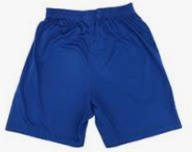
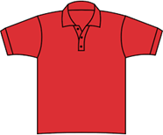




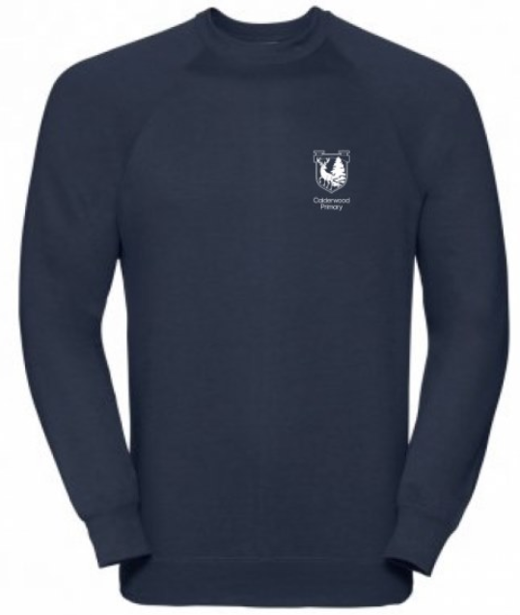
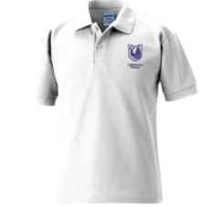

On Sports Day, my Clan and Calderwood Champions will be wearing PE clothes. PE tops will be House colours.
SIKA RED FALLOW ROE
PE clothes are different from Calderwood Couture.

Slide 10



I can wear PE clothes that I find comfortable.
SIKA RED FALLOW ROE

Slide 11

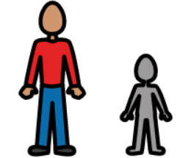
There will be lots of extra adults and families at Sports Day.
It will be very busy.

Slide 12



Some adults might use a microphone at Sports Day so that everyone can hear the announcements.
Other adults might use a whistle so we know when a Sports Activity is about to start or finish.
These voices or sounds might seem very loud .

Slide 13
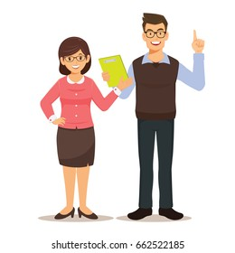
My Clan Champion and all of the other Champions will be there to help me.

Slide 14
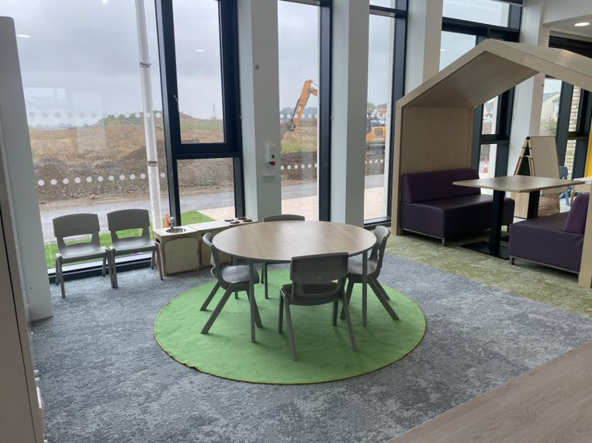

If I need some time in a quiet space, I can ask a Champion to help me.

Slide 15

At the end of the day I can tell everyone at home about Sports Day at Calderwood.

