Slide 1
Primary 1 at Calderwood Primary

Slide 2
—Miss Burton
“BEYOND THE DREAM!”

Slide 3
01
02
School Overview
Learning & Teaching
03
You Asked: We Answered
All things Calderwood!
Our playbased approach to learning & teaching in P1
Anything else you need to know!

Slide 4
01. School Overview
All things Calderwood

Slide 5
Calderwood Dictionary!
Clan – Class
Clanroom – Classroom
Champion – All staff working in school
Conga – lining up
Calderwood Cares – HWB
Calderwood Counts – Numeracy & Maths
Calderwood Communicates – Literacy & English
Creative Calderwood – Interdisciplinary Learning
All classes from P1-P7 are named after their clan room

Slide 6
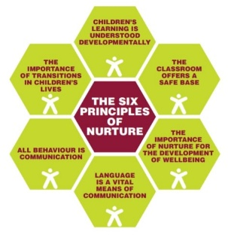
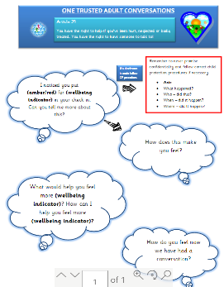
POSITIVE ETHOS
READY
RESPECTFUL
SAFE
For each term, draw a smiley face in each section of the wellbeing wheel to show your feelings.
Wellbeing check ins
Trusted
Champions

Slide 7
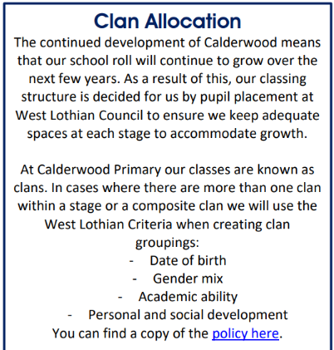
Clan Organisation
P1: mULL
P1: oRKNEY
P1: sHETLAND
P1: sKYE
P1: Bluebell
P2/1 Bramble

Slide 8
STRUCTURE OF THE DAY
Time
8.05am-8.25am | Breakfast Club
8.25am-8.40am | Safe Arrivals
8.40am | P1 and P2 Start
10.25am-10.40am | Break Time
10.45am-11am | Break Time
12noon-12.45pm | Lunch
12.45pm-1.30pm | Lunch
3.10pm | End of School Day (Mon-Thurs)
11.55am | End of School Day (Friday)

Slide 9
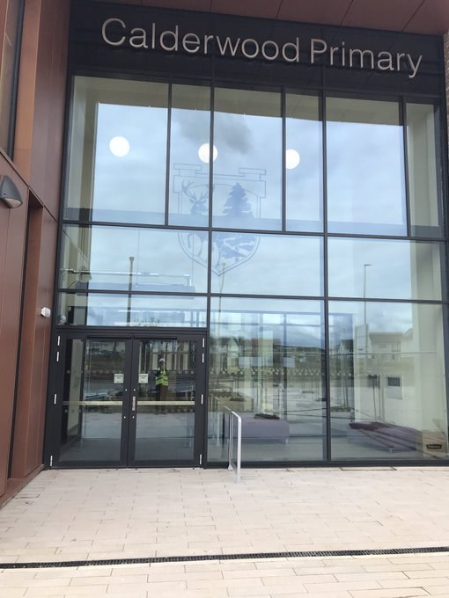
BREAKFAST CLUB
Opens - 8:05-8:25am.
No need to pre-book.
Enter through the side door and a register will be taken on arrival.
Children will be taken in to the playground at 8:25am.
We will open the Glencoe entrance at 8:05am, so children who have a bike or scooter can drop them off at the bike rack. They should dismount on at the gate.

Slide 10
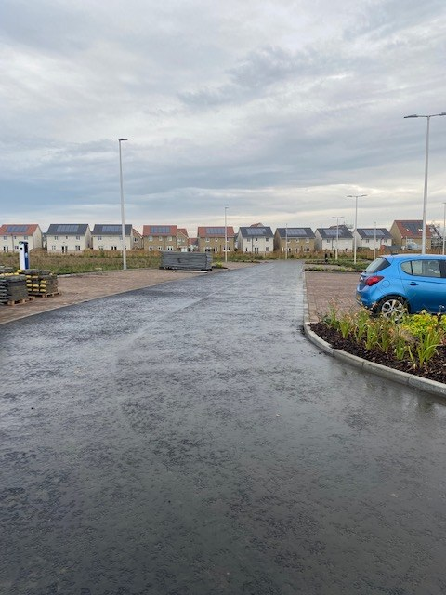
DROP OFF
We would encourage families to walk to school or park and walk.
The carpark at the school is for staff and visitors only.
If parents need to use this space in an emergency to drop off their children, they should use the first two lanes of spaces and walk their child over to the gate.
Children should not cross the car park on their own.
Please do not walk across the flowerbeds.
A one way system is operated in this area.
We would prefer you use the car park for drop, and not the road alongside the school as this can be busy with construction traffic.

Slide 11
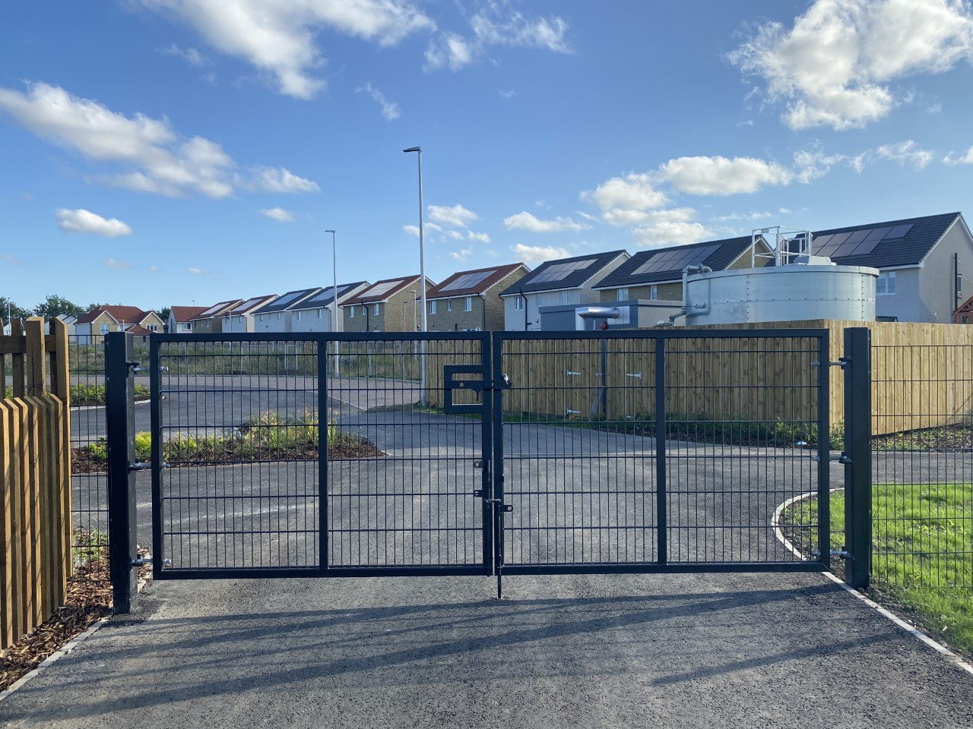
SAFE ARRIVALS
The playground will be open 8:25am-8:40am.
In unfavourable weather conditions children will access their clan rooms, they enter their clan rooms through the playground door (STEM studio door).
On these days parents/ carers can walk them into the playground.
Children enter through: Glencoe Entrance greeted by champions
Children have free play in playground – no entry for parents/carers – champions supervise
They should use the Glencoe Entrance if they want to leave their bike or scooter at the bike rack. They should dismount their bike/ scooter at the gate.
The gates will close at 8:40am, children who arrive after this time will need to access the school through the school office and will be recorded as late.
Glencoe Entrance

Slide 12
HOME TIME / PICK UP
Primary 1 - 3 children:
The gates will open at 3pm (Mon-Thurs) and at 11:45am (Fri), please do not enter the playground before then as clans may be using the outdoor facilities.
The adult can enter the playground to collect their child through the Glencoe Entrance.
No dogs in the playground please
P1 parent/ carers should wait in the designated area until they see their child.
The Champion will match the child to an adult. Please ensure your child knows who is picking them up.
Those who require an accessibility entrance should use Glencoe to enter and exit the playground.
Skye

Slide 13
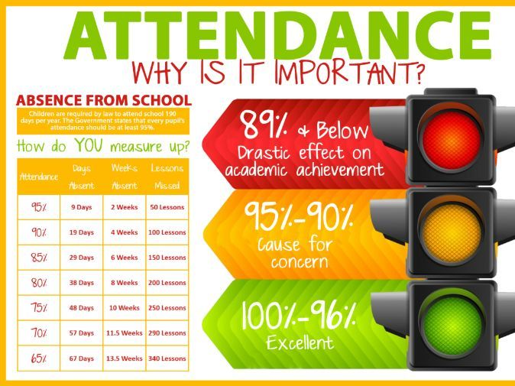
ATTENDANCE
Research shows that children with less than 95% attendance – impact on learning
Attendance & lateness is monitored monthly
If child unwell, telephone school and report absence by 9.00am
NHS Summary of Recommended Periods of Absence for Communicable Diseases
Safe Arrivals to School policy

Slide 14
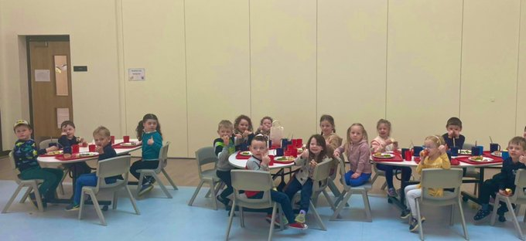
LUNCHTIME
School lunches are ordered daily through iPay impact – All P1-5 children are entitled to free school dinner
iPay log ins will be issued ASAP if you are new to Calderwood – until then your child can order within their clan
All iPay logins from Calderwood Nursery will continue on into their new clan
You can look at the lunches at home with your child and pre order your child’s lunch.
Three choices of meals daily: Red and Blue Trays are hot, cooked meals, the Green Tray is a Packed Lunch-type meal.
Children can bring their own packed lunches from home and eat them in the Café with their peers
Children going home for lunch must notify their teacher; sign in/out at office
Packed Lunches can be ordered on Fridays to
take home

Slide 15
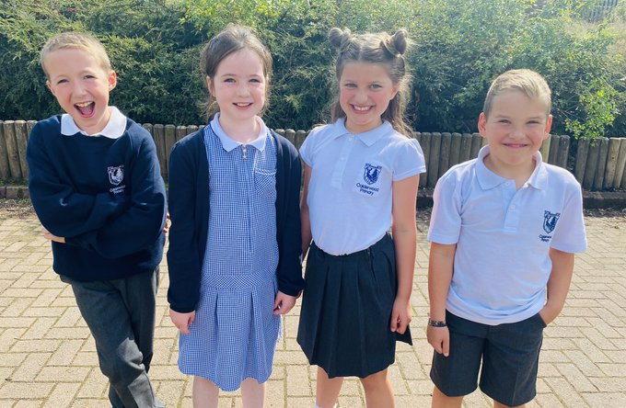
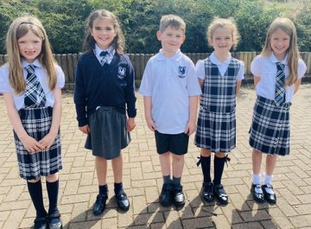
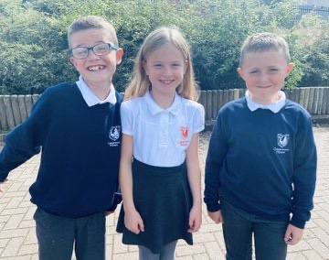
CALDERWOOD COUTURE
OPTION 1 – COMFORTABLE CASUAL
Navy sweatshirt or navy sweatshirt jumper with Calderwood logo
White polo shirt or white polo shirt with choice of colour for the Calderwood logo
Grey trousers, pinafore, skirt or shorts
White, navy or grey socks
Black school shoes
Outdoor shoes e.g. wellies/old trainers
Other options to compliment this style include:
Navy cardigan or navy cardigan with Calderwood logo
OPTION 2 – SHARP SET UP
White Shirt
Calderwood Tartan Tie
Grey trousers, pinafore, skirt or shorts
White, navy or grey socks
Black school shoes
Outdoor shoes e.g. wellies/old trainers
Other options to compliment this style include:
Navy cardigan or navy cardigan with Calderwood logo
Navy v-neck sweatshirt or navy v-neck sweatshirt with Calderwood logo
EXTRAS:
Navy and white gingham dress or navy and white gingham dress with Calderwood logo
Calderwood Tartan Pinafore
Calderwood Tartan Kilt
Calderwood Tartan Skirt
Calderwood Tartan Hair Scrunchie
ORDERING:
BORDER EMBRODIERIES & CASTINGS

Slide 16
CALDERWOOD COUTURE – P.E. DAYS
CHILDREN CAN WEAR THEIR P.E. UNIFORM TO SCHOOL ON P.E. DAYS…
The P.E. uniform on their two P.E days would consist of:
Navy sweatshirt or navy sweatshirt jumper with Calderwood logo
White polo shirt or white polo shirt with choice of colour for Calderwood logo; or plain white round neck t-shirt or white round neck t-shirt with Calderwood logo
Plain navy tracksuit bottoms or navy tracksuit bottoms with Calderwood logo; or navy shorts
Black trainers
Hooded tops are not part of our Calderwood Couture.

Slide 18
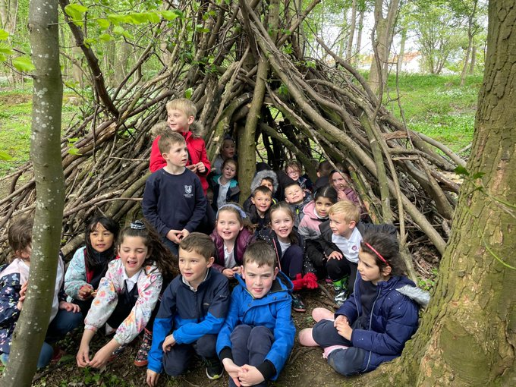
PHOTOS!
We are a very visible school who love to share the learning experiences of our children with our families and the community.
Please note:
photo permission is essential!

Slide 19
02. Learning & Teaching
Our play-based appraoch

Slide 20
What will your child be learning?
Children will build upon their learning in:
Literacy (Listening & Talking / Writing / Reading/ Languages)
Maths & Numeracy
Health & Wellbeing (HWB)
Interdisciplinary Learning (IDL)
Expressive Arts – Dance/Drama/Music/Art
Technologies
Science
Social Studies
RME
Termly Learning Letters will be available on the blog each term with a summary of learning.

Slide 21
—Whitebread, 2019
Play…
Play in all its rich variety is one of the highest achievements of the human species, alongside language, culture and technology. Indeed, without play, none of these other achievements would be possible. The value of play is increasingly recognised, by researchers and within the policy arena, for adults as well as children, as the evidence mounts of its relationship with intellectual achievement and emotional well-being”.

Slide 22
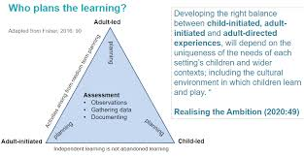
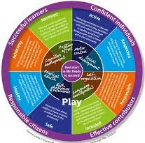
PLAY-BASED LEARNING & TEACHING OUR VALUES
Relationships based on mutual respect at all levels
01
03
Empowerment which offers freedom with guidance
Promoting Curiosity and Creativity with a flexible and responsive approach
Engaging with nature and bringing the outdoors in
02
04
Creating Connectedness and Community

Slide 23
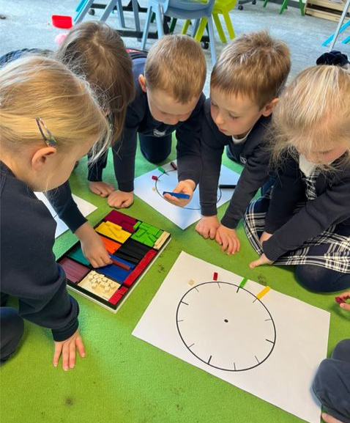
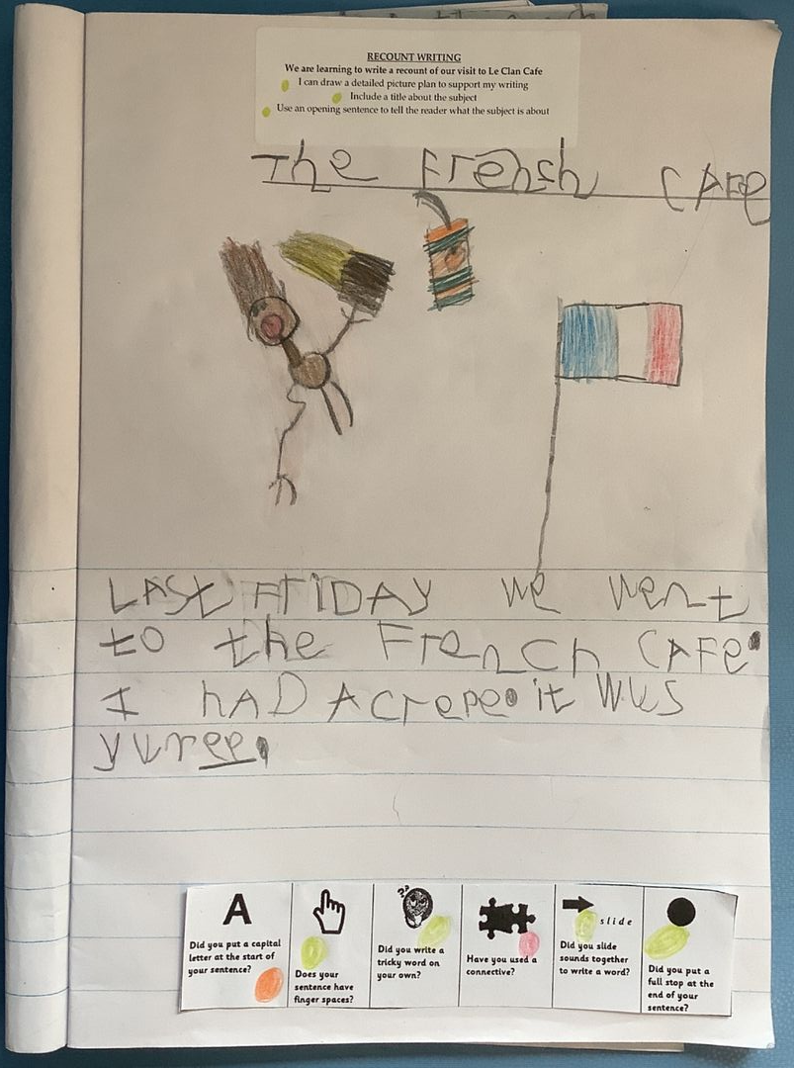
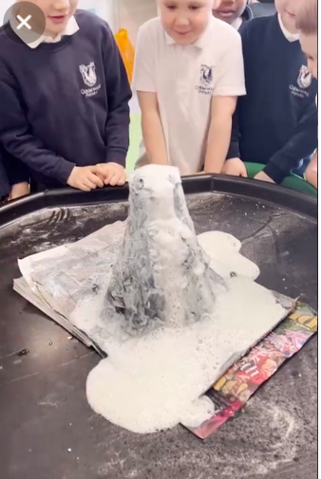
STRUCTURE OF P1 DAY
Adult-lead
learning:
Adult-initiated
learning:
Child led
learning:
Champions focus children’s thinking
Champions ignite children’s
thinking
Champions follow children’s
thinking
the champion sets up a starting point, invitation, provocation or stimulus with planned intentions and then stands back to wait, watch and wonder. Children engage independently until the adult joins to observe, interact or enhance learning.
the champion sets up a starting point, invitation, provocation or stimulus with planned intentions and then stands back to wait, watch and wonder. Children engage independently until the adult joins to observe, interact or enhance learning.
Children have daily opportunities for free flow play. Resources, experiences and outcomes are freely chosen by the child and are under the control of the child. This may or may not involve direct interaction with the adult.
MON-THURS | RCCT DAYS | FRI
Stag Start
Whole class session (e.g. literacy)
Targeted learning groups
Child Led Learning
Stag Start
Calderwood Connects
Child Led opportunities
Snack and story
Whole class session (e.g. numeracy)
Targeted learning groups
Child Led Learning
1 x per week
2 ½ hours with another teacher
(e.g. STEM, P.E.)
Snack & Story
Whole Class Session (IDL, HWB)
Targeted learning groups
Whole class session (e.g. IDL, HWB)
Outdoor/indoor play

Slide 25
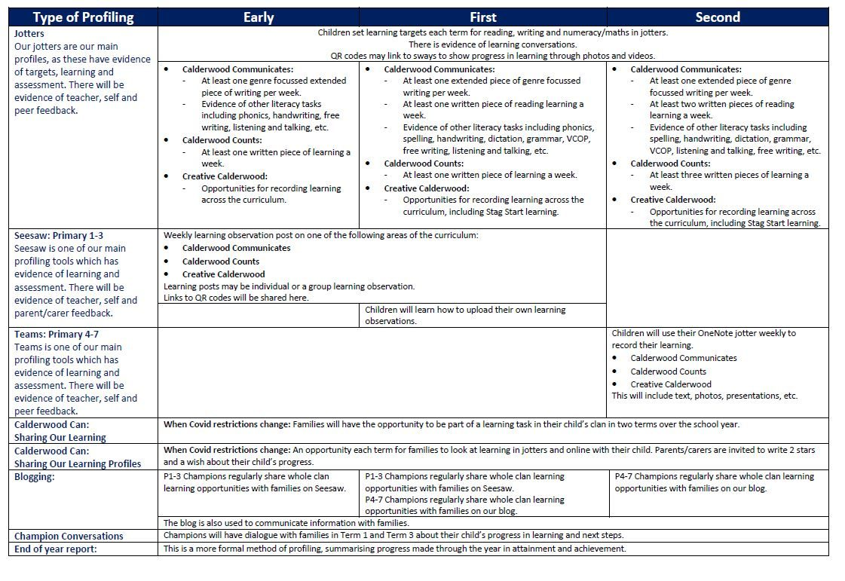

Slide 26
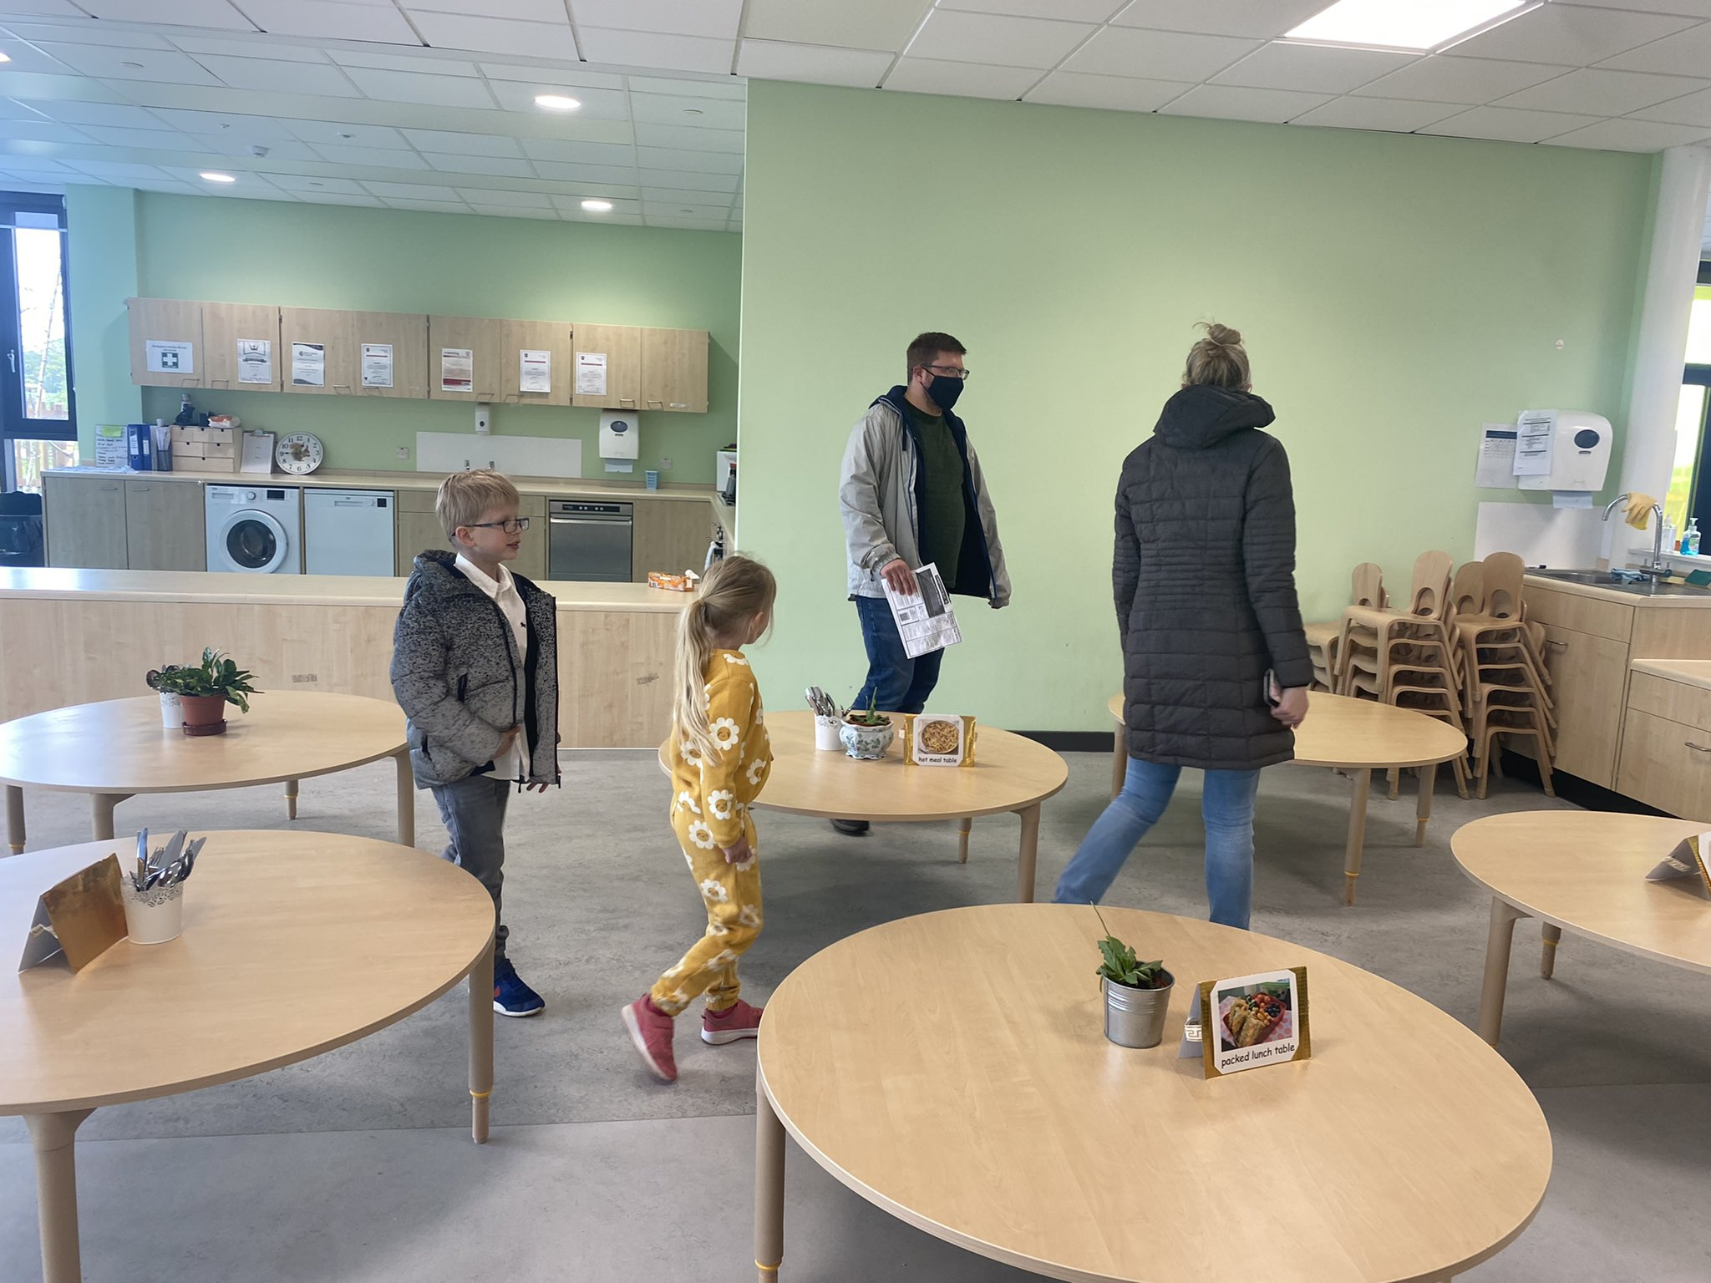
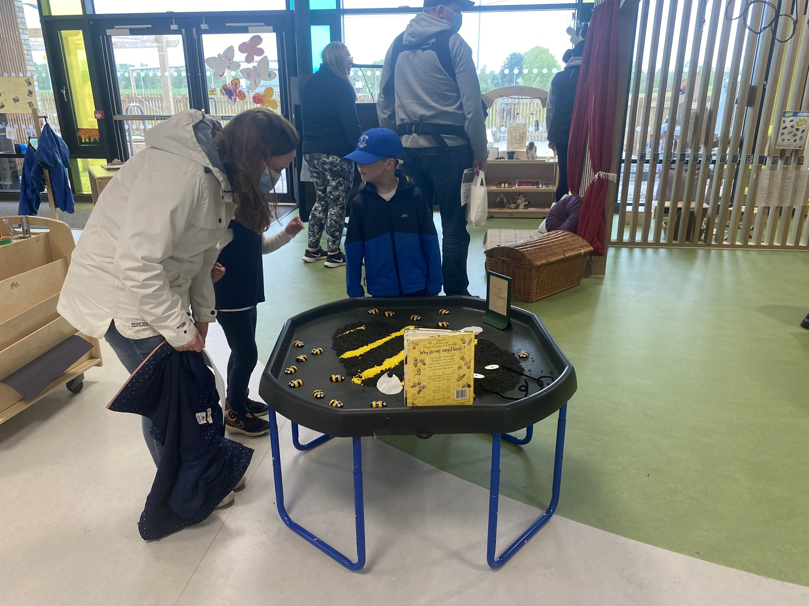
PARENT PARTICIPATION
Parent/Teacher Meetings – twice a school year
School Report at the end of the school year
Assemblies- Calderwood Connects
Termly Learning Overview
Open Afternoons
Curriculum Evenings
Volunteering – (PVG Check)
‘Parents as Partners’ meetings and events

Slide 27
PARENT PARTICIPATION
Parent Forum
Parent Council
Appoints the Parent Council
Must be parents/ carers with a child in the school
Must represent views of parents at the school
All parents and carers of children in the school
News/ info of activities
Invite/ involve in activities
Seek opinion on issues
Listen to all views: represent fairly and equally
Purpose and activity types set out in Constitution
Has the right to decide on the PC constitution – at an AGM or EGM
Headteacher has a right and duty to attend meetings
Parent Council meeting attendance open to all members of the Parent Forum
Clan Reps
Parent Council sets agenda – cannot take up individual parents’ issues
Parents aligned to each clan to support clear communication between parents and the school
Contact: calderwoodpspc@gmail.com More info: www.connect.scot

Slide 28
HOME LEARNING
Learning Grid
Reading
Tricky Words
Challenge based activities you can choose at home!
Weekly reading books/blending practise
Activities to practise tricky words

Slide 29
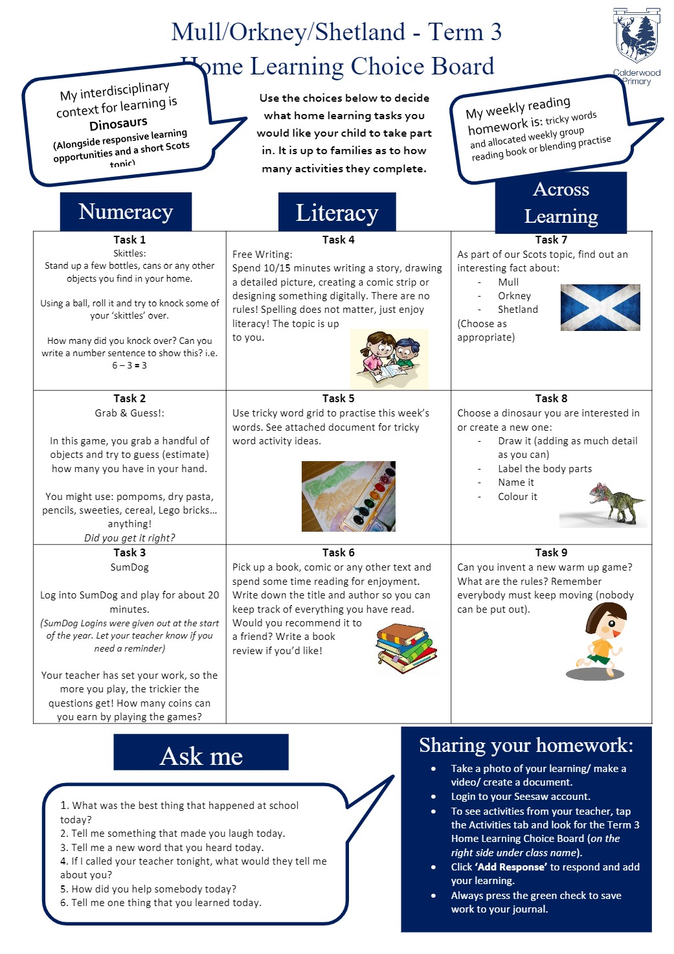
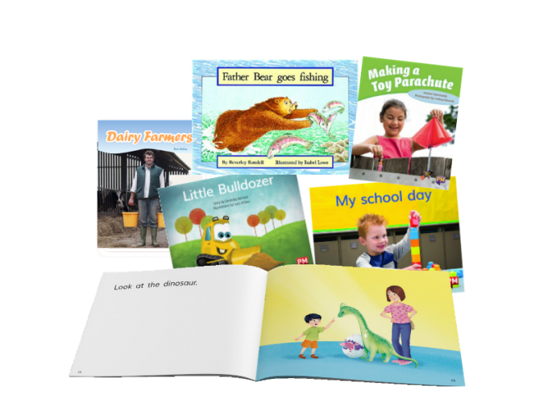
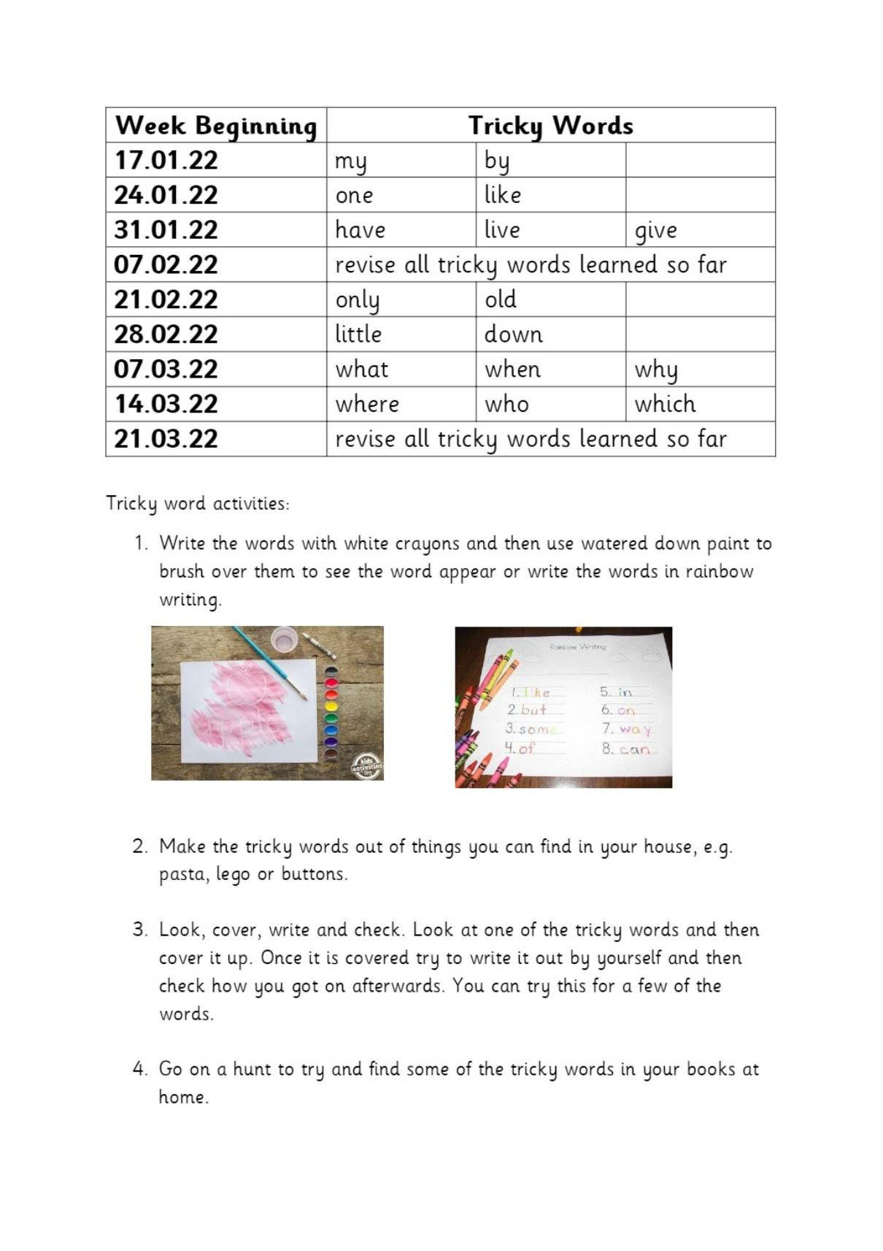

Slide 30
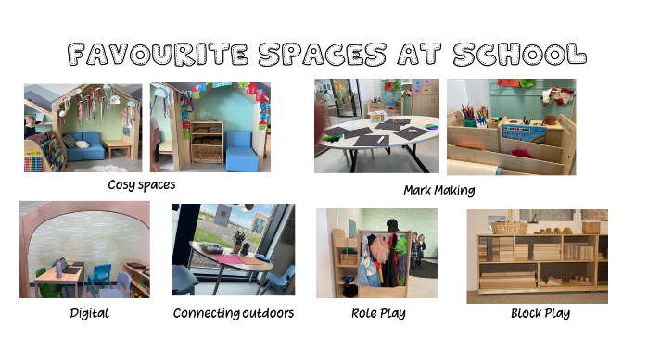
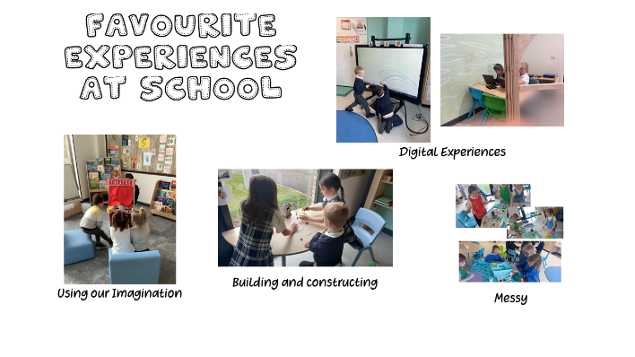
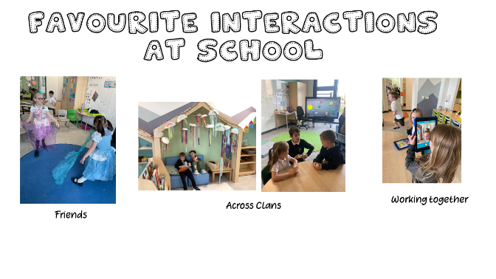
THE LEARNING ENVIRONMENT
SPACES
EXPERIENCES
INTERACTIONS
INDOORS
OUTDOORS
SKILLS FOR LEARNING & LIFE
RELATIONSHIPS
REASONING
CREATIVITY
PROBLEM SOLVING
SELF-REGULATION
RESPONSIVE
RISK TAKING
OPEN-ENDED
CHOICE
CHANGING
Children have choice of:
Multiple clans and spaces
Social interactions across the year group
A wide range of resources and open-ended materials
NEGOTIATION
CHILD’S INTEREST
responsive and intentional planning

Slide 31
What do you need to do?
COMPLETE
ORGANISE
SUPPORT
Complete the digital forms on the Welcome Letter
EE2, Medical, Photo permission
Provide emergency contact details (please update us if this information changes)
Label all uniform, jackets shoes, bags, waterbottles and clothing
Support your child with their transition
Read the social story
Take a walk by the school
Practice skills- putting on jacket, own shoes, unpacking or packing a school bag.

Slide 32
03. You Asked: We Answered

Slide 33
You Asked: We Answered
You Asked | We Answered
Pickups for multiple children Pick Up/Drop Off | Pick up P1 first and collect from other areas in the school routine information.
Break Out Spaces and how accessed | Learning Environment
Expectation of 1st Week | Blog Post: 1st week in P1
Communications | Communication @ Calderwood
Day in the Life of | Structure of P1 Day
Breakfast Club/ After School Clubs | Breakfast Club After school clubs - champions Jets/Simply Play
Homework | Home Learning – 3 aspects, Home Learning Grid, Reading, Tricky Words
Class Structure and Location | Clan Organisation Tour
Skills for Summer | What do you need to do: Support
Language in school and behaviour | Calderwood Dictionary and Positive Ethos
Notes:
Ellie Rose Quin

