Slide 1
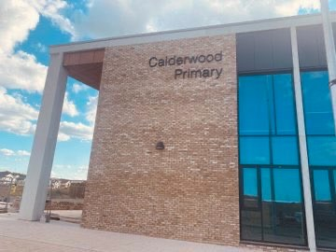
OUR CHRISTMAS SHOW AT CALDERWOOD

Slide 2
At Calderwood, P1 always perform a Christmas show for everyone to watch in December.

Slide 3
Our show this year is called
READY STEADY ELVES!
It is a lovely story.

Slide 4
In a Christmas Show, everyone has a special job.
Some pupils have
speaking parts.
Some pupils have
acting parts.
EVERYONE will sing the wonderful Show Songs and do the actions too!

Slide 5
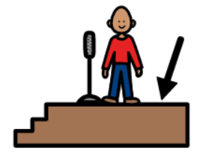
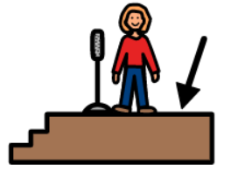
Mull and Orkney Clans, Skye and Shetland, Ness and Linlithgow clans will be performing READY STEADY ELVES! together.
This means they will all be on the stage at the same time.

Slide 6
Most days, clans will be practising their speaking and acting parts.
We will also be practising our Show Songs so we can sing
them beautifully!

Slide 7
Our champions will help us remember what it is we have to do.

Slide 8
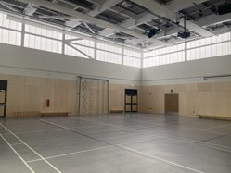
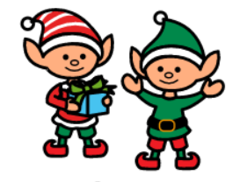
We will perform in the Arena.
There are lots of different characters in our Christmas Show.
We will wear costumes so the audience know which character parts we have.

Slide 9
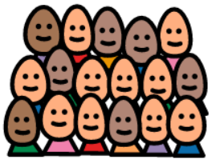
We will have a practice performance for all the Calderwood Clans.
Our parents and families will come to watch us perform our Christmas Show.
There will be morning and afternoon performances.

Slide 10
Our audience will be very excited to see us perform, especially after all of our hard work!

Slide 11
When it is over, I can tell everyone how much fun I had performing in our Christmas Show!

