Slide 1
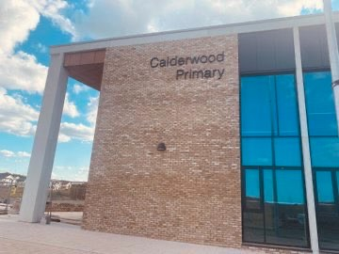
Our Families Coming to Calderwood.

Slide 2
On Wednesday afternoon, some of our clans will have their families visiting them.
On Thursday afternoon, the other clans will have their families visiting them.

Slide 3
They are coming to meet our Champions and find out about life in our Calderwood Clans!

Slide 4
There will be more people than normal in our school.
The school might feel quite busy and noisy.

Slide 5
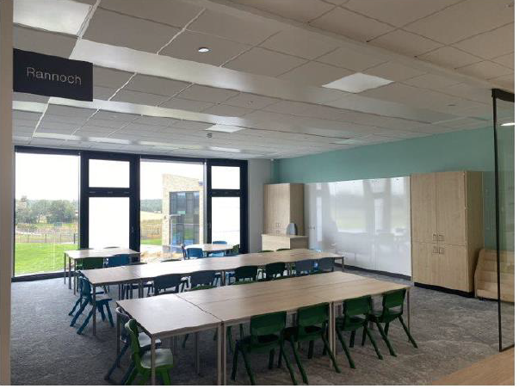
Our families will come into your clans to share in your learning.

Slide 6
Our families will love seeing how ready, respectful and safe Calderwood is.

