Slide 1
Digital Skills in the Bens
Using GLOW

Slide 2
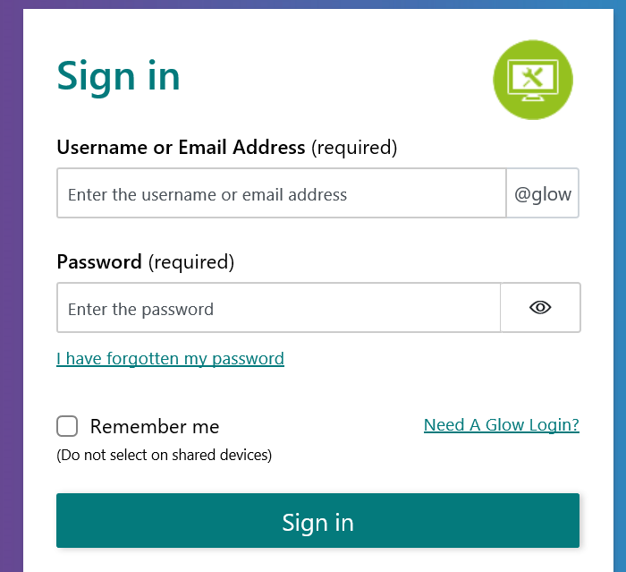
Logging In
GO TO…
https://glow.rmunify.com/
Enter your GLOW login
(if you can’t access it you can share with a friend today)

Slide 3
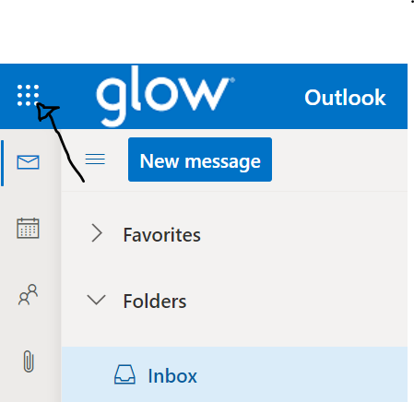
Using your waffle
Click on Outlook then your Waffle

Slide 4
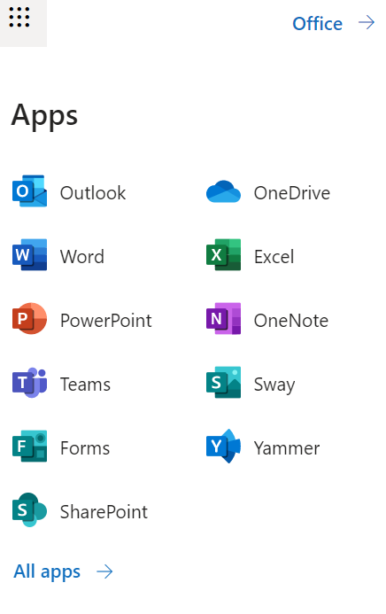
Explore…

Slide 5
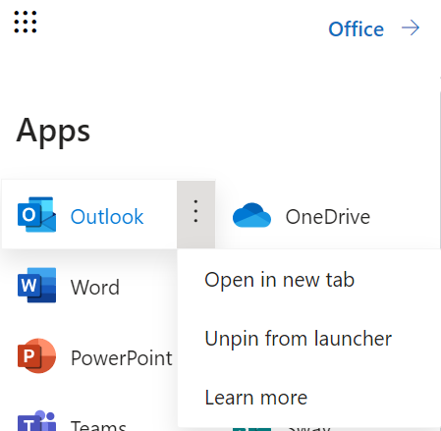
CHALLENGE!
Hover on Outlook and click the 3 dots then open in a new tab

Slide 6
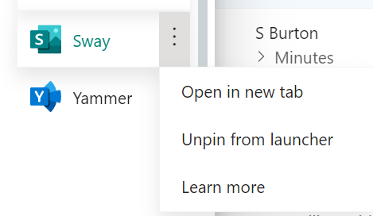
BACK TO THE WAFFLE
Hover over 3 dots
and click open in
new tab
Click on PowerPoint

Slide 7
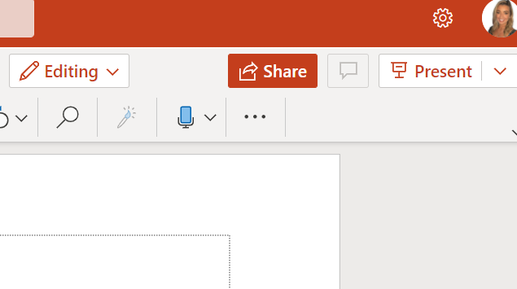
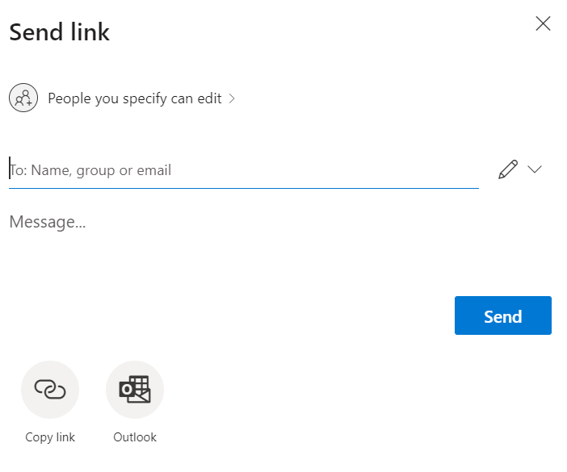
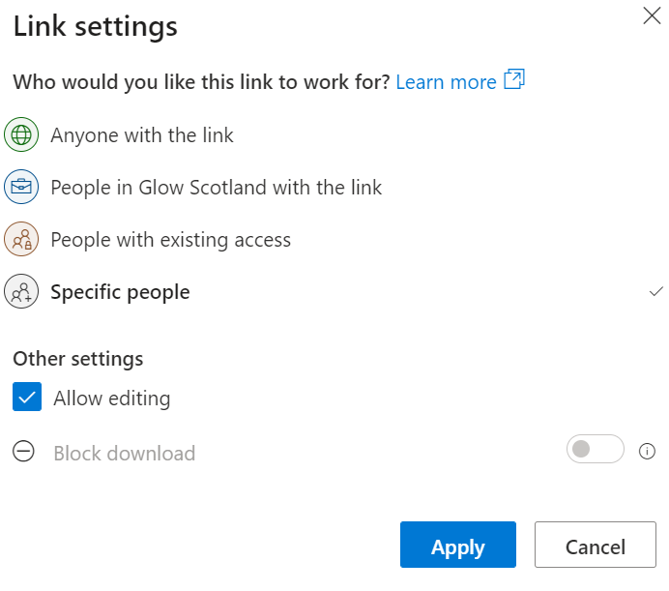
Collaborating on a PowerPoint
STEP 1: One person from your group create a new PPT
STEP 2: Click Share
STEP 3: Click this
And change to People in Glow
STEP 4: Click apply

Slide 8
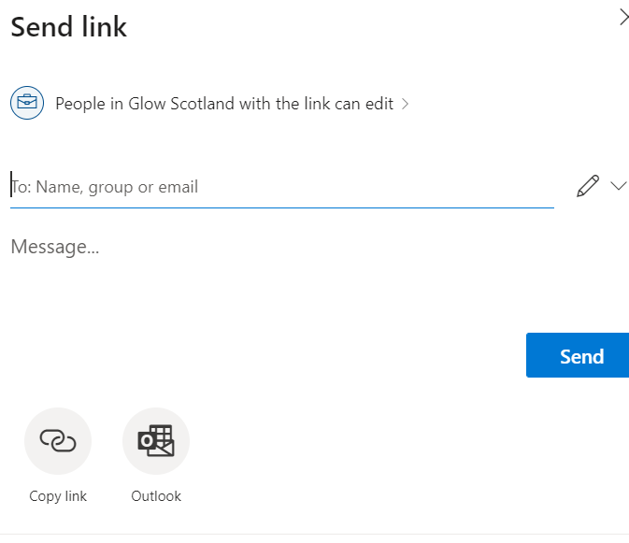
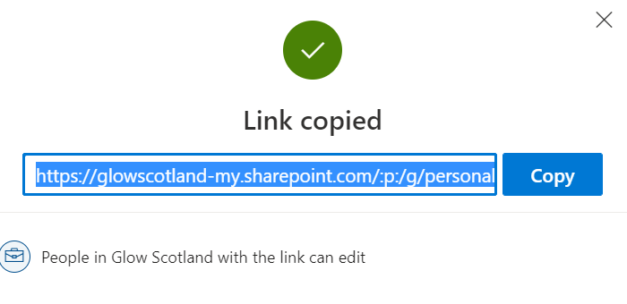
Collaborating on a PowerPoint
STEP 5: Click Copy Link
STEP 6: Copy the link

Slide 9
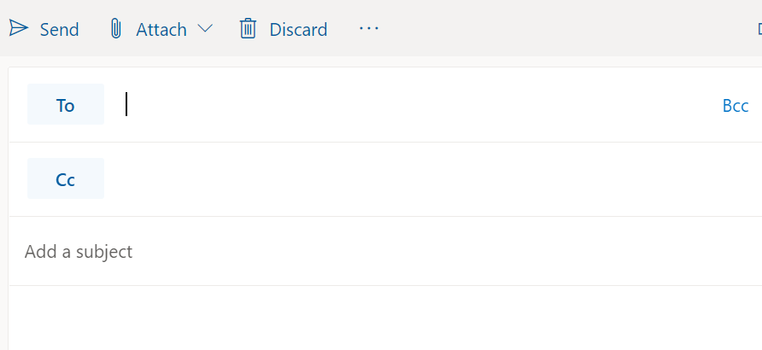
SEND AN EMAIL TO YOUR FRIEND TO COLLABORATE
STEP 1: Click new message
STEP 2: Ask for your friends email (wlusername@glow.sch.uk)
STEP 3: Add a subject (PowerPoint)
STEP 4: Write your message
STEP 5: Send
EXAMPLE:
Hi Elaine,
Please use the link to access our PowerPoint.
Kind Regards,
Amy

Slide 10
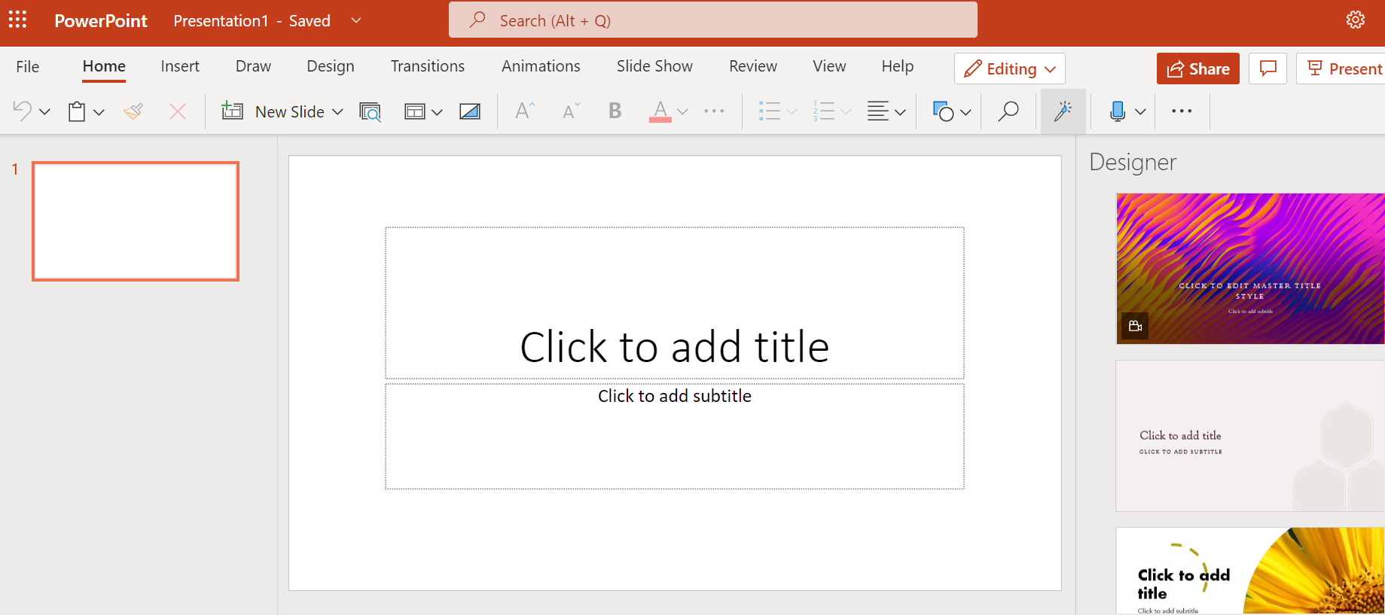
Collaborating on a PowerPoint
Using the link shared you will all be able to access the PowerPoint and work on it at the same time.
Decide what you want to make it on and GO!

Slide 11
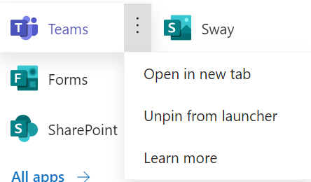
BACK TO THE WAFFLE
Hover over 3 dots
and click open in
new tab
Click on Teams

Slide 12
USING TEAMS
Click on the Bens Team

Slide 13
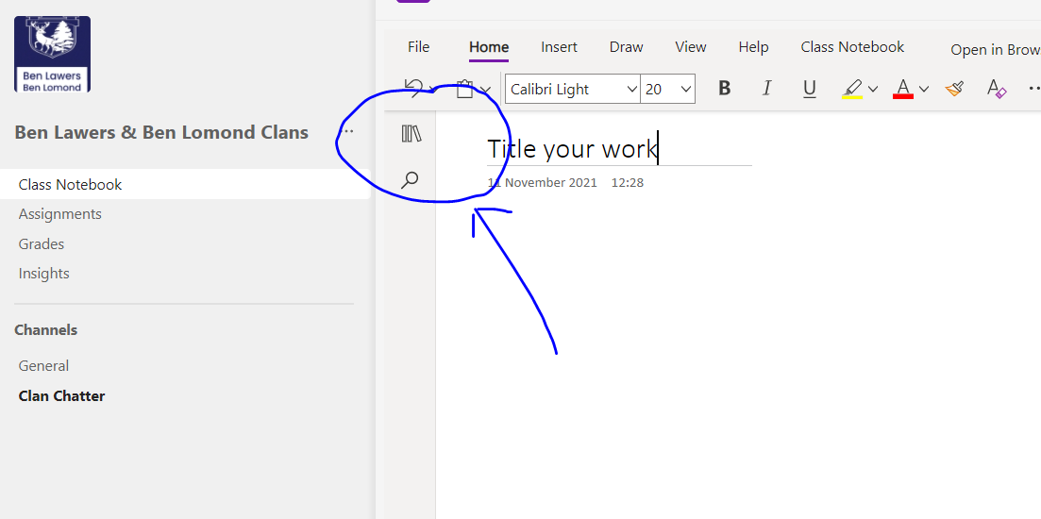
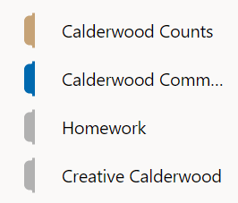
USING TEAMS
STEP1: Click on Class Notebook
STEP 2: Click the 3 book icon
STEP 3: Click Creative Calderwood
STEP 4: click add page
STEP 5: Add a Title to your page
24.11.21 My Shared PowerPoint

Slide 14
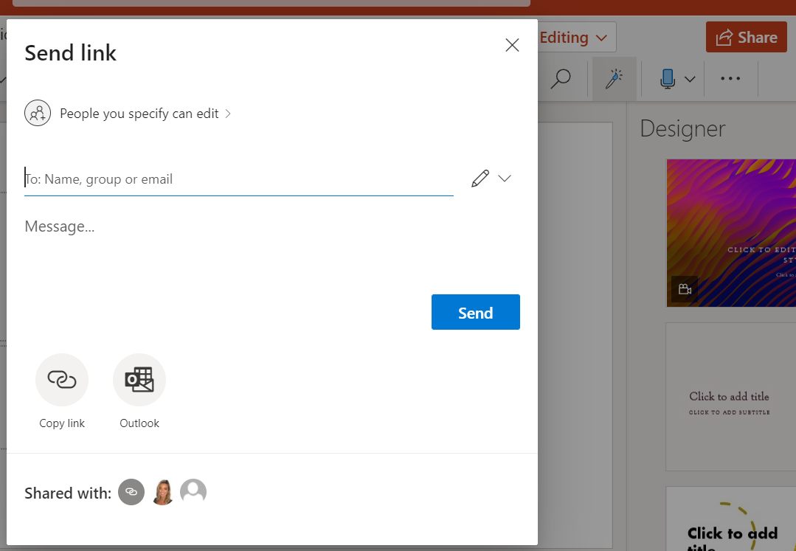
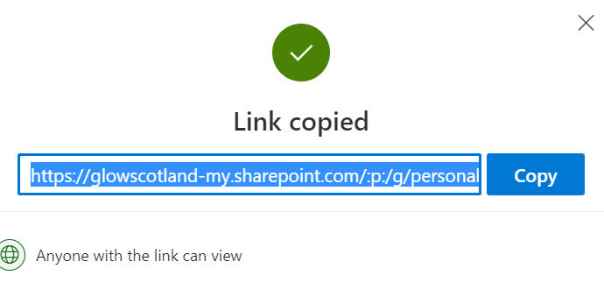
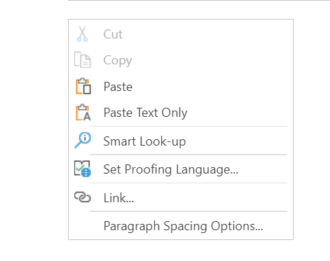
USING TEAMS
STEP 6: Go back to your PowerPoint Click Share
STEP 7: Click Copy Link
STEP 8: Paste the link to your PowerPoint in Teams by right clicking

Slide 15
EXTENSION
CAN YOU CREATE A FORM OR QUIZ?

Slide 16
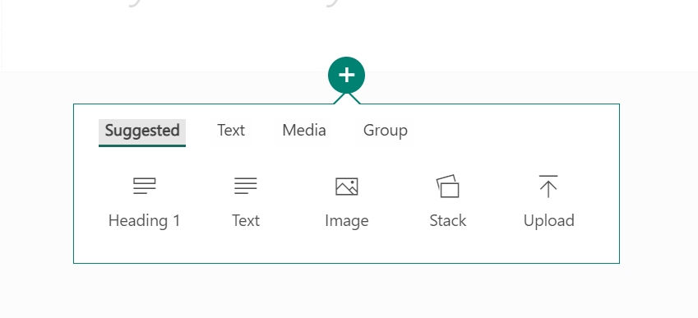
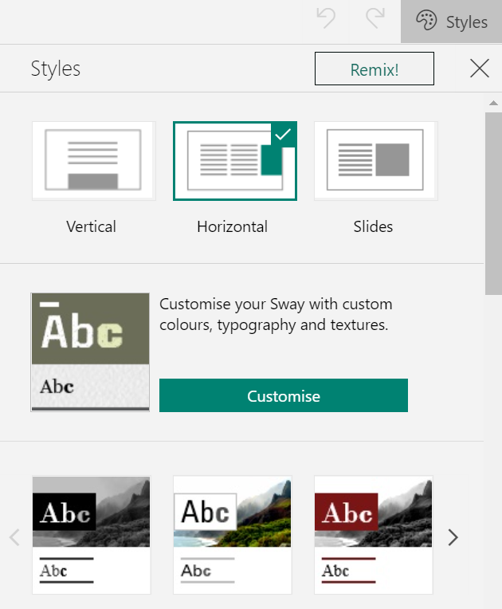
CREATE A SWAY
STEP 1: Click ‘New Blank Sway’
STEP 2: Create a Sway about your favourite thing, hobby, interest
STEP 3: Create a title
STEP 4: Click the plus button and try adding images, text, headings
STEP 5: Try out different designs click designs then styles

