Slide 1
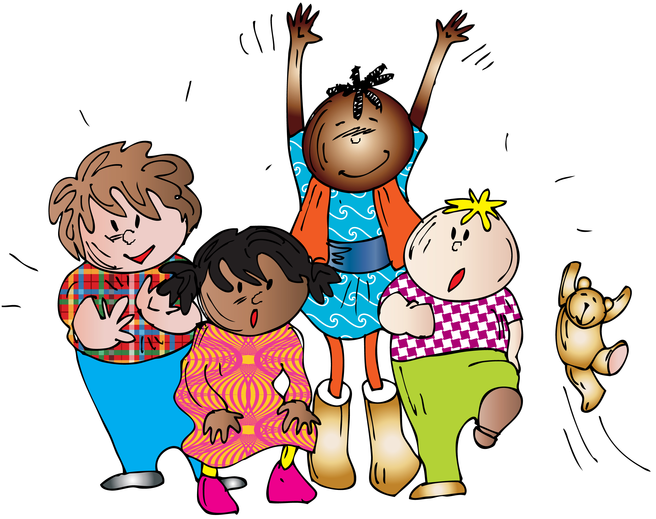
Music at Home
Wednesday 1st April 2020
Primary 1 – 3
Bellsquarry Primary School

Slide 2
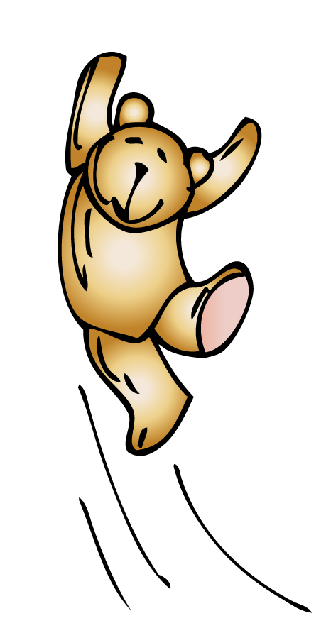
Hello everybody I hope you are all well.
Here are some of the songs we have been
singing in school for you to enjoy.
You can sing them as many times as you like.
Just click on the sound icon and then
the play arrow.
So, let’s start with a warm up song.
Have fun.

Slide 3
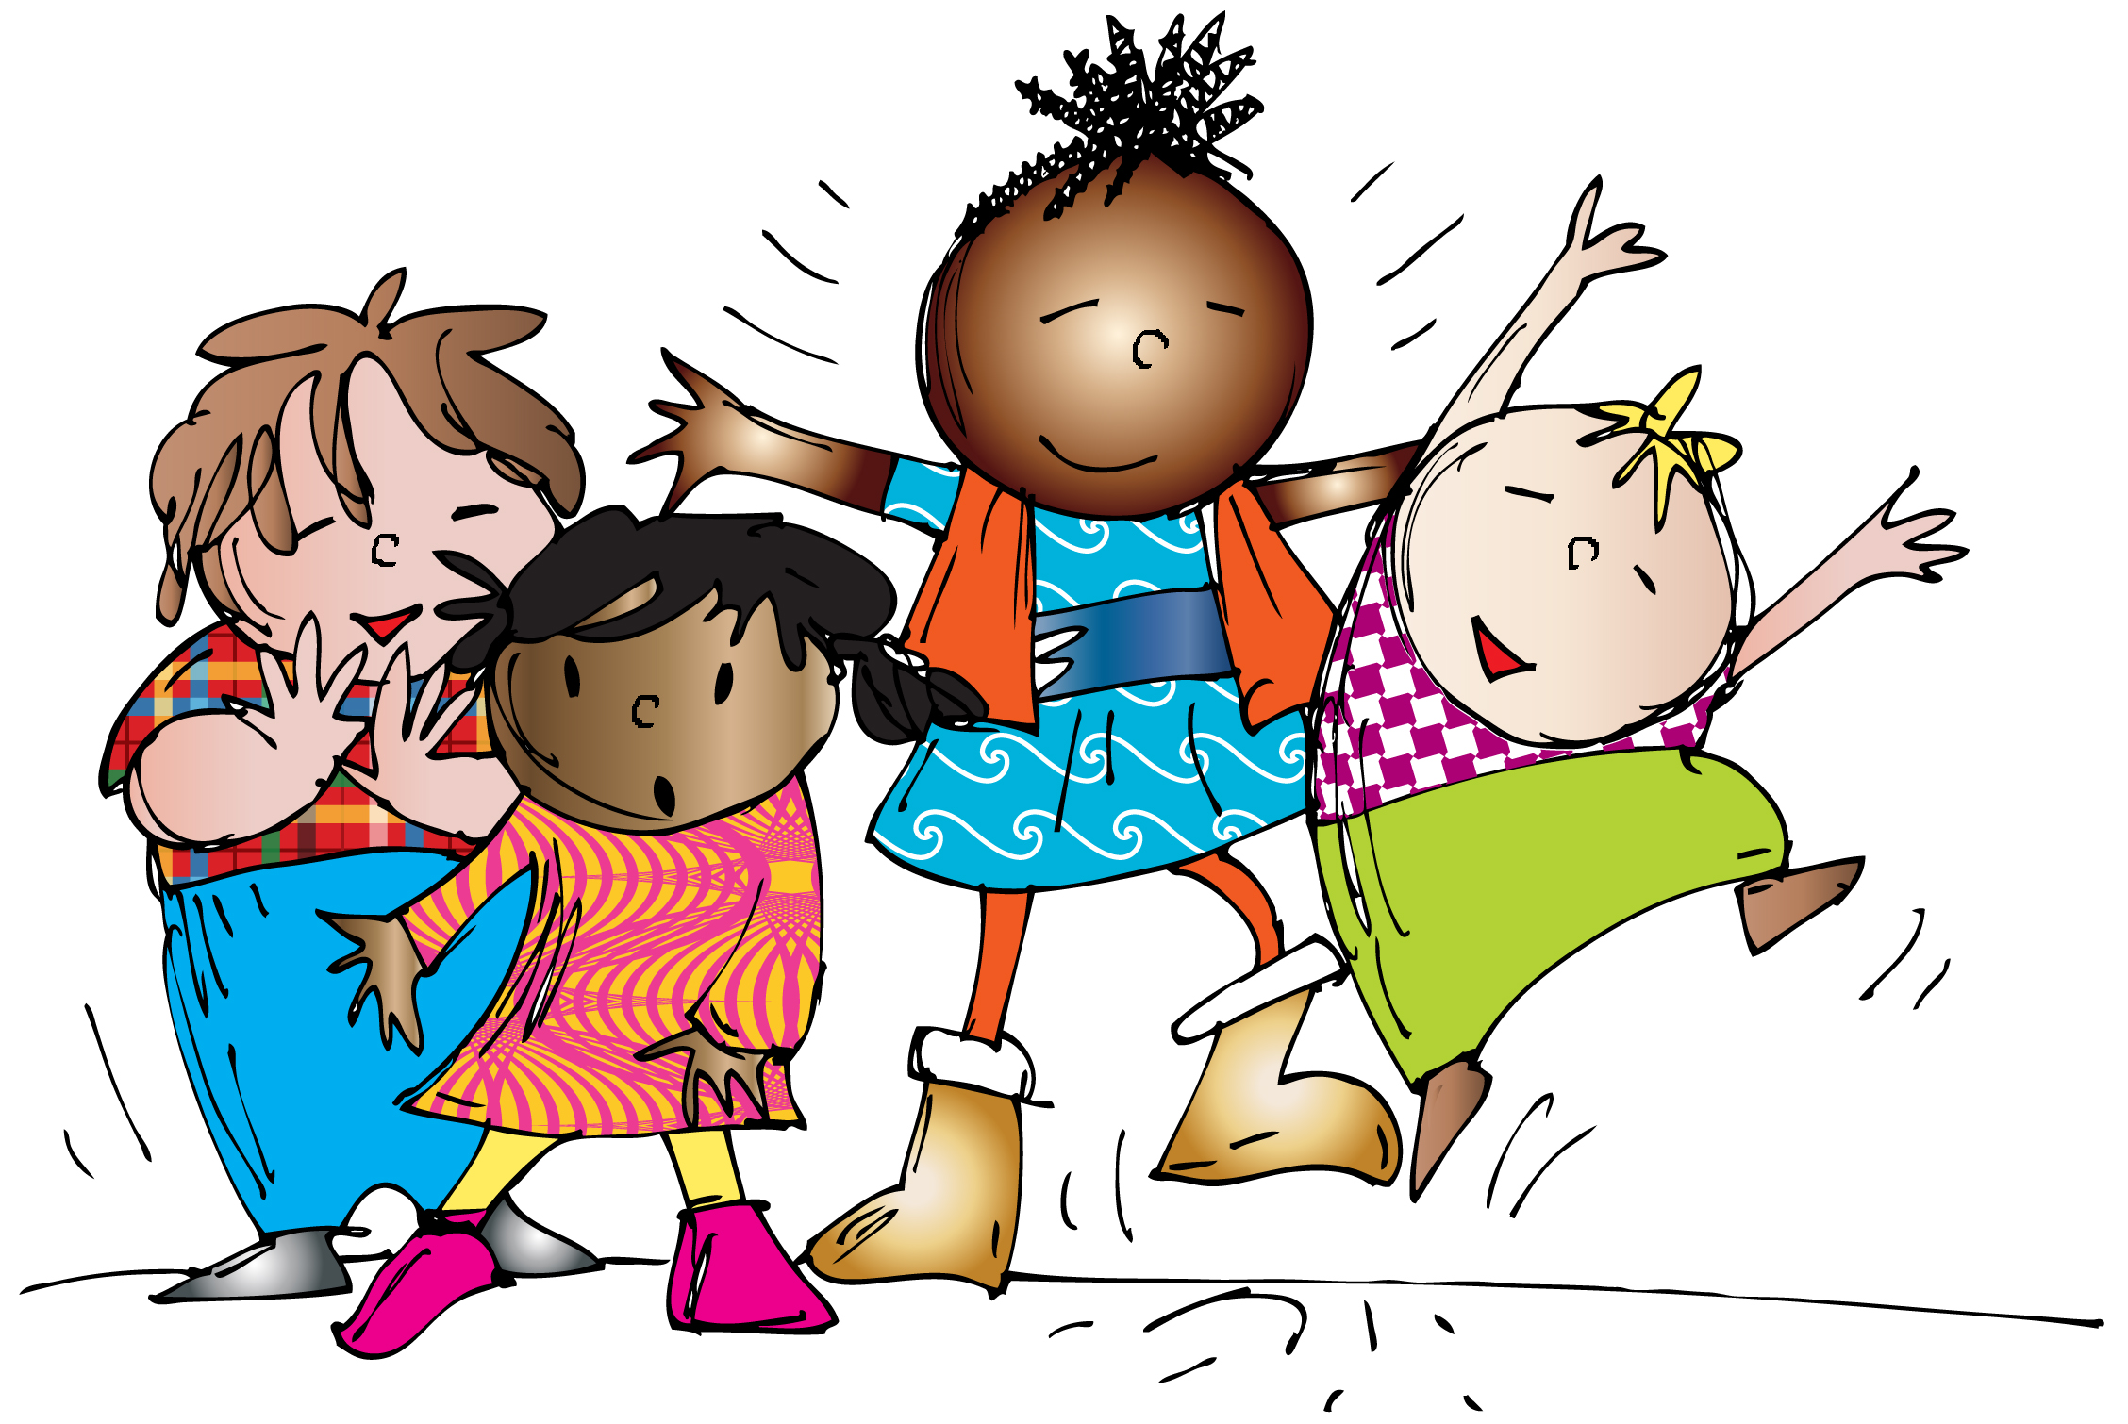
Let’s all sing and clap

Slide 4
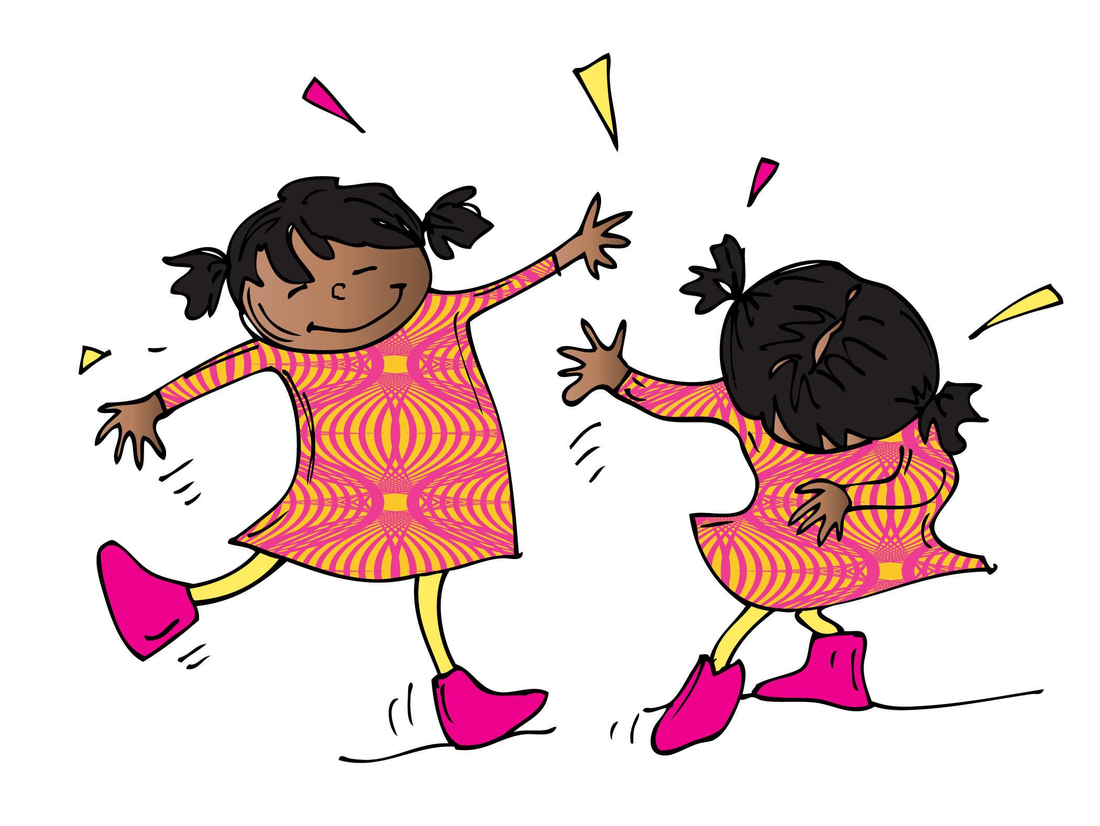
It’s a hap-hap-happy day

Slide 5
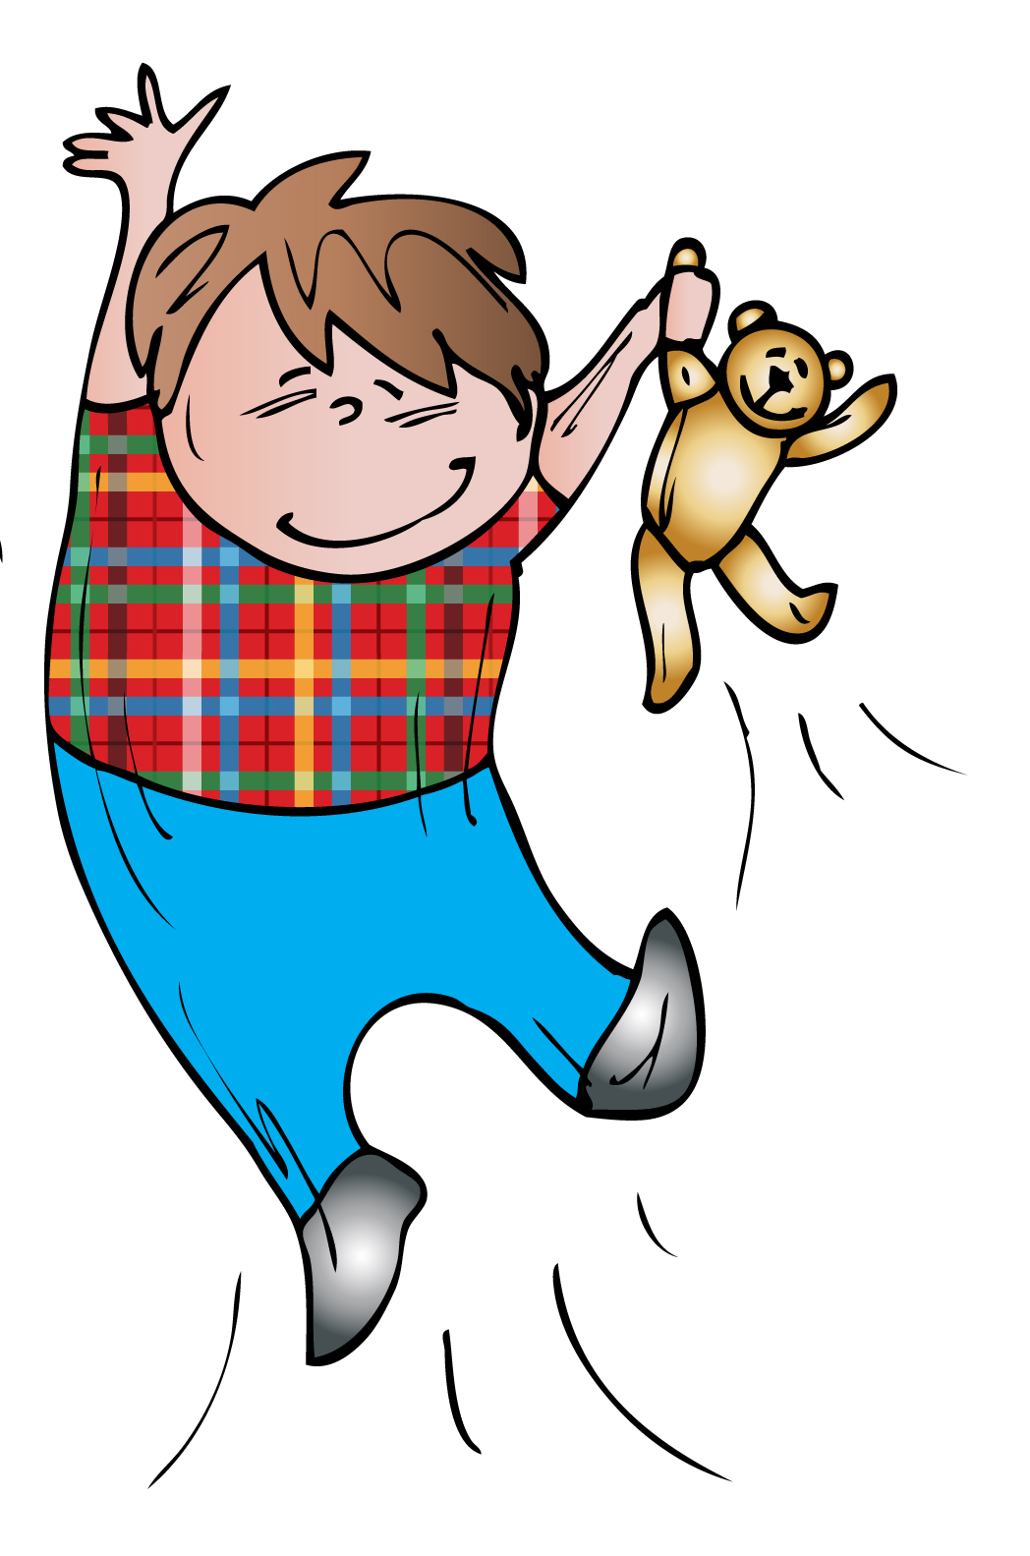
Jump up onto your feet for the next song.
Remember it gets faster …

Slide 6
Do it all again

Slide 7
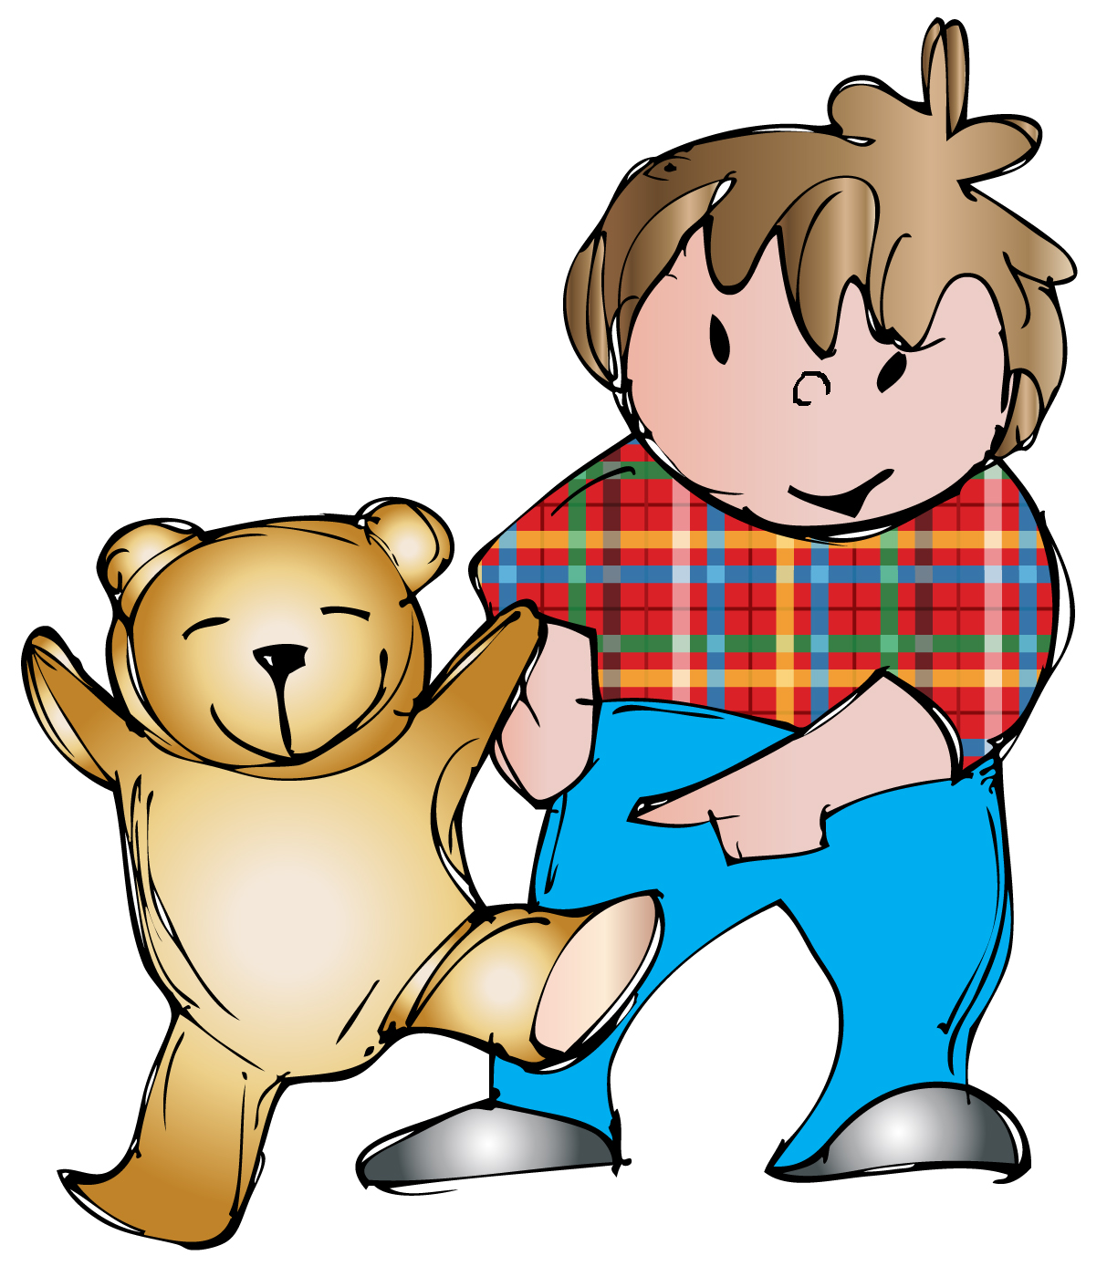
That was fun.
For the next two songs you need a teddy bear
if you can find one, but any soft
toy will do.

Slide 8
Here’s a little teddy

Slide 9
Teddy has two feet

Slide 10
Let’s go for a drive in the car now.
You can bring your teddy too if you like.
Don’t forget your seatbelt.
Beep beep!

Slide 11
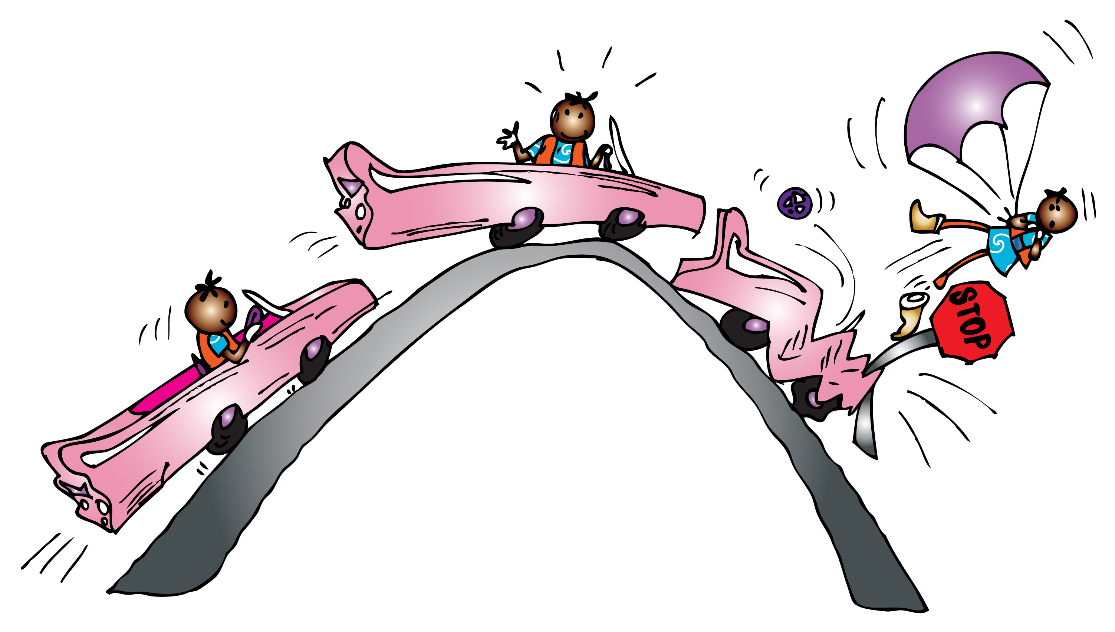
I am driving in my car

Slide 12
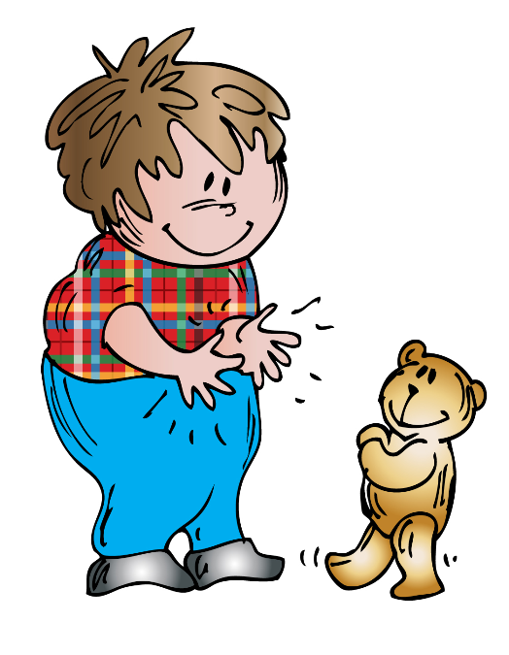
It is time for another clapping song now.
Get your hands ready and see if you can get anyone else to join in with you.

Slide 13
We are clapping along

Slide 14
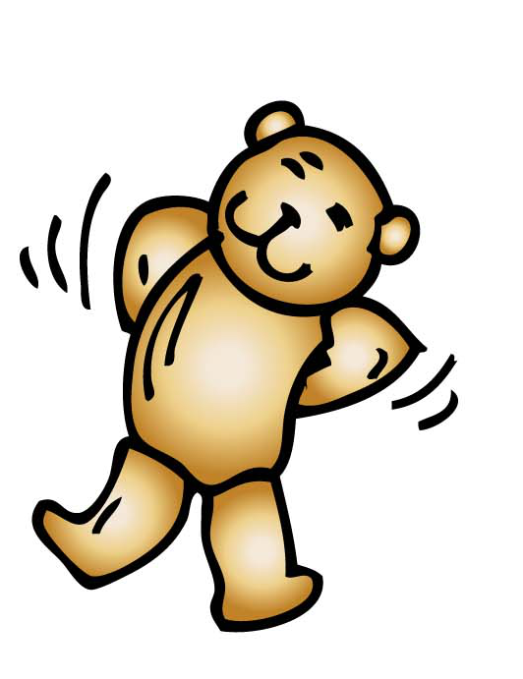
Sway gently to this next song.
It is very short so you could sing it
more than once if you like.

Slide 15
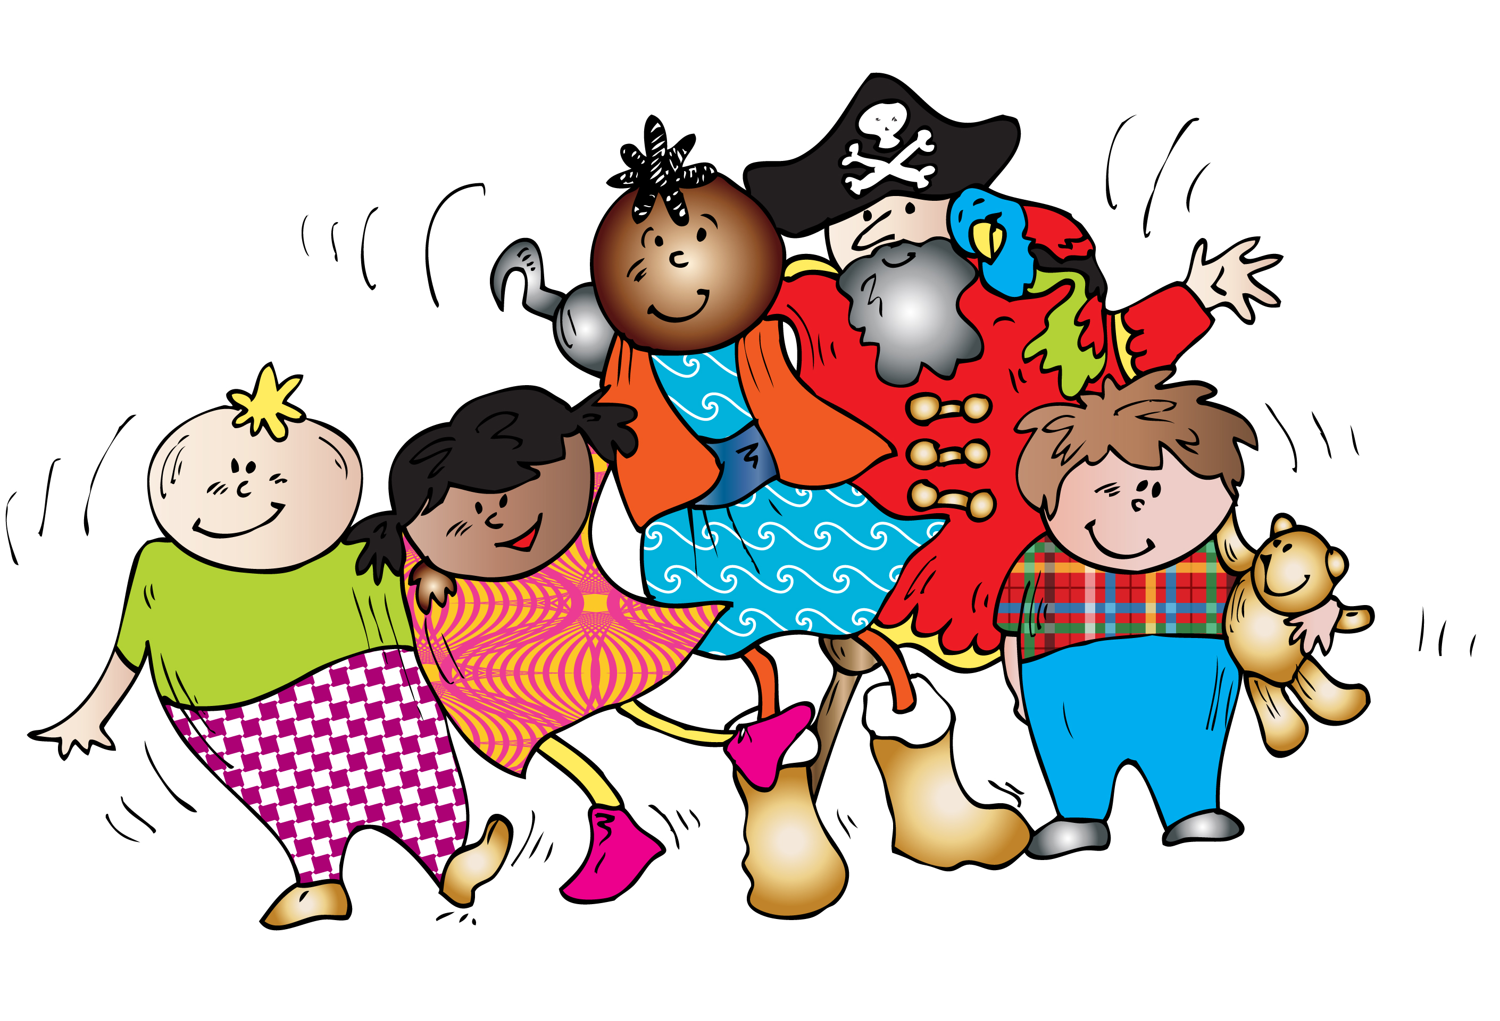
Swaying side to side

Slide 16
When you are singing the next song
remember to look after your voice
and try not to shout.

Slide 17
Can you roar like a lion?

Slide 18
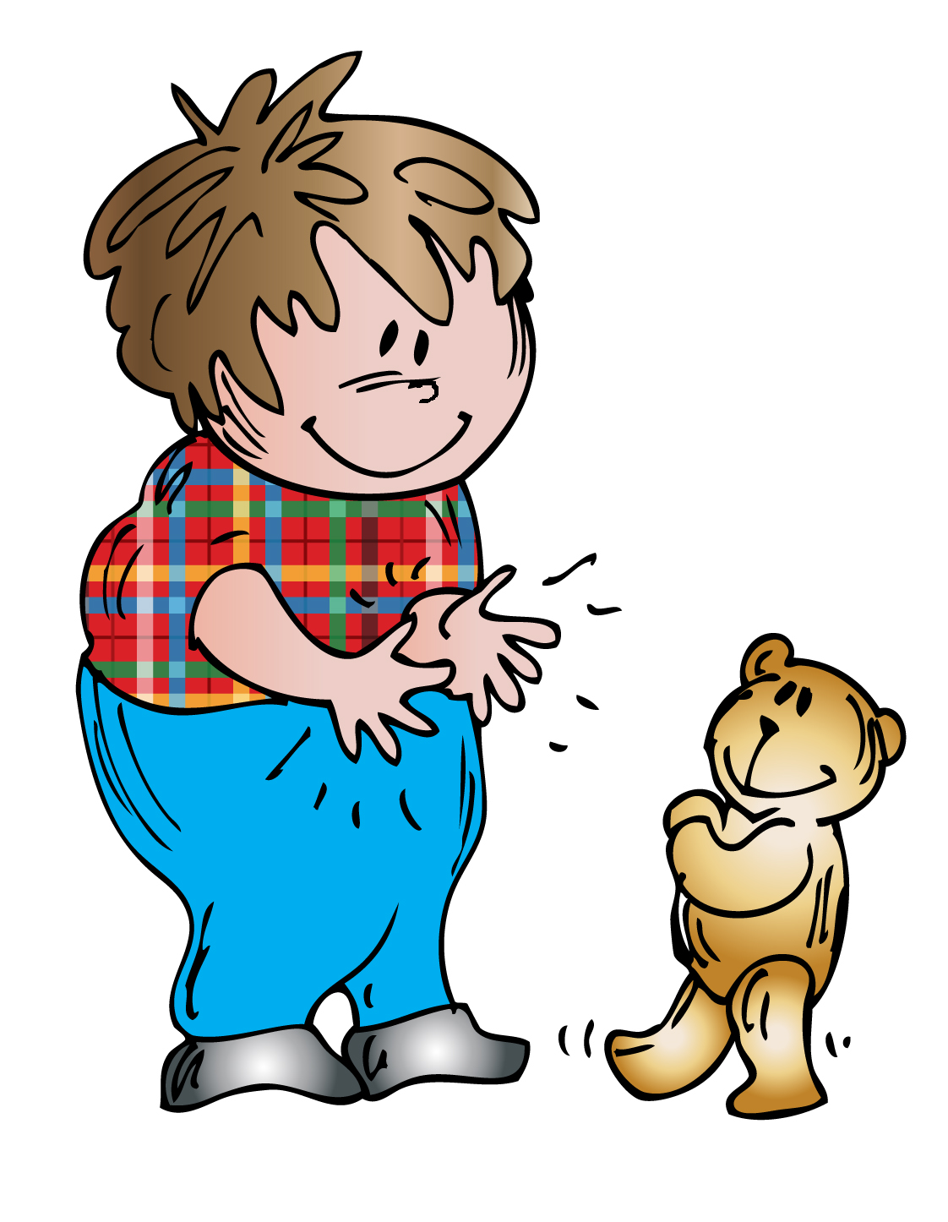
This is the last song for today.
I do not have a picture for this song.
Maybe you could draw one for me?
I would love to see your pictures.
Enjoy the song and have a nice Easter Holiday

