Slide 1
Building a Reading Culture at Bellsquarry Primary 2017-18
Reading PATPAL
Thursday 24 May 2018
Allyson Hood and Lauren McElhinney

Slide 2
Why build a reading culture at Bellsquarry?
To create a passion for reading and the world of the written word
To nurture lifelong readers by building confidence and positive attitudes towards reading
To encourage more independent readers
To weave reading into the daily life of the school
To encourage children to develop and identify their own strategies that will assist their reading

Slide 3
Where to start?
Class Reading Questionnaires
How would you describe yourself as a reader:
(select only one)
Do you enjoy reading?
Have you borrowed a book from a library?
So what did we do?
Excellent | 15
Very good | 8
Good | /
OK | /
Struggling | 2
Yes | 24
No | 1
Sort of | /
Yes | 20
No | 5

Slide 4
Building… the profile of reading in the school

Slide 5
“A reader lives a thousand lives before he dies," said Jojen. "The man who never reads lives only one.”
- George RR Martin

Slide 6
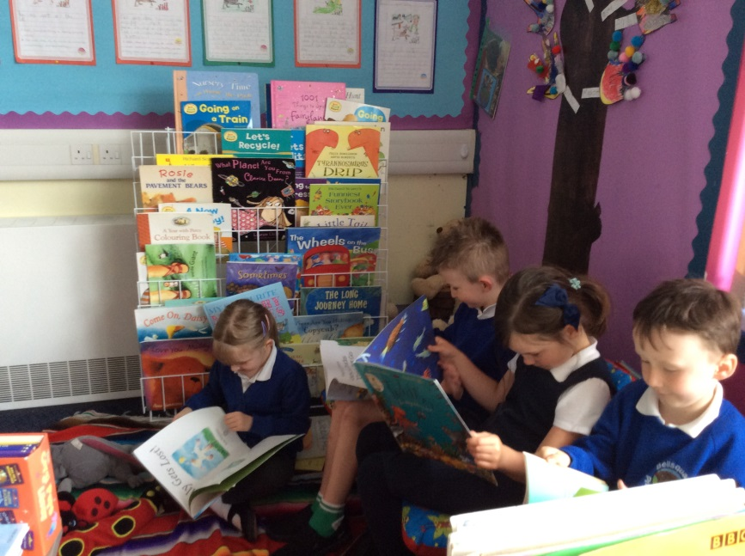
Class Libraries
A high quality reading space has been created in every classroom which engages and challenges learners.
“The children loved being involved in designing their library space. It means that they feel real ownership over it.” Mrs Green

Slide 7
Shared Library Spaces
Infant Area
Upper Area

Slide 8
Generating enthusiasm for reading
National Initiatives
World Book Day
Scottish Book Trust's Book Week
First Ministers Reading Challenge
Big Bedtime Read

Slide 9
Local Opportunities
Author visits/Online author presentations
Primary 1 pupils had a fantastic morning when Rachel McGaw came to visit. She read her new book ‘The Kilted Coo’ with the children and talked to them about being an author.
Library visits
We are planning to organise regular
opportunities for each class to visit
the library.

Slide 10
Building… our reading skills

Slide 11
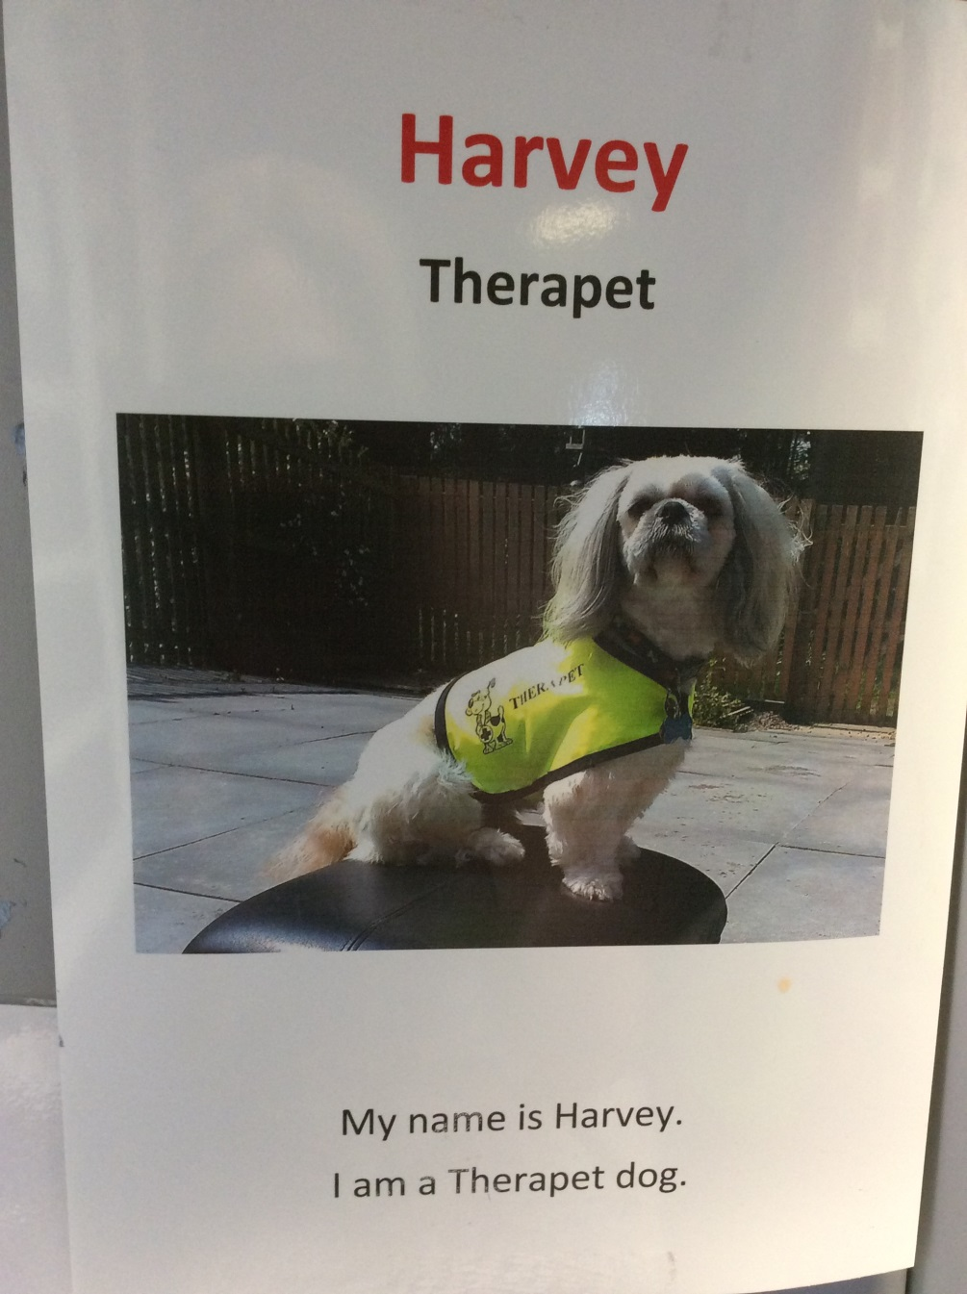
Therapets
Reading with Harvey

Slide 12
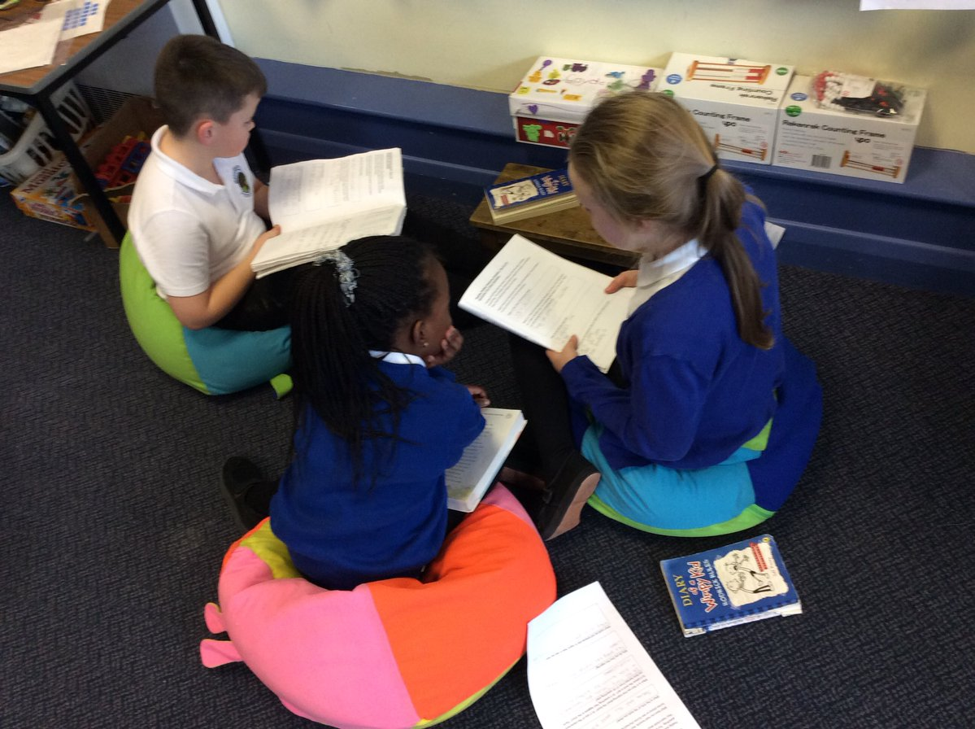
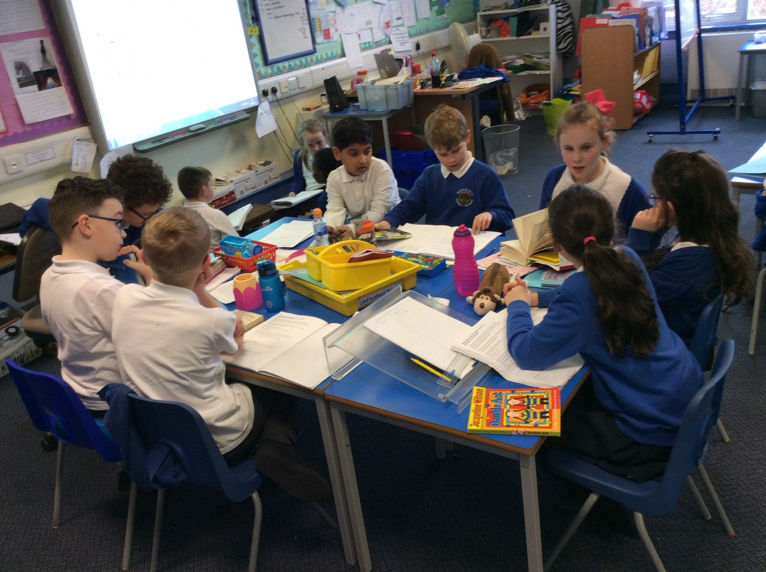
Talking about books
Reading Buddies

Slide 13
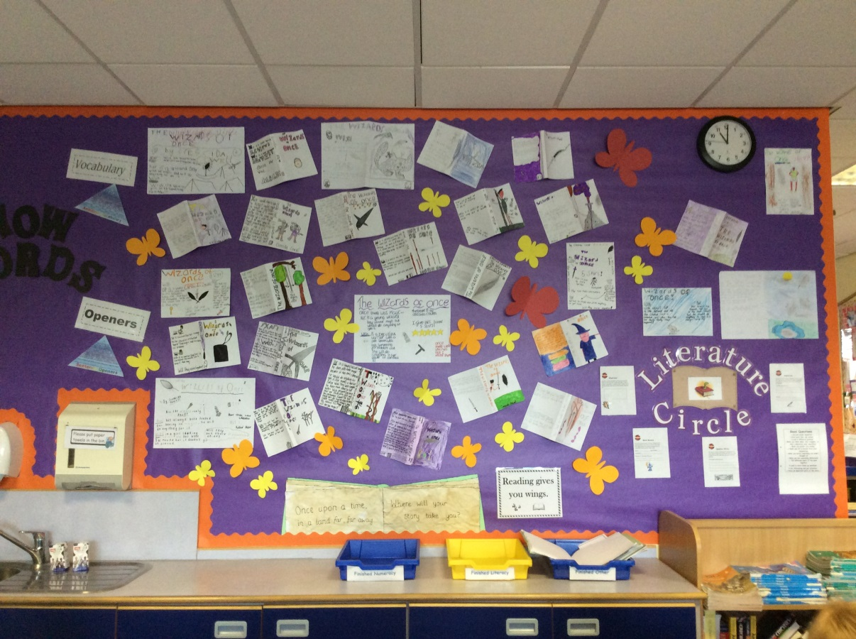
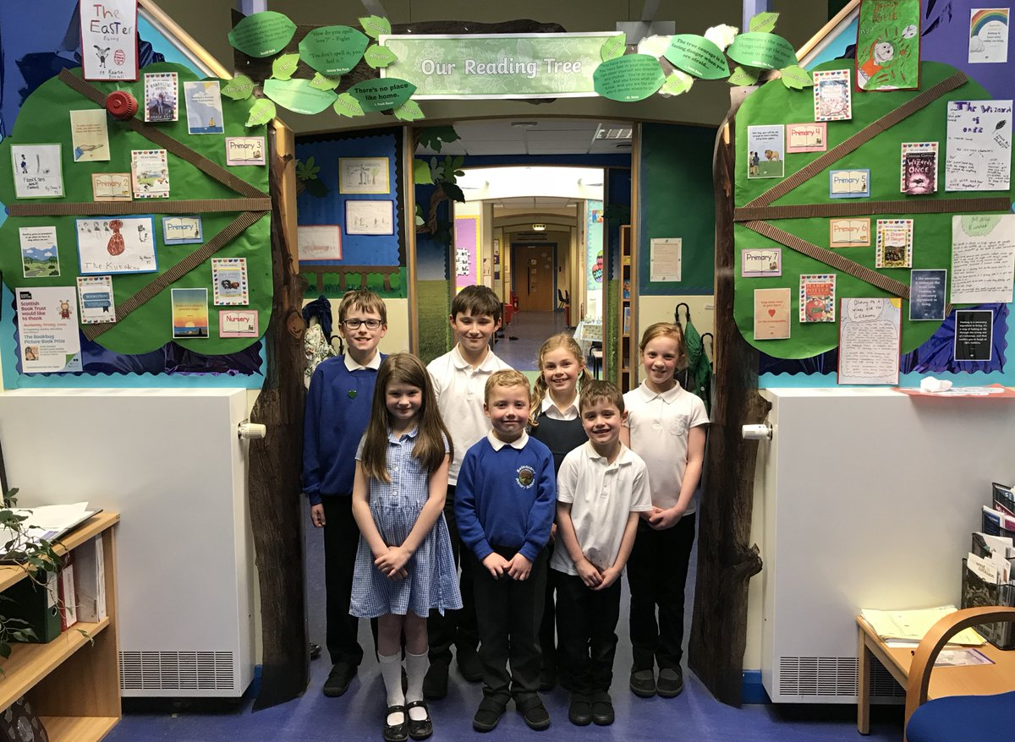
Sharing our love of books
Reading displays
Reading tree

Slide 14
Building… from a young age

Slide 15
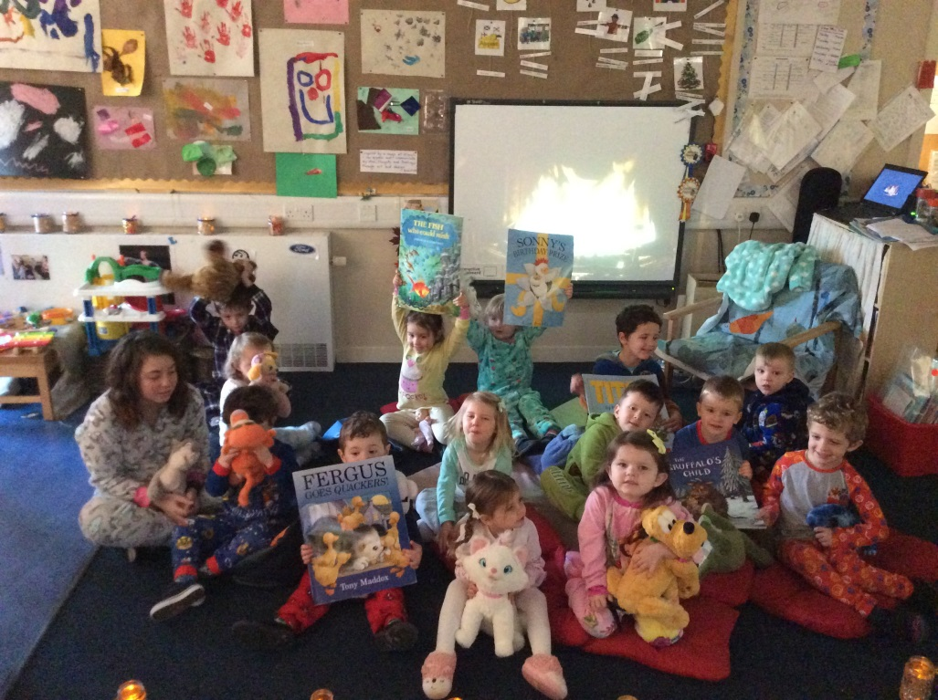
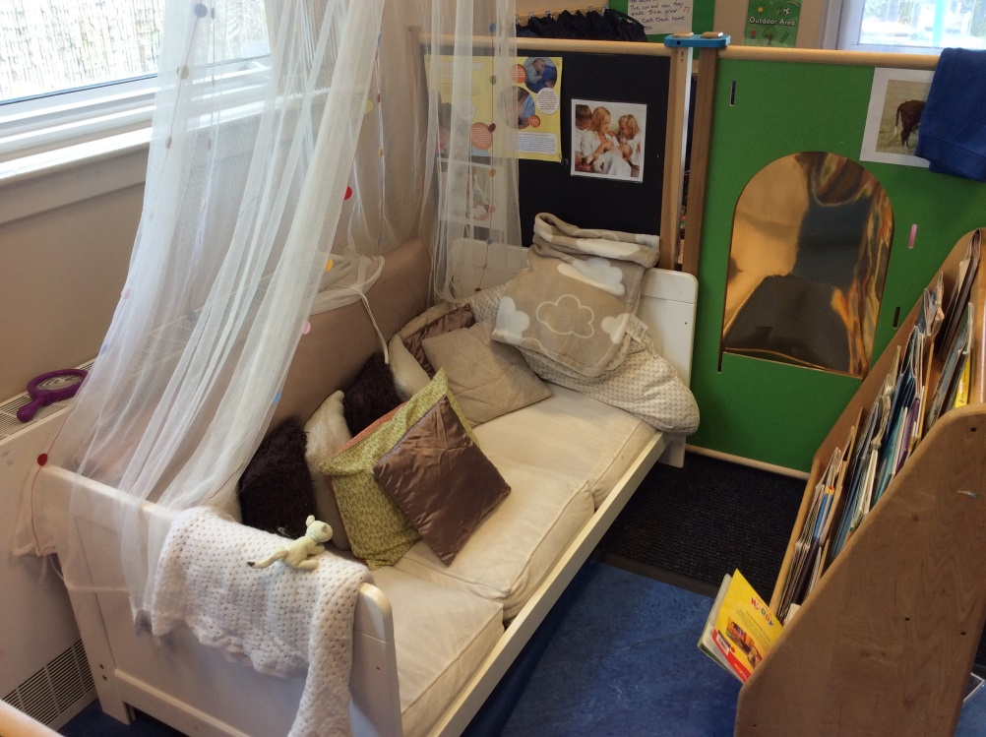
Raising the profile of reading in the nursery
Big Bed Time Read
Nursery reading corner

Slide 16
Building… on the adults passion for reading

Slide 17
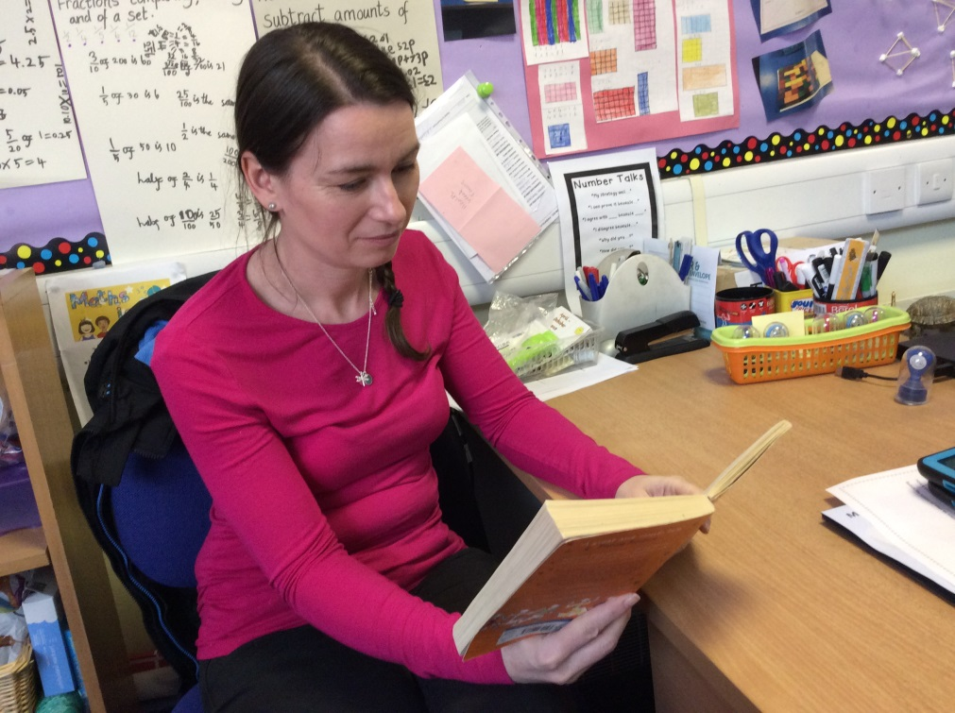
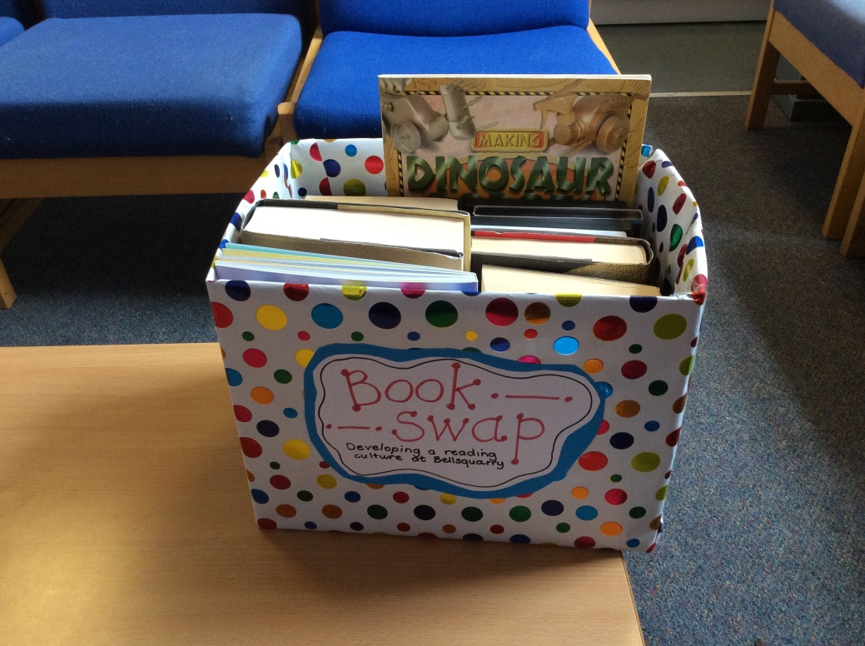
ERIC time
Staff book exchange

Slide 18
Building… on our success

Slide 19
What did the children have to say?
“I really like reading buddying because you can see how children from other classes read and help them with their reading.” Rebecca
“The World Book Day assembly was fun because you got to dress up as your favourite book character and use your imagination.” Mia
“I love reading because it takes you into different worlds and time.” Kieran
“I like reading because it makes you feel
different things, you get to feel the
different characters’ emotions.” Katie P

Slide 20
Building… our future

Slide 21
Building… our future
The Literacy Box
Continue with First Minister’s Reading Challenge
Emotion Works – link to books
Outdoor area

