Slide 1
Supporting your child with Maths and Numeracy at Bellsquarry Primary School
February 2017

Slide 2
Making Maths Count report -2016
All schools and nurseries should use a wide range of effective learning and teaching approaches to promote positive attitudes and develop high expectations, confidence and resilience in maths.
Making Maths Count (2016)

Slide 3
Promoting Maths in Scotland
Transforming public attitudes to maths.
Improving confidence and fluency in maths for children, young people, parents and all those who deliver maths education to raise attainment and achievement across learning.
Promoting the value of maths as an essential skill for every career.

Slide 4
Developing Number Sense
Number Sense is the ability to appreciate the size of numbers and their different parts and to be able to use numbers in flexible ways to help understanding.

Slide 5
Numeracy in the Early Years.
SEAL stands for (Stages of Early Arithmetical Learning)
This approach for teaching number aims to develop children’s number sense.
Achieved through teaching in different topics:
Number Word Sequences
Numerals – Identifying and sequencing/ordering
Number Structure -
Counting Strategies for addition and subtraction
Counting Strategies for multiplication and division
Notes:
It is a research based teaching approach to promote a clear understanding of numeracy in all children, using the research to inform classroom practice.
Teachers follow a framework, which was developed by colleagues in East Lothian Council, that helps them develop many aspects of a pupil’s numerical knowledge and offers clear guidance in teaching approaches that nurtures their understanding of number

Slide 6
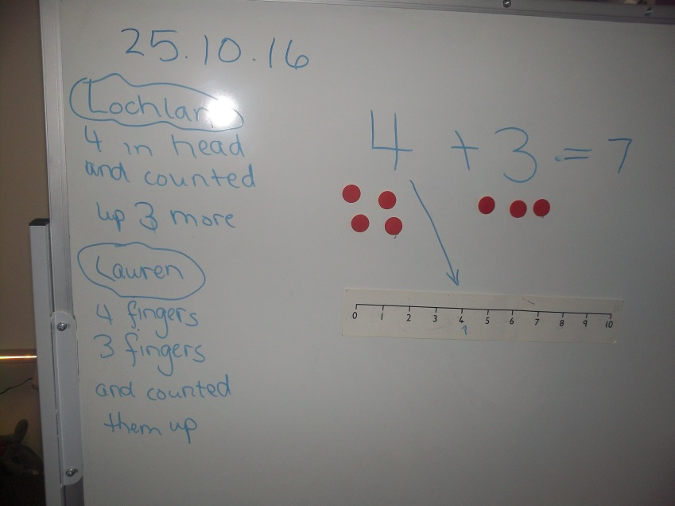
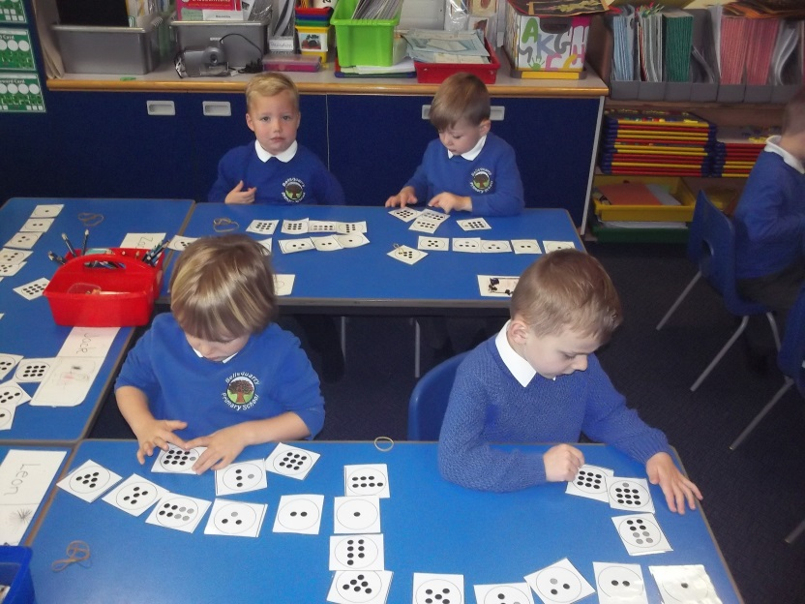
SEAL in Action

Slide 7
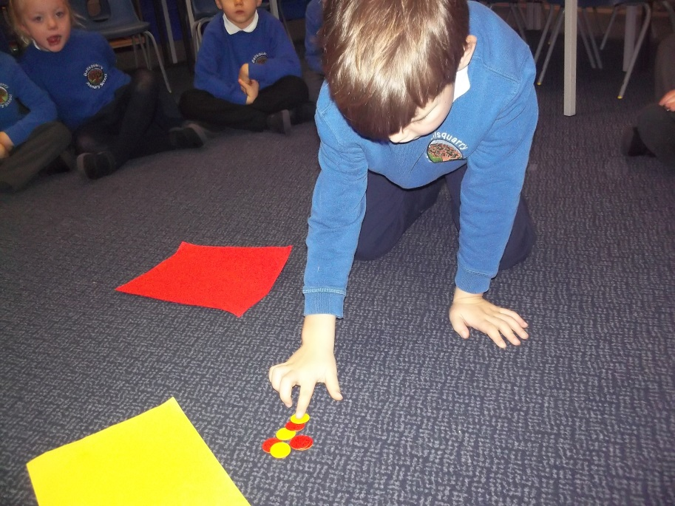
EXPLORING NUMBER IN EARLY YEARS

Slide 8
What are the Basic principles Of developing Number Sense?
Concepts of number are taught following the C.P.A model – using concrete materials, moving then to pictorial representations then the abstract calculation.

Slide 9
Numeracy & Maths in the Middle & upper school
Notes:
Teachers provide learning opportunities which will develop children’s confidence and understanding of number and how this is linked to real life contexts.
A range of active learning approaches give a mix of textbook work, making models of numbers, problem solving and technology based tasks.
We know that children can learn from the interactions they have with each other, as well as from the teacher, so we work in a range of different ways in class – whole class, individual or pair activities.

Slide 10
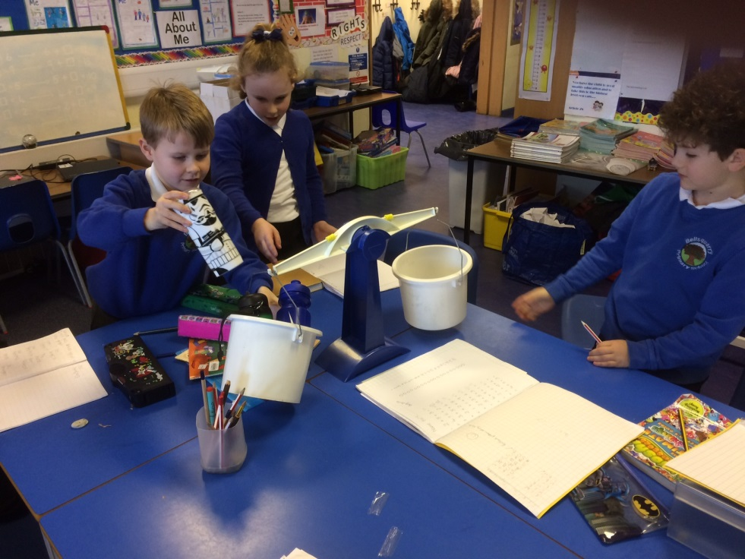
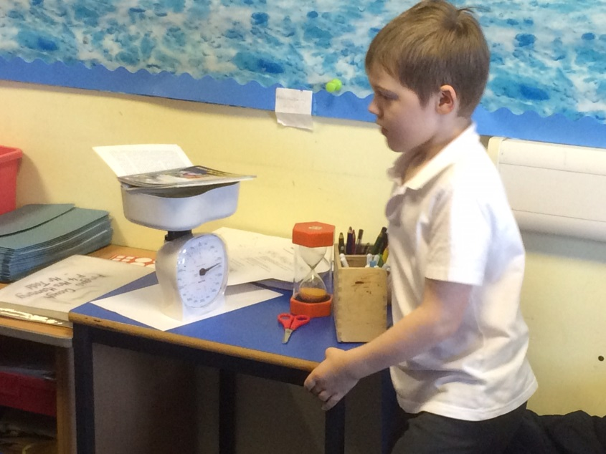
Numeracy & Maths in The Middle/ Upper School

Slide 11
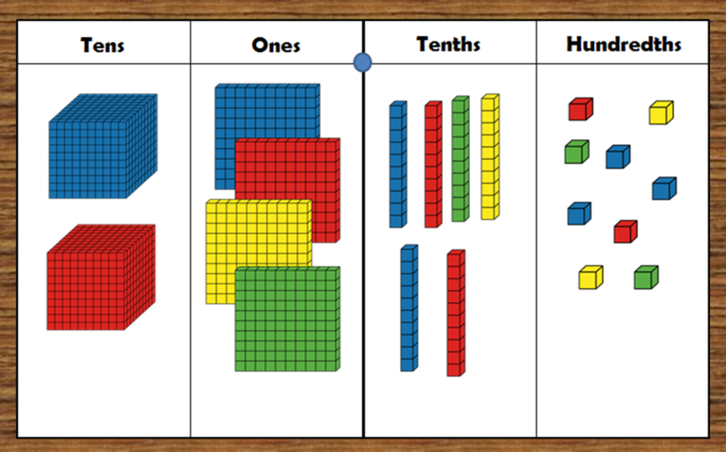
Never too old for concrete materials!

Slide 12
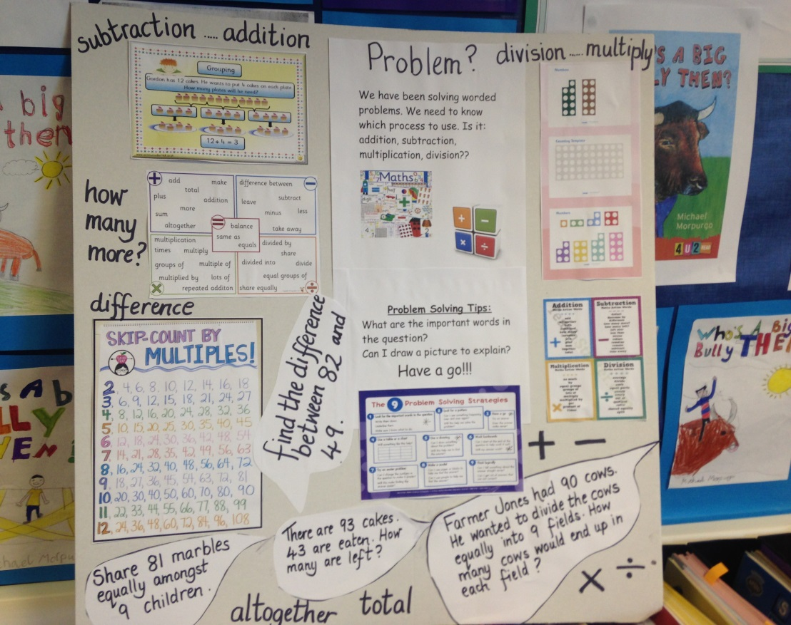
Making Learning Visible – Maths Working Walls

Slide 13
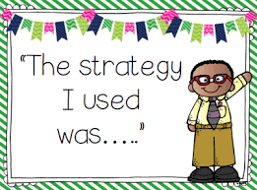
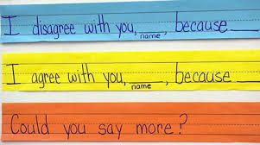
Number Talks
5 to 15 minute number conversations that take place in every class .
They are based around purposefully crafted problems, and are a way that teachers can include discussion around mental agility.
During number talks, children are asked to communicate their thinking when presenting and justifying solutions to problems they solve mentally.
Pupils develop more accurate, efficient, and flexible strategies.

Slide 14
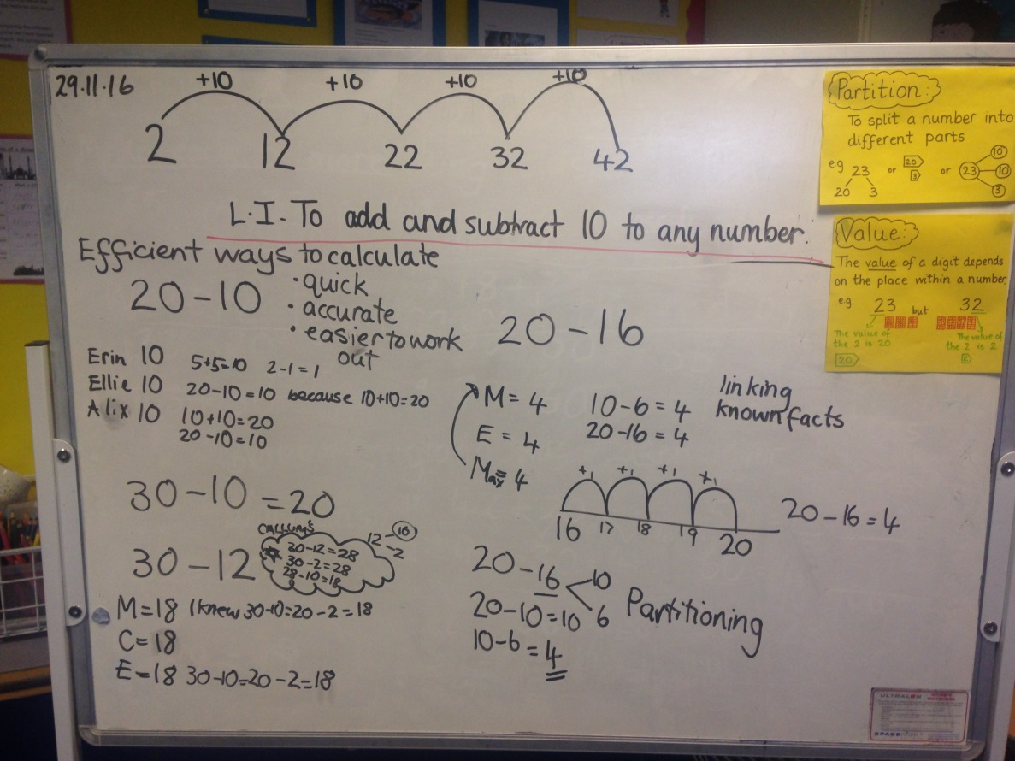
Number Talks

Slide 15
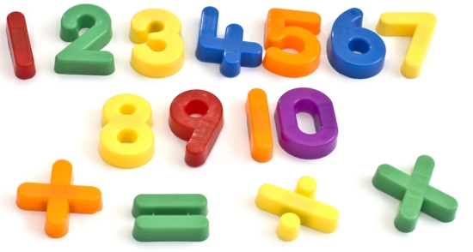
How to support your child in numeracy and maths

Slide 16
Encourage play with Games and Puzzles
Puzzles and games or anything with a dice will help children enjoy maths and develop numeracy and logic skills.
Maths Apps
Coming Soon -SumDog

Slide 17
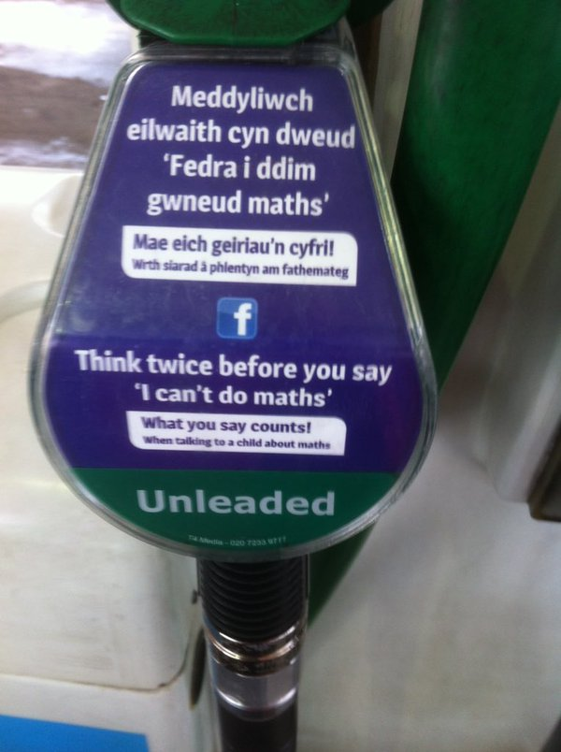
Be wary of sharing your own negative attitude of maths
Researchers found that as soon as mothers shared that idea with their daughters, their daughter’s achievement went down
(Eccles & Jacobs, 1986)

Slide 18
Always encourage - what else can I say instead of “that’s Wrong.”
Can you tell me how you got that answer? What did you do in your head?
What number did you start at?
You have tried hard to work this out– can we check the answer together?
Let’s draw a picture to see what that looks like.
3x4 = 7
Ah, I see what you did there. The x is actually a ‘multiplication sign, it means ‘groups of’ .
I will draw a picture to show you.
Notes:
Don’t tell children that they are just ‘wrong’-
Try – “This looks tricky – can we try checking it?”
“Can you tell me how you got that answer?”
“Can you draw a picture to explain your thinking?”
“ I think there might be more than one way to solve this”.
E.g. 3 x4 = 7
- “Ok, I see what you did there, this sign (x) means groups of, let’s draw a picture to see what that looks like.”

Slide 19
Encourage Number Sense
Try to encourage number sense.
What separates high and low achievers in primary school is number sense, i.e. having an idea of the size of numbers and being able to separate and put numbers together flexibly (Gray & Tall, 1994).
e.g. 29 + 56,
Can we make it easier? 30 + 55.
The flexibility to work with numbers in this way is what is called number sense and it is very important !

Slide 20
Developing Number skills for life
Playing Games – anything with a dice!
Dominos
Playing card games
Helping around the house
Baking, cooking, sorting washing, writing shopping list
Developing a sense of time
Share a clock and a calendar in the house
Checking bus timetables/TV listings/cinema times

Slide 21
I can’t do it…yet Developing a Growth Mindset
Growth Mindset is the idea that ability and smartness change as you work more and learn more.
The opposite to this is a fixed mindset, where the idea is that ability is fixed and you can either do maths or you can’t.
When children have a growth mindset, they do well with challenges and do better in school overall (Dweck, 2006)
Notes:
Growth mindset chapter parents
Education city espresso linked dan myers – maths class needs a make over

Slide 22
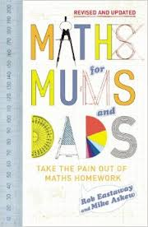
I would like to know more….
Ask your child’s teacher or a member of the management team.
Maths for Mums and Dads – Rob Eastaway & Mike Askew
Jo Boaler – What’s math got to do with it?
www.youcubed.org
www.nrich.co.uk
Family maths toolkit http://www.familymathstoolkit.org.uk
Khan Academy www.khanacademy.org
Education Scotland’s Parent Support Website
http://www.educationscotland.gov.uk/parentzone
Make Maths Count Report
http://www.gov.scot/Resource/0050/00505348.pdf

